Slide 1
Hauler E-commerce Website
By Saud

Slide 2
Resources Used:
.Html
.CSS
.Javascript
.fontawesome
.Google Fonts

Slide 3
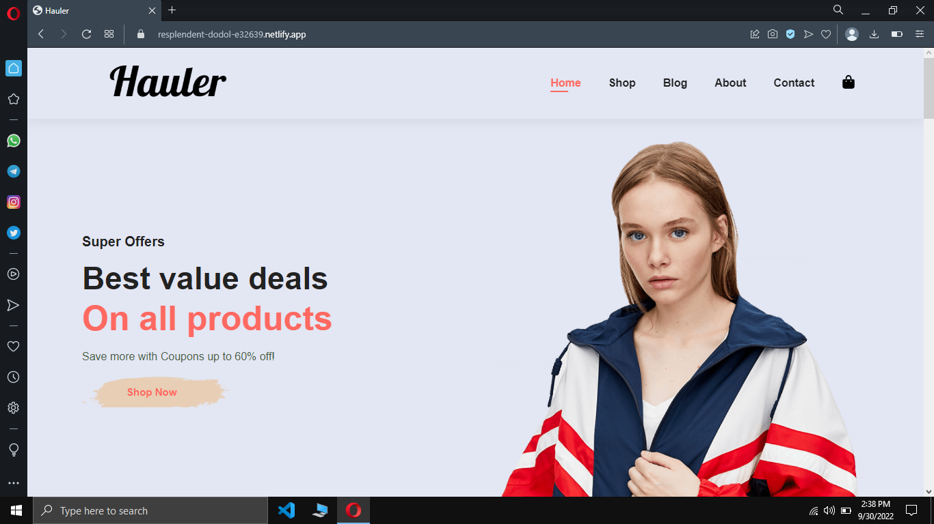
Home Page

Slide 5
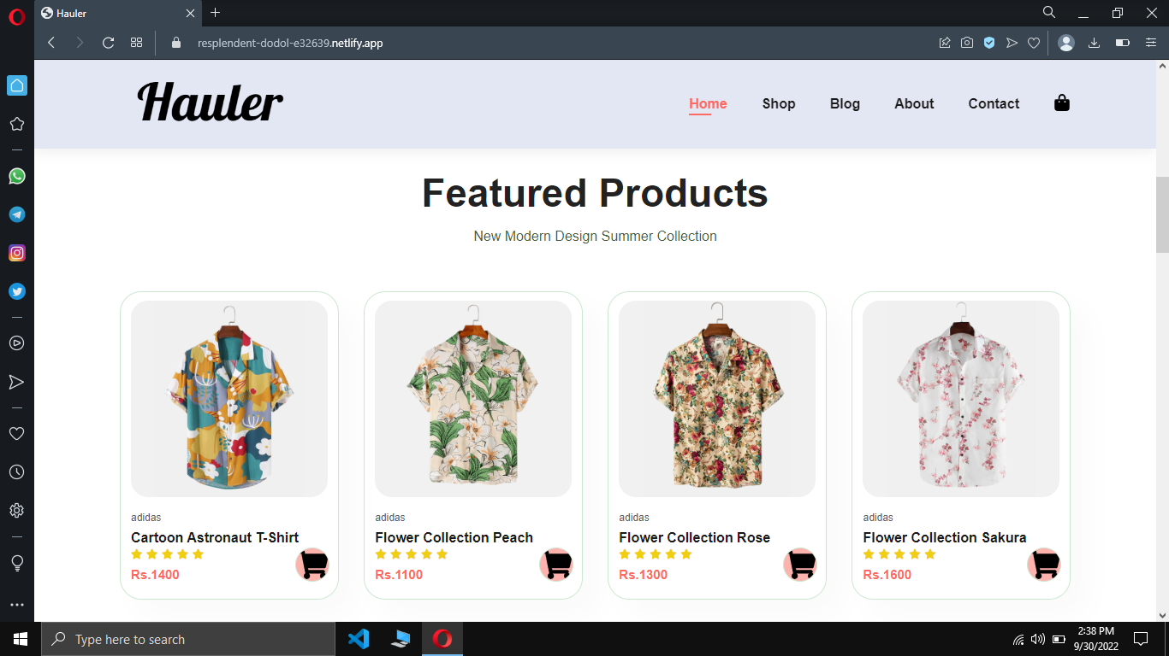

Slide 6
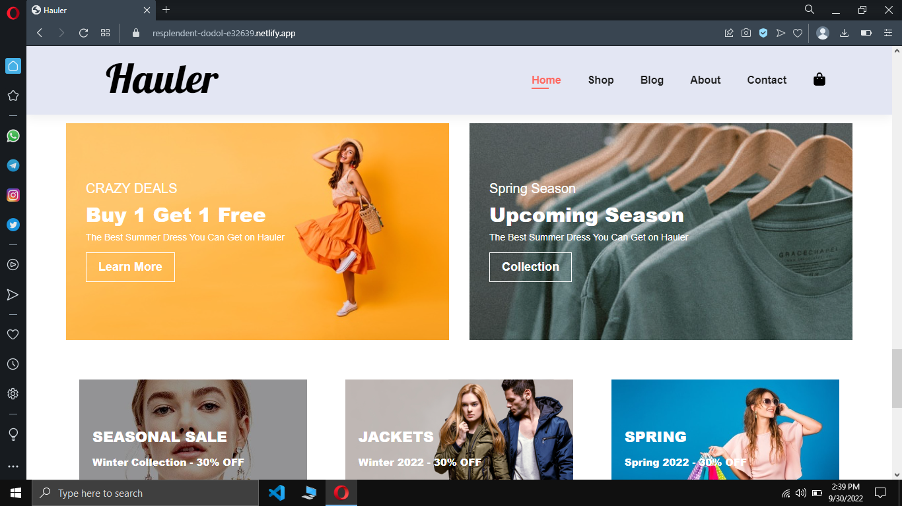

Slide 7
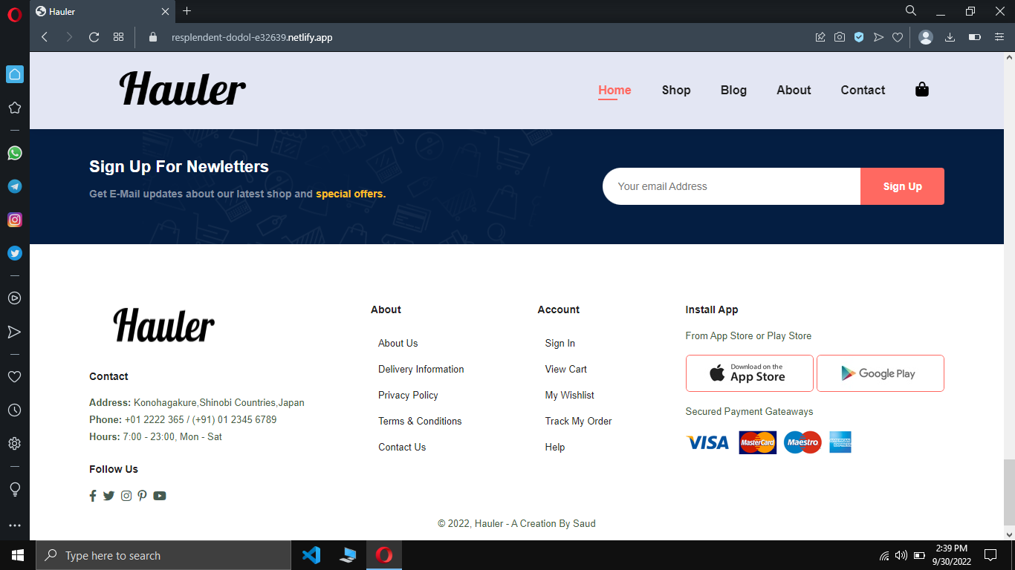

Slide 9
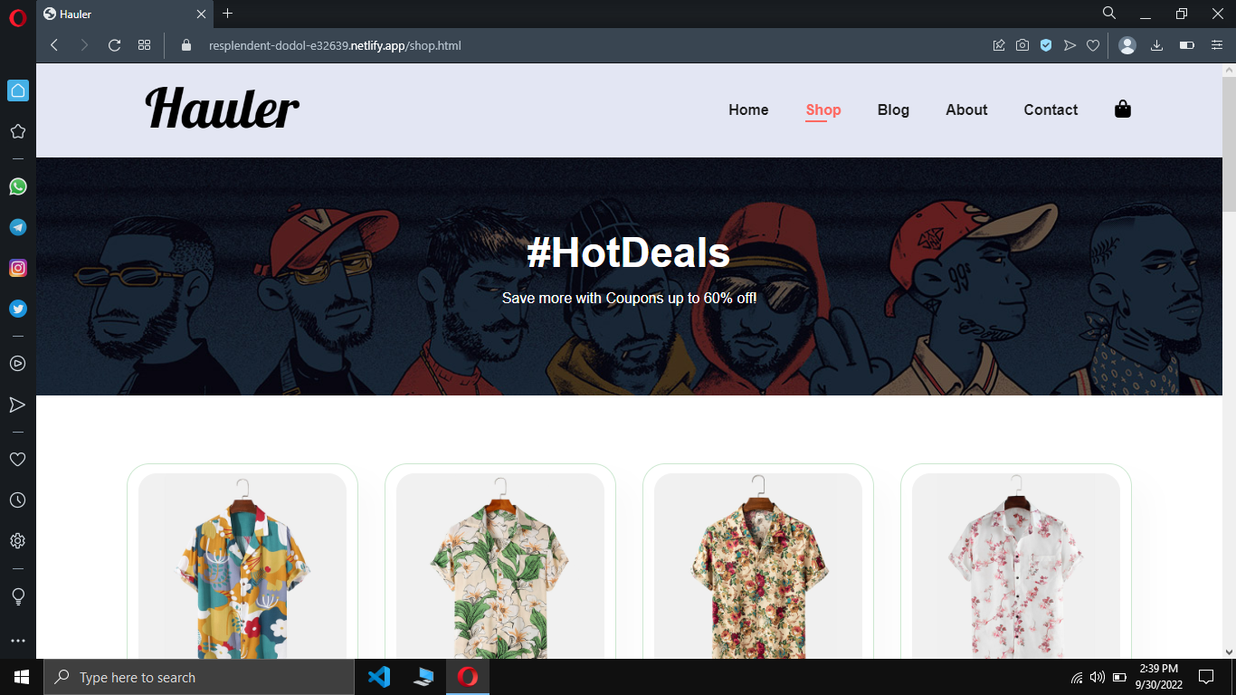

Slide 11
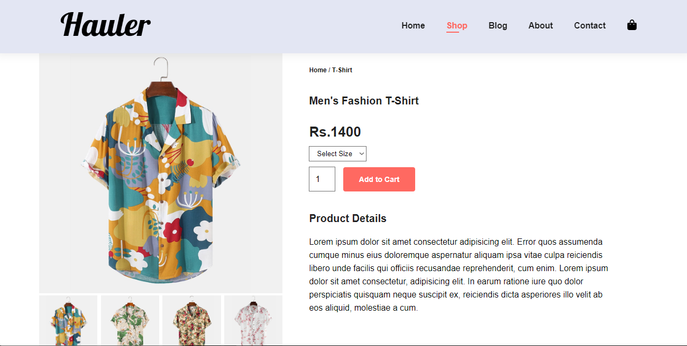

Slide 12

THANK YOU
THE END

