Slide 1

AI Housing Price Prediction System
Name: Rashaad Devonta Roberts (Solo)
Semester: Spring 2026
Course: CAP4630-002- Intro to AI Intelligence

Slide 2
Objectives
What problem am I solving? Why is it important?
Millions of buyers of homes everyday are affected by such a very large decision, and with this we can empower buyers/sellers to know if a property is overpriced, underpriced, or a fantastic deal.
Goal:
To build a machine learning model that predicts how much a home will cost based off the U.S Housing Dataset on Kaggle.

Slide 3
Dataset
Dataset (USA Housing)
USA Housing Dataset (Kaggle) Approximately 5000 Samples
Final Model
Captures non-linear patterns Reduces overfitting (ensemble)
Results
Predicted House Prices Evaluated with R² & MAE
Features
Models Tested
Preprocessing
Random Forest Regressor
Income, House Age Rooms & Bedrooms Area Population
Removed duplicates Handled missing values Dropped irrelevant columns (Address)
Linear Regression Ridge (L2), Lasso (L1) Elastic Net

Slide 4
Pipeline
Raw Data📊
Loaded U.S housing dataset with relevant columns used for prediction
Results ✔
Trained Model
Provides a percentage of how accurate model is
Evaluation📈
R^2 Score (performance)
Cleaning🧹
Feature Selection🧹
Train/Test Split🧠
Model Training🧠
Prediction📈
Checked for any missing, NaN or duplicate values and cleaned them out.
Selected relevant features, Dropped unnecessary columns and prepared input variables (X)
80% to 20% Testing Data Split
Prevents overfitting
Random Forest Regressor
Learned patterns from data/built predictive model
Predicted housing prices
Applied model to unseen data/Generate Outputs
MAE (prediction error)/ Compare actual vs predicted

Slide 5
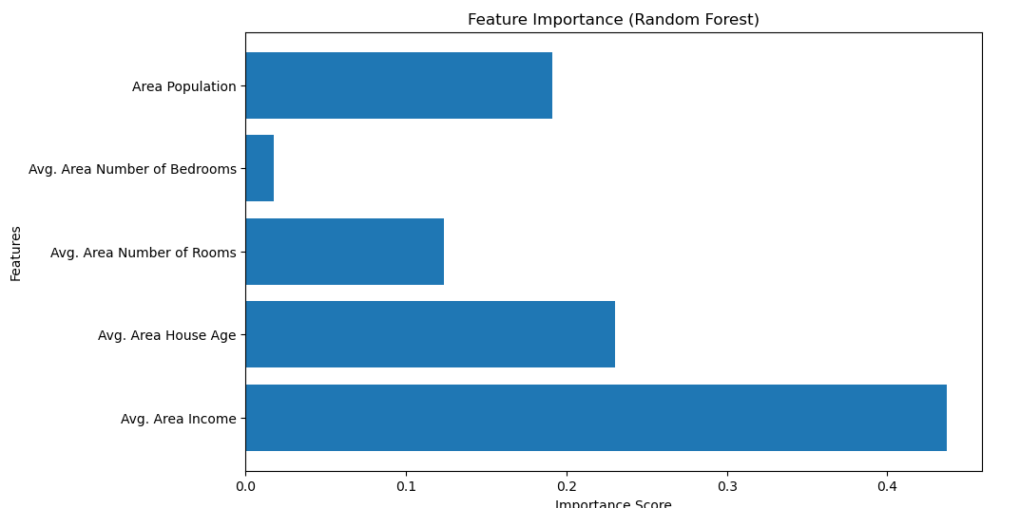
Implementation/STATS
Random Forest Regressor: Training R²: 0.9842 Testing R² : 0.8832 Training MAE: $35,293 Testing MAE : $94,021
Ridge R²: 0.9180 Lasso R²: 0.9180 Elastic Net R²: 0.9161 (Consistent)
The Random Forest model achieved a training R² of 0.98 and a testing R² of 0.88, showing strong predictive performance with slight overfitting. The Mean Absolute Error indicates an average prediction error of about $94,000 on unseen data.
Avg Area Income is the most key feature (~0.45)
Area Population and Avg House Age are close, but with House Age having more relevance (0.2~)
Number of Rooms is the 2nd lowest.
Area Number of Bedrooms is the lowest, having almost no importance.

Slide 6

Conclusion
Built a full machine-learning AI from a house price dataset to evaluate and predict housing prices.
Model is suitable for housing price prediction tasks, as it achieved a MAE of above 80%. Relatively predicts solidly, with good performance.
Through this project, I learned how machine learning models can be applied to predict real-world housing prices using structured data. I explored multiple regression models and found that ensemble methods like Random Forest perform strongly the best.
Learned how to clean, preprocess a dataset, how to use Random Forest Regressor along with the importance of feature selection and evaluation metrics for building reliable models.
Future improvements include hyperparameter tuning, cross-validation, and expanding the dataset to improve generalization.

