Slide 1
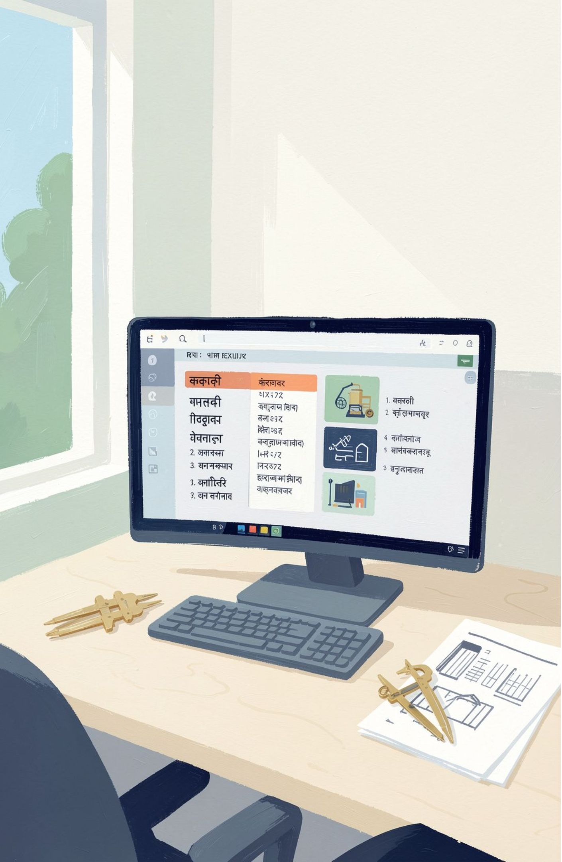
IndicSearch: An Efficient Keyword-Based Search Engine
A DSA-driven search system for Indian-language Wikipedia with Unicode processing and ranked retrieval.
PROJECT TEAM
2520030001 — M. ASWITHA
2520030098 — G. SUSHMA
2520030414 — N. YISHNAANI
Notes:
Good morning, faculty and evaluators. We present IndicSearch, a keyword-based search engine designed specifically for Indian-language Wikipedia content. The core objective of this project is demonstrating how fundamental data structures and algorithms—including HashMaps, Inverted Indexes, Tries, and Merge Sort—solve real-world challenges in multilingual information retrieval.

Slide 2


EXECUTIVE OVERVIEW
Abstract
IndicSearch retrieves relevant information from Indian-language Wikipedia through Unicode-aware preprocessing, keyword matching, and frequency-based ranking.
STORAGE & INDEX
AUTOCOMPLETE
SCORING & SORT
USER INTERFACE
HashMap & Inverted Index
Trie Prefix Engine
Merge Sort Ranking
Interactive Web Client
Structured keyword-to-document posting lists enable instant candidate lookup without sequential corpus scanning.
Retrieves real-time query suggestions dynamically as users type Indian-language script prefixes.
Orders retrieved documents deterministically in time by keyword occurrence frequency.
A clean frontend facilitating query input, language selection, ranked snippets, and live execution metrics.
END-TO-END PIPELINE ARCHITECTURE
01
02
03
04
05
06
User Query
Text Processing
Index Lookup
Search Engine
Merge Sort
Ranked Results
Target language & terms
Unicode normalize & tokenize
HashMap keyword map
Frequency scoring
Rank by relevance
Display in web UI
02
Notes:
This abstract highlights our architectural pipeline. We couple high-level Wikipedia API document retrieval with core algorithmic components: Trie-based prefix completion, Inverted Index mapping, and Merge Sort ranking by keyword frequency, all wrapped in a clean web interface.

Slide 3
Problem Statement
Scanning every document in a large multilingual collection can be inefficient.
Indian-language content requires correct Unicode text handling.
Users need relevant results rather than arbitrary document order.
Prefix suggestions can improve the search experience.
Indexing, retrieval, and ranking require suitable data structures and algorithms.
DESIGN GOAL
Build an efficient keyword-based search system that demonstrates DSA techniques for multilingual Wikipedia search.
03
Notes:
Here we formalize the problem. Scanning documents linearly is computationally impractical. Furthermore, Indian languages require precise Unicode handling so matras and compound glyphs tokenize accurately. Our project addresses these challenges directly using foundational computer science data structures.

Slide 4








SYSTEM CAPABILITIES
Proposed Functionalities
Eight cohesive capabilities bridging user inputs, linguistic processing, and algorithmic retrieval.
Keyword Search
Indian-Language Support
Text Preprocessing
Inverted Index Search
Supports single and multi-term queries with boolean term matching.
Full Unicode UTF-8 support across Indian-language Wikipedia domains.
Normalizes script variants and tokenizes query text into clean search terms.
Maps individual tokens directly to matching candidate document IDs.
Frequency-Based Ranking
Prefix Suggestions
Real-Time Metrics
Web Interface
Computes term occurrence frequencies to prioritize the most relevant pages.
Interactive autocomplete backed by a memory-efficient character Trie.
Surfaces query latency, total documents matched, and indexed keys.
Responsive UI to enter queries, toggle languages, and inspect ranked results.
END-USER & ALGORITHMIC CAPABILITIES IMPLEMENTED IN INDICSEARCH
04
Notes:
This grid outlines the eight functional modules. Key highlights include our dedicated text preprocessing engine for Indian script tokens, the dual search and autocomplete flow, and transparent diagnostic metrics displayed directly in the web UI for evaluation.

Slide 5
Algorithms, Tools & Technologies
DATA STRUCTURES & ALGORITHMS
TOOLS & TECHNOLOGIES
HashMap
Java · HTML · CSS · JavaScript · Java HttpClient · Wikipedia MediaWiki API · VS Code
Document storage and score management
Architecture
Inverted Index
Frontend → Java API Server → Wikipedia API → DSA Search Engine → Ranked Results
Keyword-to-document mapping
Trie
Text layer
Prefix-based suggestions
Unicode / UTF-8 support for Indian-language text
Merge Sort
Ranking by frequency
Text preprocessing
Normalization and tokenization
05

Slide 6
PROJECT TARGETS
Objectives
Eight benchmark milestones driving the implementation and evaluation of IndicSearch.
TARGET | CORE OBJECTIVE | TECHNICAL IMPLEMENTATION & SCOPE | CATEGORY
OBJ-01 | DSA-based search engine Build an efficient keyword-based retrieval engine. | Custom in-memory index pipelines replacing linear file scanning. | CORE
OBJ-02 | Indian-language Wikipedia search Support querying across diverse Indian languages. | Robust Unicode UTF-8 handling for scripts such as Hindi, Telugu, and Tamil. | LANGUAGE
OBJ-03 | Inverted Index architecture Implement fast keyword-to-document mapping. | Posting list structures allowing instant candidate article identification. | INDEXING
OBJ-04 | HashMap storage & frequencies Efficient document caching and score tracking. | Average O(1) access for term occurrence counts and document metadata. | STORAGE
OBJ-05 | Trie-based prefix suggestions Real-time autocomplete for vernacular keywords. | Character-level Trie traversal executing as user types in the search bar. | UX / DSA
OBJ-06 | Merge Sort frequency ranking Order retrieved articles by keyword relevance. | Guaranteed O(n \log n) divide-and-conquer sorting by match frequency. | ALGORITHM
OBJ-07 | Interactive web interface Provide an accessible, responsive search UI. | Intuitive query submission, real-time metrics, and snippet preview cards. | INTERFACE
OBJ-08 | Real-world DSA demonstration Prove textbook concepts on live web APIs. | Integration of theoretical data structures with live Wikipedia MediaWiki API. | PRACTICAL
06
Notes:
This table summarizes our eight project objectives across four categories: Core system, Language handling, Indexing & UX, and Evaluation. Each objective directly correlates with an implemented algorithm or software module presented today.

Slide 7
EXECUTION ARCHITECTURE
System Flow
Step-by-step query lifecycle alongside the concurrent Trie suggestion side-flow.
User: enter keyword or query
Select language
Text preprocessing: normalization + tokenization
Wikipedia Search API: retrieve candidate documents
HashMap: store documents
Inverted Index: build or apply keyword mapping
Match keyword frequency and calculate document scores
Merge Sort: rank results
Display results
Trie: provide search suggestions
SUGGESTION SIDE-FLOW
User Types Prefix
↓
Trie
↓
Matching Prefix Suggestions
07
Notes:
This architectural diagram illustrates the runtime flow. The main sequence covers keyword entry, language selection, text preprocessing, document retrieval, indexing, scoring, ranking, and results. The Trie side-flow provides search suggestions.

Slide 8
Conclusion
Future Scope
IndicSearch shows how HashMap, Inverted Index, Trie, and Merge Sort can support structured storage, efficient keyword retrieval, prefix suggestions, and frequency-based ranking over real Wikipedia data accessed through an API.
Support a larger locally indexed multilingual corpus.
Improve ranking with additional relevance factors.
Add more Indian languages.
Improve autocomplete and query understanding.
Introduce caching for faster repeated searches.
08
Notes:
In conclusion, IndicSearch accomplishes all stated project goals, verifying how textbook DSA techniques successfully underpin real-world multilingual search applications. In future iterations, we look forward to incorporating local corpus indexing, TF-IDF weighting, and LRU caching.

Slide 9
THANK YOU

