Slide 1


Spam Email Classification Using Decision Trees and XGBoost with Cross-Validation
DECISION TREES & XGBOOST · CEAS-08 CORPUS · TF-IDF
TEAM MEMBERS:
2520030414 NAGABHYRAVA YISHNAANI
2520030430 PRAGNYA
Guide: Shaik Asif, Assistant Professor, CSE Dept. — Academic Year: 2026–27
Notes:
Welcome to our project presentation on Spam Email Classification using Decision Trees and XGBoost. We evaluate both classifiers on the CEAS-08 corpus under identical TF-IDF features and stratified 5-fold cross-validation to ensure an unbiased algorithmic comparison.

Slide 2
PROBLEM & OBJECTIVE
Machine learning can separate spam from legitimate email
PROBLEM STATEMENT:
Spam and Legitimate emails are common threats to email users.
Manually identifying unwanted emails is inefficient.
Email content contains textual patterns that can be used for classification.
Machine learning can automatically classify emails as Spam or Legitimate.
Objective
To develop and compare Decision Tree and XGBoost models for spam email classification using the CEAS-08 dataset.
02
Notes:
Spam detection is an active adversarial classification challenge. Rather than examining code syntax, this presentation investigates the end-to-end classification system: data hygiene, linguistic feature extraction, and a direct benchmark between interpretable decision trees and ensemble gradient boosting.

Slide 3
DATASET SPECIFICATION
CEAS-08 provides the project’s labeled email corpus
SCHEMA DEFINITION & SAMPLE STRUCTURE (CEAS_08.CSV)
FIELD | DATA FEATURES | DESCRIPTION & SAMPLE VALUE
sender | Text (Header) | Originating address or domain · "alerts@service-update.net"
receiver | Text (Header) | Recipient mailbox identifier · "user@organization.edu"
date | Timestamp | Transmission metadata · "Wed, 13 Aug 2008 09:14:22 -0400"
subject | Text (Primary) | Header subject line · "Urgent: Account verification required"
body | Text (Primary) | Full message body payload containing links and text
label | Binary Target | 0 or 1
url | text url | url information
SOURCE: CEAS-08 EMAIL DATASET · KAGGLE BENCHMARK CORPUS
03
Notes:
CEAS-08 is a widely cited email corpus sourced via Kaggle. While metadata attributes such as sender, receiver, and date exist in the raw CSV, our classification experiments center on natural language processing of the concatenated subject and body fields mapped to the ground-truth binary label.

Slide 4
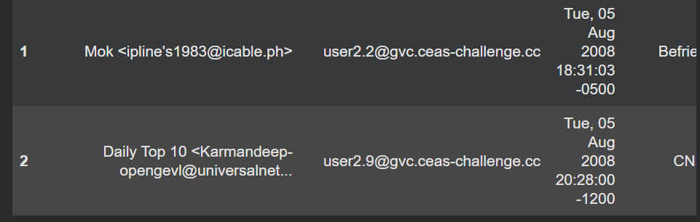
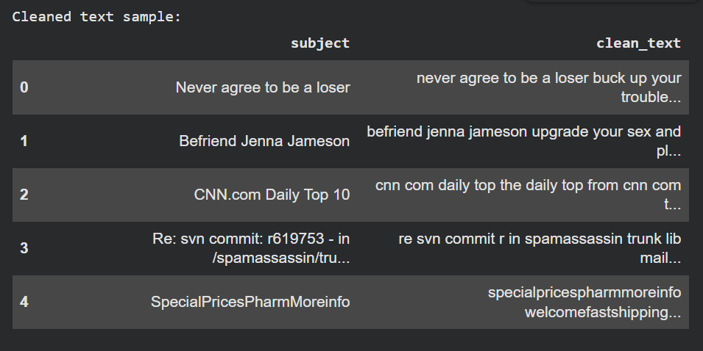
Data Cleaning & Preprocessing
Raw Email
Before cleaning:
↓
Handle Missing Values
↓
Remove Duplicates
↓
Clean HTML / URLs / Email IDs
↓
Convert to Lowercase
↓
Remove Unnecessary Characters
↓
Combine Subject + Body
↓
Clean Text
04

Slide 5
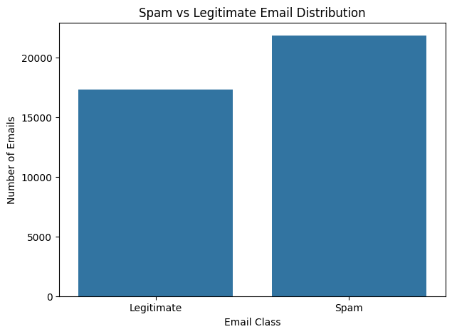
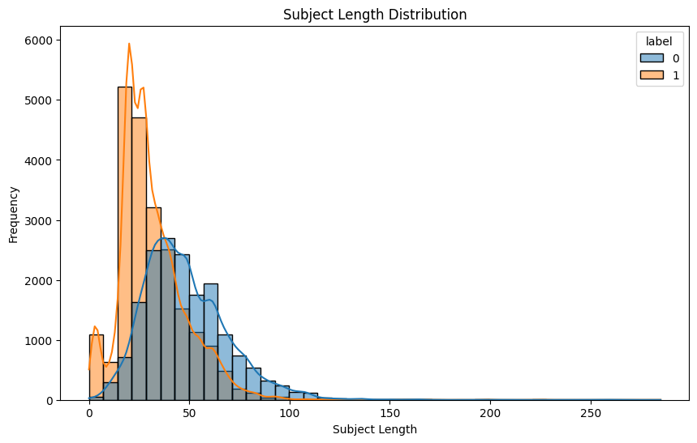
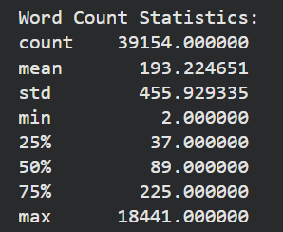
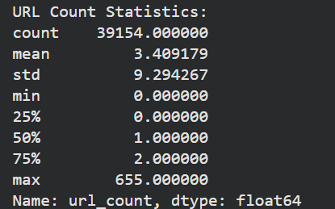
EXPLORATORY DATA ANALYSIS
EDA REPORT
PANEL 1 · CLASS DISTRIBUTION
PANEL 2 · EMAIL LENGTH
PANEL 3 · URL COUNTS
PANEL 4 · SUBJECT LENGTH
Email length and word count
URL counts
Subject length
Class distribution
05

Slide 6
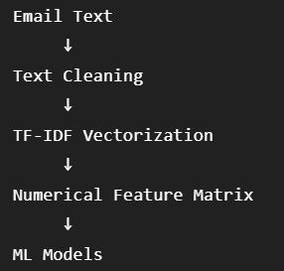

FEATURE ENGINEERING
TF-IDF turns email language into model-ready features
TF-IDF converts email text into numerical feature vectors based on the importance of words within the emails.
TRANSFORMATION
TF-IDF Feature Extraction
1) TF-IDF converts email text into numerical features that can be understood by machine learning models.
2) It uses unigrams and bigrams, removes common English stop words, and keeps up to 10,000 features.
This helps the models identify important words and phrases related to spam emails.
06

Slide 7
SYSTEM ARCHITECTURE
The full pipeline keeps comparison fair
CEAS-08 Dataset
Parallel Model Training
01
Data Cleaning
Decision Tree
XGBoost
02
Exploratory Data Analysis
03
5-Fold Stratified Cross-Validation
TF-IDF Feature Extraction
04
Evaluation
Train / Test Split
05
Comparison
07

Slide 8
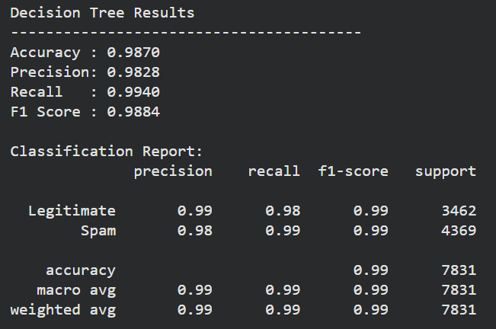
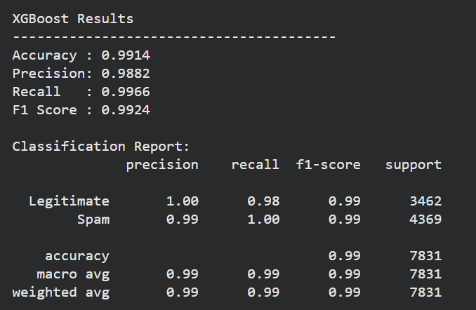

MODELS USED
Machine Learning Models
Decision Tree
XGBoost
Tree-based classification algorithm.
Makes decisions using feature-based splits.
Easy to interpret.
Used as one of the baseline classification models.
Gradient boosting algorithm.
Builds multiple decision trees sequentially.
Uses boosting to improve predictions.
Applied for spam classification.
08
Notes:
We compare a clear, interpretable Decision Tree baseline with XGBoost, a gradient boosting algorithm that builds decision trees sequentially. Both models use the same dataset and TF-IDF feature representation so their performance can be compared fairly.

Slide 9
Cross-Validation & Evaluation
Model Validation
Evaluation Metrics
Dataset
↓
Metric | Meaning
Accuracy | Overall correct predictions
Precision | Correct spam predictions
Recall | Spam emails successfully detected
F1 Score | Balance of precision and recall
F1 | F2 | F3 | F4 | F5
↓
Train / Validate
↓
Repeat 5 Times
↓
Mean Score
09

Slide 10
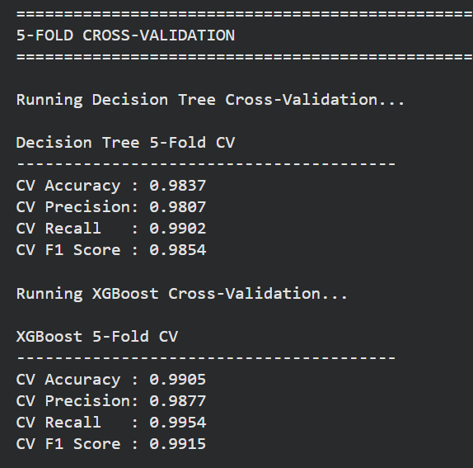
Results & Comparison
The performance of Decision Tree and XGBoost is compared using Accuracy, Precision, Recall, and F1 Score.
The 5-Fold Cross-Validation results show how consistently each model performs across different data splits.
The confusion matrices show the number of spam and legitimate emails correctly and incorrectly classified.
The comparison helps identify which model performed better based on the actual experimental results.
EVALUATION LOG: HELD-OUT TEST RUNS & 5-FOLD STRATIFIED CV REPLICATES
10
Notes:
This final comparison slide brings together both held-out test metrics and cross-validation averages. The layout is structured with explicit bracketed placeholders so the actual experiment findings can be verified directly without preempting empirical results.

Slide 11
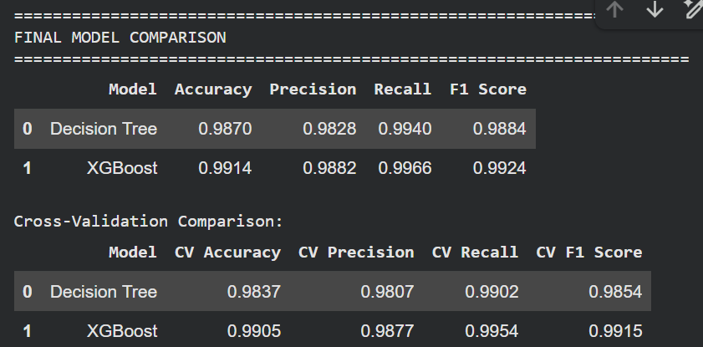
RESULT INTERPRETATION
Key Findings
INTERPRETATION
TEST-SET RESULTS
The models were compared using Accuracy, Precision, Recall and F1-score.
5-fold cross-validation was used to assess consistency across training/validation splits.
Based on the selected evaluation metric, [model shown by the actual results] achieved the higher test-set performance.
Cross-validation results were used to check whether the observed performance was consistent across different splits.
11
Notes:
Use the actual notebook values to complete the table and the selected-metric interpretation. Do not name a winner until the finalized results support that conclusion.

Slide 12
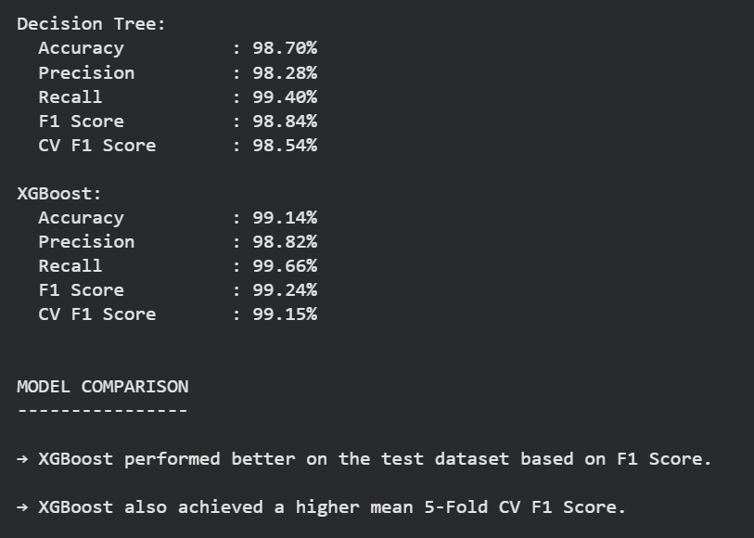
Conclusion
The CEAS-08 dataset was successfully cleaned, analyzed, and prepared for spam email classification.
TF-IDF effectively converted email text into numerical features suitable for machine learning models.
Both Decision Tree and XGBoost were successfully trained and evaluated using Accuracy, Precision, Recall, and F1 Score.
5-Fold Stratified Cross-Validation was used to verify the consistency and reliability of the models' performance.
Based on the experimental results, XGBoost achieved better overall performance than Decision Tree, demonstrating its effectiveness for spam email classification
12
Notes:
Close by summarizing the implemented pipeline, then invite questions and point to the four practical directions for extending the work.

Slide 13
THANK YOU

