Slide 1

Spam Email Classification Using Decision Trees and XGBoost with Cross-Validation
Machine Learning Project — concise classification pipeline for email.
Team:
N. Yishnaani — 2520030414
Pragnya — 2520030430
Guide: Shaik Asif, Assistant Professor, CSE Dept. — Academic Year: 2026–27
Visual: Email → Machine Learning → SPAM / LEGITIMATE

Slide 2
Why Do We Need Spam Detection?
Email is ubiquitous. Volume makes manual filtering impractical.
Spam harms users. Phishing, scams, and unwanted content.
ML learns patterns from labeled emails to classify new messages.
Automation saves time and reduces user exposure to threats.
Problem Statement
Develop a simple ML system to classify emails as Spam or Legitimate.

Slide 3
Objectives & Basic Approach
Prepare and clean the email dataset.
Convert text into numerical features (TF-IDF).
Train multiple ML models and compare.
Evaluate with cross-validation and metrics.
Identify effectiveness of Decision Tree and XGBoost.
Visual summary: Dataset → Preprocessing → Feature Extraction → Model Training → Cross-Validation → Evaluation → Prediction

Slide 4
Data Preprocessing & TF‑IDF
Step 1 — Preprocessing
Clean text: remove HTML, headers, punctuation, and non‑text noise.
Normalize: lowercasing, tokenization, optional stopword removal.
Result: processed plain-text ready for feature extraction.
Step 2 — TF‑IDF
TF‑IDF converts processed text to numerical features by weighting terms by importance across the corpus.

Slide 5

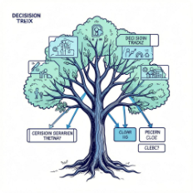


Logistic Regression
Decision Tree
Random Forest
XGBoost
Tree-based. Rules split features to decide Spam vs Legitimate. Easy to visualize.
Boosting model. Sequential trees improve errors; often strong performance.
Baseline model. Linear separation of classes. Fast and interpretable.
Ensemble of trees. Reduces variance by averaging many trees.
Goal: Compare models using the same data and validation process. No claims about which is best without results.

Slide 6
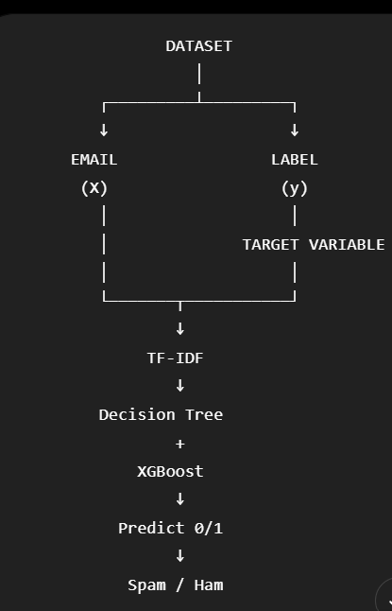
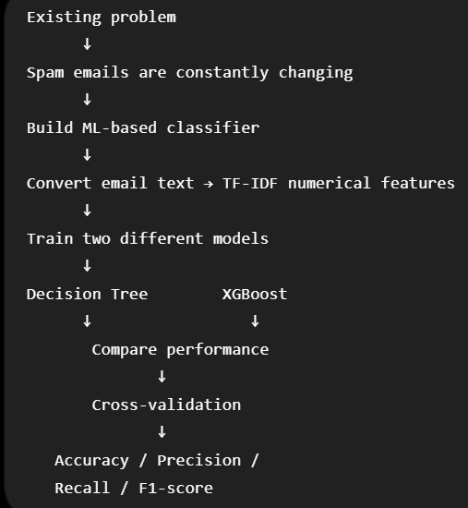
FLOW OF THE SPAM EMAIL DETECTION

Slide 7
6048 EMAILS
↓
┌─────────────┐
│ EDA │
└──────┬──────┘
↓
Missing values
Duplicate emails
Spam/Ham balance
Email length
Outliers
Sample emails
↓
DATA PREPROCESSING
↓
TEXT CLEANING
↓
TF-IDF
↓
┌──────────┴──────────┐
↓ ↓
Decision Tree XGBoost
↓ ↓
└──────────┬──────────┘
↓
5-Fold CV
↓
Accuracy / Precision /
Recall / F1-score
↓
MODEL COMPARISON

Slide 8
Decision Tree vs XGBoost — Key Differences
Decision Tree
Single model with branch decisions. Simple splits and easy to explain.
XGBoost
Sequential ensemble of trees using gradient boosting. Focuses on correcting previous errors.
Interpretability
Decision Tree: high. XGBoost: lower but can be explained with SHAP (optional).

Slide 9
Cross‑Validation & Hyperparameter Tuning
Avoid memorization. Do not let models simply memorize training examples.
Cross‑validation tests models on multiple data portions for robust estimates.
Hyperparameter tuning searches for settings that improve generalization.
Final evaluation uses held‑out data after tuning for an unbiased check.

Slide 10






Evaluation Metrics — What to Measure
Accuracy
Precision
Overall fraction of correct predictions.
How many predicted spam are actually spam.
Recall
F1‑Score
How much actual spam the model detects.
Harmonic mean of precision and recall.
ROC‑AUC & PR‑AUC
Calibration
Separation ability and precision-recall tradeoffs.
Whether predicted probabilities reflect real confidence.

Slide 11
Unsupervised Learning & Data Exploration
K‑Means: find similar groups of emails.
DBSCAN: detect dense clusters and anomalies.
PCA: reduce dimensions for simpler views.
t‑SNE / UMAP: visualize high‑dimensional patterns.
Purpose: Discover patterns and anomalies separate from the supervised task.

Slide 12
Conclusion
Built a simple ML pipeline for Spam vs Legitimate classification.
Used preprocessing and TF‑IDF to create features from email text.
Compared models including Decision Tree and XGBoost.
Applied cross‑validation and multiple metrics for reliable assessment.
Used unsupervised methods to explore patterns and anomalies.
Thank You
Questions?

