Slide 1
Ragade’s Cube

Slide 2
Inception
Project Management

Slide 3
Team Organization
Used ego-less approach
Analyst
Tester
Programmer
Designer
Librarian

Slide 4
Team Organization
Modified ego-less approach
Analysts
Designer/Librarian/
Programmer
Tester

Slide 5
Inception
Client centered requirements
Gamers
Customers who would buy this product

Slide 6
Choosing Client
We are not looking at one customer
We are looking at a group of potential customers and catering our requirement for them
Leaning towards the population that interested in puzzle games in a competitive environment

Slide 7
Client Requirements
The client is where the game is played
Communicates with the server and allows networked multiplayer games
The following slides detail the client’s requirements

Slide 8
Sound Requirements
Plays sound for particular actions that occur during game process
Background music will play through out the game

Slide 9
Input Requirements
Client will expose an abstract input system capable of collecting input from different input devices
These include
Mouse
Keyboard
XBox 360 Controller
And misc devices

Slide 10
GUI Requirements
Shall provide game menus that allows the user to begin game play and select options
GUI provides the cursor to select controls
Highlight selected row or column of cube on display
Will be able to display up to 4 cubes in split screen
Display statistics for each person on screen

Slide 11
Game Logic Requirements
Should interpret input events and carry out actions accordingly
Control flow of the game is done by managing states

Slide 12
Game Play Requirements
Multiple players are allowed to compete one another

Slide 13
A.I. Requirements
AI shall have a common interface that will allow it to communicate to the client and server
Shall be able to solve the cube with varying levels of expertise

Slide 14
Network Requirements
Allow communication to server over TCP/IP to start or join a game session

Slide 15
Server Requirements
Will mediate game sessions
Will close a game session when no clients are present
Will allow restart of a game session after a completion of a game match
Keep an accurate log of activities
Will block IP addresses that attempt to cause harm

Slide 16
Anticipated Architecture

Slide 17
Configurations
Windows XP or higher
Keyboard and Mouse
360 Gamepad Controller for Windows
Must include Video card that supports
Shader Model 1.1
XBox 360
360 Gamepad Controller

Slide 18
Development Environment
C# Express 2005
XNA Game Studio Express Ver. 1.0
.Net Framework 2.0
DirectX 9.0
Anim8or
XAct

Slide 19
Elaboration
Software Requirements

Slide 20
Starting Design
From the software requirements we can formulate a high level architecture for a basis for further design
The high level design will be shown and each component examined

Slide 21
High Level Architecture

Slide 22
Engine

Slide 23
Input

Slide 24
Input (cont)

Slide 25
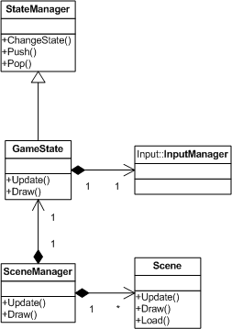
State Management

Slide 26
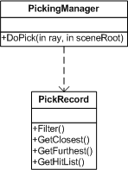
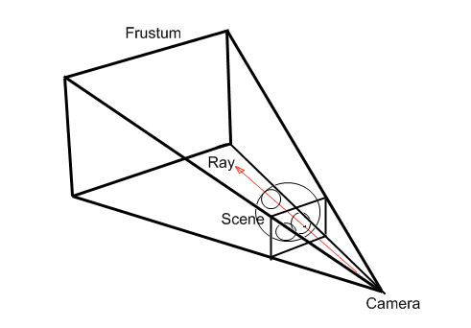
Picking

Slide 27
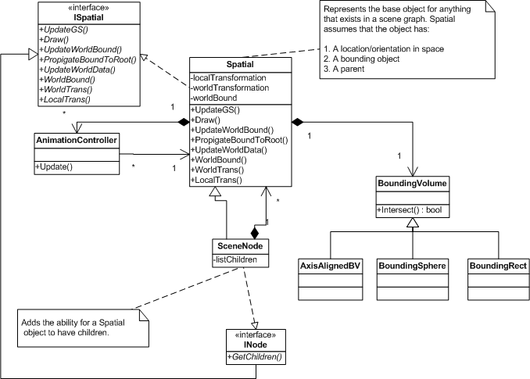
Scene Graph

Slide 28
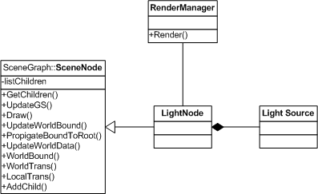
Rendering

Slide 29
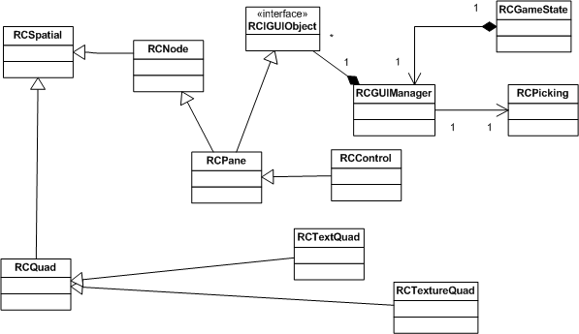
GUI

Slide 30
Game
The following slides describe the components to the game

Slide 31
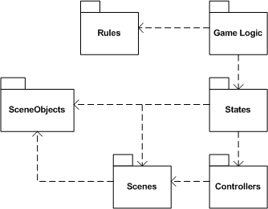
Game Logic

Slide 32
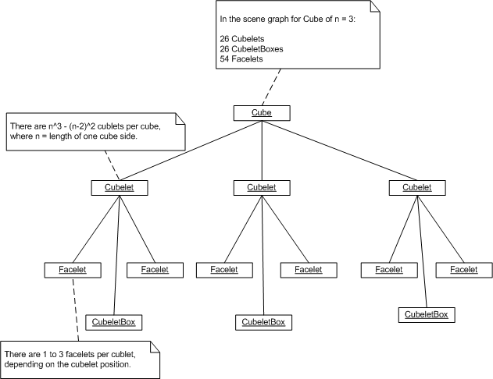
Cube Scene Graph

Slide 33
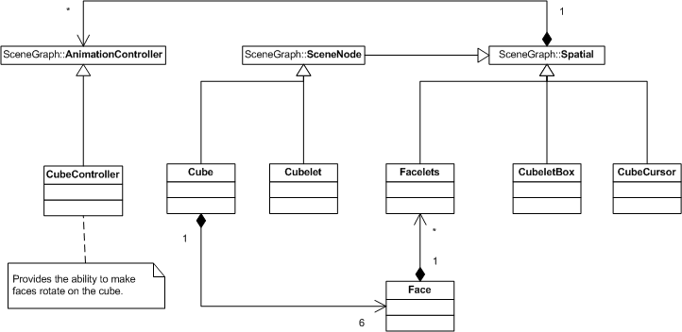
Cube Scene Graph (cont)

Slide 34
Engine Design Metrics

Slide 35
Regade’s Cube Design Metrics

Slide 36
Complexity
The complexity is proportional to V(G)
Fan in/Fan out of the components is less than or equal to one
Indicates low design complexity

Slide 37
Dependency

Slide 38
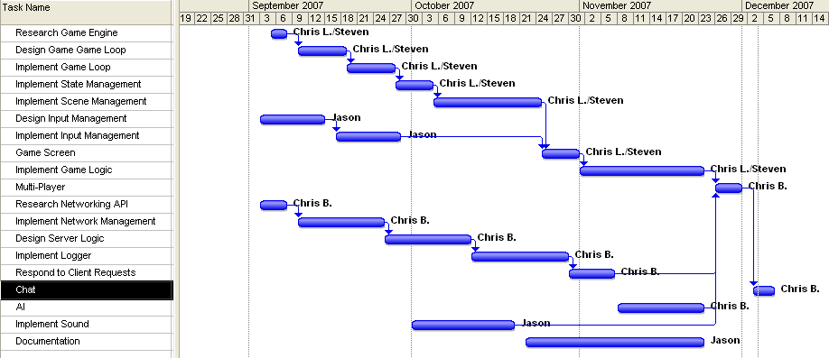
Project Development Schedule
Changes are needed!

Slide 39
Dependencies and Work Schedule
Though simple, the project is very large and is very impractical for such a short period of time

Slide 40
Agile
Design phase was not mutually exclusive to construction or implementation
Each component design requirements were updated during component implementation
Immediately prior to implementation, the component was designed as needed. This meant that not all components were designed together.

Slide 41
Cuts
We were design and implementing at the same time. As it progressed, it became apparent that not all features could be designed and coded. Not to mention tested.
Networking
AI
Misc Controls
Options
Game modes (“Ragade’s Revenge”)
NxNxN Cube

Slide 42
Construction
Creation of the Product

Slide 43
Effort Estimation
Two methods were used to estimate effort time
COCOMO II
Dependency Graph Analysis

Slide 44
COCOMO II
Using the COCOMO II Estimation process because we will be taking the project through all three stages of the development cycle. The basic model is E = bS^{c}m(X).
Estimated Effort 3.105263 person-months
Approximately 500 person hours

Slide 45
Dependency Graph Analysis
Defining weights for each link in the Dependency Graph, we were able to find a total amount of effort.
275 Hours
Task | Assigned | Hours
Research Game Engine | Chris L./Steven | 5
Design Game Loop | Chris L./Steven | 3
Implement Game Loop | Chris L./Steven | 10
Implement State Management | Chris L./Steven | 16
Implement Scene Management | Chris L./Steven | 24
Design Input Management | Jason | 10
Implement Input Management | Jason | 10
Game Screen | Chris L./Steven | 40
Implement Game Logic | Chris L./Steven | 40
Multi-Player | Chris B. | 5
Research Networking API | Chris B. | 5
Implement Network Management | Chris B. | 10
Design Server Logic | Chris B. | 10
Implement Logger | Chris B. | 10
Respond to Client Requests | Chris B. | 5
Chat | Chris B. | 5
AI | Chris B. | 32
Implement Sound | Jason | 15
Documentation | Jason | 20
Total Hours: |  | 275

Slide 46
Component Effort Time

Slide 47
Effort Over Time

Slide 48
Estimation and Actual
COCOMO II
500 Hours
Dependency
275 Hours
Actual
534 Hours

Slide 49
McCabe’s Metrics

Slide 50
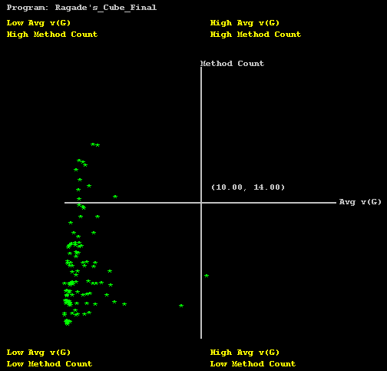
Average Method Count vs. Complexity

Slide 51
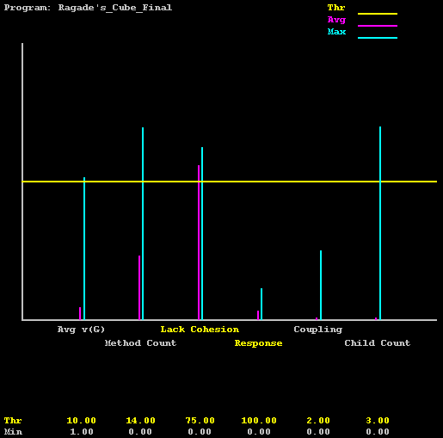
Histogram

Slide 52
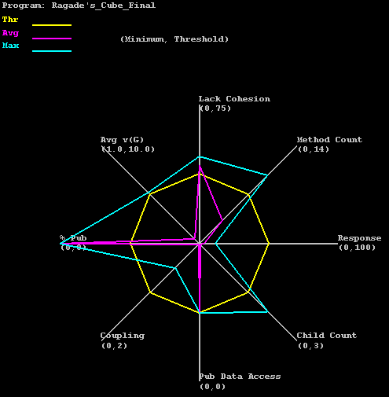
Kiviat Diagram

Slide 53
Transition
Test and Deploy

Slide 54
Test Software
Test Log
Mantis (Bug Tracker)
NCover
Nunit

Slide 55
Make Test Plan
Outlines a systematic approach for testing the entire system.
The test plan will contain:
Test inventory
Risk analysis (MITS)
Test effort estimation
Resources
Progress tracking

Slide 56
Building Test Inventory
The test inventory contains all possible tests.
Test cases are generated from:
Use Cases
Requirements
Classes and Components
Links between components

Slide 57
Test Case Estimation
After consideration of McCabe Metrics, it was found that the program is very large.
Over 713 functions would require >= 713 possible unit tests.
Each unit test would take > 30 minutes to perform and implement.
An estimation of the total number of possible test cases is 2097.
THERE ARE TOO MANY!!!!!

Slide 58
Risk Analysis
Using MITS Risk Analysis
Each test case was categorized by:
Severity
Cost
Each category was given a weight.
The average of the weights were determined for each test case to produce a priority.
The priority determined the test ordering.

Slide 59
Test Cases (that survived)
Acceptance Tests – test for requirement validation.
Menu screen test to begin game and select options.
Cursor test for GUI.
Split screen test for game play.
Game stats test for game play.

Slide 60
Test Cases (that survived)
System Tests
Test the make sure cube start shuffled.
Test to see game goes to the title screen after a win.
Test to see the cursor makes a sound when rotating.

Slide 61
Test Cases (that survived)
Integration Tests
Test to see if a scene was drawn and updated.
Test to see if picking subsystem works.
Test to see if GUI receives an input.

Slide 62
Test Cases After MITS
No Unit Tests survived the MITS Risk Analysis.
We made sure that every requirement was covered in test case selection.

Slide 63
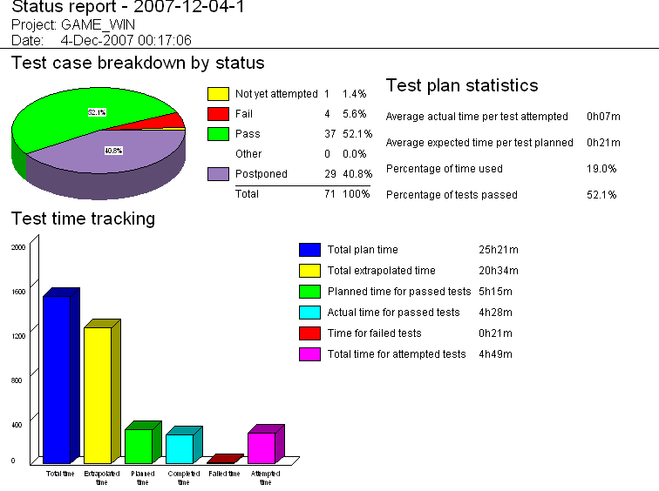
Test Status

Slide 64
Test Effort

Slide 65
Bug Finding and Fixing

Slide 66
Error Rate

Slide 67
Known Defects(Ragade’s Cube)
After exiting a game, the title screen does not display correctly.
Game receives input when not in focusCube does not shuffle the appropriate amount
Change focus sound on menu when no focus has changed
Strange artifacts appear around words and buttons on the menu screens.

Slide 68
Known Defects (Engine)
Scenes need to have draw order.
Control item texture asset names should be specified with full path.

Slide 69
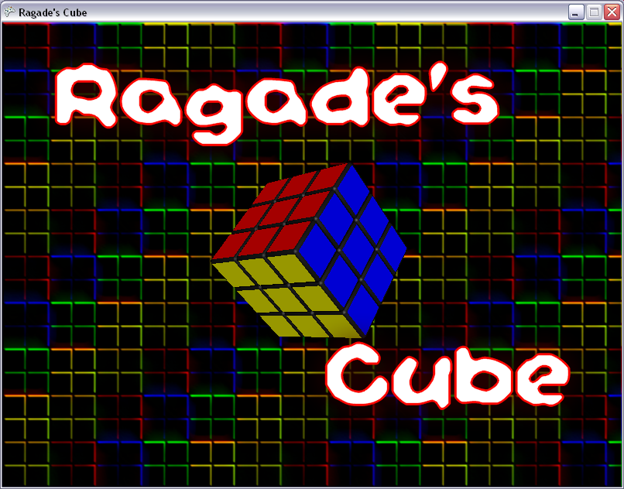
DEMO TIME!

