Slide 1
Bayesian Online Changepoint Detection
Max Mihailescu
07.08.2020

Slide 2
Outlook
Motivation at Linac3
Presentation of the Algorithm
Code example
07.08.2020
Max Mihailescu | Bayesian Online Changepoint Detection
<Foliennummer>

Slide 3
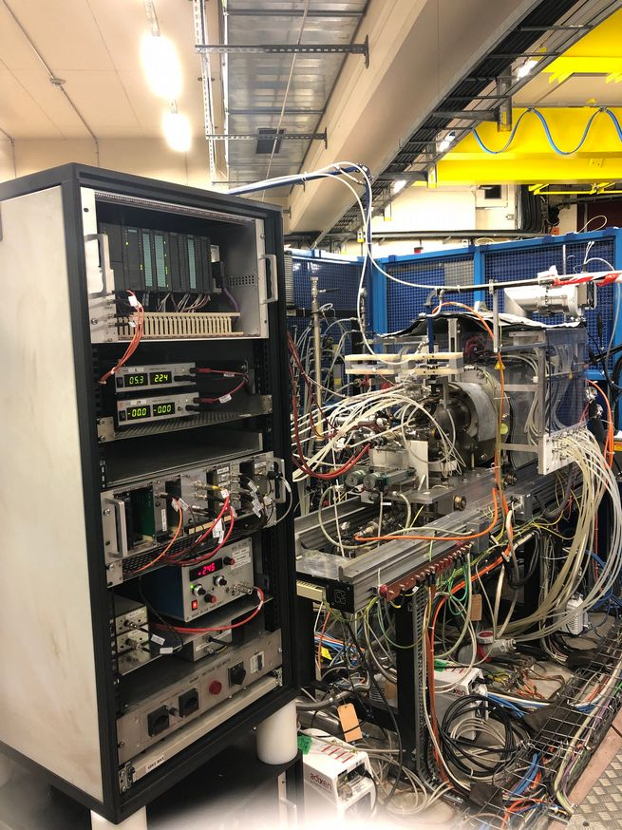
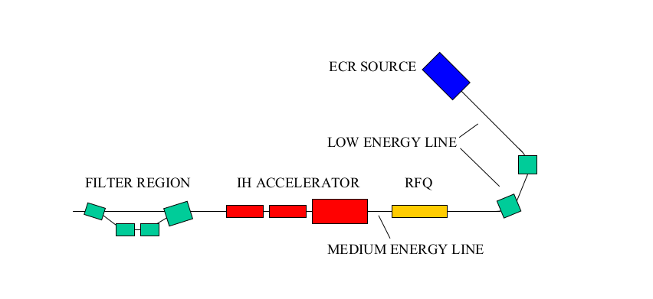
Layout of LINAC3 and the objective
Linac3 produces heavy ions, mainly Pb.
07.08.2020
Max Mihailescu | Bayesian Online Changepoint Detection
<Foliennummer>

Slide 4
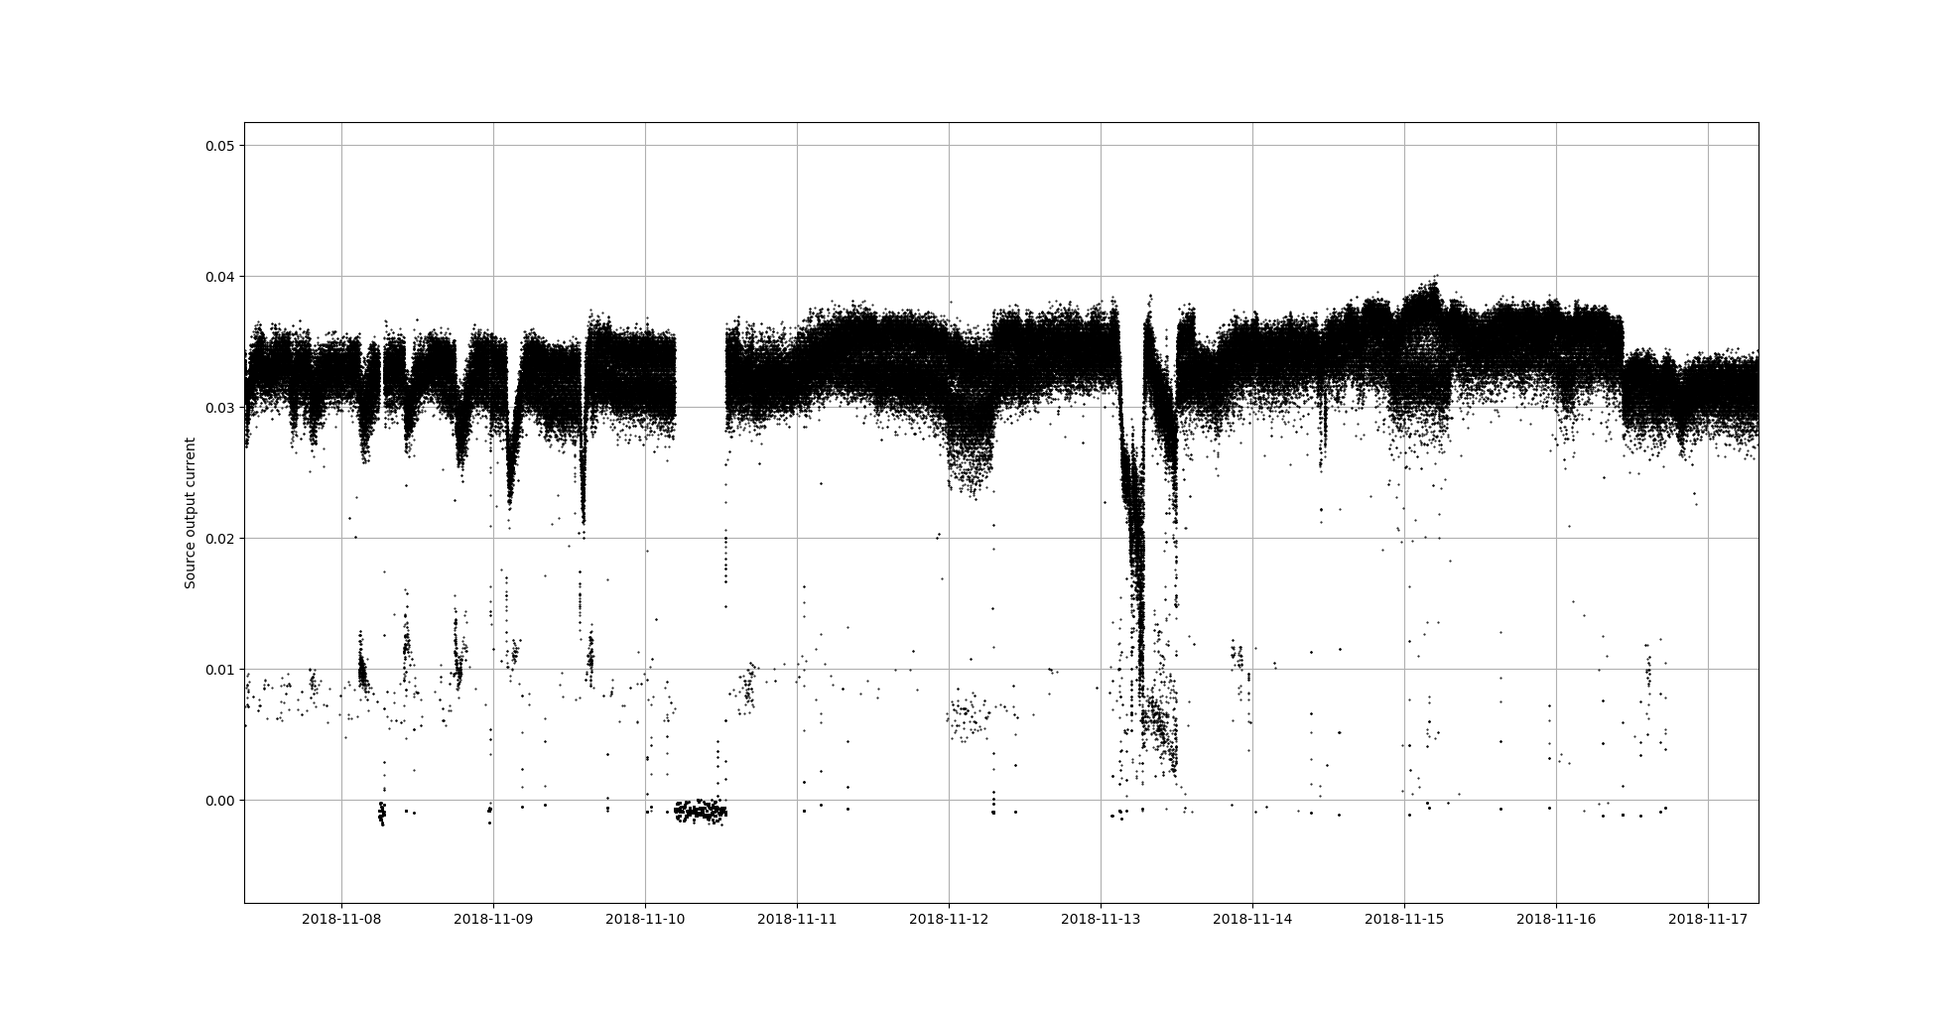
Layout of LINAC3 and the objective
There is a lot to tweak at the source:
Oven Power, RF, three solenoids, gas inflow, …
This leads to a very complex system which can produce results that are very difficult to predict.
ITL.BCT.05:CURRENT
The goal is to quickly identify regime changes in the output beam current
BCT05 current [mA]
07.08.2020
Max Mihailescu | Bayesian Online Changepoint Detection
<Foliennummer>

Slide 5
Online Changepoint Detection
Given an ordered collection of data points (a time series)...
...changepoint detection is the task of detecting qualitative changes in the observed time series.
Probabilistic models search for changes in distribution of data
Other models minimize a cost function (e.g. piece wise linear regression)
...online changepoint detection performs analysis on streaming data.
The full time series is typically not known
Whenever new data is observed, decide if a changepoint occurred
update model to include new knowledge (optional)
07.08.2020
Max Mihailescu | Bayesian Online Changepoint Detection
<Foliennummer>

Slide 6
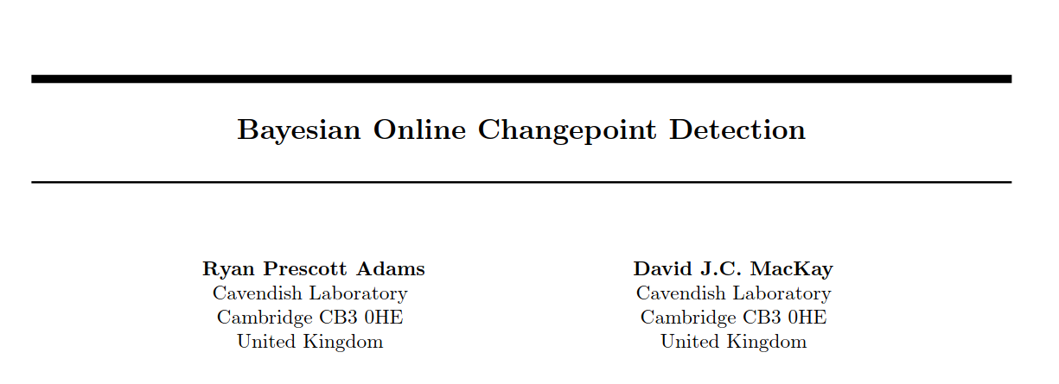
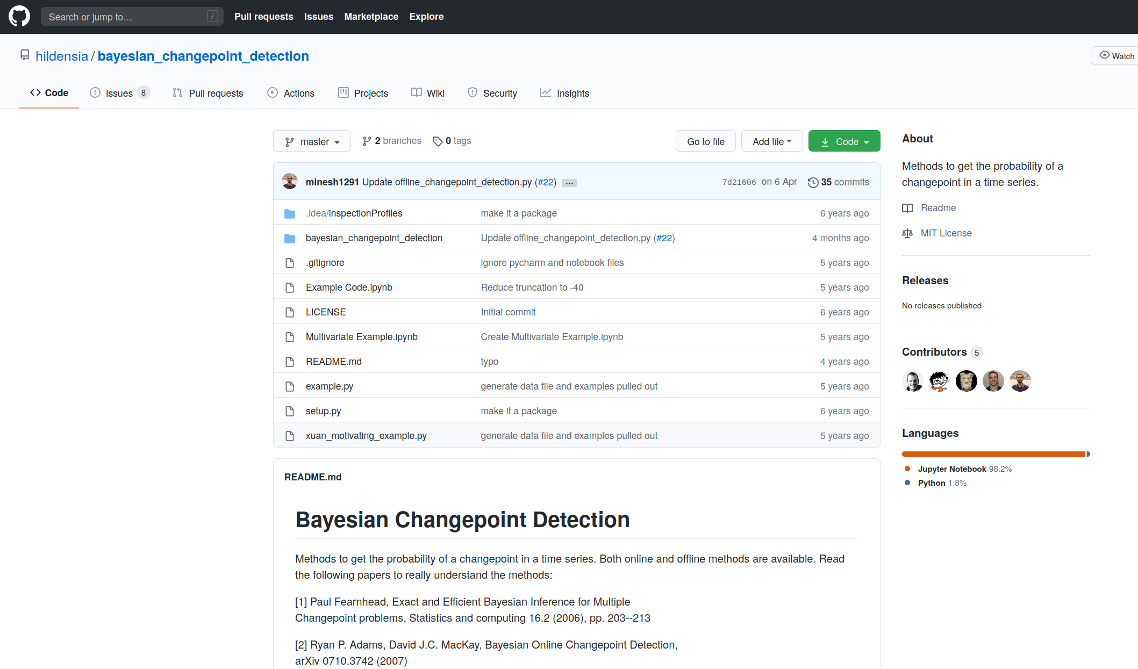
Paper by Adams and MacKay (2007)
Published on arXiv: https://arxiv.org/abs/0710.3742
Python implementation (MIT license): https://github.com/hildensia/bayesian_changepoint_detection
07.08.2020
Max Mihailescu | Bayesian Online Changepoint Detection
<Foliennummer>

Slide 7
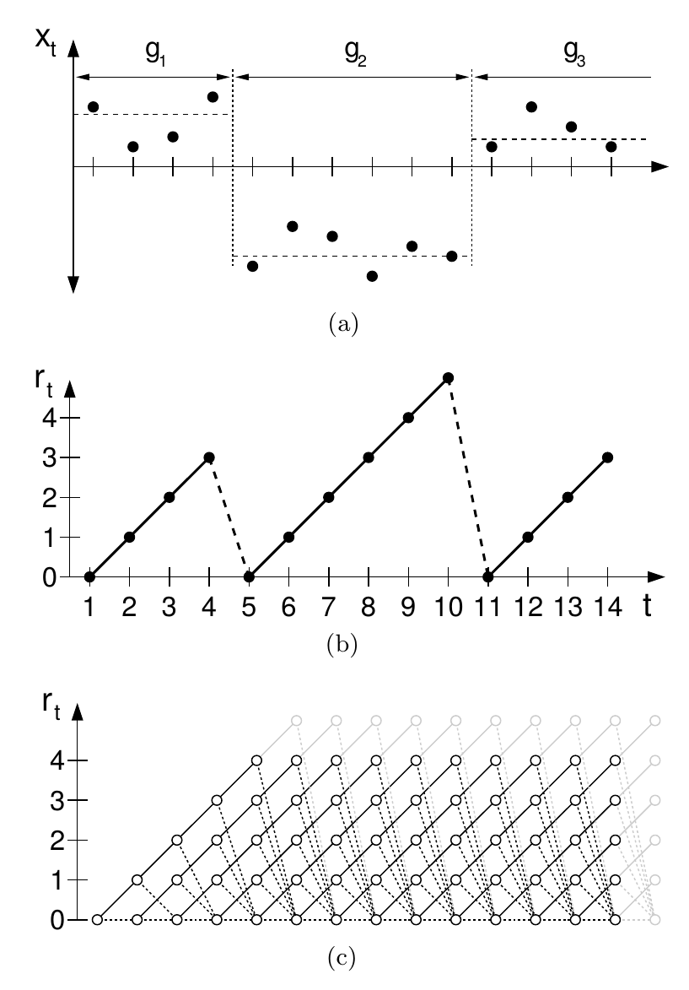
The concept of run lengths
Consider an ordered series of points where the observations are drawn i.i.d. from different distributions.
The run length r_{t} indicates how many time steps have passed since the last changepoint occurred.
Build a probabilistic model with probabilities for all possible run lengths at every time step.
Graphic from Bayesian Online Changepoint Detection, Adams & MacKay (2007)
07.08.2020
Max Mihailescu | Bayesian Online Changepoint Detection
<Foliennummer>

Slide 8
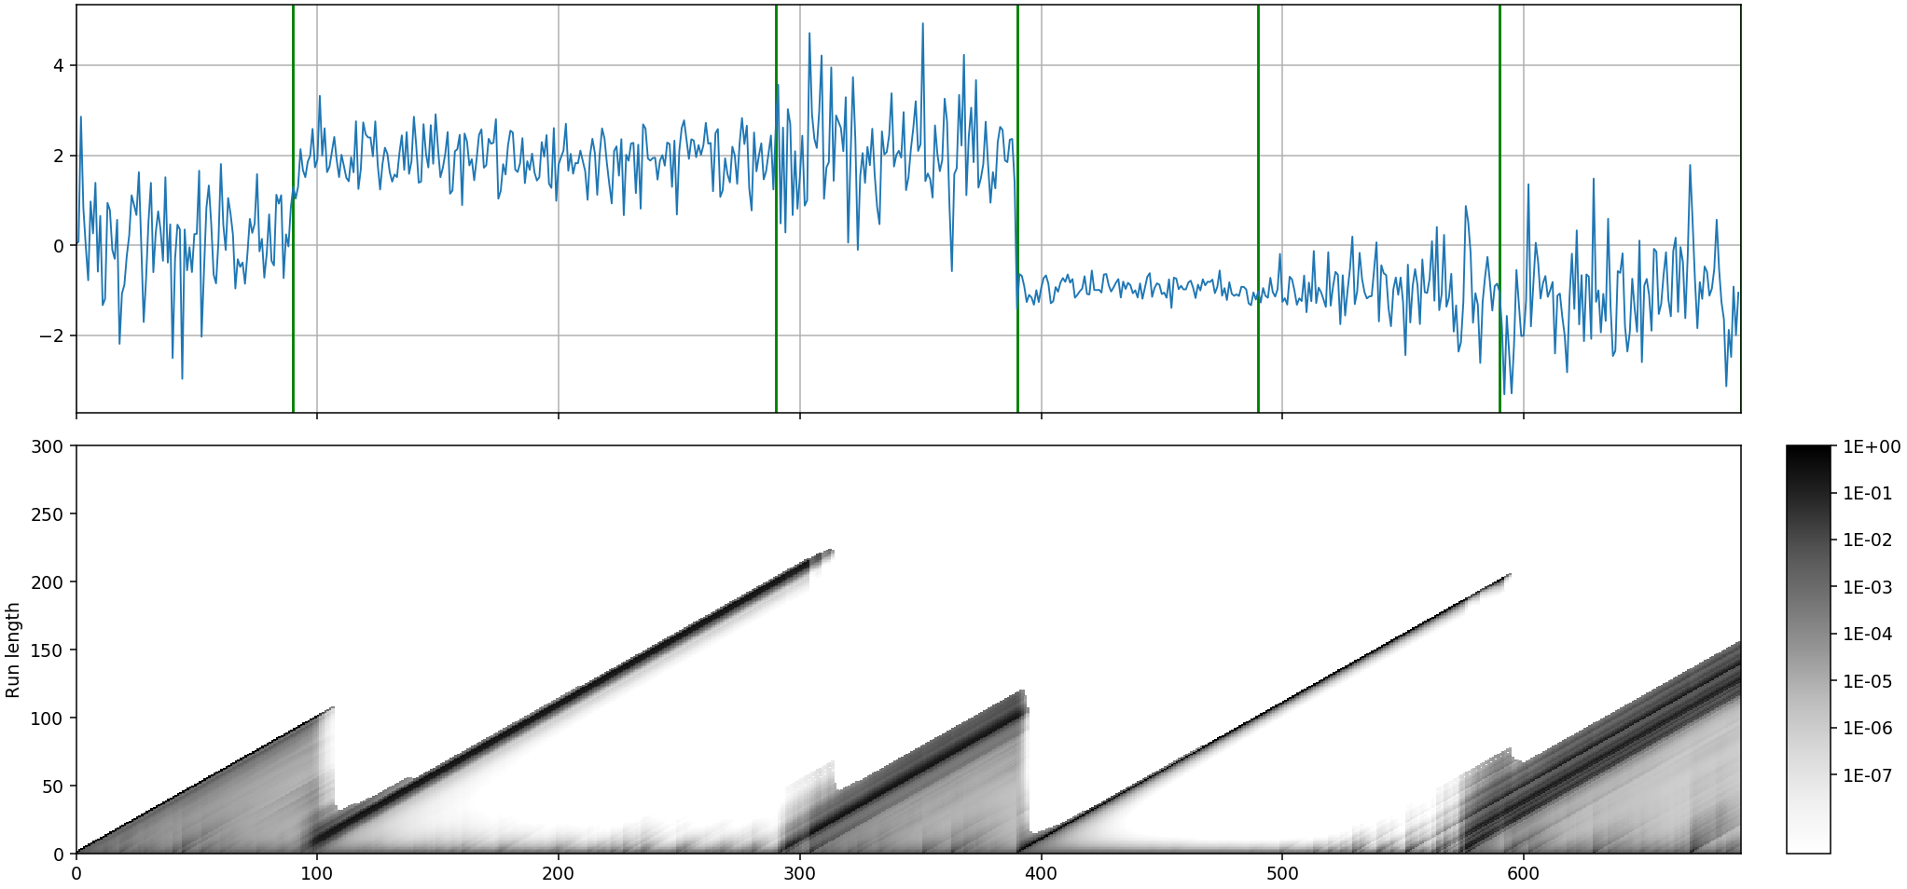
Example output on simulated data
Simulated time series with true changepoints in green (top),
Run length probabilities (bottom) – darker pixels mean represent higher probability
07.08.2020
Max Mihailescu | Bayesian Online Changepoint Detection
<Foliennummer>

Slide 9
Mathematical formulation of the model
We are interested in every time a new observation arrives
Expansion leads to recursive term
Changepoint prior
Predictive probability of new observation
Previous run length probabilities
Afterwards update model parameters to reflect information gained from x_{t}
Graphic from Bayesian Online Changepoint Detection, Adams & MacKay (2007)
07.08.2020
Max Mihailescu | Bayesian Online Changepoint Detection
<Foliennummer>

Slide 10
The Changepoint Prior
Given r_{t – 1} there are only two possible outcomes for r_{t} :
Changepoint happened: r_{t} = 0
No changepoint: r_{t} = r_{t – 1} + 1
H is called hazard function and encodes how the changepoint probability relates to the time passed this the last change
e.g. a mechanic piece that is more likely to break as it gets older
If changepoints are equally likely at any time: with expected duration of segment
07.08.2020
Max Mihailescu | Bayesian Online Changepoint Detection
<Foliennummer>

Slide 11
A word on the predictive probability
Lets assume our data is in a segment follows a distribution D with (unknown) parameters θ.
Then, one could say
With an estimate of the parameter.
But, we are unsure about this estimate
Likelihood (how likely is the observation?)
Prior (how well does the parameter explain the previous observations)
In general, this integral needs to be evaluated numerically (using MCMC methods)
In general, this integral needs to be evaluated numerically (using MCMC methods)
07.08.2020
Max Mihailescu | Bayesian Online Changepoint Detection
<Foliennummer>

Slide 12
A word on the predictive probability
In our case we can make our lives easier using conjugate priors!
This is a normal with unknown mean and variance
We can choose prior distribution to get an algebraic expression
The conjugate prior has four parameters that we update every time a new data point x is observed.
Without going into detail, the integral equals the probability density of a Student-T distribution
07.08.2020
Max Mihailescu | Bayesian Online Changepoint Detection
<Foliennummer>

Slide 13
And now?
Simulated time series with true changepoints in green (top),
Run length probabilities (bottom) – darker pixels mean represent higher probability
07.08.2020
Max Mihailescu | Bayesian Online Changepoint Detection
<Foliennummer>

Slide 14
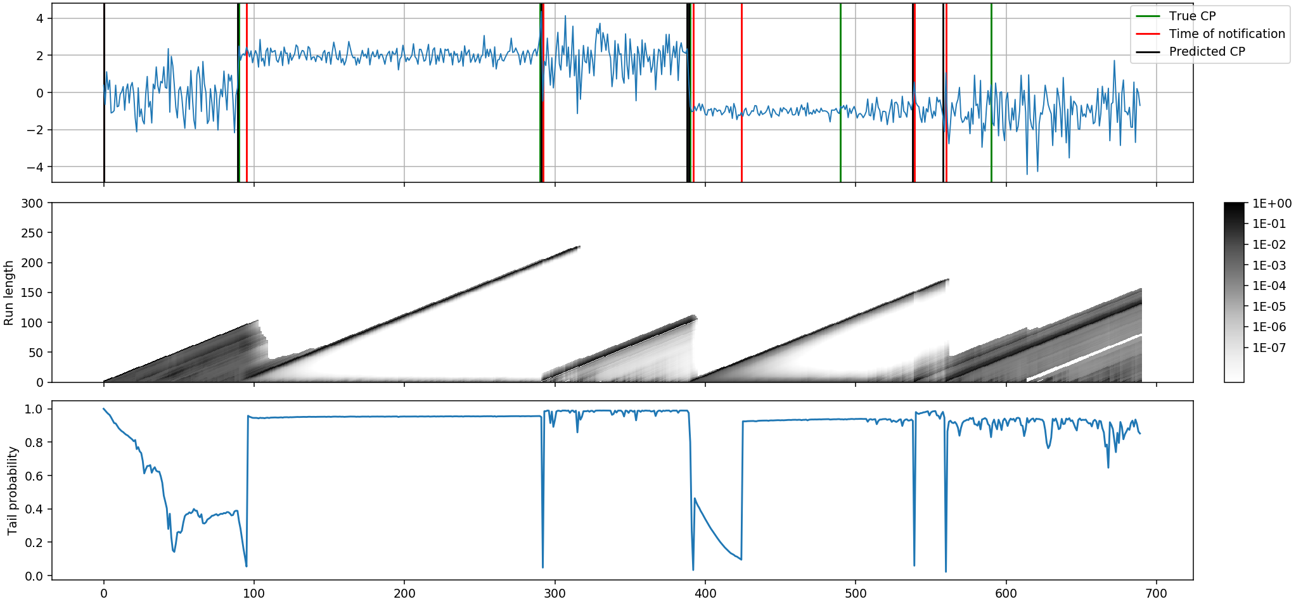
And now?
How to translate probabilities to actionable information?
Every time new data arrives, ask “Is it likely that the new data point is in the same segment?“
Sum up the probability of the longest 20% run lengths and check if sum is smaller than 0.1
07.08.2020
Max Mihailescu | Bayesian Online Changepoint Detection
<Foliennummer>

Slide 15
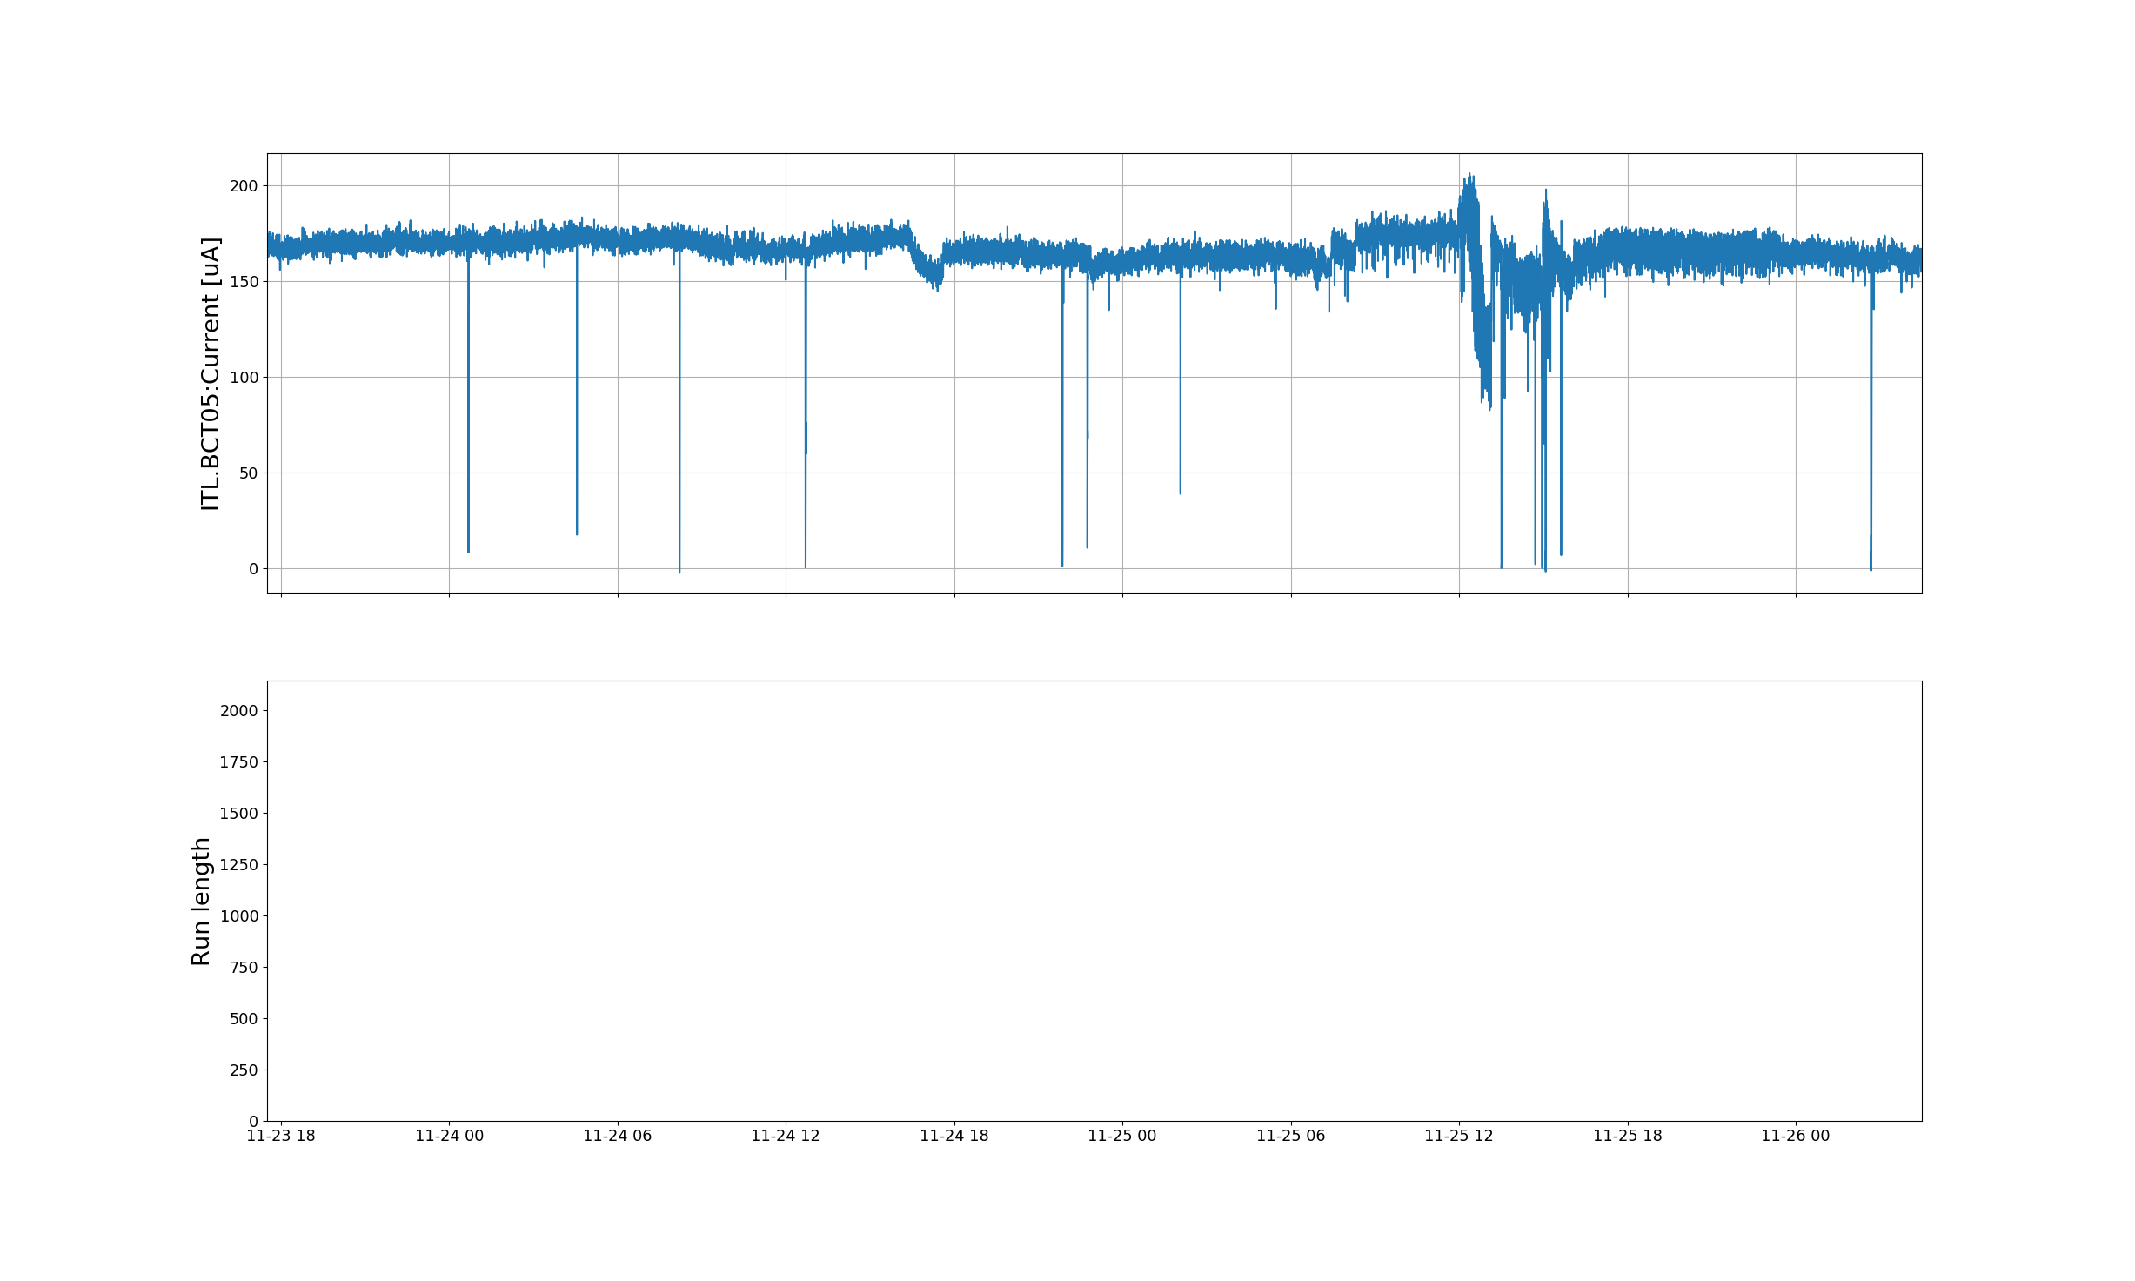
First results on linac3 data
07.08.2020
Max Mihailescu | Bayesian Online Changepoint Detection
<Foliennummer>

Slide 16
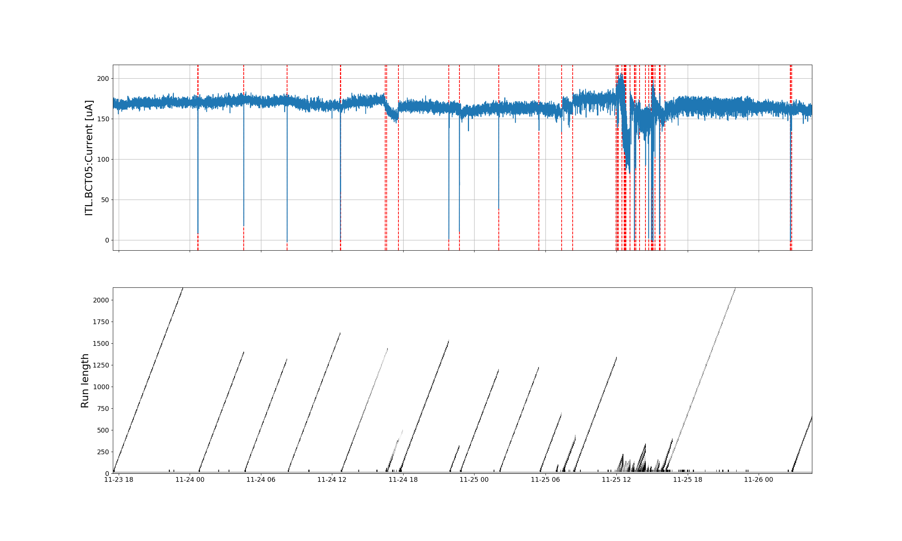
First results on linac3 data
07.08.2020
Max Mihailescu | Bayesian Online Changepoint Detection
<Foliennummer>

