Slide 1
Predicting the LINAC3 Beam Current Summary of work done by BE-ICS
Max Mihailescu
22.07.2020

Slide 2
Overview of the Cooperation
Three year old cooperation with BE-ICS/Siemens
Develop a Machine Learning Model supporting LINAC3 operation
Since October: Filip Široký and Marc Bengulescu
Presented multiple times at ML-coffee (informal CO plattform on machine learning)
Goal: Predicting the Beam current of the LINAC3 using Neural Networks
Thank you to Filip and Marc as everything presented here is their work.
22.07.2020
Max Mihailescu | Predicting the LINAC3 Beam Current
1

Slide 3
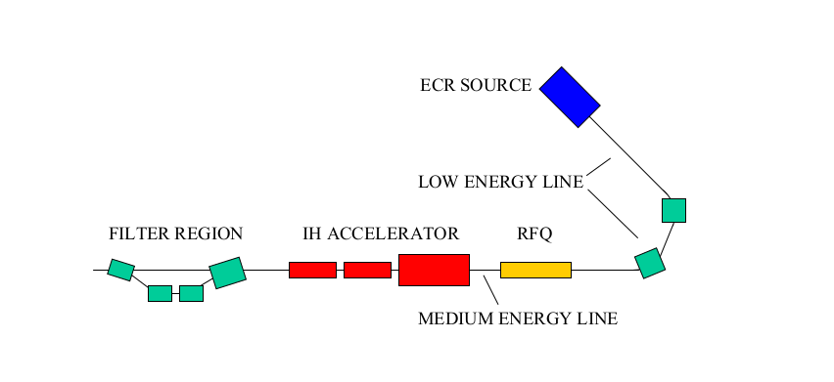
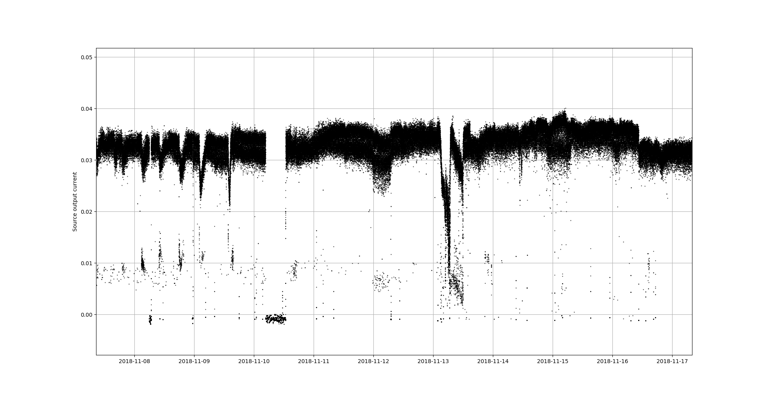
Layout of LINAC3 and the objective
Objective:
Using all source Aquisitions, can we predict what the intensity of the beam will be in the near future?
ITF.BCT.15:CURRENT
ITL.BCT.05:CURRENT
Solenoids
Bias
Disc
RF
HT
BCT05 current [mA]
Oven
Power
Gas V
Beam
Intensity
Dates (08.11.2018 – 17.11.2018)
22.07.2020
Max Mihailescu | Predicting the LINAC3 Beam Current
1

Slide 4
Numerous possible applications
During operation:
Automatically correct (small) instabilities
Have a pre-warn system that alerts operators if the current is about to degrade
Will the beam intensity drop over the next 30min?
Are there going to be many bad shots in the next hour?
Offline analysis:
Study how certain source settings might influence the current (simulation)
Understand what variables cause the beam intensity to change
22.07.2020
Max Mihailescu | Predicting the LINAC3 Beam Current
1

Slide 5
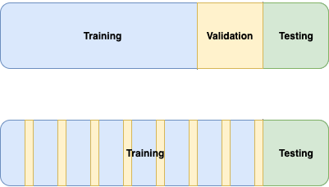
Machine learning crash course
How do you train a (supervised) model?
Solenoids
Take all your data and split it up
Bias
Disc
RF
HT
Oven
Power
Gas V
Present it a lot of (input, expected output) pairs and adjust model to minimize an error function
Measure performance on unseen data
Test behaviour in real application
This is what we call a model
Beam
Intensity
At the begining, the model knows nothing.
22.07.2020
Max Mihailescu | Predicting the LINAC3 Beam Current
1

Slide 6
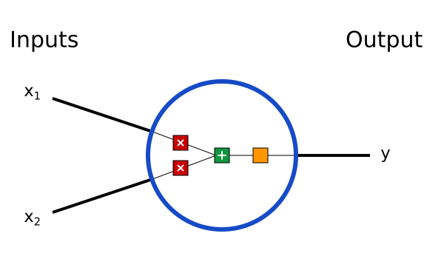
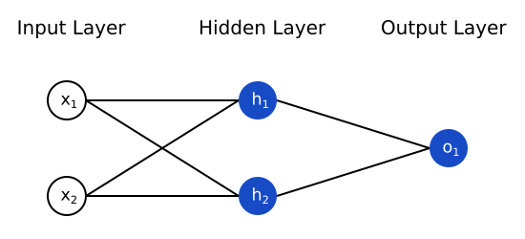
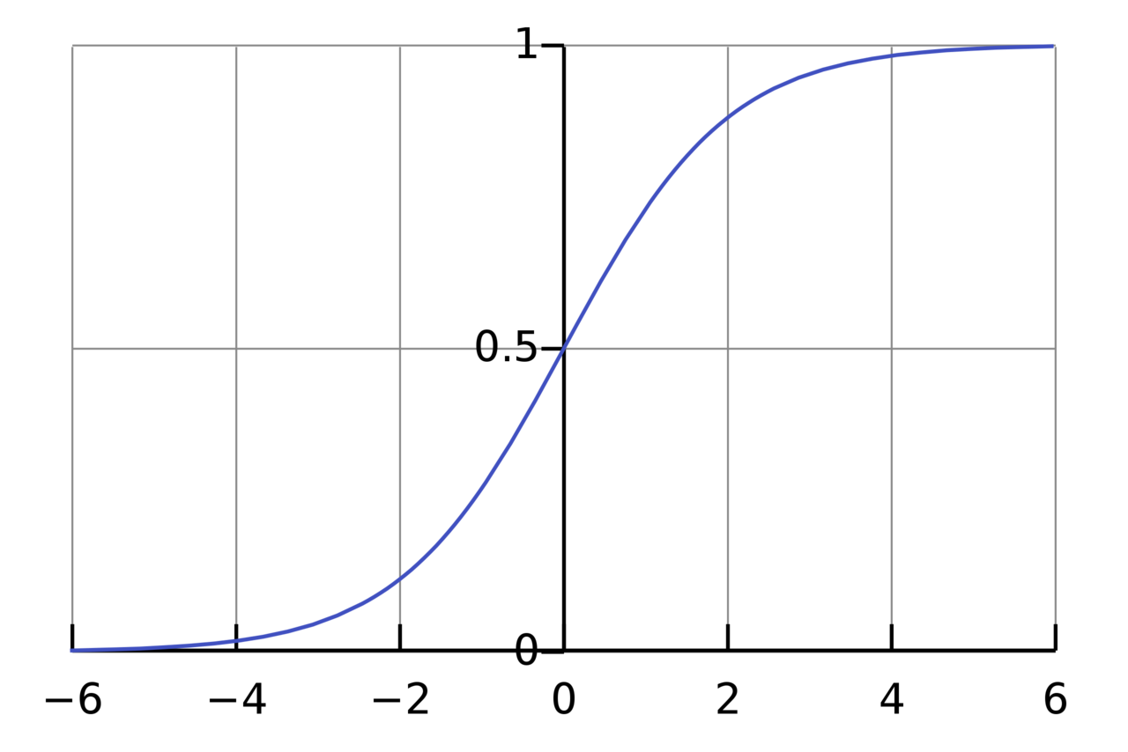
Machine learning crash course
Neural network basics
w₁
g
w₂
Building Blocks: Neurons
$y=g\left(w_{1}∗x_{1}+w_{2}∗x_{2}\right)$
Combine units to get a neural net
You need this, to model non-linear functions!
A typical activation function
Images from https://towardsdatascience.com/machine-learning-for-beginners-an-introduction-to-neural-networks-d49f22d238f9 (03.07.2020)
22.07.2020
Max Mihailescu | Predicting the LINAC3 Beam Current
1

Slide 7
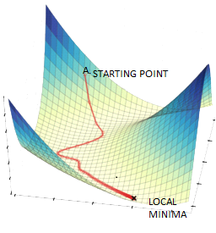
Machine learning crash course
Neural network basics
The most common error function is
$\sum_{\left(x,y\right)∈Training}{{\left(f\left(x\right)−y\right)}^{2}}$
In our case we have
$f\left(x\right)≡f\left(x,w_{1},…,w_{n}\right)$
Partial derivatives of error function with respect to w_i give the direction you have to move w_i to decrease the error.
Can in theory approximate any function
Images from https://towardsdatascience.com/machine-learning-for-beginners-an-introduction-to-neural-networks-d49f22d238f9 (03.07.2020)
22.07.2020
Max Mihailescu | Predicting the LINAC3 Beam Current
1

Slide 8
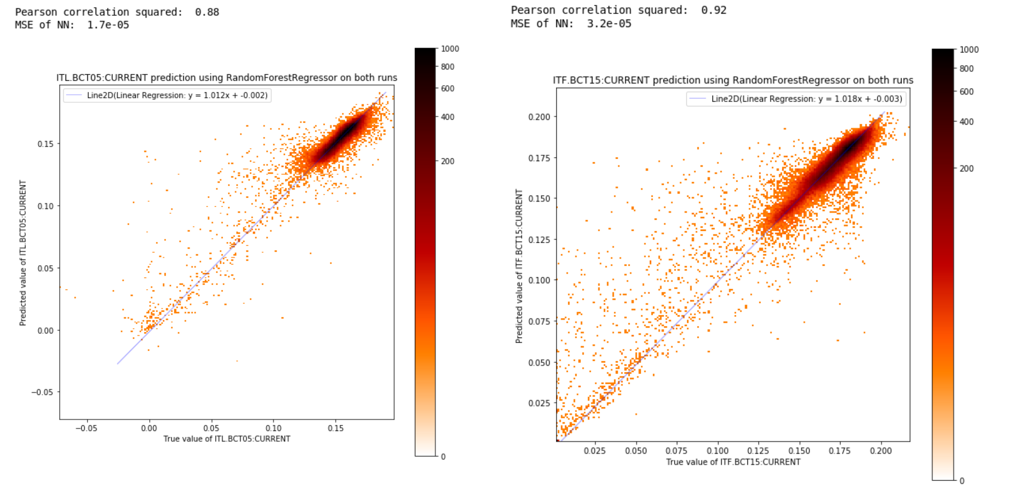
A first, promising result
Testing on two weeks of training data
ITL.BCT05
ITF.BCT15
True ion current on x-axis
Predicted current on y-axis
Almost perfect prediction
Plots by Filip Široký
22.07.2020
Max Mihailescu | Predicting the LINAC3 Beam Current
1

Slide 9
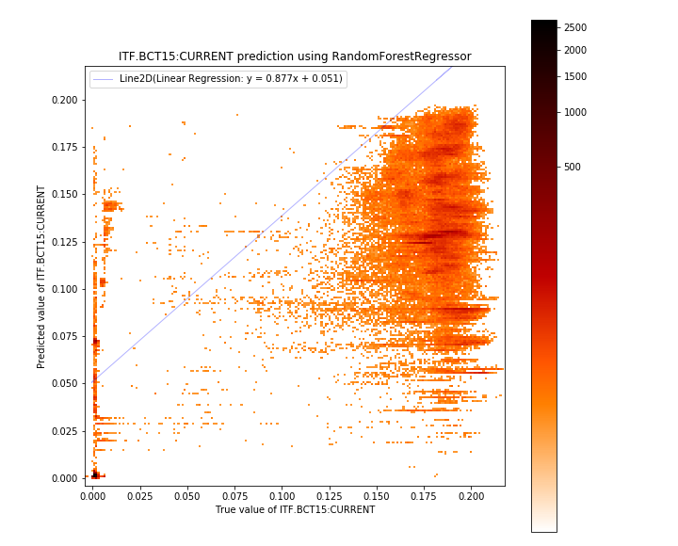
However, it generalizes poorly
Applying the previous model to new data
Why?
Training data of only two weeks
No time component included
A surprise?
Supports Cluster Analysis that showed no direct link between used setting and source performance
Many settings used throughout a year,
test data might be from unknown regime
True BCT15 current (x-axis): constant ~180 uA
Predicted BCT15 current (yaxis): full range 25 uA - 200uA
Need to model time series
Plots by Filip Široký
22.07.2020
Max Mihailescu | Predicting the LINAC3 Beam Current
1

Slide 10
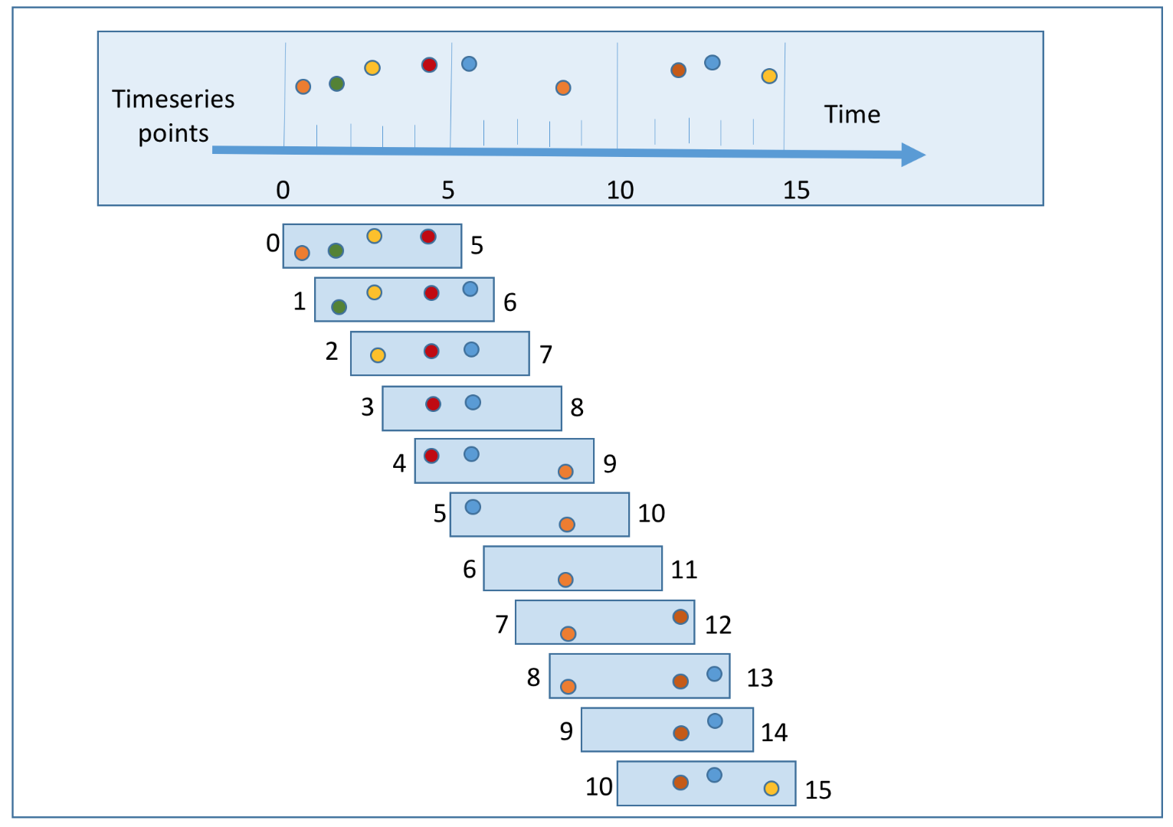
Modeling the next instant
Given the data from n points, what will the n+1 point look like?
Model should learn the near future
Can be viewed as a real-time simulation
Input data can be multidimensional (HT current, Bias Disc Voltage, Oven Power, ...)
In our case: Given all information from the last 60s, what will the beam intensity be in the next few shots (1s).
Classical training approach
Time series training
22.07.2020
Max Mihailescu | Predicting the LINAC3 Beam Current
1

Slide 11
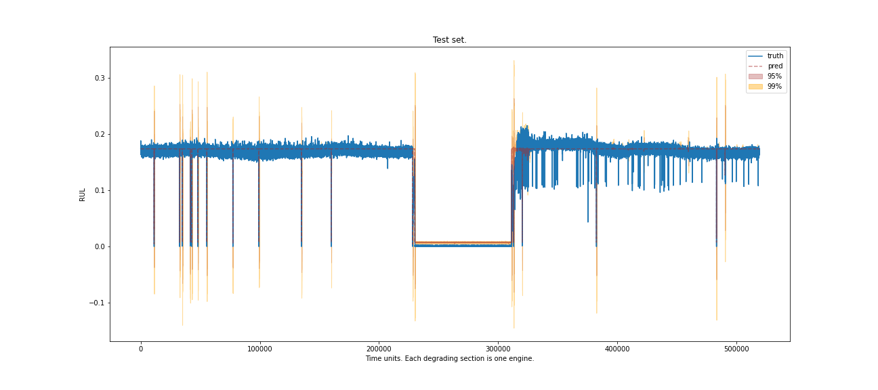
Predictions of a temporal model
Results of a model trained on periods of September 2018
BCT05 current [mA]
Model outputs uncertainties
Datapoints sorted by acquisition time (Sep 2018)
Model learns HT voltage
breakdown artifacts
There is potential to learn (stable) source operation
Plots by Filip Široký
22.07.2020
Max Mihailescu | Predicting the LINAC3 Beam Current
1

Slide 12
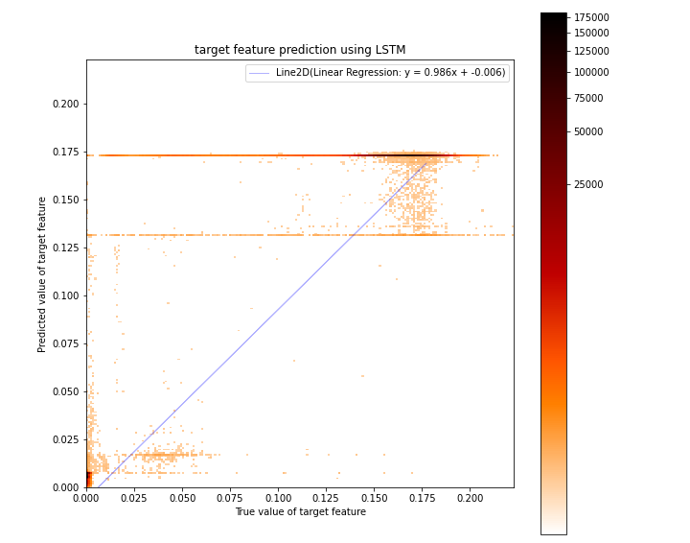
Predictions of a temporal model
Results of a model trained on periods of September 2018
Model learns to predict three
distinct levels
Average Beam current
Average value of bad shots
Source was off
Possible
Interpretation?
Some Key features of interest for operation could not yet be represented
Training and predicting Sep 2018
Plots by Filip Široký
22.07.2020
Max Mihailescu | Predicting the LINAC3 Beam Current
<Foliennummer>

Slide 13
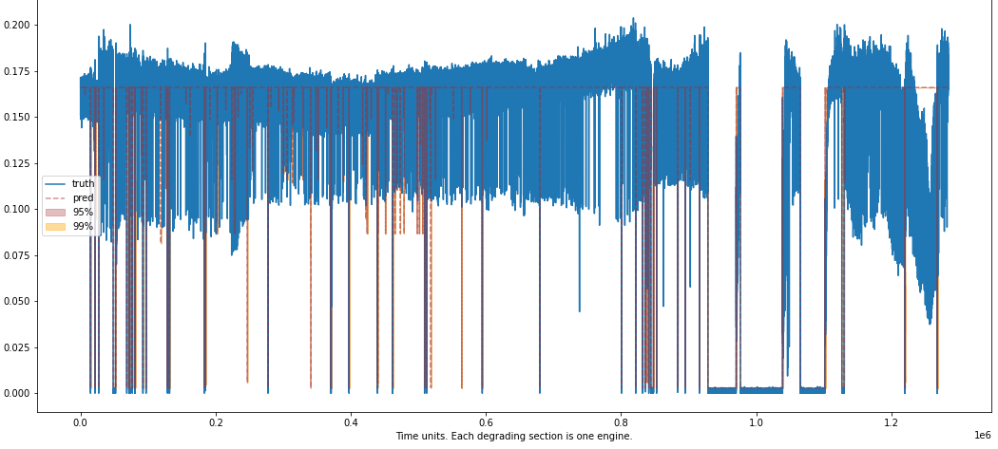
Forcasting new horizons
Previous model predicting October 2018
Instability regions not modeled
Beam degradation
BCT05 current [mA]
HT voltage breakdowns identified, but with lag
Source-off phase correct
Plots by Filip Široký
22.07.2020
Max Mihailescu | Predicting the LINAC3 Beam Current
<Foliennummer>

Slide 14
Conclusion and next steps
Promising time series models that already learned very basic current features
Improvement over randomly shuffled data (without time component)
Output of uncertainity can be of very great interest to indicate degradation of the beam
Predict Longer future (e.g. next 30min instead of next second)
Understand lag and prediction of discrete states
Try out different ML approaches
Have a different representation of the target (Wavelet/FFT Transform of current)
22.07.2020
Max Mihailescu | Predicting the LINAC3 Beam Current
<Foliennummer>

