Slide 1
Results of the Linac3 Source Clustering
Max Mihailescu
April 6th, 2020

Slide 2
Motivation
Can an autopilot or automatic source operation support be developed?
Study on how the source was operated in 2015, 2016 and 2018 (lead periods)
Did recurring settings exist that could be used as a general rule?
How was stability linked to different settings?
Clustering can help to answer some of these questions
06.04.2020
Max Mihailescu | Results of the Linac3 Source Clustering
<Foliennummer>

Slide 3
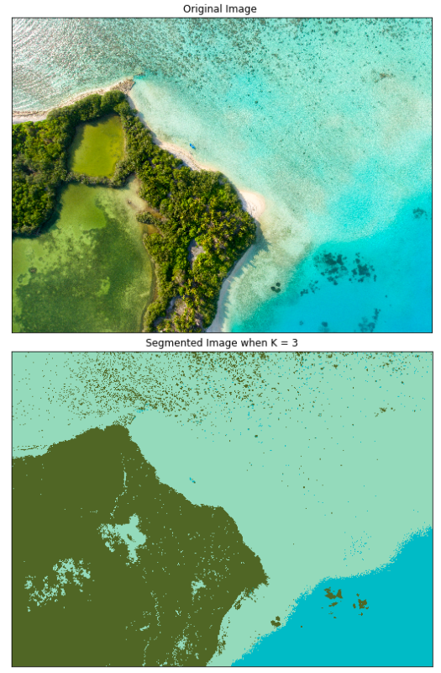
What is Clustering?
Given a set of data-points, the goal of clustering is to group similar points together and have a high dissimilarity between the groups.
For Linac3: Group together points that represent the same settings of the source.
Gas Voltage
Bias Disc Voltage
RF Power
Solenoid Currents (Inj./Central/Ext.)
HT Current
Oven Power
BCT25
Features
Additional
Time information is lost!
https://towardsdatascience.com/introduction-to-image-segmentation-with-k-means-clustering-83fd0a9e2fc3
06.04.2020
Max Mihailescu | Results of the Linac3 Source Clustering
<Foliennummer>

Slide 4
Overview of the process
Raw Data
(Timber)
Preprocessing
Clustering
Analysis
Removal of time periods without interest
Source off or no beam (BCT05)
Two regimes: Stable vs unstable source (measured at BCT25)
Lower bound for output current (15µA)
Upper bound for standard deviation (ca. 5-10% from mean)
06.04.2020
Max Mihailescu | Results of the Linac3 Source Clustering
<Foliennummer>

Slide 5
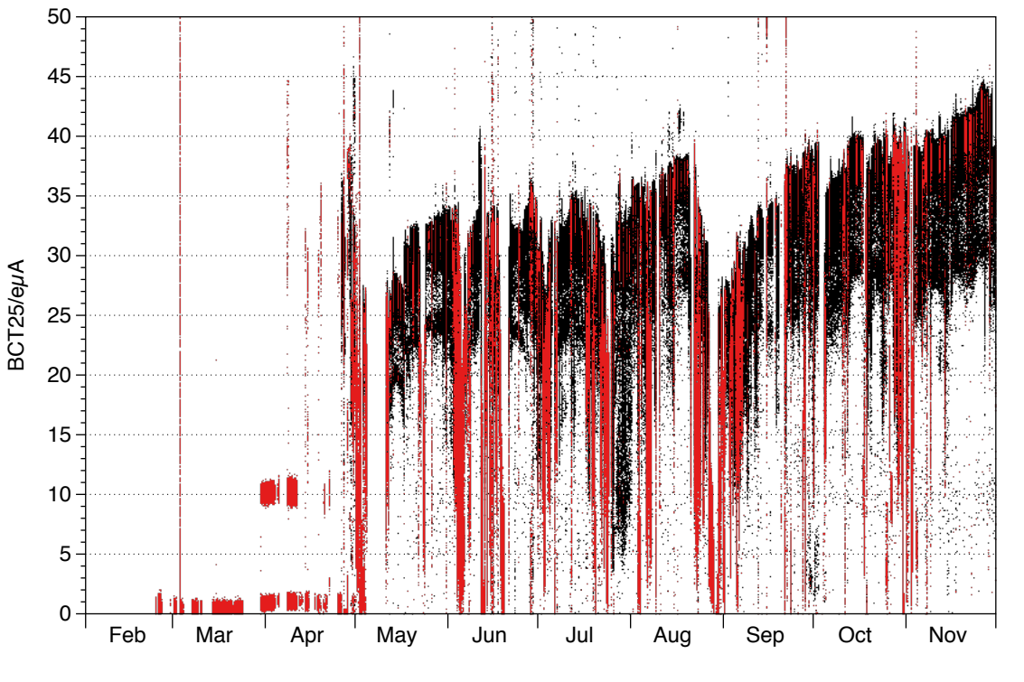
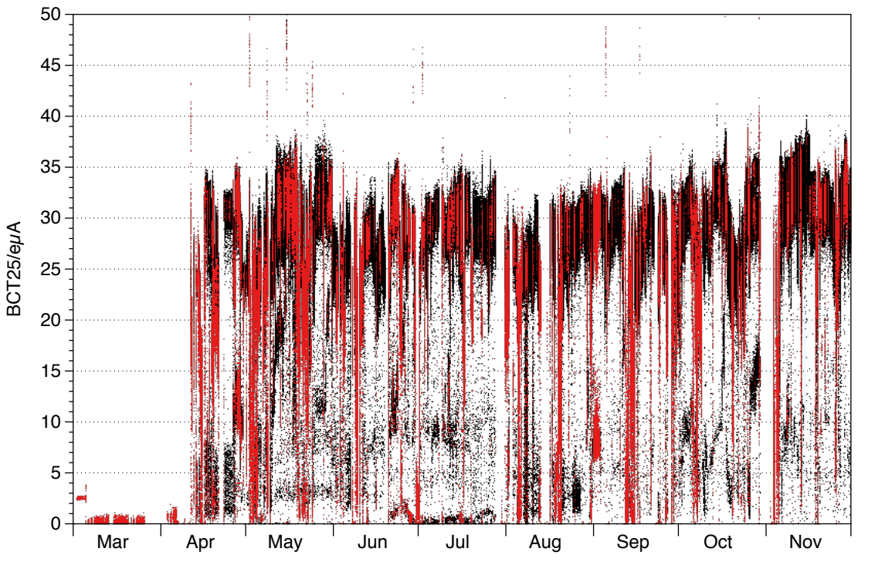
Demonstration
Figure: Yearliy plot of BCT25 with unstable periods in red (2016, left compared to 2018, right)
In total the source was running stable…
…62.8% of the time in 2015. …70% in 2016. ….68% in 2018.
06.04.2020
Max Mihailescu | Results of the Linac3 Source Clustering
<Foliennummer>

Slide 6
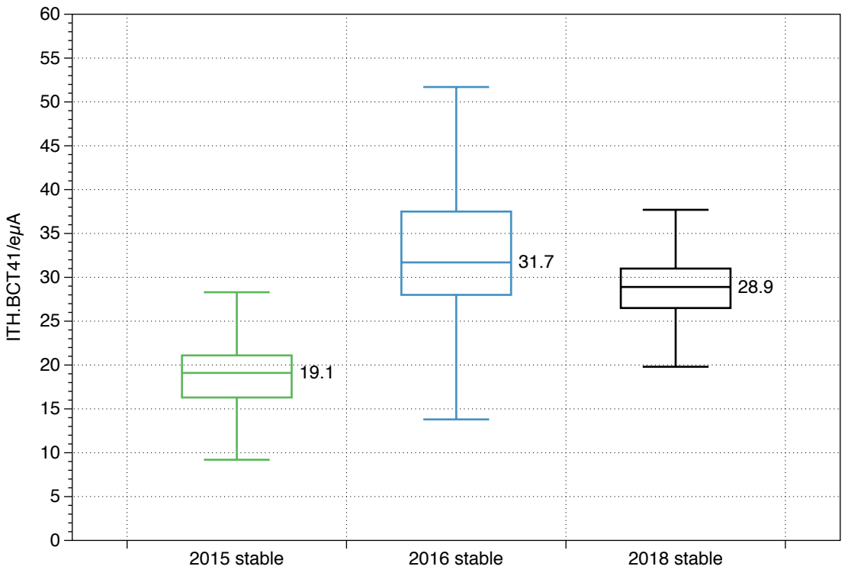
BCT41 intensities during stable operation
Maximum (excluding outliers)
Median
Contains 50% of data
Minimum (excluding outliers)
Figure: Boxplots for BCT41 current during the stable periods of the three years
Different intensities where reached during the three years
Highest intensity in 2016
06.04.2020
Max Mihailescu | Results of the Linac3 Source Clustering
<Foliennummer>

Slide 7
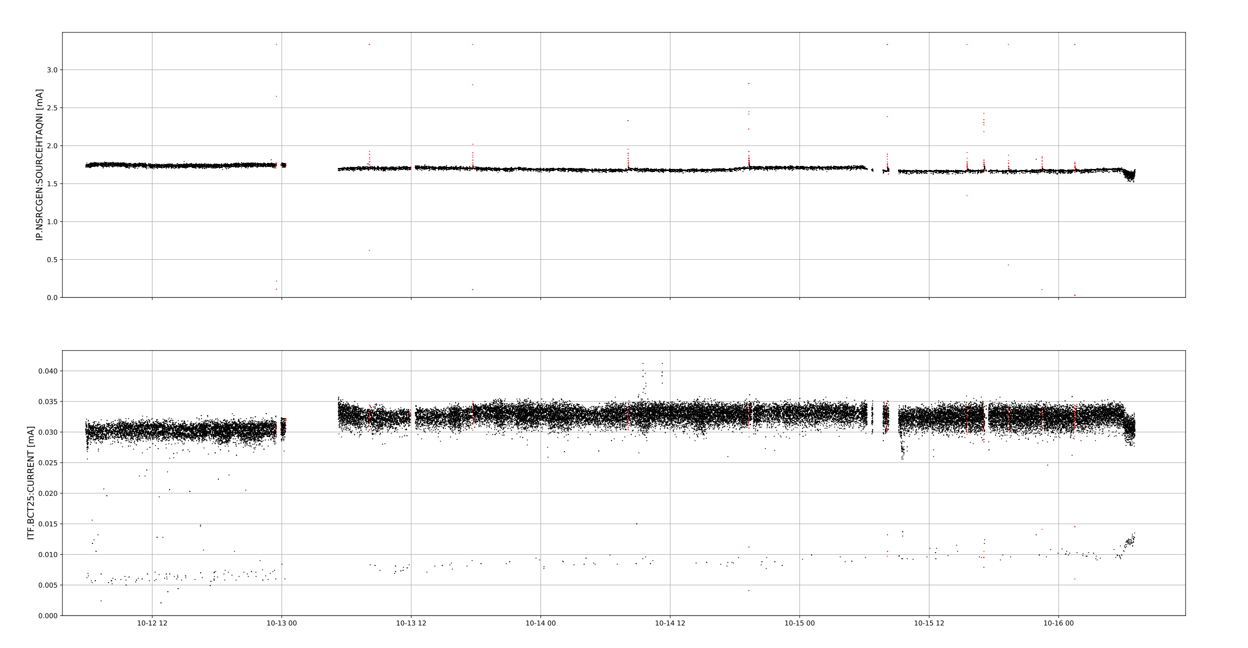
An example cluster
Three fragments
18h + 48h + 21h = 87h total duration
Figure: One of the longest clusters of 2018
06.04.2020
Max Mihailescu | Results of the Linac3 Source Clustering
<Foliennummer>

Slide 8
A lot of variability within a year
Parameter | Median (% std)
Bias Disc [V] | -305 (0.3) | -299 (0.2) | -297 (0.0) | -340 (0.1)
Gas [V] | 9.92 (0.0) | 9.92 (0.0) | 9.92 (0.0) | 9.93 (0.0)
Oven [W] | 20.8 (8.7) | 21.4 (7.6) | 9.7 (5.4) | 10.4 (4.3)
RF [W] | 1903 (0.9) | 1883 (0.2) | 1879 (0.1) | 1997 (0.01)
Inj. Solenoid [A] | 1180 (0.6) | 1220 (0.3) | 1250 (0.0) | 1230 (0.0)
Cen. Sol. [A] | 150 (0.2) | 180 (0.0) | 175 (0.0) | 220 (0.0)
Ext. Solenoid [A] | 1259 (0.0) | 1259 (0.0) | 1259 (0.0) | 1249 (0.0)
HT current [mA] | 1.92 (1.4) | 1.86 (9.0) | 1.0 (1.9) | 2.15 (1.3)
BCT25 [µA] | 35 (5.8) | 38 (3.5) | 40 (3.8) | 30 (10.2)
Table: Four biggest clusters of 2016, stable operation
06.04.2020
Max Mihailescu | Results of the Linac3 Source Clustering
<Foliennummer>

Slide 9
A lot of variability within a year
Parameter | Median (% std)
Bias Disc [V] | -305 (0.3) | -299 (0.2) | -297 (0.0) | -340 (0.1)
Gas [V] | 9.92 (0.0) | 9.92 (0.0) | 9.92 (0.0) | 9.93 (0.0)
Oven [W] | 20.8 (8.7) | 21.4 (7.6) | 9.7 (5.4) | 10.4 (4.3)
RF [W] | 1903 (0.9) | 1883 (0.2) | 1879 (0.1) | 1997 (0.01)
Inj. Solenoid [A] | 1180 (0.6) | 1220 (0.3) | 1250 (0.0) | 1230 (0.0)
Cen. Sol. [A] | 150 (0.2) | 180 (0.0) | 175 (0.0) | 220 (0.0)
Ext. Solenoid [A] | 1259 (0.0) | 1259 (0.0) | 1259 (0.0) | 1249 (0.0)
HT current [mA] | 1.92 (1.4) | 1.86 (9.0) | 1.0 (1.9) | 2.15 (1.3)
BCT25 [µA] | 35 (5.8) | 38 (3.5) | 40 (3.8) | 30 (10.2)
Table: Four biggest clusters of 2016, stable operation
Even within a year parameters had very different values
No accumulation around certain settings
06.04.2020
Max Mihailescu | Results of the Linac3 Source Clustering
<Foliennummer>

Slide 10
A lot of variability within a year
Parameter | Median (% std)
Bias Disc [V] | -305 (0.3) | -299 (0.2) | -297 (0.0) | -340 (0.1)
Gas [V] | 9.92 (0.0) | 9.92 (0.0) | 9.92 (0.0) | 9.93 (0.0)
Oven [W] | 20.8 (8.7) | 21.4 (7.6) | 9.7 (5.4) | 10.4 (4.3)
RF [W] | 1903 (0.9) | 1883 (0.2) | 1879 (0.1) | 1997 (0.01)
Inj. Solenoid [A] | 1180 (0.6) | 1220 (0.3) | 1250 (0.0) | 1230 (0.0)
Cen. Sol. [A] | 150 (0.2) | 180 (0.0) | 175 (0.0) | 220 (0.0)
Ext. Solenoid [A] | 1259 (0.0) | 1259 (0.0) | 1259 (0.0) | 1249 (0.0)
HT current [mA] | 1.92 (1.4) | 1.86 (9.0) | 1.0 (1.9) | 2.15 (1.3)
BCT25 [µA] | 35 (5.8) | 38 (3.5) | 40 (3.8) | 30 (10.2)
Table: Four biggest clusters of 2016, stable operation
Even within a year parameters had very different values
No accumulation around certain settings
06.04.2020
Max Mihailescu | Results of the Linac3 Source Clustering
<Foliennummer>

Slide 11
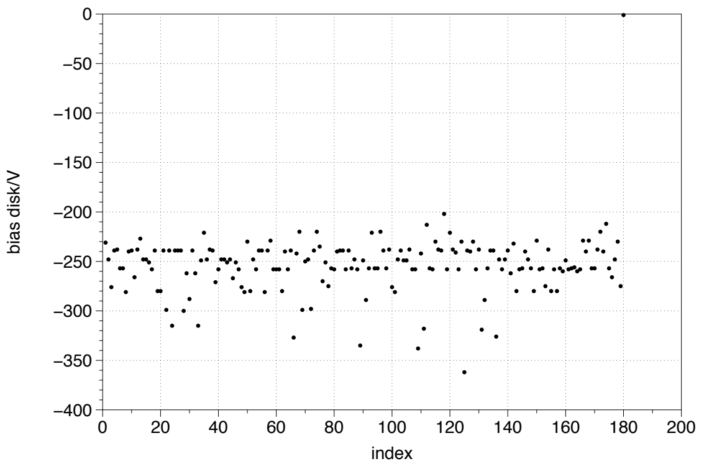
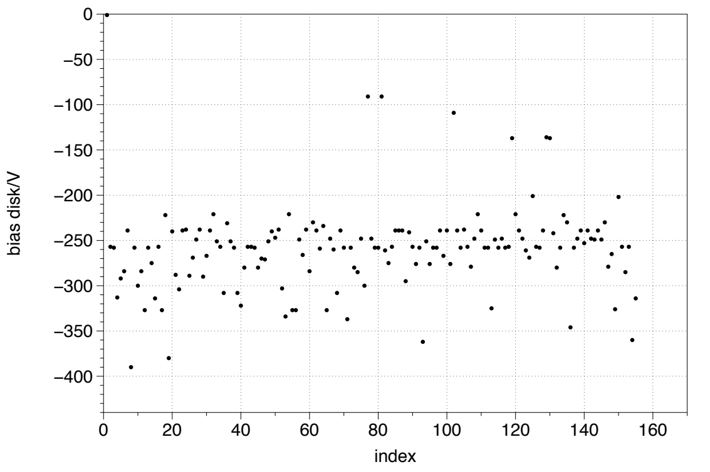
Two examples
Figure: Bias Disc in 2018 (stable, left vs unstable, right), sorted by total cluster duration (longest at lower index)
06.04.2020
Max Mihailescu | Results of the Linac3 Source Clustering
<Foliennummer>

Slide 12
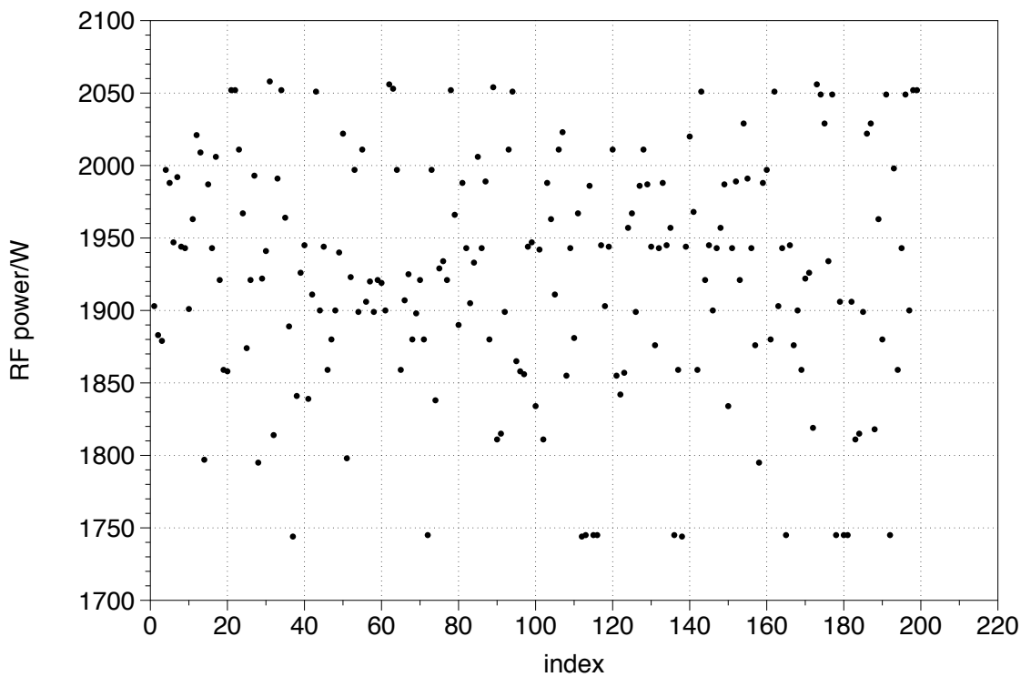
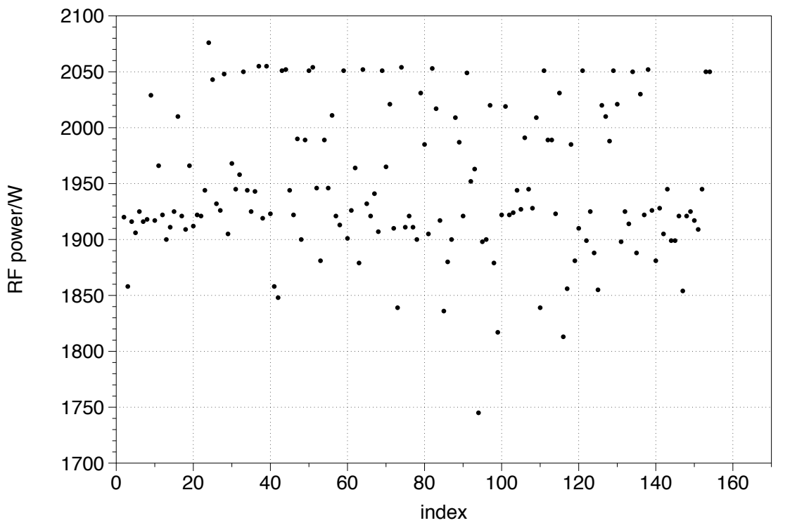
Two examples
Figure: RF in 2016 (stable, left vs unstable, right), sorted by total cluster duration (longest at lower index)
06.04.2020
Max Mihailescu | Results of the Linac3 Source Clustering
<Foliennummer>

Slide 13
.. and also between the years
Similar result when comparing the different years
Settings were very different in 2015, 2016 and 2017
Instabilities did not show any correlation with parameters
Same settings could have lead to a stable or an unstable source
Neither linear regression nor SVMs (support vector machines) found any general rules
06.04.2020
Max Mihailescu | Results of the Linac3 Source Clustering
<Foliennummer>

Slide 14
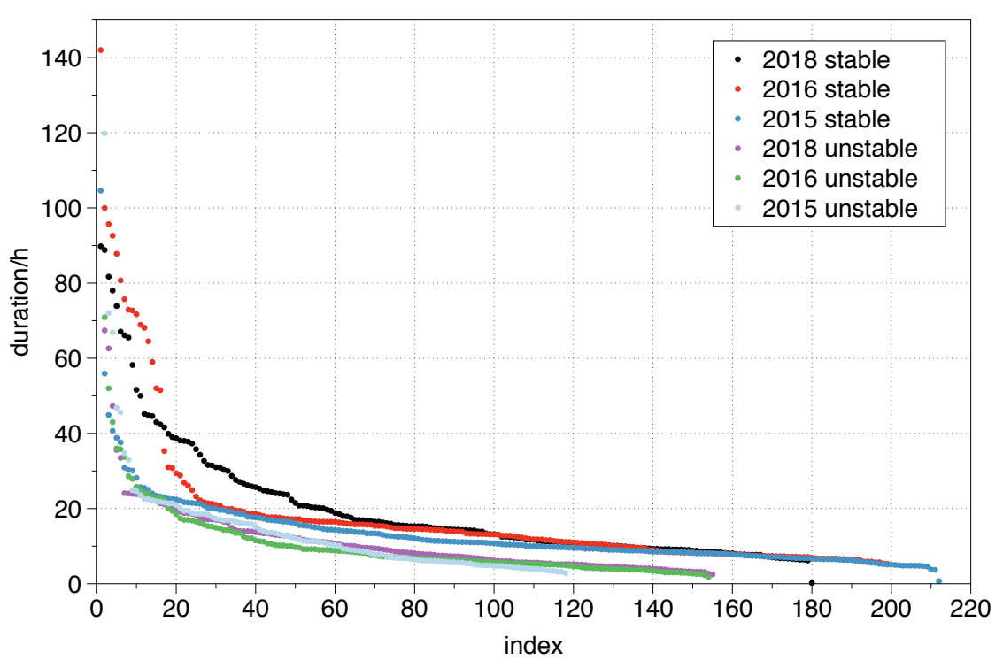
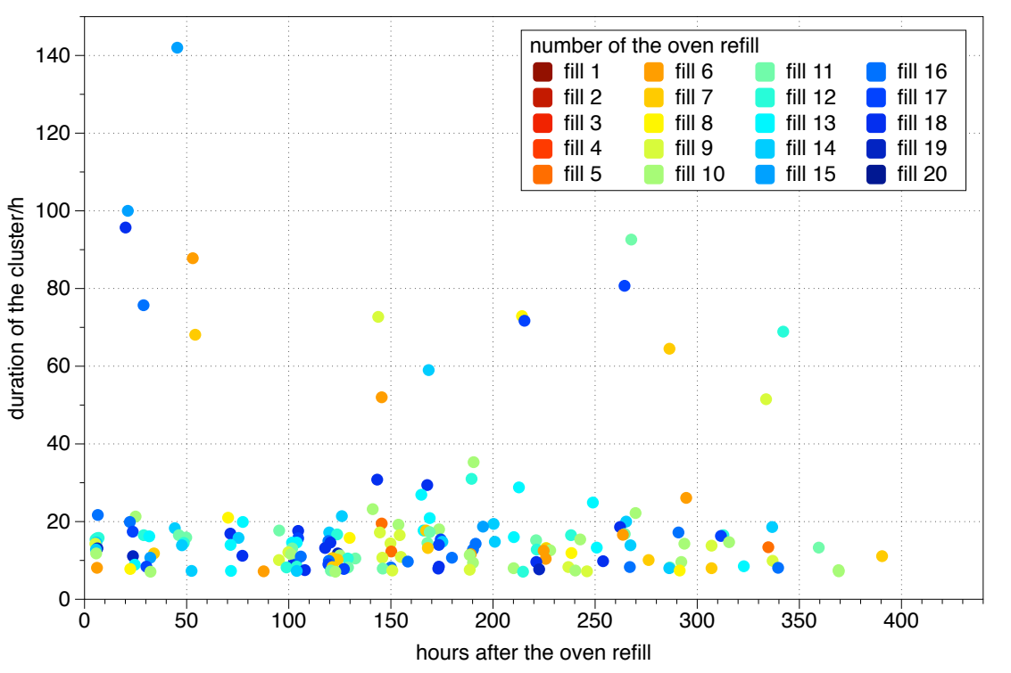
Results regarding setting duration
Figure: Cluster durations throughout the years
Figure: Duration of the clusters in relation to last ofen refill (2016)
No single setting was used for a long time (Total operation ~6000h)
Setting duration did not depend on the “when?” after a refill
06.04.2020
Max Mihailescu | Results of the Linac3 Source Clustering
<Foliennummer>

Slide 15
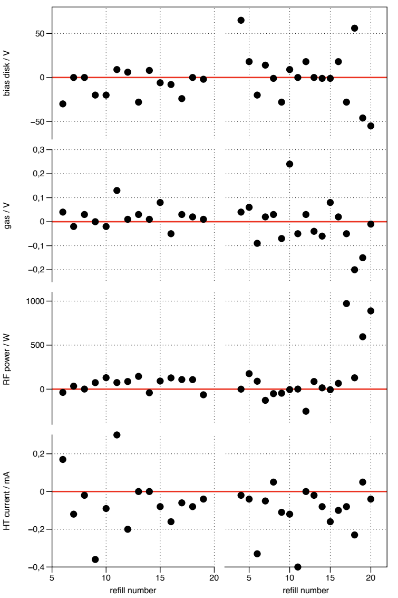
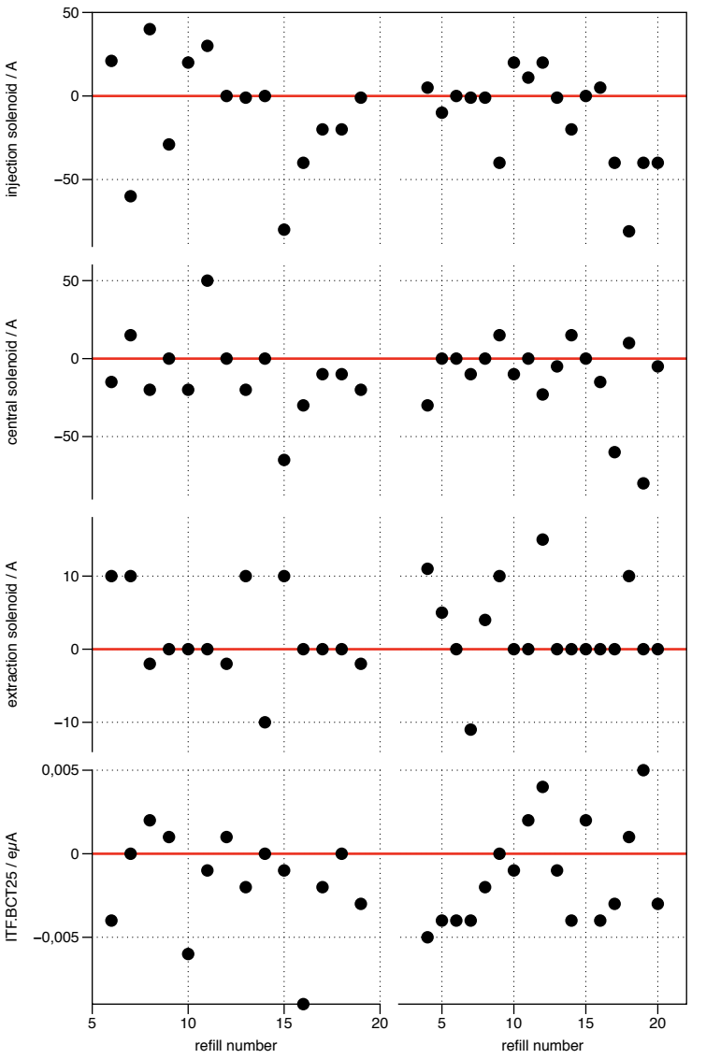
Did the source take off where it left after a refill?
Figure: Difference of parameters after/before refill. 2016 (left) vs 2018 (right)
Significant changes when comparing last stable interval before and first one after refill
Source requires adjustments after new lead is filled in
06.04.2020
Max Mihailescu | Results of the Linac3 Source Clustering
<Foliennummer>

Slide 16
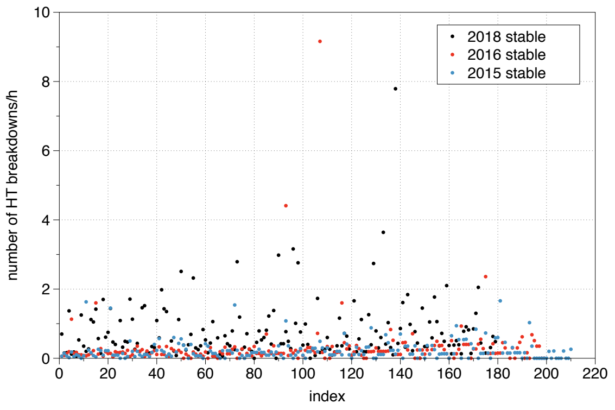
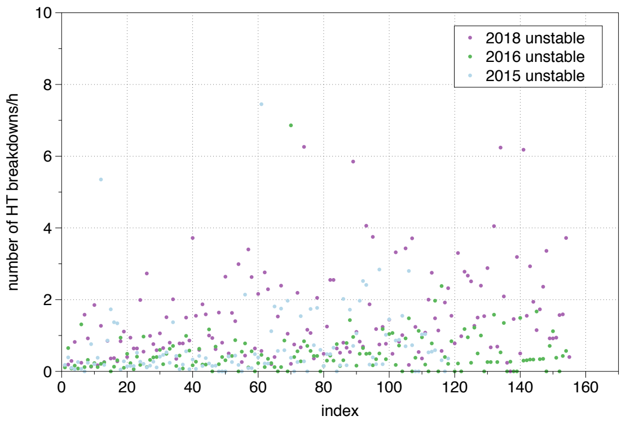
Analysis of the HT breakdown rate
Figure: Number of HT breakdowns per cluster (stable periods, left compared to unstable periods, right)
Slightly higher breakdown rate when the source was unstable
No indication that certain settings lead to more breakdowns found
06.04.2020
Max Mihailescu | Results of the Linac3 Source Clustering
<Foliennummer>

Slide 17
Conclusion and outlook
Behavior of source and operations is very complex
Many relationships are not well understood yet
No quantitative results could be yet established
Time dependency was not taken into account
Important features of the source could be missing (Plasma Temperature, ...)
06.04.2020
Max Mihailescu | Results of the Linac3 Source Clustering
<Foliennummer>

Slide 19
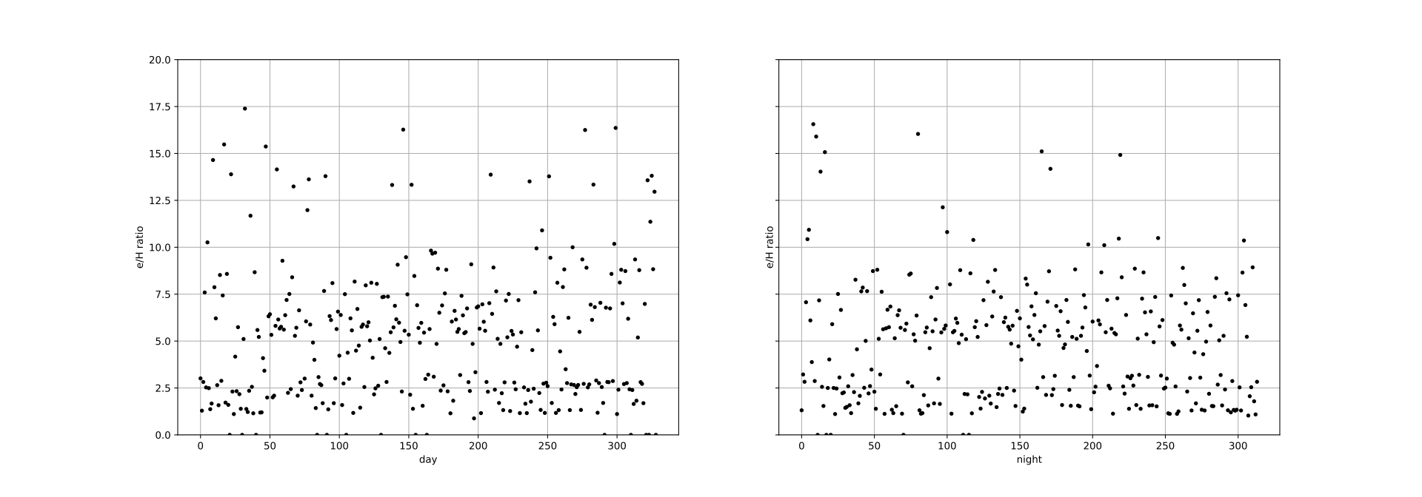
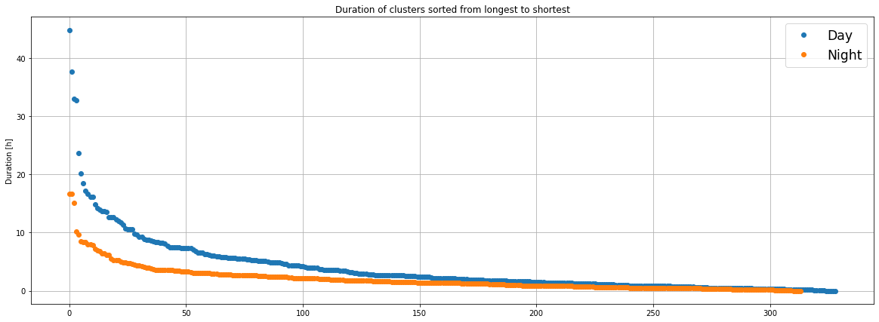
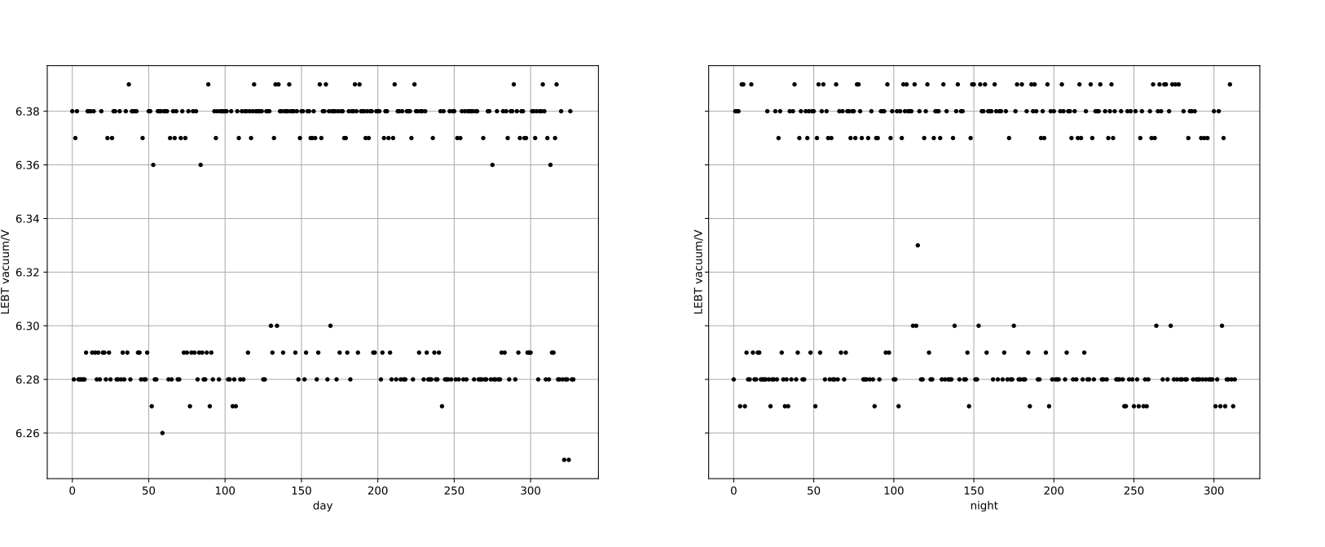
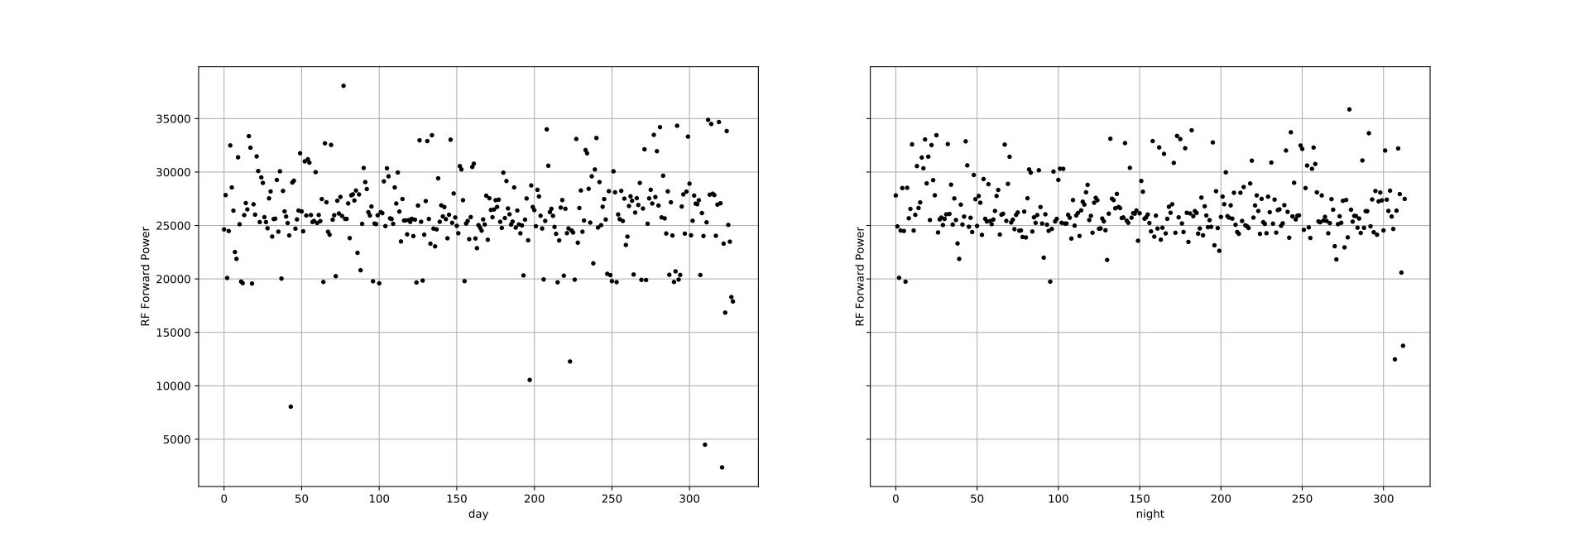
For Linac 4 (LBE run 2019)
Source, Dump and Einzel voltage constant (as expected?)
Lot of variation of the RF forward power and e/H ratio
Two regimes of LEBT vacuum
More and shorter clusters than with Linac3
More tuning?
More data?
Algorithm settings more sensible?
06.04.2020
Max Mihailescu | Results of the Linac3 Source Clustering
<Foliennummer>

