Slide 1
Are mTEC-HI and mTEC-LO

Slide 2
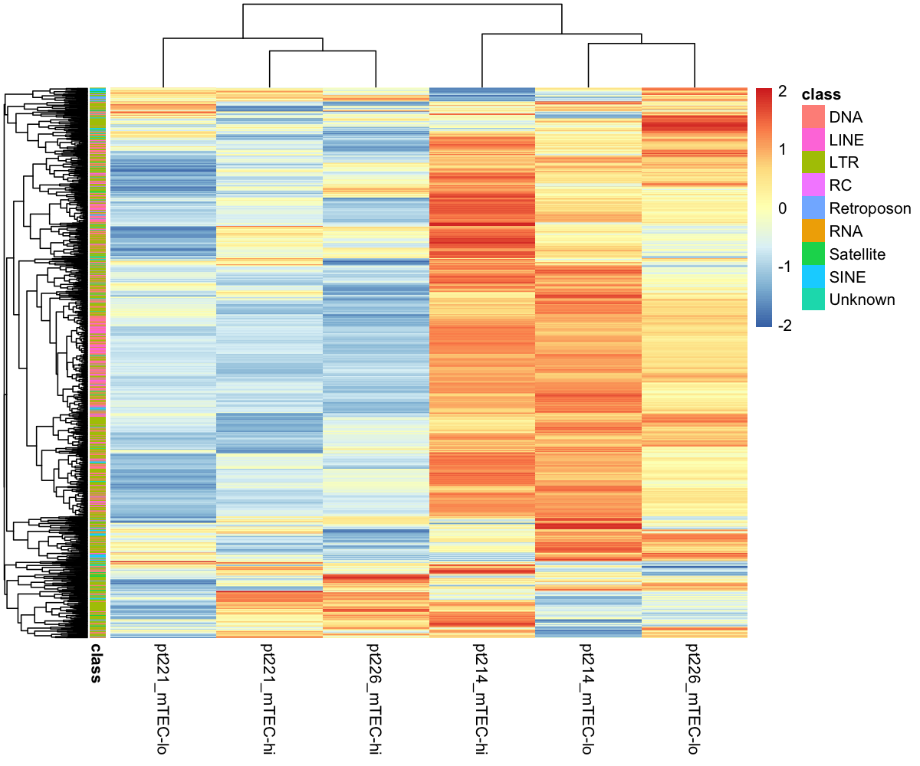

Slide 3
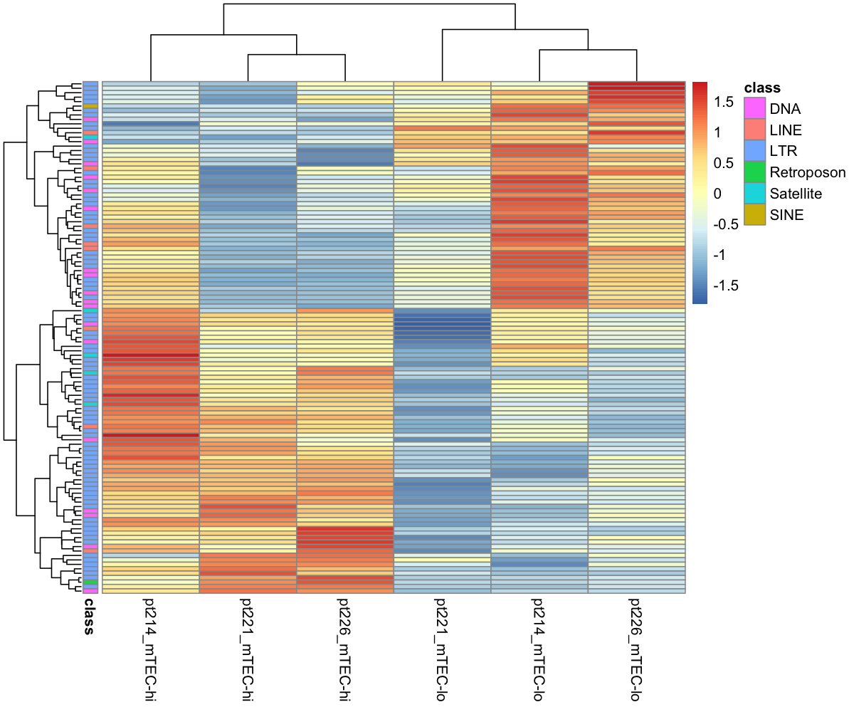

Slide 4
How does TE expression in mTEC-LO/HI cells compare to other tissues?

Slide 5
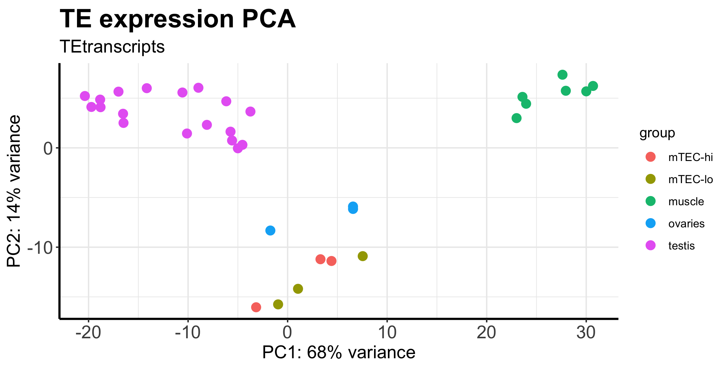

Slide 6
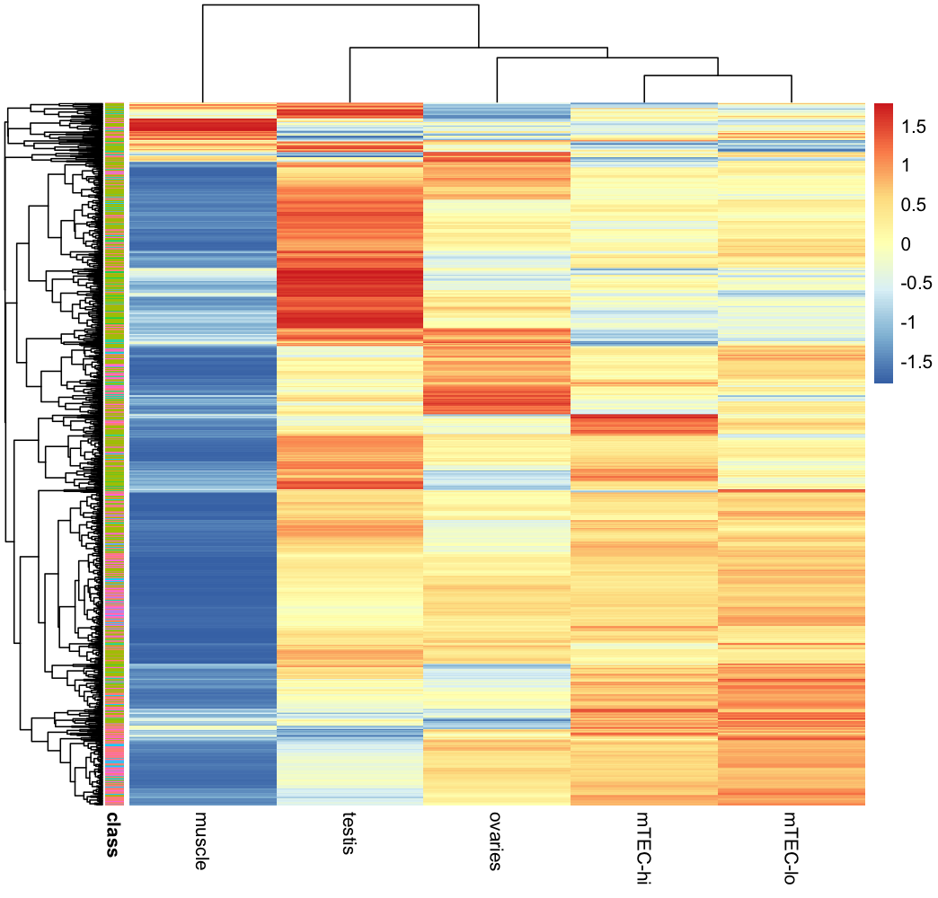
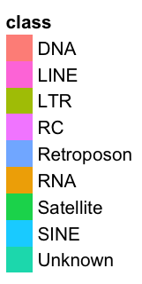
Z-score

