Slide 1
How does TE expression in mTEC-LO/HI cells compare to other tissues?

Slide 2
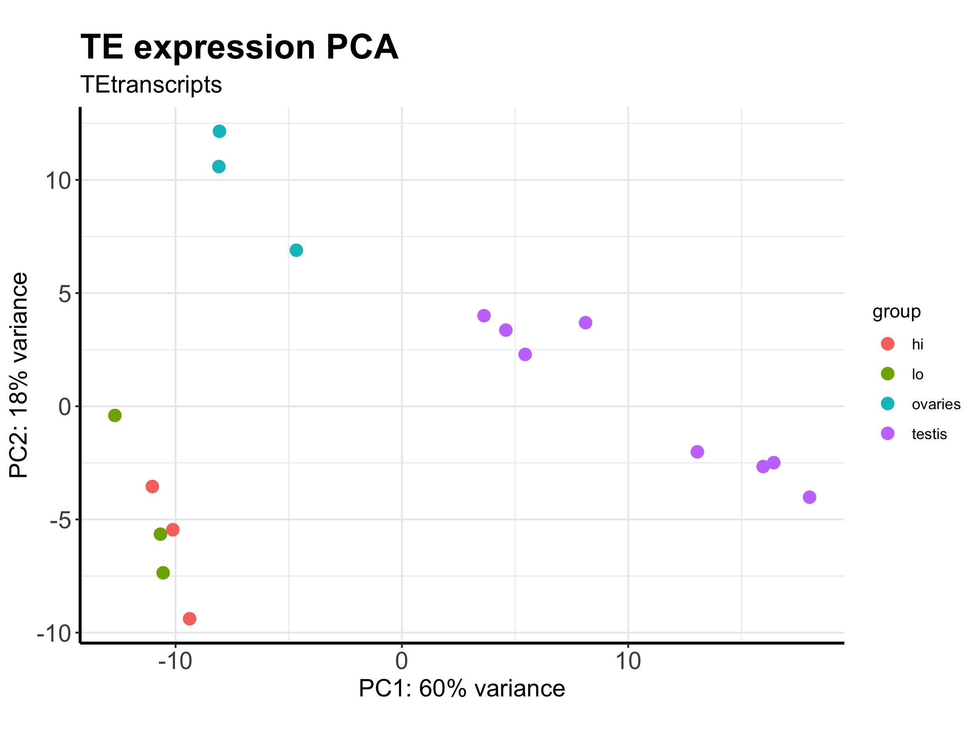

Slide 3
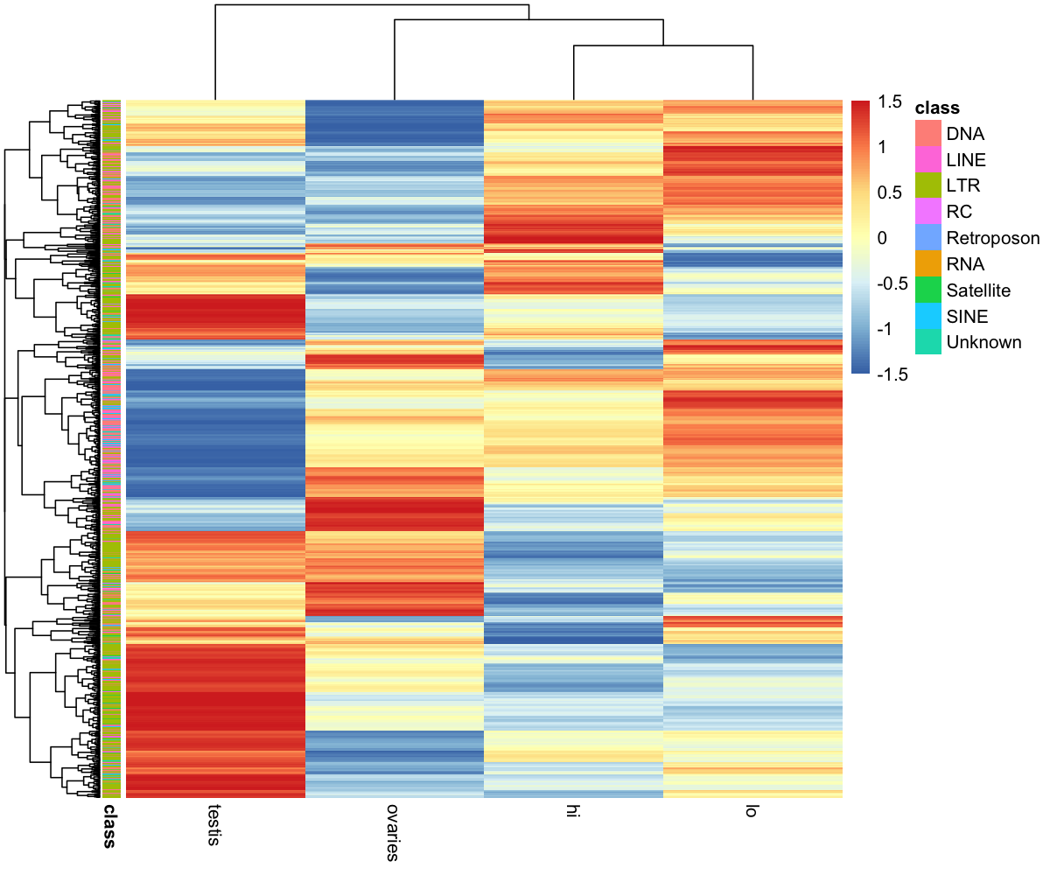
Z-score

