Slide 1
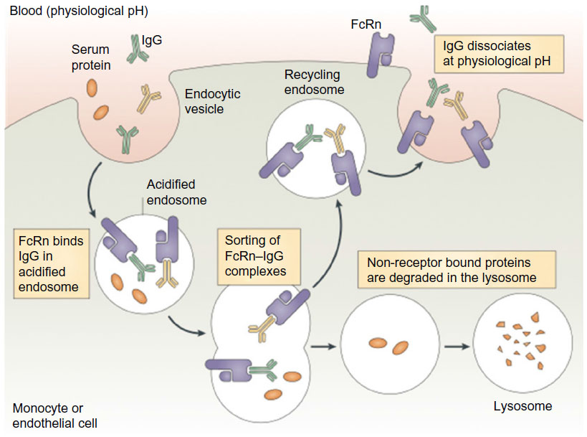
FcRn-mediated IgG recycling mechanism
Step 1. Pinocytosis
Why?
1) limited expression level of FcRn on the surface (Ober et al., 2004 JI, Sally Ward group)
Extremely low affinity of IgG to FcRn at pH7.4
Step 2. Acidification of endosome and interaction of FcRn and IgG (Highly localized FcRn in early endosome).
** Important step! How important is the increase in affinity at acidic pH? For example, wild type IgG vs. “A” antibody (5-fold high affinity) vs. “B” antibody (10-fold high affinity)
Presumably, most three antibodies will be “bound” status in endosome because of 1) avidity of FcRn and 2) small space of endosome. The difference of “bound/unbound ratio” among antibodies will be small.
Step 3. Sorting of FcRn-IgG complexes (?)
Step 4. Exocytosis (IgG dissociation at pH7.4)
** Important step! Now, IgG should escape from FcRn. Endosome fused with plasma membrane so this spot might be temporarily “high density FcRn spot”. How important is the difference of affinity of IgG to FcRn at pH7.4 ?
Step 5. Endocytosis with un-released IgG
Step 6. Transport to lysosome
Nat Immunol review 2007
Black: Generally accepted theory for FcRn-mediated IgG recycling
Blue: Chang-Han’s opinion
Briefly, the ratio of KD of IgG at pH6 / KD of IgG at pH7.4 failed to show “correlation” with PK (or beta phase T1/2) in the previous studies. And there were a few reports that “KD of IgG at pH7.4” is more important for enhancing PK (Weirong Wang et al., 2011 Drug Metabolism and Disposition).

Slide 2
Table 1. KD values for FcRn at pH 5.8
 | K_{on} (10⁵ M⁻¹ sec⁻¹) | K_{off} (10⁻² sec⁻¹) | K_{D} (nM)
Herceptin | 5.4 ± 0.30 | 29 ± 0.85 | 550 ± 46
Herceptin-LS | 6.2 ± 1.6 | 3.3 ± 0.07 | 55 ± 3.2
Herceptin-YTE | 8.2 ± 1.4 | 2.3 ± 0.1 | 23 ± 1.0
Herceptin-DHS | 7.77 ± 0.24 | 8.7 ± 0.09 | 111 ± 20

Slide 3
KD values for FcRn at pH 7.4
A
Low density
Medium density
High density
WT
DHS
LS
YTE
Response unit (RU)
Response unit (RU)
Response unit (RU)
Time (sec)
Time (sec)
Time (sec)
B
FcRn density | WT | DHS | LS | YTE
Low | - | - | - | -
Medium | - | - | 58.7 nM | 4.73 uM
High | - | - | 22.7 nM | 4.29 uM

Slide 4
PK studies in Tg276 mouse model
human FcRn/mouse β2m
Human IgG has almost same binding properties to hFcRn/mβ2m comparing with hFcRn/hβ2m
Presence of mouse IgG in the serum
Since mouse IgG does not bind to hFcRn, it can not compete for binding to hFcRn with "injected human IgG“.
Tg276 mice has mouse Fcγ receptors
a
Herceptin (wild type IgG1)
Herceptin-LS
Herceptin-DHS
IgG concentration in serum (μg/ml)
Time (hours)
b
 | Clearance (ml/days/kg) | β phase T_{1/2} (hrs) | AUC_{inf.} (μg*days/ml) | Vss (ml/kg)
Wild-type | 0.58 ± 0.17 | 49.3 ± 8.8 | 41.2 ± 23.6 | 1.11 ± 0.15
DHS | 0.061 ± 0.003 | 336 ± 49.5 | 326.6 ± 17.9 | 0.28 ± 0.01
LS | 0.099 ± 0.004 | 107 ± 14.3 | 200.7 ± 9.4 | 0.34 ± 0.01

