Slide 1
Mechanistic Autoencoders Update
Will Yashar
June 04, 2021

Slide 2
Data
“Cell Line Time Course Uncorrected Phosphoproteomics”
syn25618653
“Cytokine-induced Drug Sensitivity Phosphoproteomics Unnormalized”
syn24389738
“Gilteritinib treated MOLM14 Phosphoproteomics Unnormalized”
syn24189487

Slide 3
Cell Line | Treatment(s) | Time point(s)
MOLM-13 | None MCP-1 Trametinib Trametinib + MCP-1 | 0 min 5 min, 60 min 5 min, 60 min 5 min, 60 min
MOLM-13 Tr Resistant | None MCP-1 Trametinib Trametinib Withdrawn | 0 min 5 min, 60 min 60 min 0 min
MOLM14-a MOLM14-b | None DMSO Gilteritinib | 0 min 30 min, 180 min 30 min 180 min
K562 | None Dasatinib | 16 hours 30 min, 3 hours, 16 hours
MOLM | None Sorafenib | 16 hours 30 min, 3 hours, 16 hours
CMK | None Ruxolitinib | 3 hours 30 min, 3 hours, 16 hours
HL60 | None Trametinib | 3 hours 30 min, 3 hours, 16 hours

Slide 4
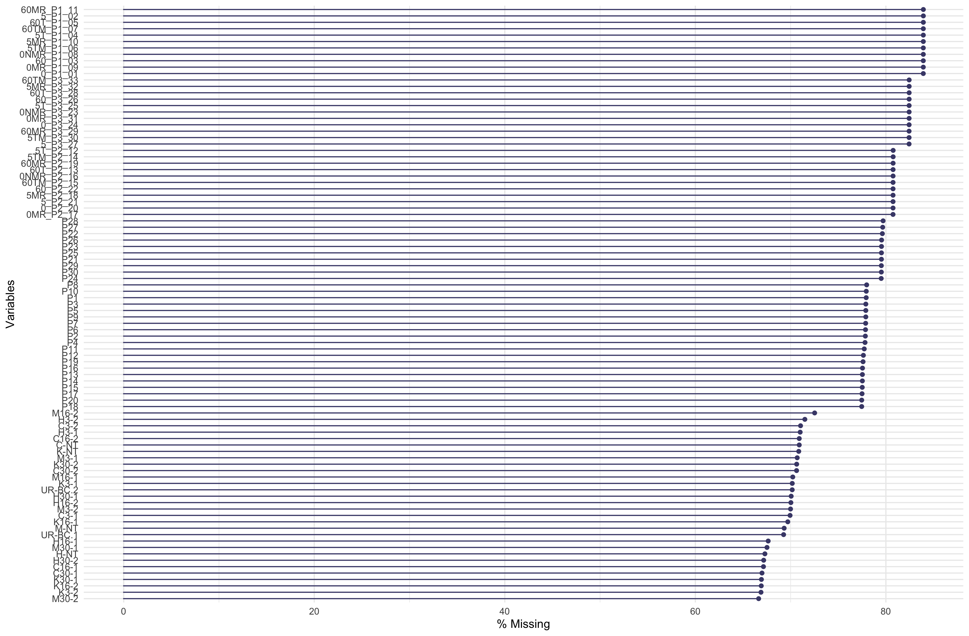
Data Preparation
66.6%
83.9%
Normalization/Scaling
  Quantile-adjusted
  Row vs column
Data sparsity

Slide 5
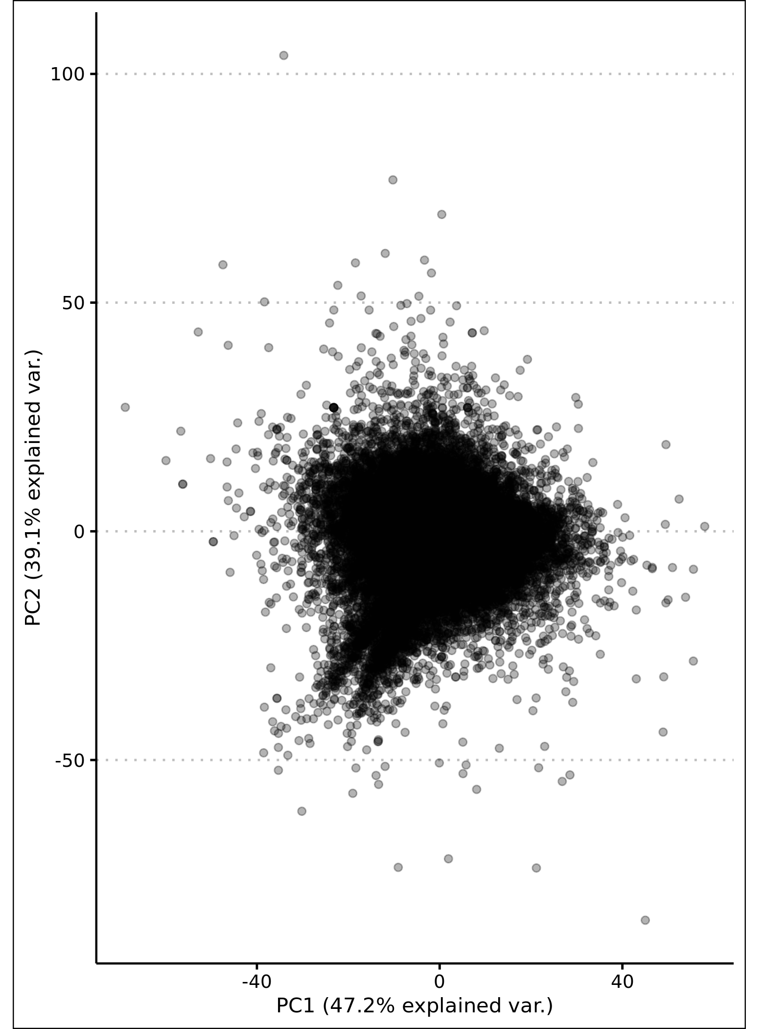
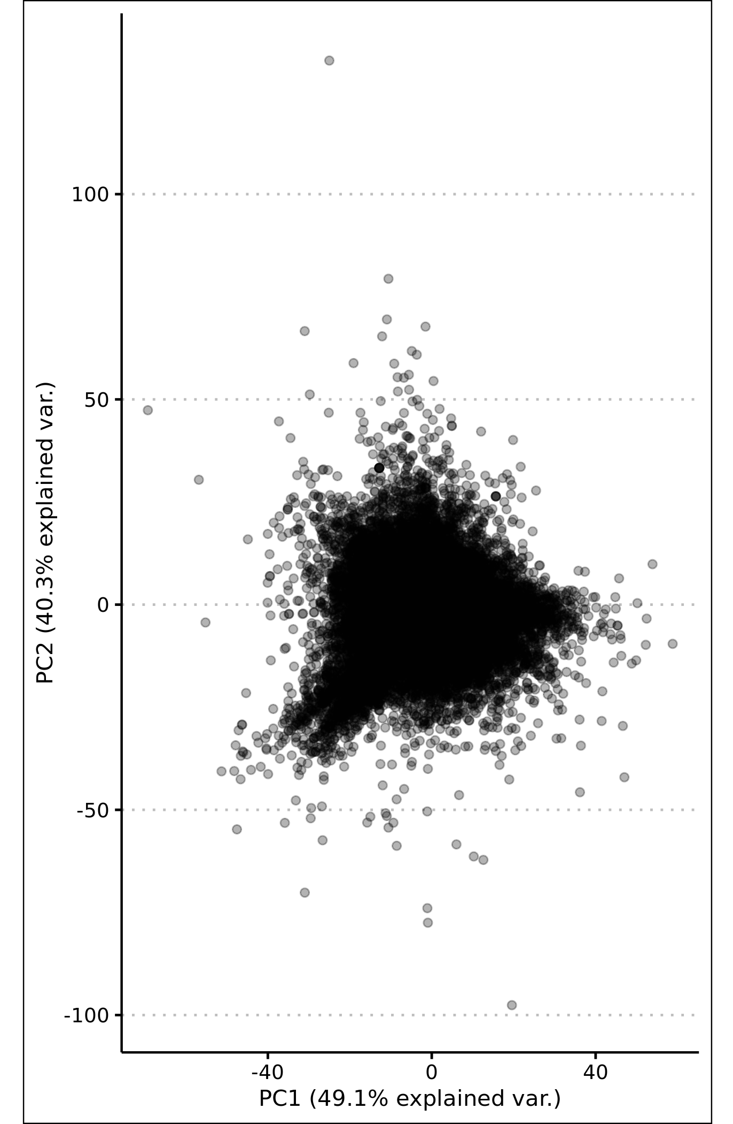
PCA Pre- and Post- Normalization
Pre-Normalization
Column Normalized

Slide 6
CausalPath Analysis
Controls per cell line
  Example:
    Control: MOLM-13 cells, no treatment @ 0 min
    Test: MOLM-13 cells, Trametinib @ 30 min
Pooled controls
  Example:
    Control: All cell lines, no treatment @ 0 min
    Test: MOLM-13 cells, Trametinib @ 30 min

Slide 7
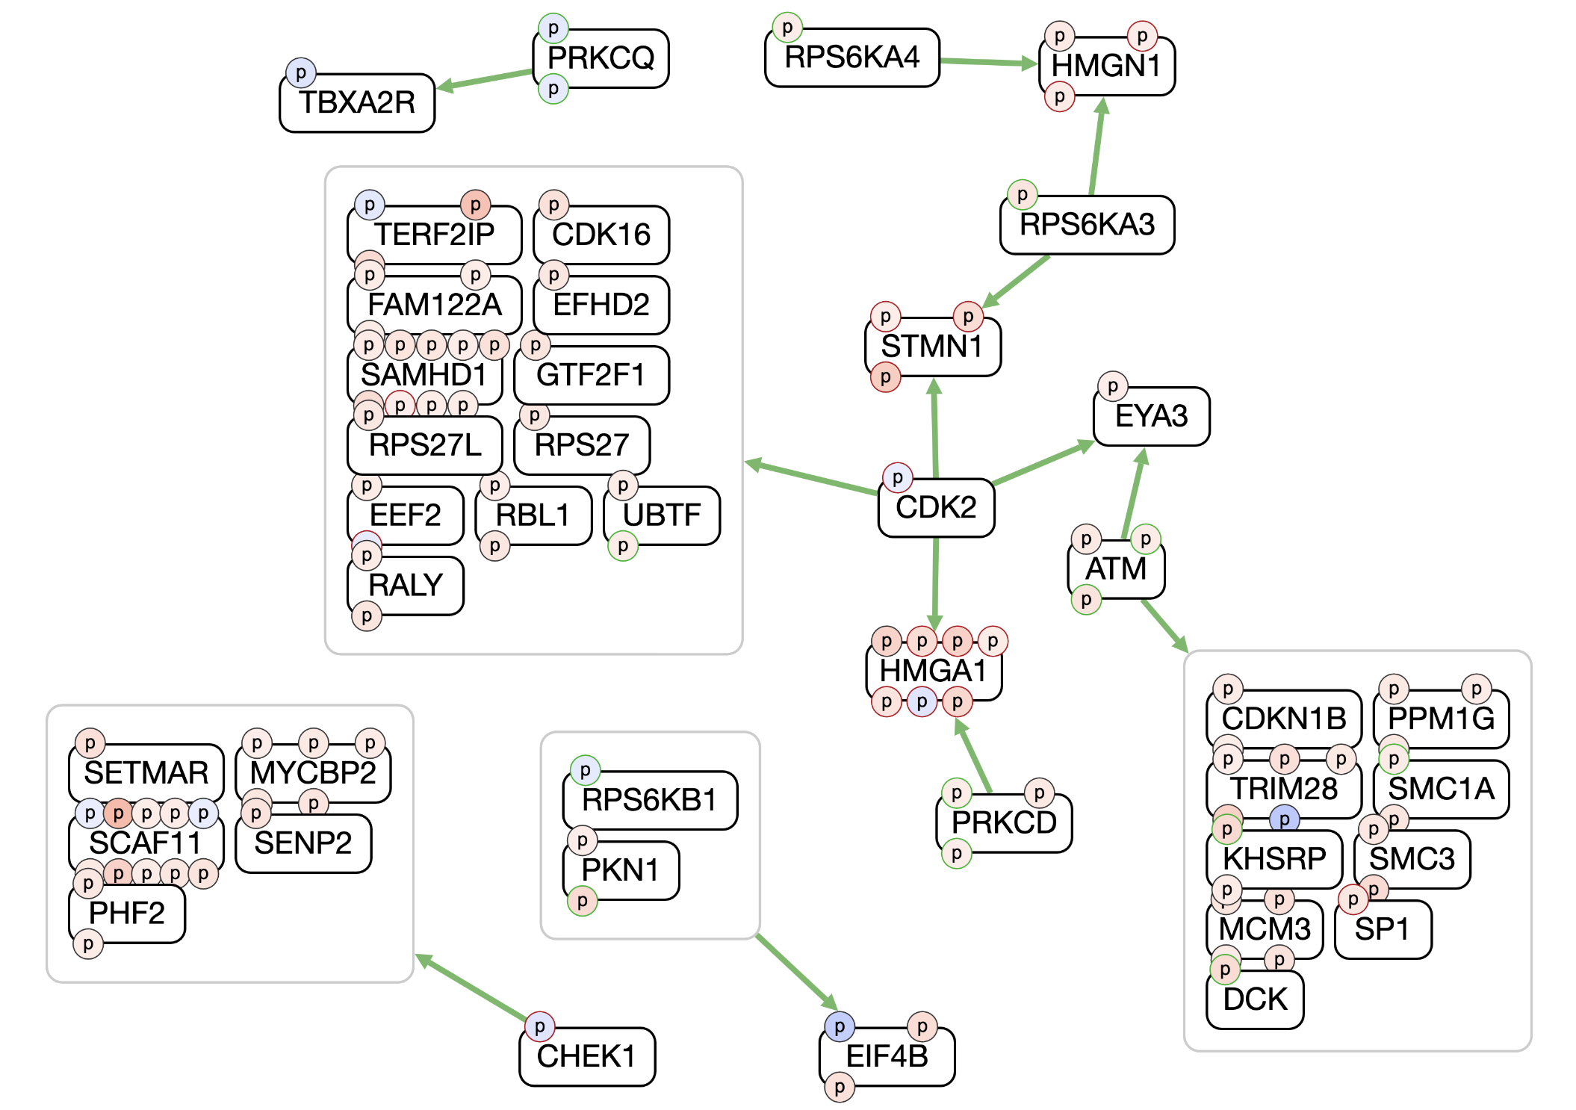
Trametinib (30 min, pooled control)
Notes:
FDR = 0.1
Control = All cell lines

Slide 8
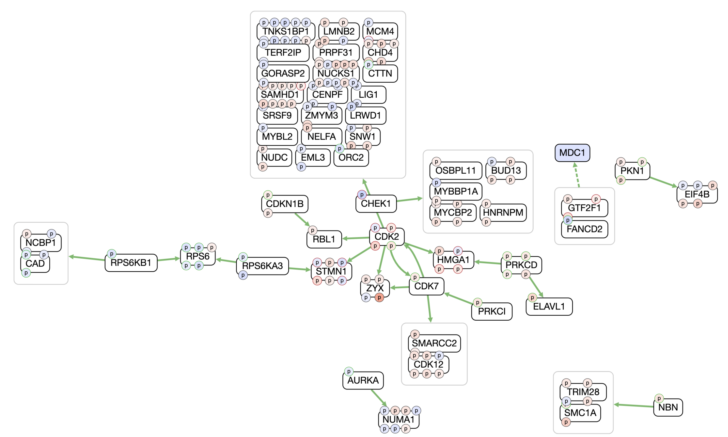
Trametinib (3 hours, pooled control)
Notes:
FDR = 0.1
Control = All cell lines

Slide 9
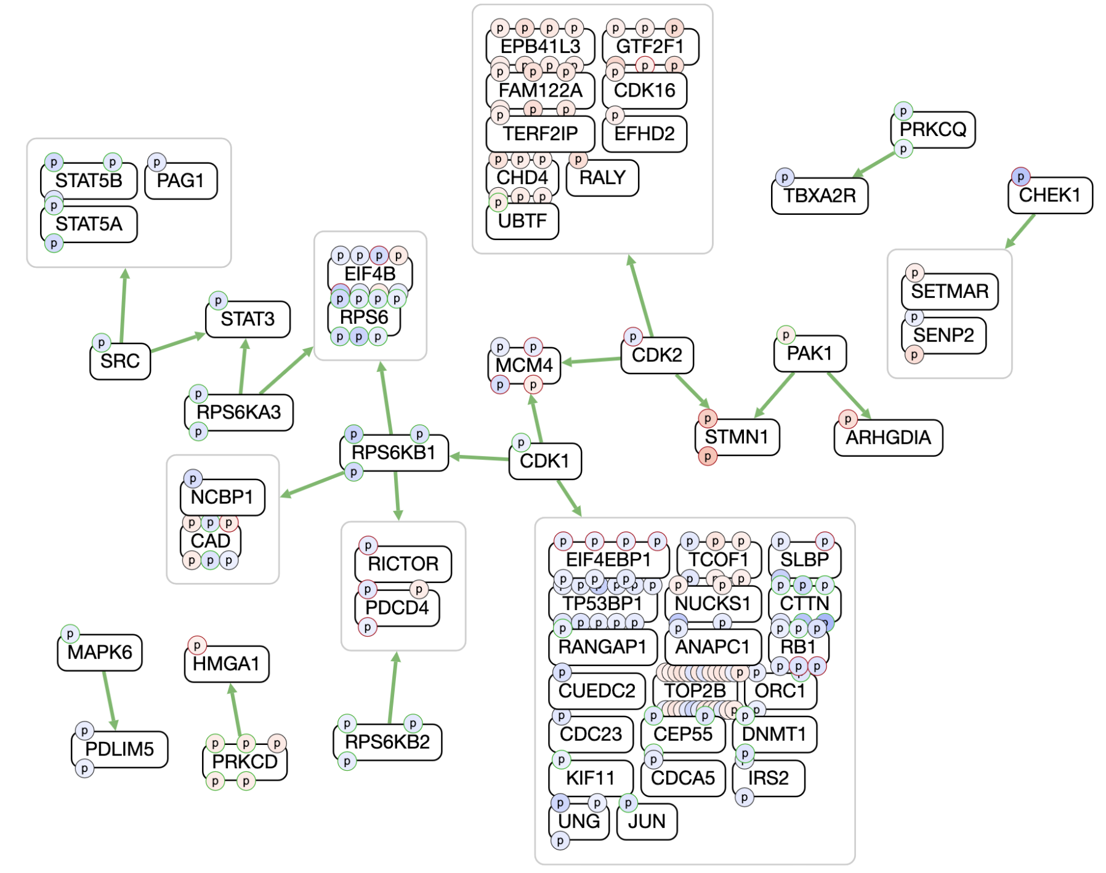
Trametinib (16 hours, pooled control)
Notes:
FDR = 0.1
Control = All cell lines

Slide 10
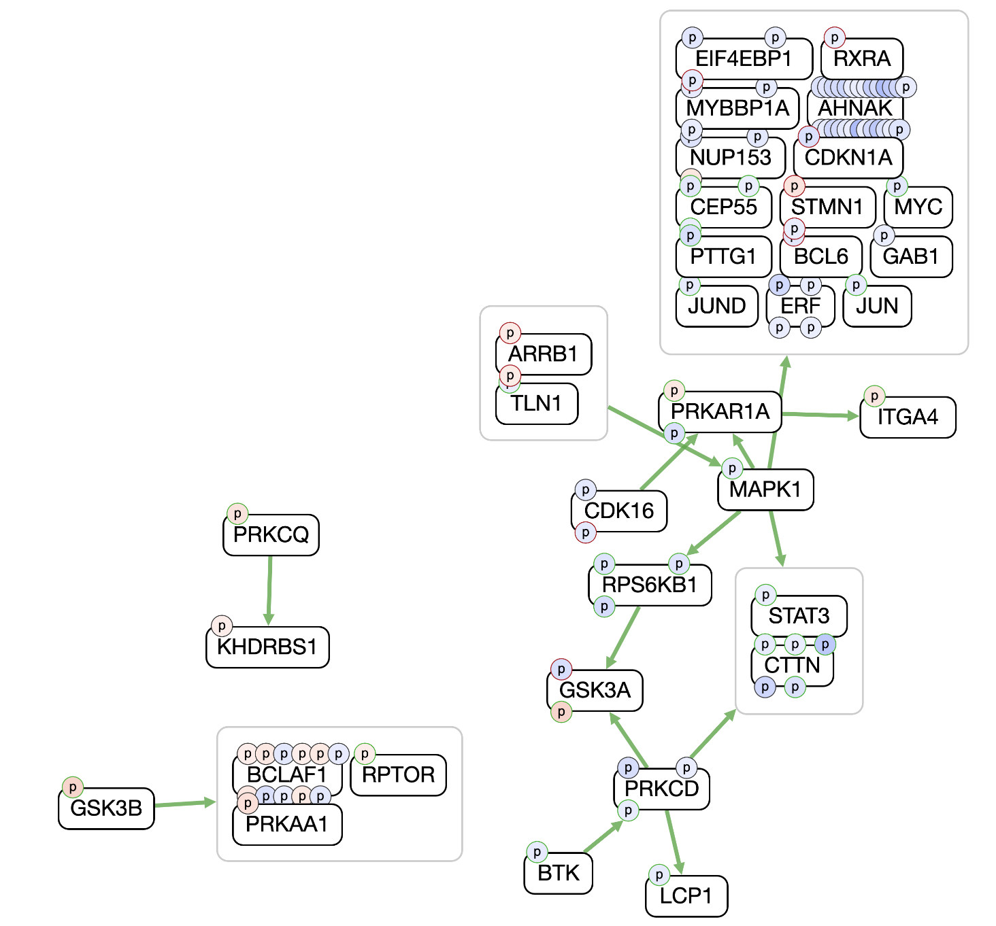
Ruxolitinib (30 min, pooled control)
Notes:
FDR = 0.1
Control = All cell lines

Slide 11
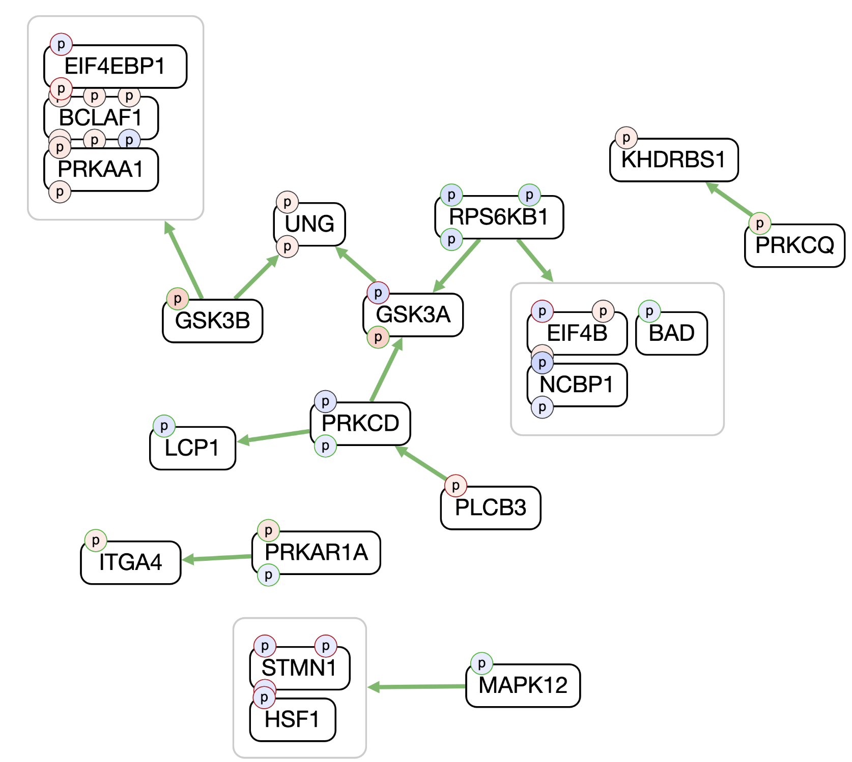
Ruxolitinib (3 hours, pooled control)
Notes:
FDR = 0.1
Control = All cell lines

Slide 12
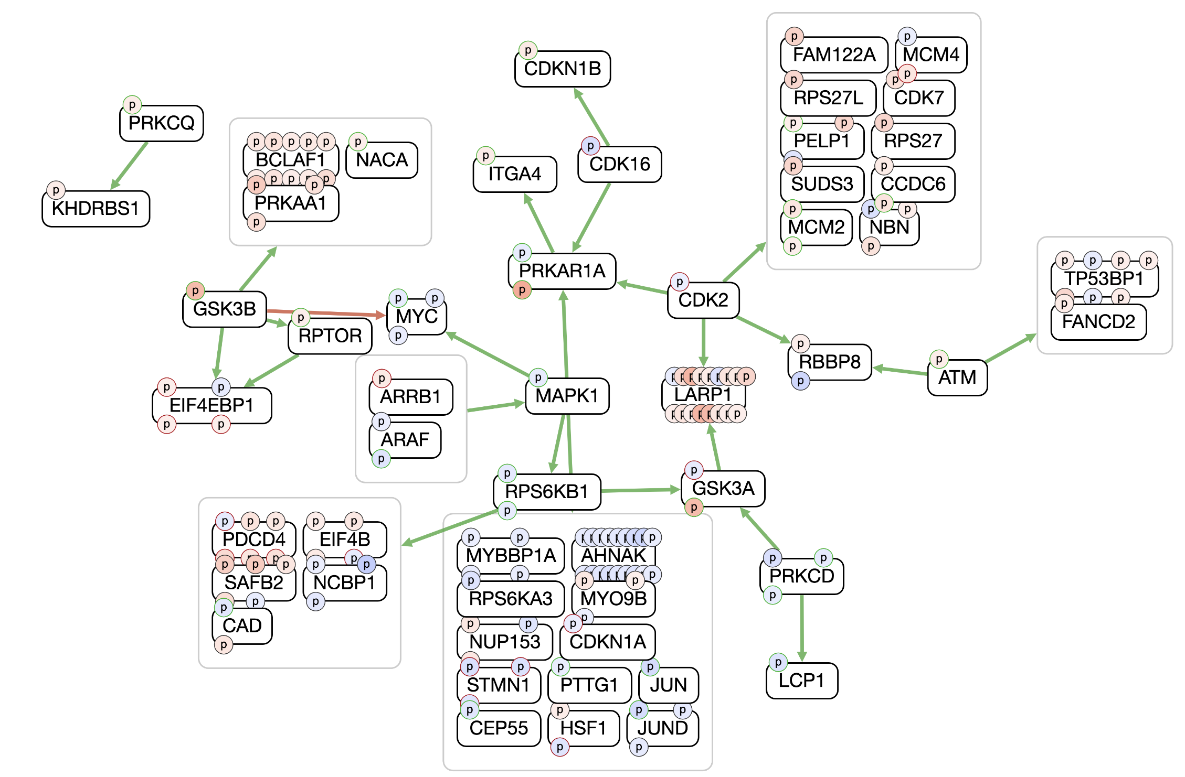
Trametinib (16 hours, pooled control)
Notes:
FDR = 0.1
Control = All cell lines

Slide 13
Next steps
Iterate value transformations and FDR thresholds
  Significant change of mean (t-test)
  Fold change of mean
Row normalization
Upload results to GitHub

