Slide 1

PLATFORM UPDATE
Digital Examination
Moderation System
Moderation from set paper to signed report, in one place
Presented by John Meyer
Cape Peninsula University of Technology
Notes:
Welcome. I am John Meyer. Last time I showed the first version of the platform. Today is the update: what is new since then, who it helps, and what comes next. About 20 minutes plus questions.

Slide 2
THE REASON
Why moderation is moving online
Before
Now
What this update adds
Word and PDF files e-mailed back and forth.
No single view of what is overdue.
Hard to prove which version was approved and by whom.
Paper forms and re-typed details.
One record per assessment, with every document, comment and signature on it.
Deadlines and reminders built in.
Digital signatures and a tamper-evident audit trail.
The official CPUT Appendix 2 report is produced automatically.
Overview dashboards for heads of department and programme.
A report for the Dean, with an AI-written discussion.
Multiple documents with versions, and comments on Word and PDF.
Install on any device.
Goal: every assessment is moderated before it is written, signed off after it is marked, and visible to the people who need to see it.
Digital Examination Moderation System · John Meyer · Cape Peninsula University of Technology
2
Notes:
Paper forms and e-mailed attachments make it hard to know who has what, which version was approved, and whether deadlines are met. The platform keeps one record per assessment from start to signed report.

Slide 3
OVERVIEW
The process at a glance
1
2
3
4
5
6
Section 1
Gate 1
Section 2
Gate 2
Gate 3
Archive
Examiner
Internal moderator
Examiner
Internal moderator
External moderator
Examiner + HOD
Details, question weightings and the paper
Reviews the paper in the browser; approves or sends back
Marks, statistics and comments
Final review and signature
Only if assigned: Section 3
Sign Section 3; PDF report archived
Before the assessment
After the assessment
Pre-moderation (steps 1–2) is finished 14 days before the assessment date.
Post-moderation (steps 3–6) is finished 14 days after the assessment date.
Digital Examination Moderation System · John Meyer · Cape Peninsula University of Technology
3
Notes:
Six steps. Steps 1 to 2 finish 14 days before the assessment is written; steps 3 to 6 finish 14 days after. Gate 3 only applies when an external moderator is assigned.

Slide 4
ROLES
Who uses it, and what they see
Examiner
Internal moderator
External moderator
Sets the assessment, uploads the paper, submits marks and signs.
Reviews papers and results; comments in the document; approves or sends back.
Independent review (Section 3) once the internal moderator has signed off.
Head of Department
Head of Programme
System Administrator
Sees all subjects, signs off, and reports to the Dean. Can delete practice records.
Sees the progress dashboard for the qualification(s) they head. No papers or marks.
Runs the platform: accounts, approvals, uploads. No access to assessments or audit trails.
A person can hold several roles, for example Examiner and Internal Moderator.
Digital Examination Moderation System · John Meyer · Cape Peninsula University of Technology
4
Notes:
People can hold more than one role. Visibility follows the assignment: you only see assessments you are part of, except the HOD who sees their subjects, and the Head of Programme who sees the dashboard for their qualification only.

Slide 5
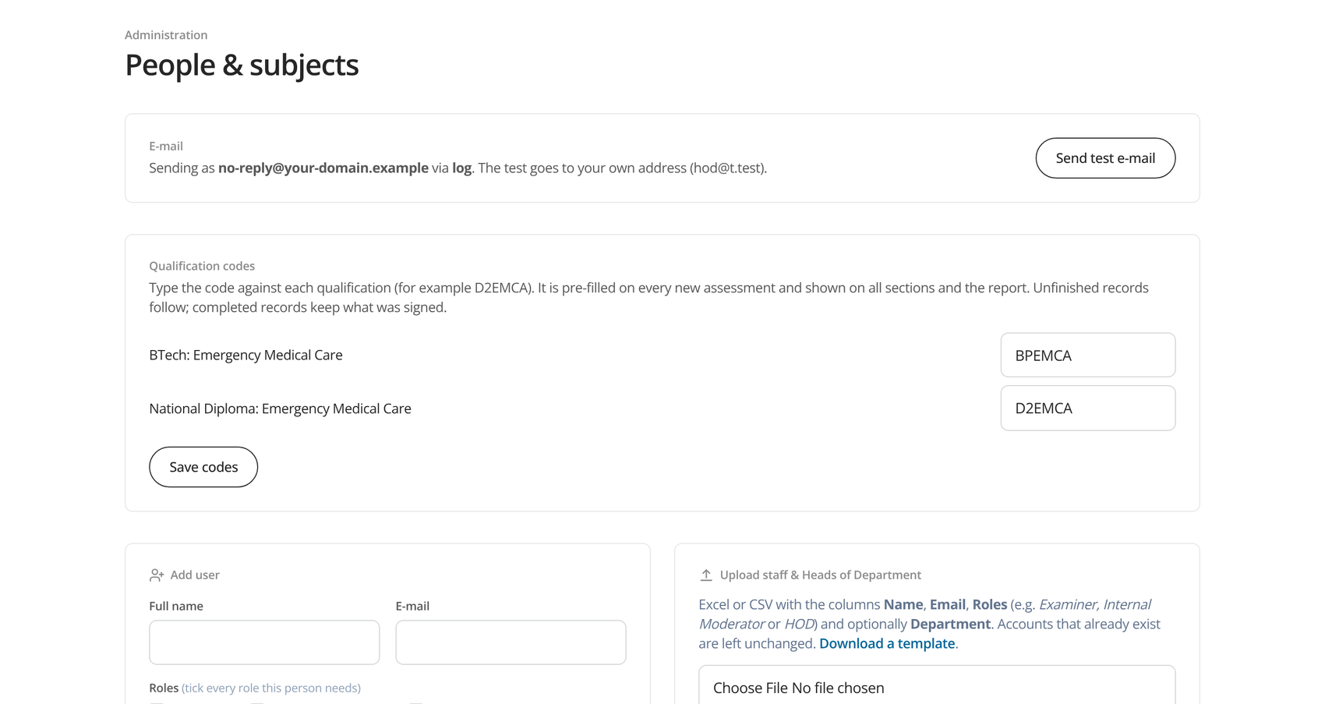
GETTING STARTED
Getting an account
Register — staff choose their roles (Examiner, Moderators, Head of Programme) and wait for approval.
Approve — the HOD or System Administrator checks the request and confirms the roles.
Upload staff — an Excel or CSV list of names, e-mails and roles creates accounts in one go.
Subjects — import the subject list (qualification, code, name); set qualification codes once.
Safe sign-in — passwords of 10+ characters; each person can change theirs, or delete their account.
Digital Examination Moderation System · John Meyer · Cape Peninsula University of Technology
5
Notes:
Staff register themselves and choose the roles they need. The HOD or System Administrator approves. Admins can also upload a whole staff list in one go with a spreadsheet. Qualification codes are matched to qualifications once in Admin.

Slide 6
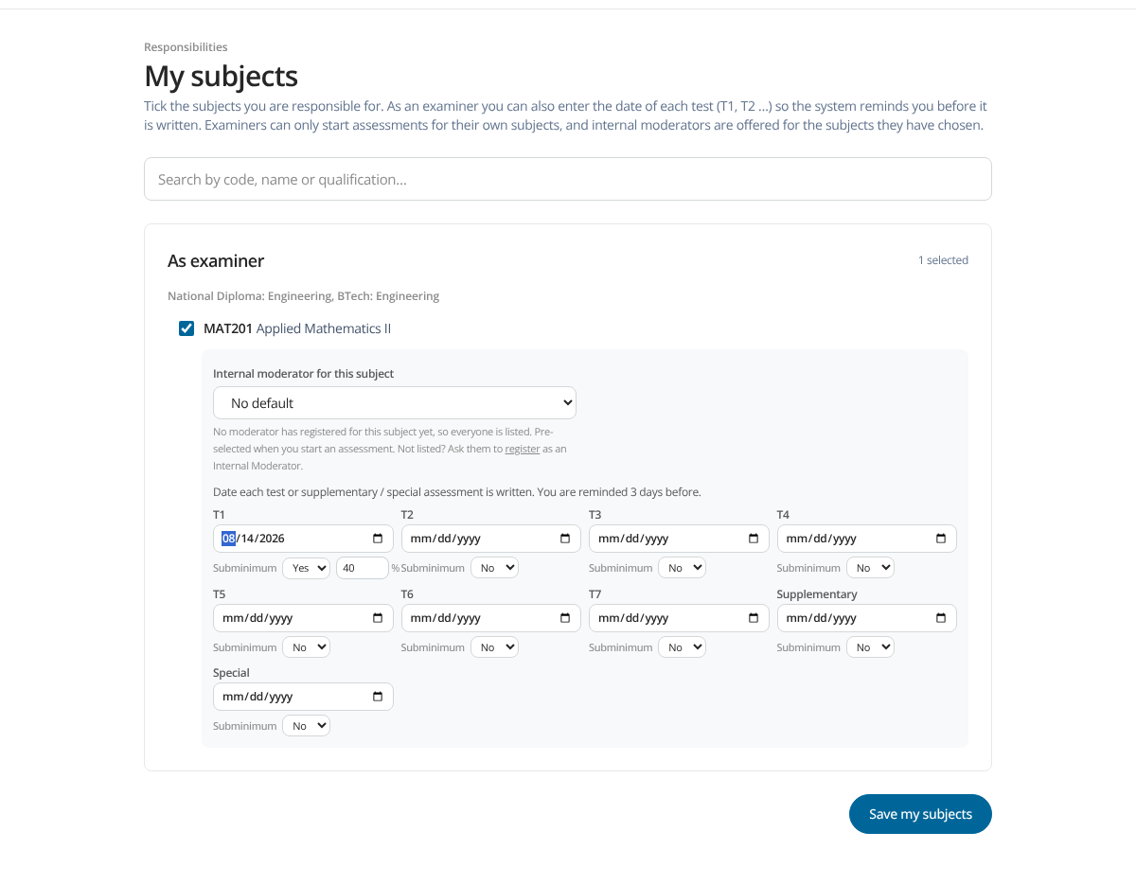
EXAMINERS AND MODERATORS
My subjects and the test calendar
Pick your subjects and your usual internal moderator.
Date every test — T1 to T7, Supplementary, Special, Sick and Deferred.
Subminimum — Yes or No per test, with the % the student must reach.
Reminders three days before each test, and when a moderation deadline is close or missed.
Historic dates are accepted, for assessments already written.
Digital Examination Moderation System · John Meyer · Cape Peninsula University of Technology
6
Notes:
Each examiner ticks their subjects and enters the date of every test. The system reminds them three days before. New this time: Sick and Deferred assessments next to Supplementary and Special, and a subminimum option per test.

Slide 7
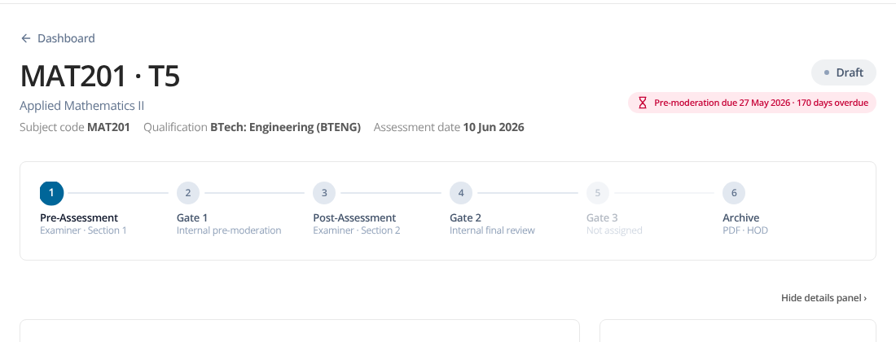
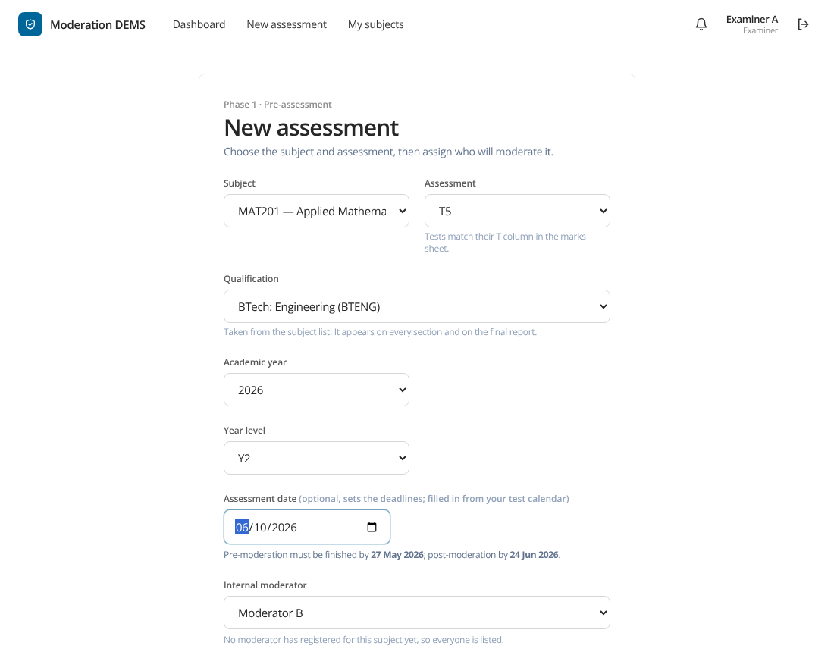
EXAMINER
Starting an assessment: type it once
Subject, qualification and date are pulled through to every section and the PDF report.
Qualification codes (for example D2EMCA) are set once by the administrator.
Deadlines are worked out from the date: 14 days before and after.
Digital Examination Moderation System · John Meyer · Cape Peninsula University of Technology
7
Notes:
The qualification name, its code, the subject code and the assessment date are chosen once at the start. They then appear on every section and on the final report, so nothing is retyped.

Slide 8
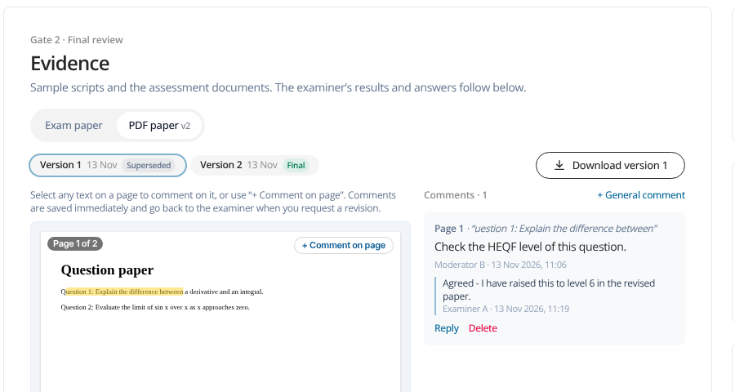
DOCUMENTS
Several documents, clear versions, no separate memo
Upload the paper — it already contains the memorandum.
Add other documents — annexures, formula sheets, extra papers.
Version 2, 3 … every revision is kept and labelled.
Final marks the version that passed pre-moderation.
Everything is read inline in the browser, with comments.
Digital Examination Moderation System · John Meyer · Cape Peninsula University of Technology
8
Notes:
The exam paper already contains the memorandum, so only one upload is needed. An examiner can add as many other documents as the assessment has. A revised upload becomes Version 2, 3 and so on, and the version that passed pre-moderation is marked Final.

Slide 9
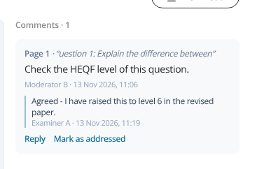
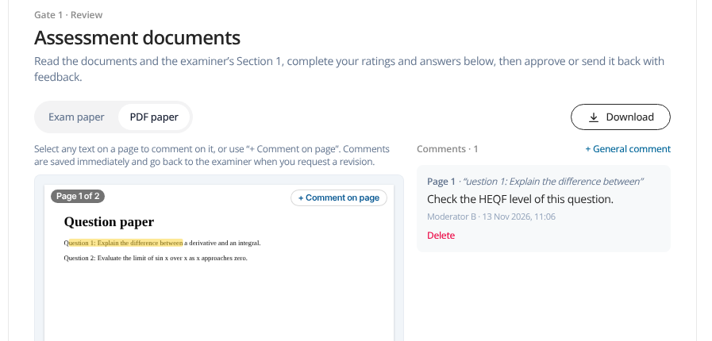
INTERNAL AND EXTERNAL MODERATORS
Comment on the document itself, and reply
Select text in Word or PDF and comment.
Reply — examiner and moderator talk under each comment.
Mark addressed when the change is made.
Digital Examination Moderation System · John Meyer · Cape Peninsula University of Technology
9
Notes:
Moderators select text in a Word document or a PDF and comment on it. The examiner sees each comment when the paper comes back, can reply under it, and marks it addressed. PDFs can be commented page by page too.

Slide 10
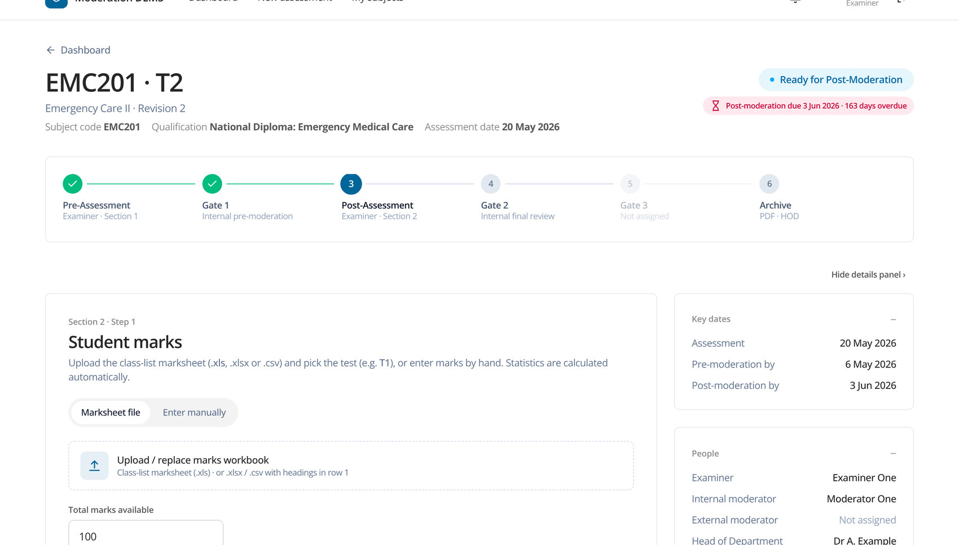
EXAMINER
Section 2: marks, results and the subminimum
Marks from the class list column that matches the test (T1…T7, Supplementary, Special, Sick, Deferred).
Statistics — pass rate, average, highest, lowest, distribution.
Subminimum — how many met it, how many passed or failed.
No student data leaves the system; marks are anonymous numbers.
Digital Examination Moderation System · John Meyer · Cape Peninsula University of Technology
10
Notes:
The examiner uploads the marks or pastes them. The system calculates the statistics server-side; raw marks are anonymous. If the test has a subminimum, the report also shows how many students met it and how many passed or failed.

Slide 11
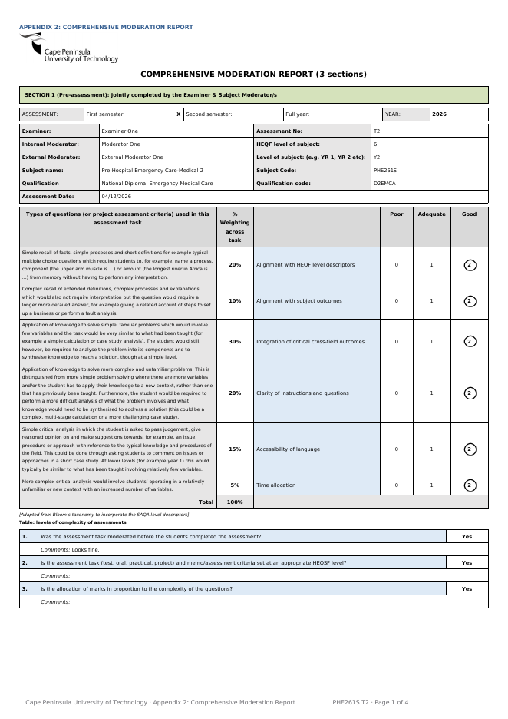
APPENDIX 2
Signed and sealed: the official CPUT report
Digital signatures — drawn and confirmed with the signer’s password.
Audit trail — hash-chained: any change to the history is detectable.
Official form — Appendix 2: Comprehensive Moderation Report, produced as a PDF.
Pass and fail figures and the subminimum sit under the “general adjustments of the marks” question.
The record can be deleted by the HOD only if it was a demo or practice run, with a password and a typed confirmation.
Digital Examination Moderation System · John Meyer · Cape Peninsula University of Technology
11
Notes:
Every gate needs the person to enter their password to sign. Every action is written to an audit trail where each entry covers the one before it. When all signatures are in, the official CPUT Appendix 2 PDF is produced.

Slide 12
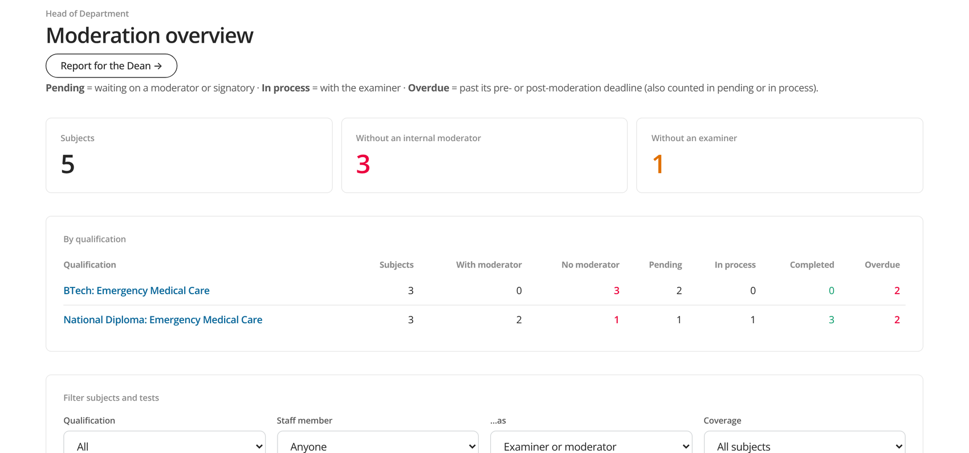
HEAD OF DEPARTMENT
The overview: every qualification and subject
By qualification — pending, in process, completed, overdue.
Drill down from qualification to subject.
Coverage — subjects without an internal moderator or examiner.
Filter by staff member (examiner or moderator) and by date.
Head of Programme sees only this view, for their own qualification(s).
Digital Examination Moderation System · John Meyer · Cape Peninsula University of Technology
12
Notes:
The HOD sees, per qualification: how many subjects have moderators, and how many assessments are pending, in process, completed or overdue. Click a qualification to see its subjects, then a subject for its assessments. Filter by staff member, coverage and date.

Slide 13
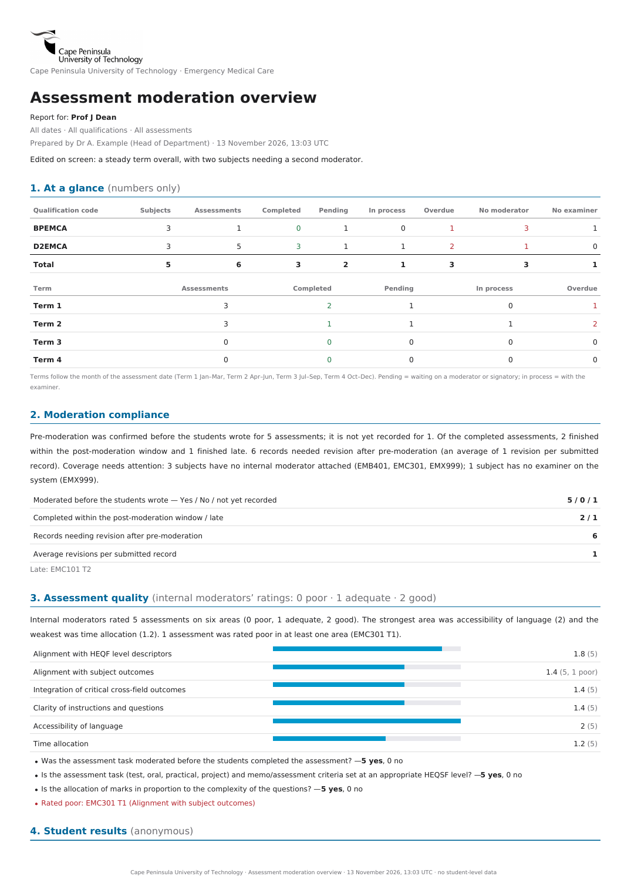
HEAD OF DEPARTMENT
The report for the Dean
At a glance — numbers only, one line per qualification code, plus Term 1 to 4.
Compliance — moderated before the test, on time, revisions.
Quality — the moderators’ ratings on six areas.
Results — pass rates by qualification, term and year level; falls and low rates.
Matters for attention — mark adjustments, overdue items, subjects without moderators.
Appendix — every assessment, in four terms. PDF or Word, any time.
Digital Examination Moderation System · John Meyer · Cape Peninsula University of Technology
13
Notes:
A separate report from the per-assessment moderation report. It is always up to date, covers all subjects, and has no student names or individual marks. It can be downloaded as PDF or as an editable Word document.

Slide 14
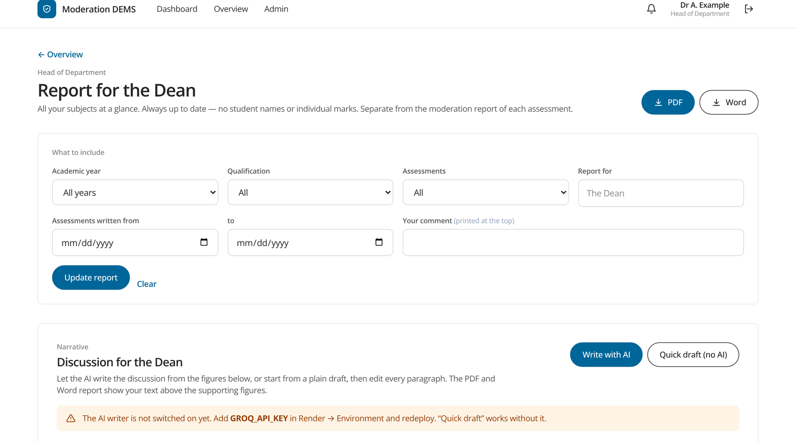
HEAD OF DEPARTMENT
The discussion for the Dean: written with AI
Write with AI — six paragraphs from the figures, in plain formal English.
Quick draft — the same, without AI.
You edit every paragraph; the PDF and Word include exactly what is on screen.
Privacy — no student data, no staff names, e-mail addresses removed.
Digital Examination Moderation System · John Meyer · Cape Peninsula University of Technology
14
Notes:
The HOD presses Write with AI. The AI, using Groq, writes six short paragraphs from the figures only. The HOD reads and edits every paragraph before downloading. There is also a plain draft that works without AI. Privacy: only summary figures, subject codes and written comments with e-mail addresses removed are sent; no student data and no staff names.

Slide 15
TRUST
Safe by design
Right people, right records
Signed and traceable
Anonymous marks
Examiners and moderators see only their assessments; the external moderator only after sign-off; the Head of Programme only a dashboard.
Signatures need the signer’s password; the audit trail is hash-chained and cannot be edited quietly.
Raw marks are numbers only; the class list stays with the examiner.
Controlled changes
Data stays put
AI with limits
Deleting a record needs the HOD’s password and a typed confirmation, and is logged.
Hosted with a managed database; row-level security is on; secrets are kept out of the code.
Only summary figures and subject codes are sent; the HOD edits the text before it is used.
Digital Examination Moderation System · John Meyer · Cape Peninsula University of Technology
15
Notes:
Security and privacy points. Marks are anonymous numbers. People only see what they are part of. Passwords are required for signing and deleting. The database has row-level security turned on. The AI only receives summary figures.

Slide 16
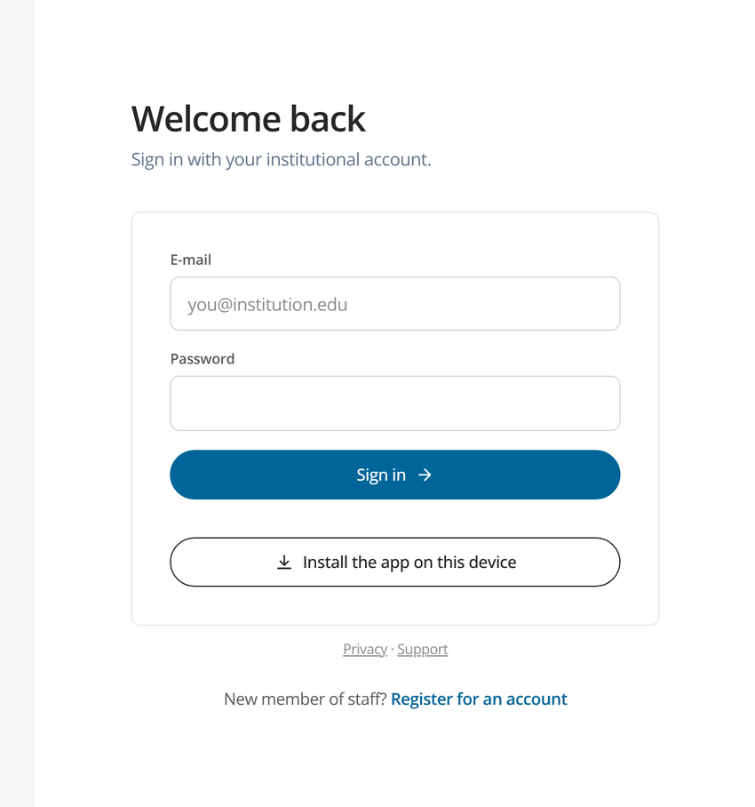
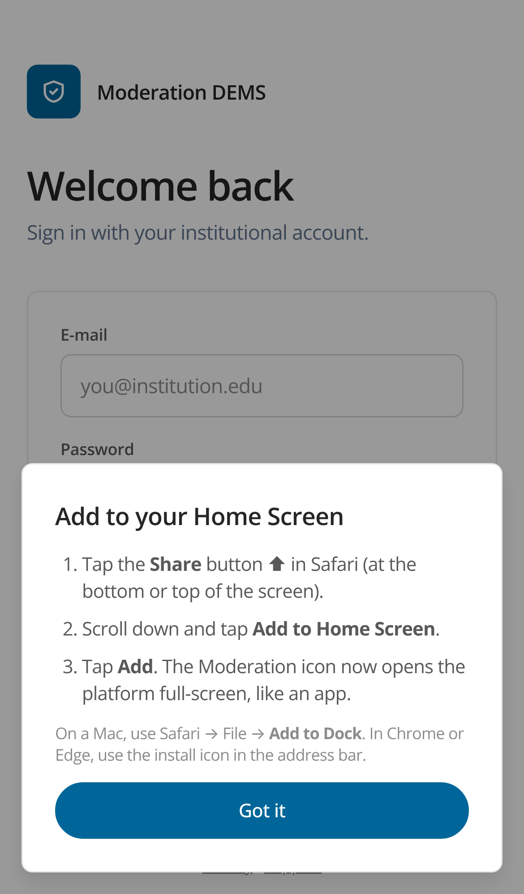
ACCESS
Works on any device, and installs like an app
Install app button on the sign-in page, the top bar and the account page.
iPhone and iPad — Share, then Add to Home Screen.
Full-screen with a home-screen icon and quick links.
Phone friendly — every screen works on a phone.
App Store app — prepared; waiting for CPUT’s Apple account.
Chrome, Edge, Android
iPhone and iPad
Digital Examination Moderation System · John Meyer · Cape Peninsula University of Technology
16
Notes:
In Chrome, Edge or on Android there is an Install app button; on iPhone and iPad it shows the Add to Home Screen steps. A native iPhone app for the App Store is prepared but still needs CPUT’s Apple developer account and a Mac build.

Slide 17
ROADMAP
Where we are, and what comes next
Live today
Next
Planned, not built
Full moderation workflow
Multiple documents and versions
Inline comments, Word and PDF
Overview and Dean report
AI-written discussion (needs the Groq key)
Installable in the browser
E-mail reminders (need mail set-up)
Apple developer account and Mac build for the iPhone app
Push notifications and Face ID in the app
Final privacy wording
Mail from a CPUT address for reminders
AI check of the paper against the question-weighting table
A replacement test linked to the original for supplementary, sick and deferred cases
Digital Examination Moderation System · John Meyer · Cape Peninsula University of Technology
17
Notes:
Be clear about what is live and what is planned. The AI paper check and the replacement-test handling are written as plans only. The iPhone app is prepared but not yet built or submitted.

Slide 18
NEXT STEPS
What I need from you
Confirm the HODs and Heads of Programme so their roles and qualifications can be set up.
Check the qualification codes for each qualification.
Choose a pilot group of examiners and moderators for one term.
Provide the CPUT mailbox (or an approved mail service) so reminders go out by e-mail.
Apple account details from the person who holds CPUT’s developer account.
Questions?
John Meyer
Moderation platform · Cape Peninsula University of Technology
Thank you.
Digital Examination Moderation System · John Meyer · Cape Peninsula University of Technology
18
Notes:
Close with the asks: names for the HOD roles, qualification codes, mail address, and a pilot group.

