Slide 1

STAFF BRIEFING
Digital Examination Moderation System
Moderating assessments online, from draft paper to signed, archived report
[Presenter name] · [Date]
[Site address]
Notes:
Welcome. This is a 30-40 minute walk-through of the new online moderation platform. Fill in the presenter name, date and site address on this slide before presenting.

Slide 2
THE REASON
Why we are moving moderation online
Today
With the platform
Papers, memos and marks travel by e-mail and in folders
Hard to see where an assessment is stuck
Deadlines are missed or discovered late
Signatures and comments are scattered
The final report is assembled by hand
One record per assessment, start to archive
Everyone sees whose turn it is
Deadlines and reminders built in
Digital signatures, confirmed with your password
One signed PDF in the official Appendix 2 layout
Digital Examination Moderation System · Cape Peninsula University of Technology
2
Notes:
Today moderation depends on paper, e-mail and memory. The platform keeps everything for one assessment in one place, shows whose turn it is, and ends with one signed PDF in the official CPUT format (Appendix 2).

Slide 3
OVERVIEW
The process at a glance
1
2
3
4
5
6
Section 1
Gate 1
Section 2
Gate 2
Gate 3
Archive
Examiner
Internal moderator
Examiner
Internal moderator
External moderator
Examiner + HOD
Details, weightings, paper and memo
Reviews the paper; approves or sends back
Marks, statistics, answers
Final review and signature
Only if assigned: Section 3
Sign Section 3; PDF archived
Before the assessment
After the assessment
Pre-moderation (steps 1–2) is finished 14 days before the assessment date.
Post-moderation (steps 3–6) is finished 14 days after the assessment date.
Digital Examination Moderation System · Cape Peninsula University of Technology
3
Notes:
Walk through the six steps left to right. Stress that the external moderator is optional. The two deadline boxes at the bottom come from the assessment date.

Slide 4
ROLES
Who does what
Examiner
Internal moderator
External moderator
Head of Department
Sets up the assessment
Section 1, paper and memo
Uploads marks (Section 2)
Signs Section 3
Reviews the paper (Gate 1)
Rates the criteria 0/1/2
Final review (Gate 2)
Comments in the Word paper
Sees the record only after Gate 2
Completes Section 3
Optional step
Approves staff registrations
Manages users and subjects
Signs Section 3
Receives the final PDF
Staff can hold several roles. Nobody moderates their own assessment.
Digital Examination Moderation System · Cape Peninsula University of Technology
4
Notes:
One person can hold more than one role, for example a Head of Department who also examines. You can never moderate your own assessment.

Slide 5
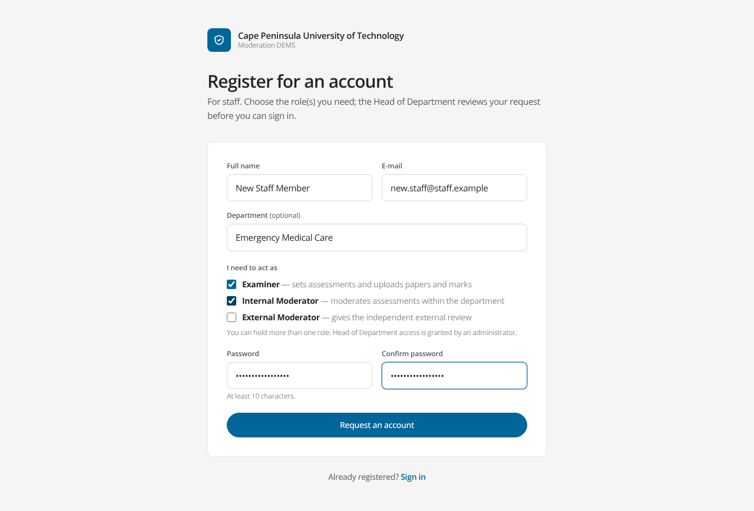
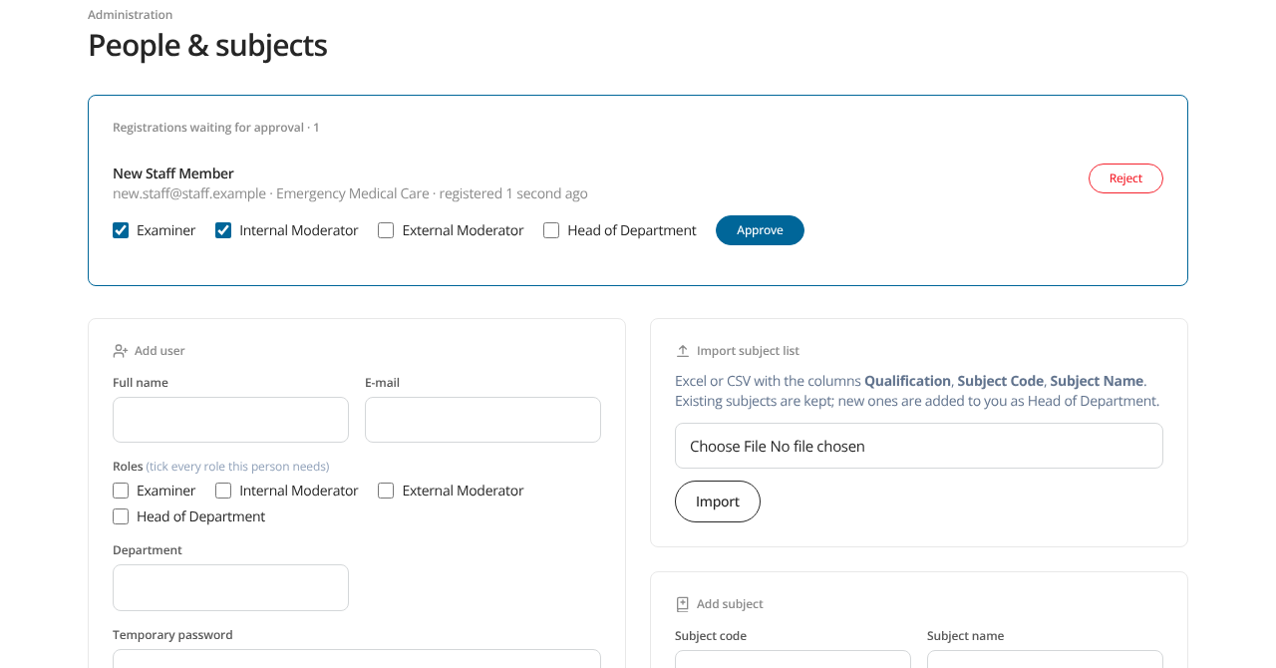
GETTING STARTED
Getting an account
1. Click Register on the sign-in page
2. Choose Examiner, Internal or External Moderator
3. The HOD approves (and can change the roles)
4. Sign in; change your password any time
The HOD approves in Admin
Staff register with their role(s)
Digital Examination Moderation System · Cape Peninsula University of Technology
5
Notes:
Staff register themselves. The Head of Department approves and can adjust the roles. Until then the person cannot sign in, and is told why.

Slide 6
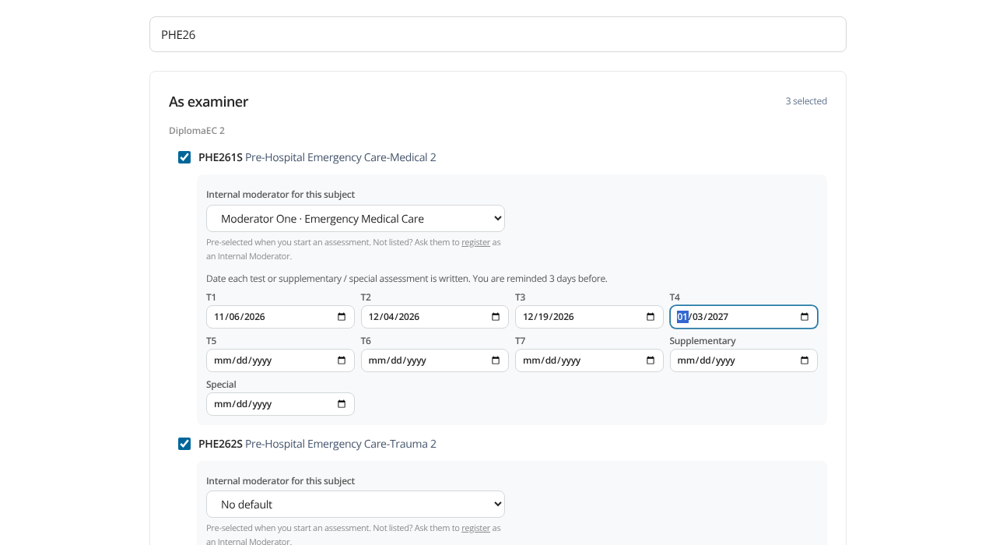
EXAMINERS AND MODERATORS
My subjects and test calendar
Tick the subjects you are responsible for
Examiners can only start assessments for their own subjects
Choose your usual internal moderator for each subject
Enter the date of each test: T1–T7, Supplementary and Special
The dates drive your reminders and deadlines
Digital Examination Moderation System · Cape Peninsula University of Technology
6
Notes:
The CPUT subject list is loaded already. Each person ticks the subjects they are responsible for. Examiners also enter the date of each test, and choose their usual internal moderator per subject.

Slide 7
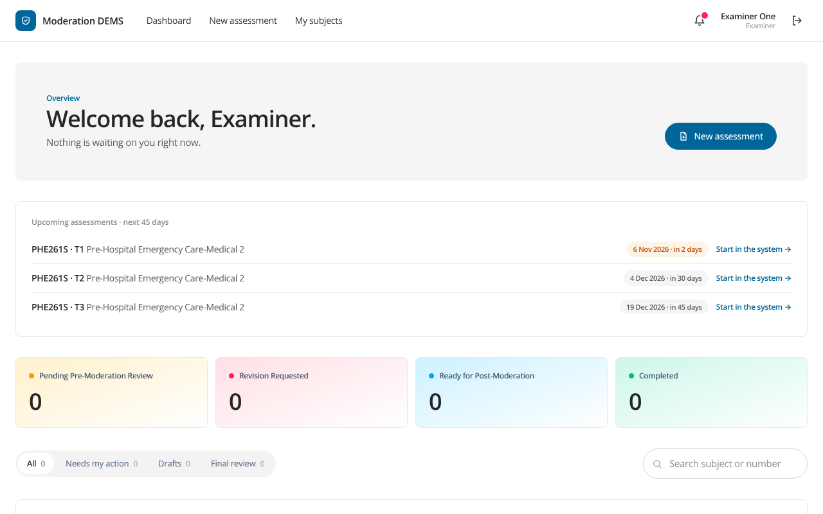
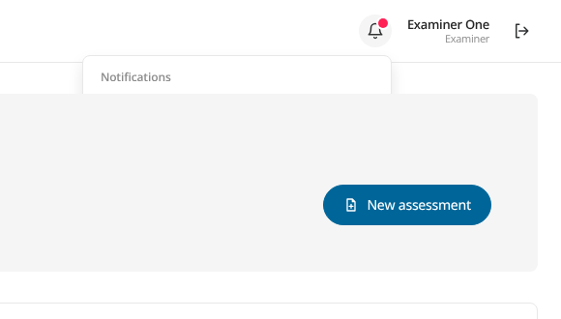
STAYING ON TRACK
Your dashboard and reminders
Upcoming assessments for the next 45 days
Reminders from 3 days before
Due dates turn amber, then red when overdue
Digital Examination Moderation System · Cape Peninsula University of Technology
7
Notes:
The dashboard shows what is waiting on you and what is coming up. Reminders start three days before a planned assessment and repeat daily until it is written.

Slide 8
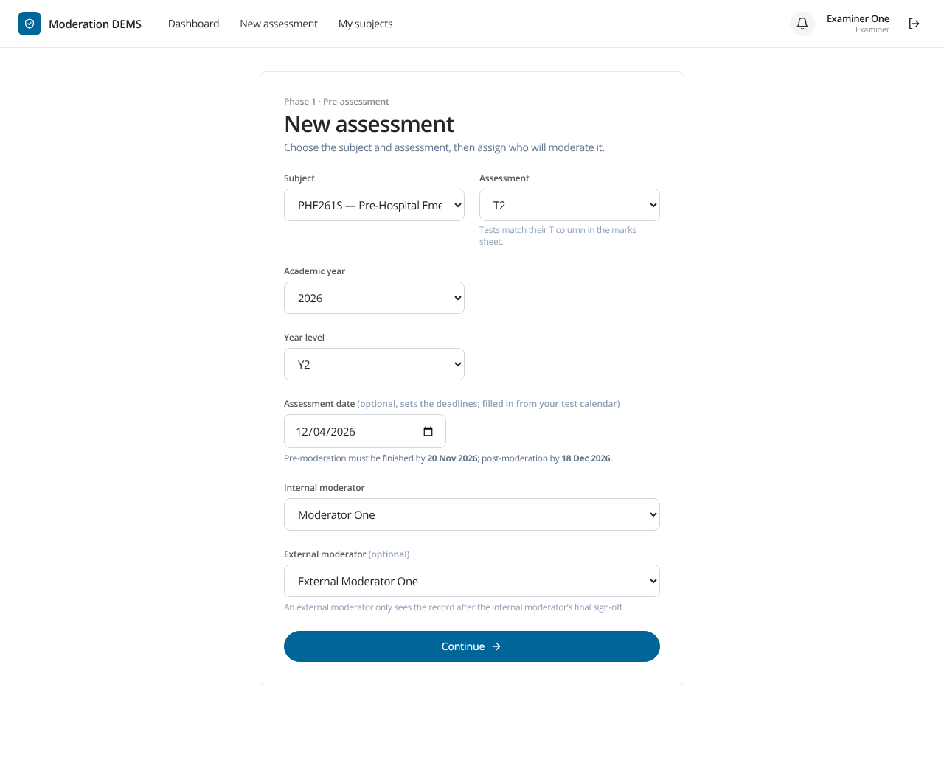
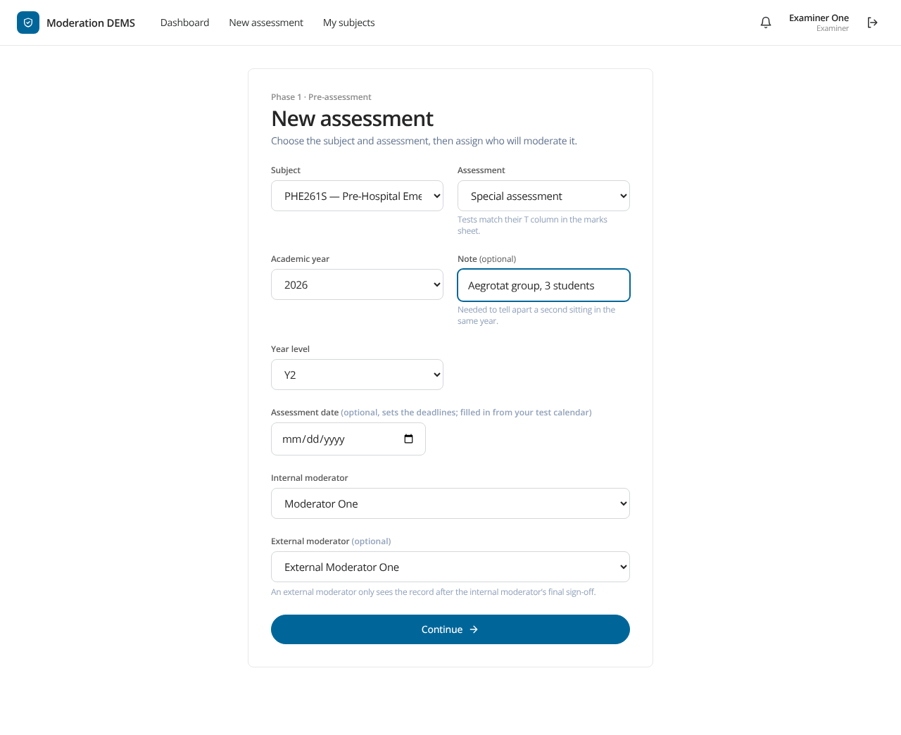
EXAMINER
Starting an assessment
Subject and assessment (T1–T7, Supplementary, Special)
Academic year and year level
Date: sets the deadlines
Internal moderator pre-selected
Optional external moderator
Digital Examination Moderation System · Cape Peninsula University of Technology
8
Notes:
Pick the subject and the assessment. Tests are T1 to T7, and supplementary and special assessments are available as well. The year level and academic year identify the sitting; a note tells apart several sittings in one year.

Slide 9
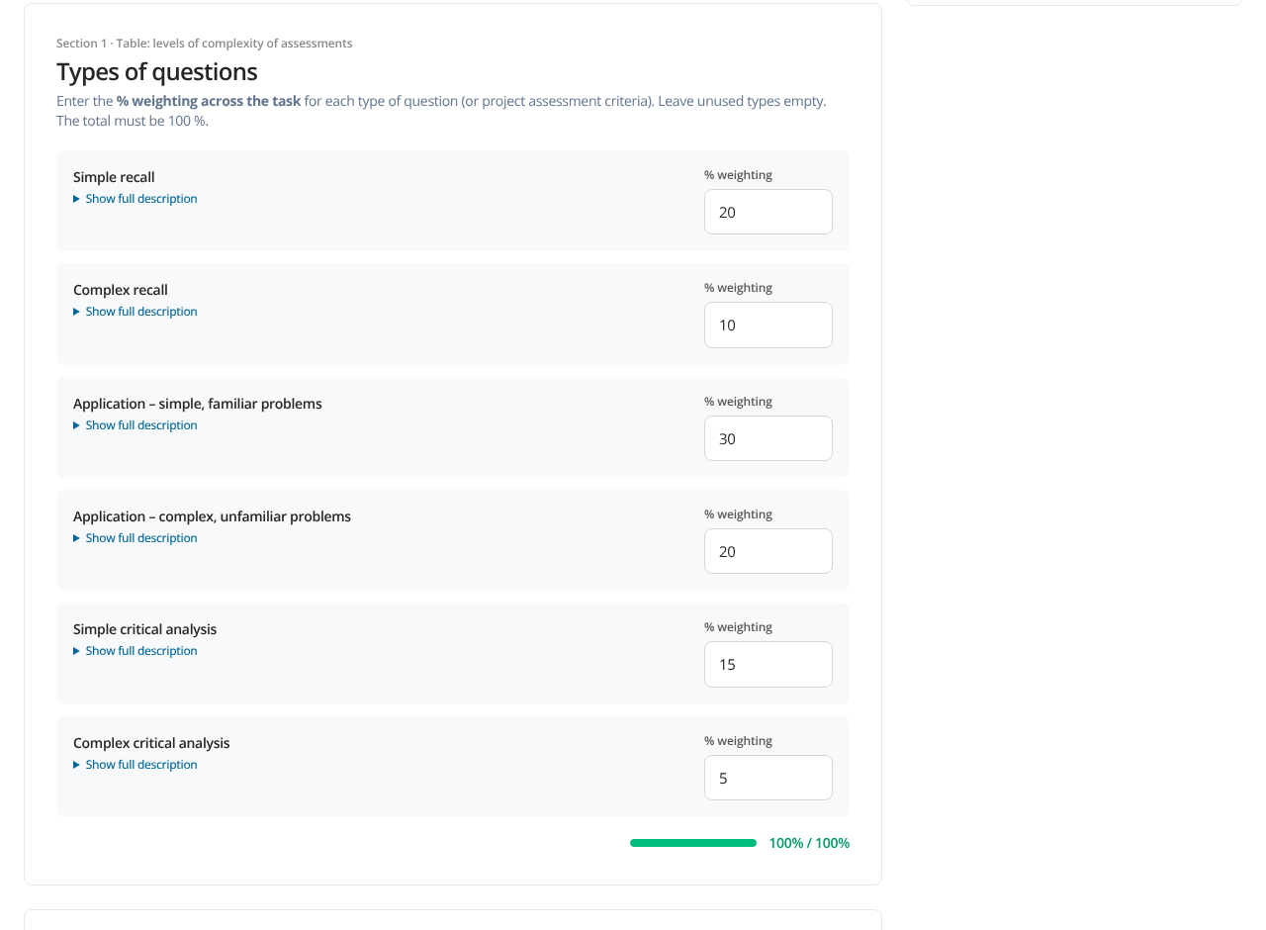
EXAMINER
Section 1: the examiner’s part
Assessment details as on the official form
Weighting of the six question types, totalling 100%
Upload the paper (Word or PDF) and the memorandum
Sign with your drawn signature and password
Digital Examination Moderation System · Cape Peninsula University of Technology
9
Notes:
Section 1 mirrors the official form. The six question types must add up to 100 percent. The paper can be Word or PDF, and may be password protected. The examiner signs with a drawn signature and confirms with the password.

Slide 10
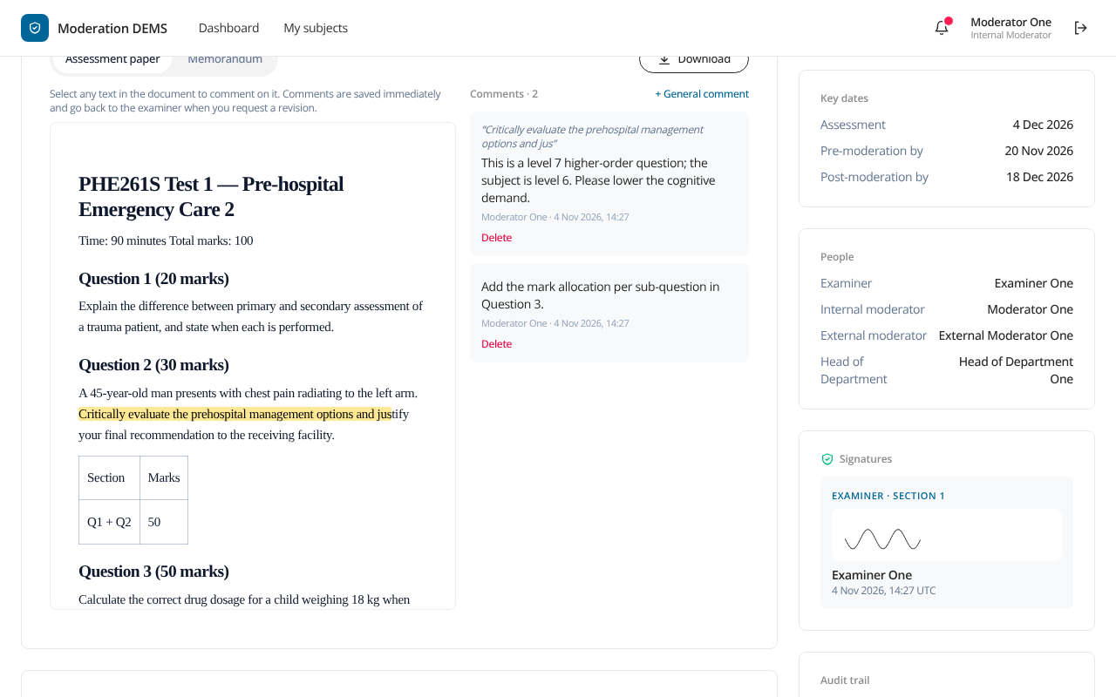
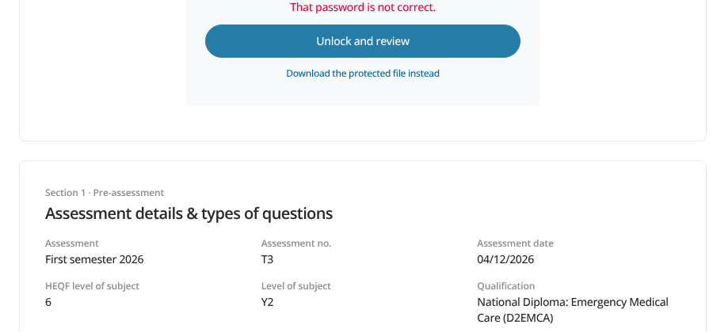
INTERNAL MODERATOR
Gate 1: reviewing the paper in the browser
Select text, add a comment
Comments return to the examiner
Protected Word papers unlock in your browser
Digital Examination Moderation System · Cape Peninsula University of Technology
10
Notes:
Word papers open in the page. Select text to comment on it. Comments are saved at once and go back to the examiner with a revision request. A password-protected Word file asks for its password and unlocks in the browser only; the password is never sent to the server.

Slide 11
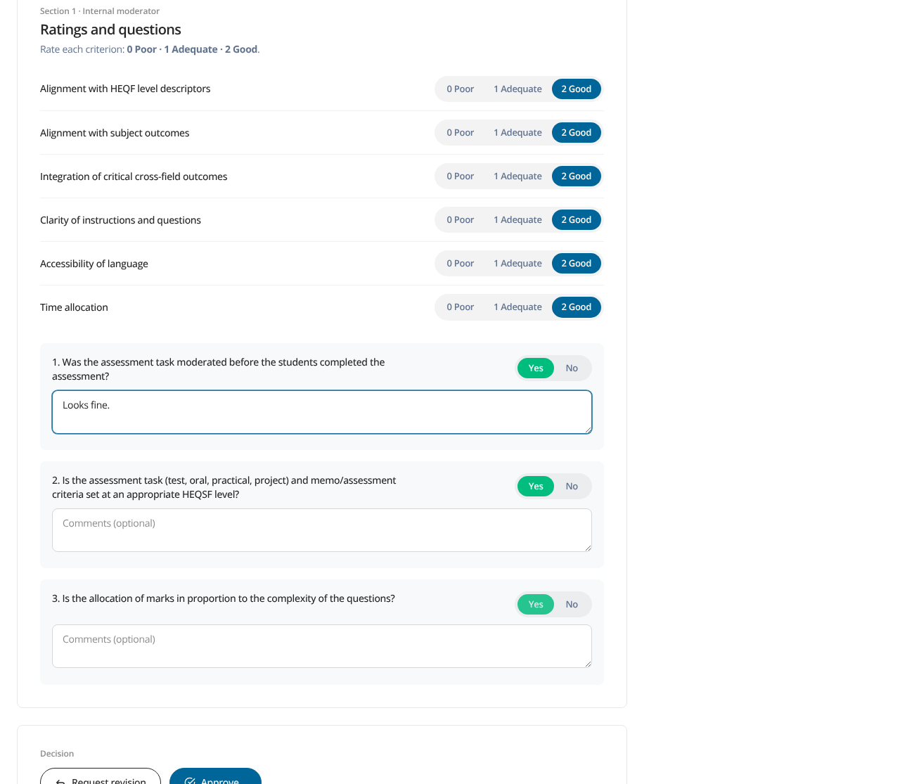
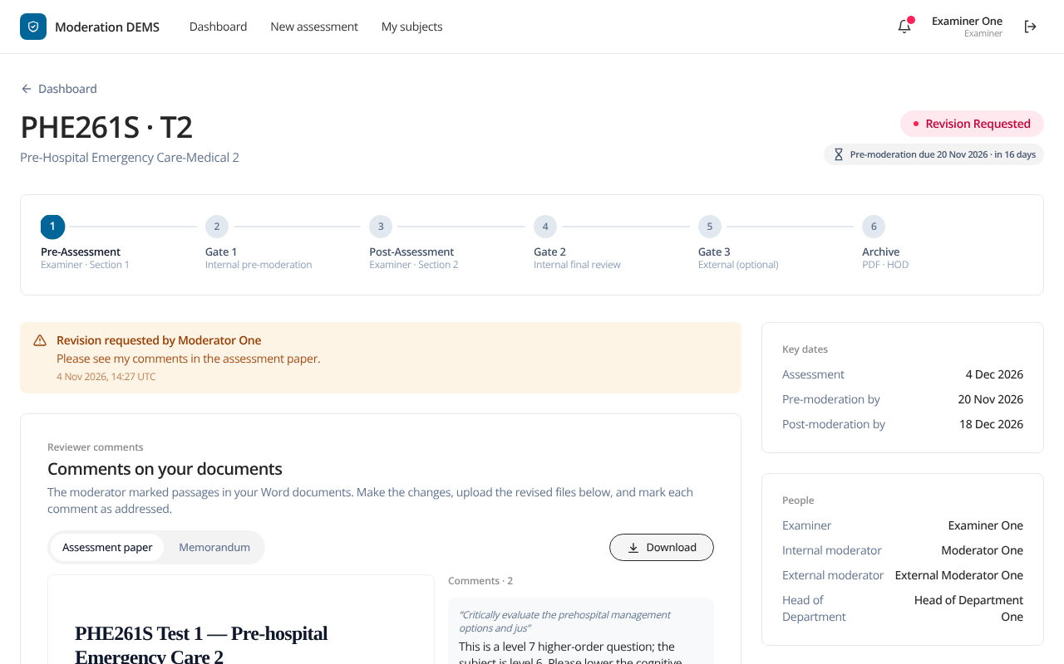
INTERNAL MODERATOR
Gate 1: ratings and decision
Rate six criteria: 0 Poor, 1 Adequate, 2 Good
Request revision, or approve with consensus and signature
Digital Examination Moderation System · Cape Peninsula University of Technology
11
Notes:
The moderator rates the six criteria 0, 1 or 2 and answers three questions. They can send the record back with comments or approve with consensus and a signature.

Slide 12
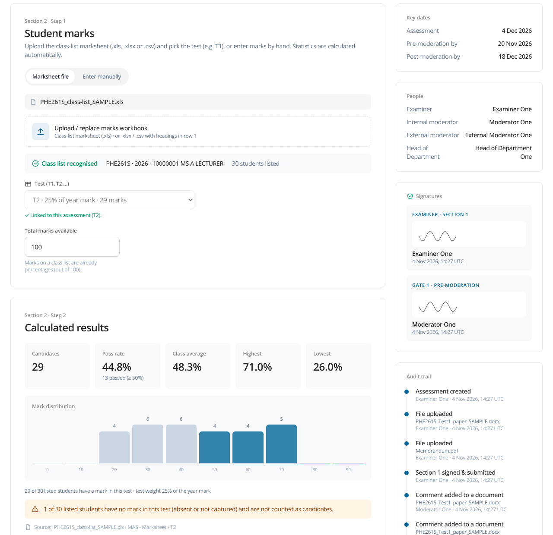
EXAMINER
Section 2: marks and statistics
Upload the class-list marks sheet (.xls, .xlsx or .csv)
The assessment number selects its own column (T2 → T2)
Statistics are calculated automatically
Registered and absent numbers, then five short questions
Sign and submit for final moderation
Digital Examination Moderation System · Cape Peninsula University of Technology
12
Notes:
The examiner uploads the class list. The assessment number picks the matching column: T2 uses column T2. Pass rate, average and the distribution are calculated automatically. Absent is worked out from the registered number.

Slide 13
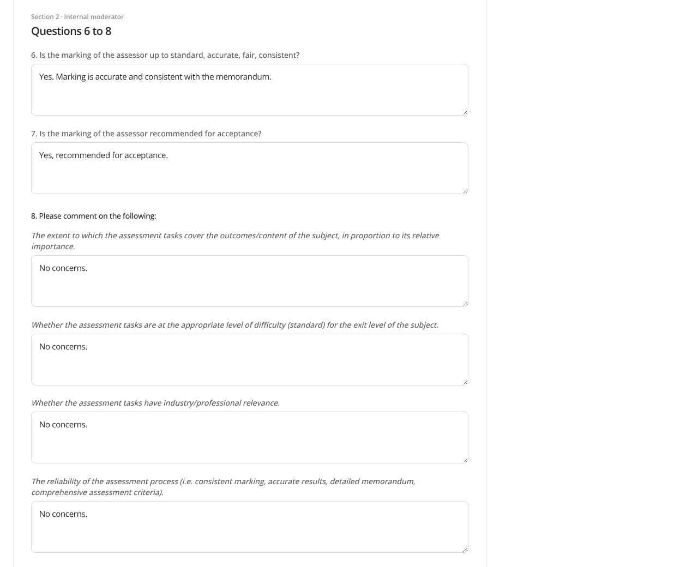
INTERNAL MODERATOR
Gate 2: final review
Answers to Section 2 questions 6–8
Comments on coverage, difficulty, reliability, validity
Any adjustment of marks recommended
Consensus and signature
Completes the record when there is no external moderator
Digital Examination Moderation System · Cape Peninsula University of Technology
13
Notes:
The moderator checks the results, answers questions 6 to 8 and comments on the items, notes any mark adjustment, and signs. If there is no external moderator the record completes here.

Slide 14
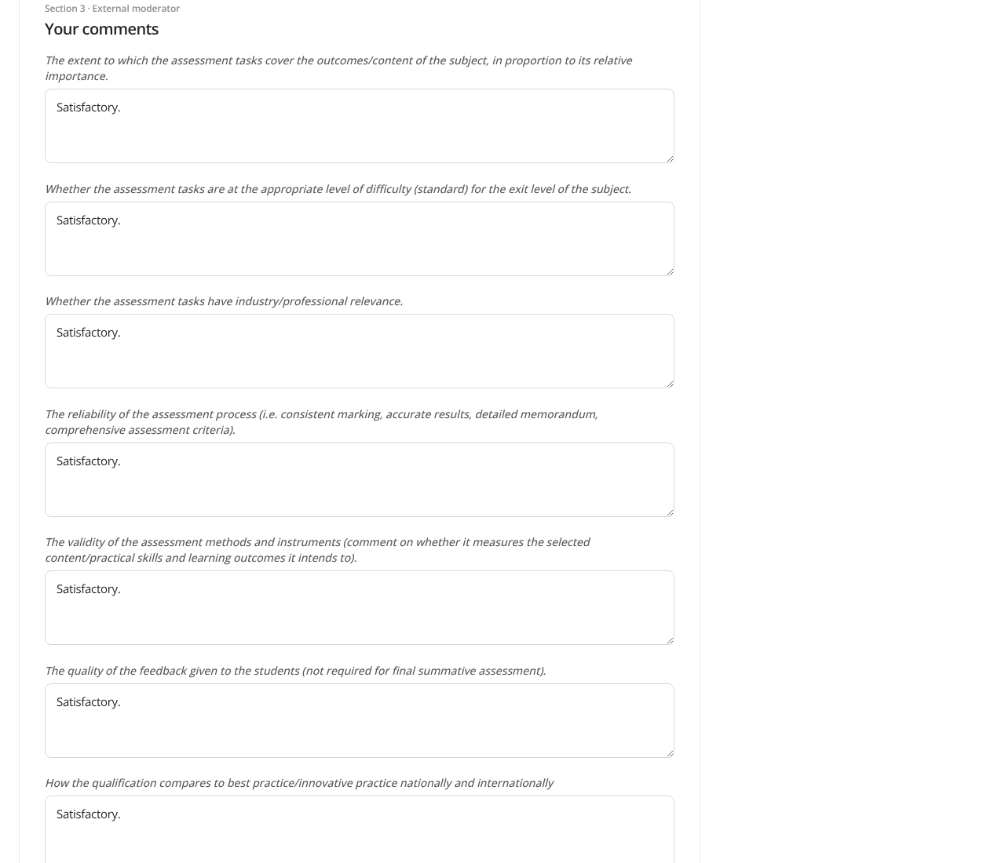
EXTERNAL MODERATOR
External moderator: Section 3
Visible only after the internal moderator’s final sign-off
Comments on standards and best practice
Recommendations and any mark adjustment
Signs Section 3
Digital Examination Moderation System · Cape Peninsula University of Technology
14
Notes:
The external moderator only sees the record once Gate 2 is signed. They complete Section 3 and sign.

Slide 15
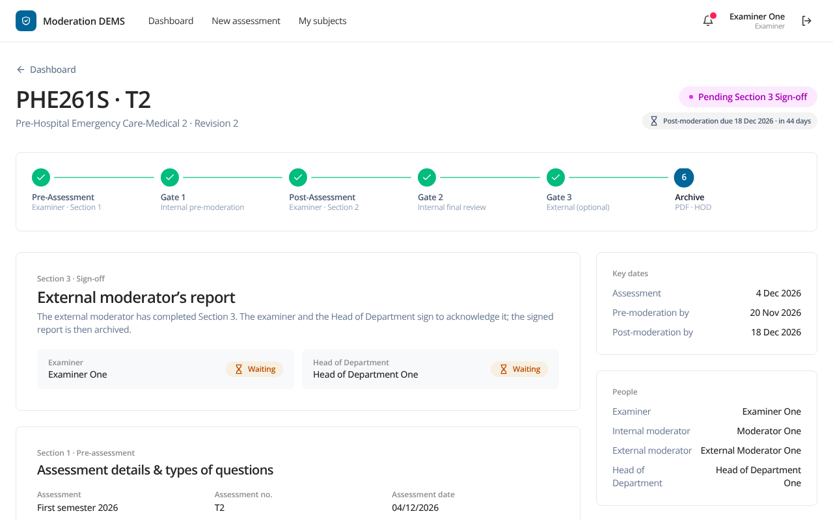
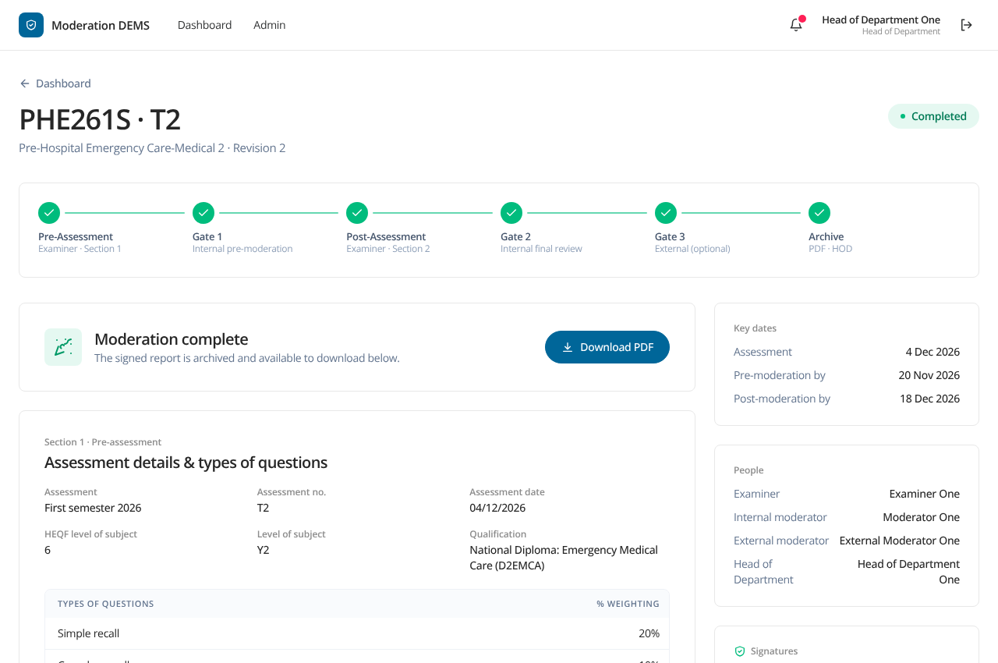
EXAMINER AND HEAD OF DEPARTMENT
Sign-off and completion
The examiner and the Head of Department sign Section 3 (the same person signs twice if they hold both roles)
The last signature completes and archives the record; the signed PDF can be downloaded
Digital Examination Moderation System · Cape Peninsula University of Technology
15
Notes:
With an external moderator, the examiner and the Head of Department both sign Section 3. The last signature completes the record and generates the PDF.

Slide 16
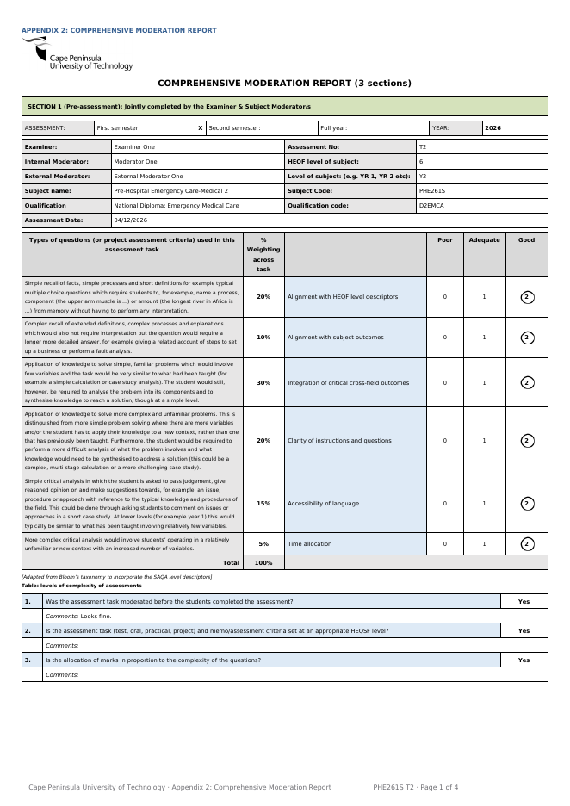
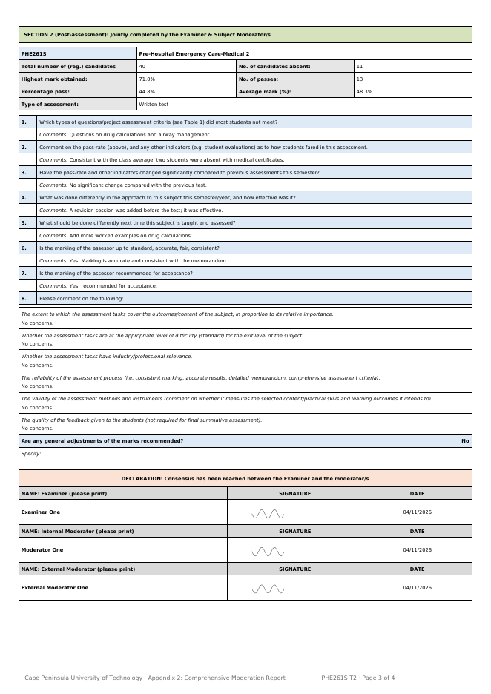
APPENDIX 2
The final report: the official CPUT form
Same layout as the official Appendix 2
Chosen ratings circled, as on paper
Signatures of everyone who signed
Document fingerprints and an audit reference
Downloadable from the record by those involved
Digital Examination Moderation System · Cape Peninsula University of Technology
16
Notes:
The PDF reproduces the official Comprehensive Moderation Report: assessment details, the six question types with the chosen rating circled, Sections 1 to 3, adjustments and signatures.

Slide 17
TRUST
Safe by design
Who can see what
Signing
Audit
A record is visible only to its examiner, internal moderator and subject HOD
The external moderator sees it after Gate 2
Staff registrations are approved by the HOD
Drawn signature plus password at every sign-off
A signature is tied to the exact content signed
Passwords can be changed by each person
Every action is logged with time and person
The log is chained so edits are detectable
Uploaded files are fingerprinted
Every sign-off asks for the drawn signature and the password again: nobody can sign for someone else.
Digital Examination Moderation System · Cape Peninsula University of Technology
17
Notes:
Every sign-off needs the drawn signature and the password. Every action is recorded in a tamper-evident trail. Only the people involved can see a record.

Slide 18
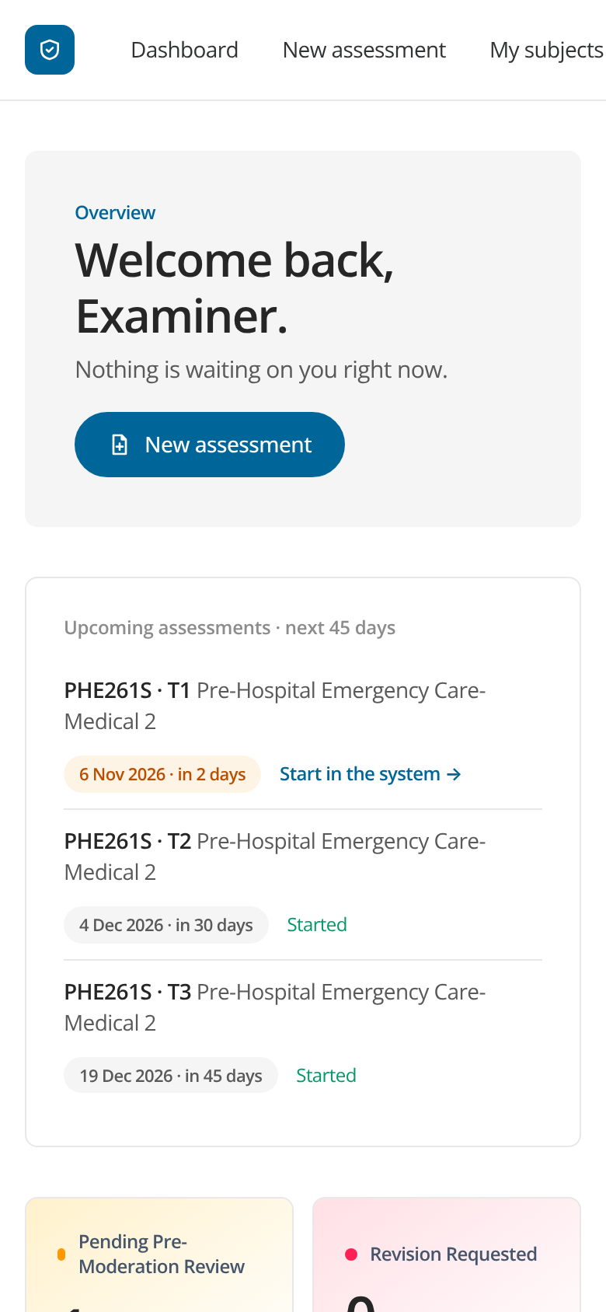
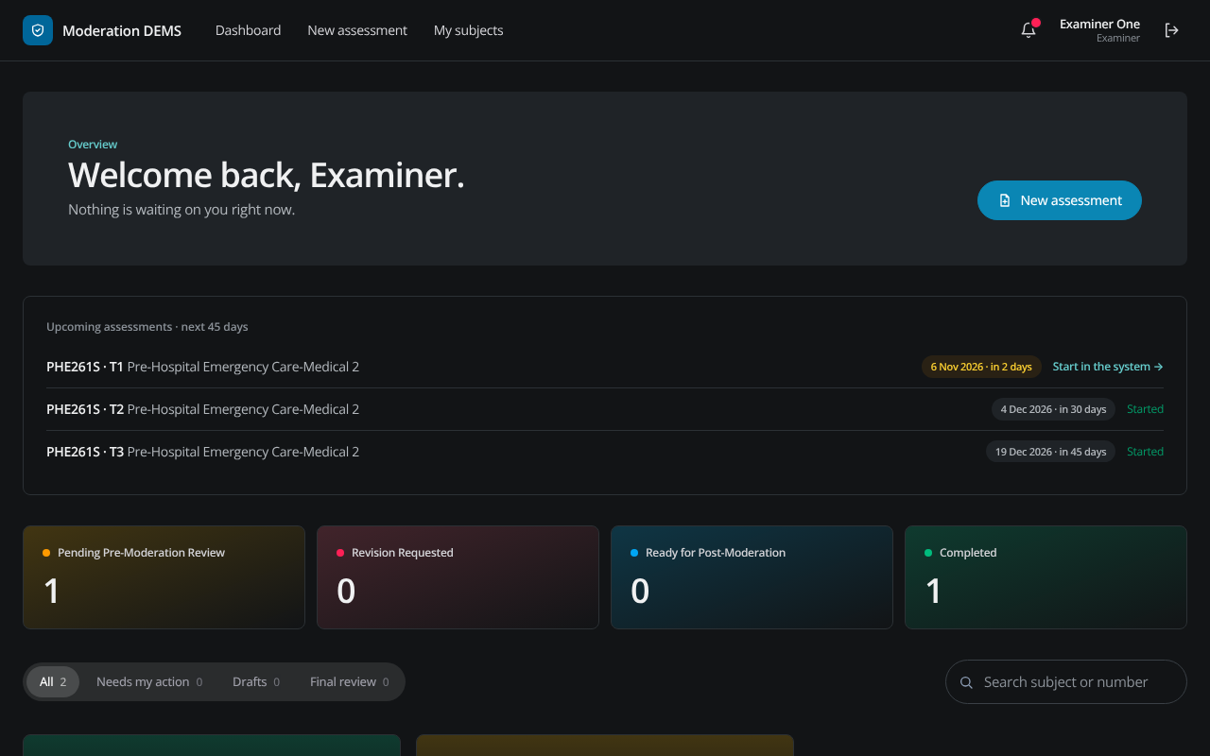
ACCESS
Works on any device
Phone, tablet or computer
Light and dark themes
No software to install
Dark mode
Phone
Digital Examination Moderation System · Cape Peninsula University of Technology
18
Notes:
The site works on phones and tablets and follows the device's light or dark setting.

Slide 19
ROADMAP
What comes next
Under consideration
Your feedback shapes this
An optional AI check of the question paper against the Section 1 criteria (advisory only; needs a confidentiality decision first)
E-mail notifications in addition to in-app reminders
Linking supplementary assessments to the test they replace
What is confusing or slow?
What is missing from the form?
Which reports would you like to see?
Digital Examination Moderation System · Cape Peninsula University of Technology
19
Notes:
These are ideas, not promises. The AI paper check is only a plan so far; it needs a confidentiality decision first. We want your feedback to set priorities.

Slide 20
NEXT STEPS
Getting started: your checklist
1. Register on the site and wait for approval
2. Open My subjects: tick your subjects
3. Enter your test dates and your usual moderator
4. Start each assessment when you are ready, with the right date
5. Follow the prompts; the dashboard shows whose turn it is
Site
[Site address]
Questions and support
[Name, e-mail, phone]
Thank you. Questions?
Digital Examination Moderation System · Cape Peninsula University of Technology
20
Notes:
Close with the five steps and the support contact. Fill in the placeholders before presenting.

