Slide 1
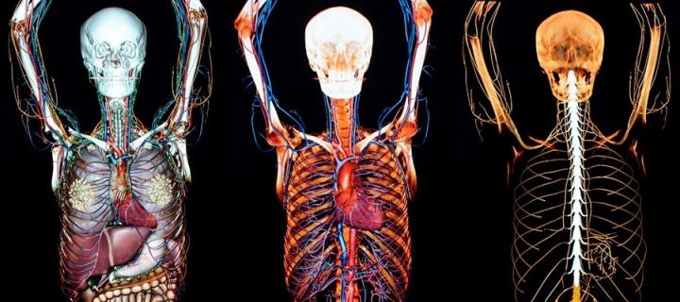

The Anatomy of a Function Call
Dan Maxwell, PhD

Slide 2
The Anatomy of a Function Call
“You can think of a function as a small program inside a program. The basic idea of a function is that we write a sequence of statements and give that sequence a name. The instructions can then be executed at any point in the program by referring to the function name…
When a function is subsequently used in a program, we say that the definition is called or invoked.”
John Zelle

