Slide 1
Implementing BRAHMA: A Loop-Free Program Synthesizer

Slide 2
Outline
Overview
Implementation
results
Advantage over 3 PS Dimentions
Building 4 main components
Cegis-based Algorithm
Working with Z3
Future Intentions
Any Questions?

Slide 3
Brahma Pros over 3 PS Dimensions
Motivation
Behavioral
Constraints
Structural
Constraints
Search
Strategies
Using base components:
Useful for hardware developers
Scalable verification of modular-designed systems
Program is correct by construction

Slide 4


Brahma Pros over 3 PS Dimensions
Motivation
Behavioral
Constraints
Structural
Constraints
Search
Strategies
Bitvector programs:
Hard to discover; even for experts
Can reduce vulnerability in software:
$$(x+y)/2$$
$$\left(x | y\right)−(\left(x⊕y\right)≫1)$$
Sensitive to overflow!

Slide 5
Brahma Pros over 3 PS Dimensions
Motivation
Behavioral
Constraints
Structural
Constraints
Search
Strategies
Leveraging constraint-based search:
Way much better than enumerative search
Exploitation of the SAT and SMT solvers strength

Slide 6











Building the constraints (An Example)
Methods
$$^$$
$$($$
$$^$$
$$→$$
$${\text{φ}}_{spec}(\vec{I}, O)$$
$$)$$
$${\text{ψ}}_{wfp}(L)$$
$${\text{φ}}_{lib}(T)$$
$${\text{ψ}}_{conn}(\vec{I}, O, T, L)$$
P1(x) : Turn-off the rightmost 1 bit
$$0011100$$
$$0011000$$

Slide 7
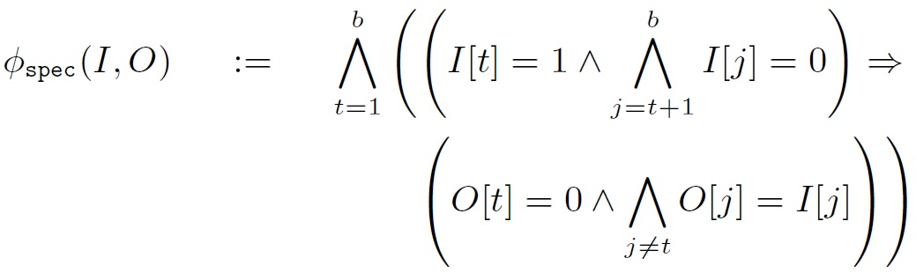

Building the constraints (An Example)
Methods
$$^$$
$$($$
$$^$$
$$→$$
$${\text{φ}}_{spec}(\vec{I}, O)$$
$$)$$
$${\text{ψ}}_{wfp}(L)$$
$${\text{φ}}_{lib}(T)$$
$${\text{ψ}}_{conn}(\vec{I}, O, T, L)$$

Slide 8
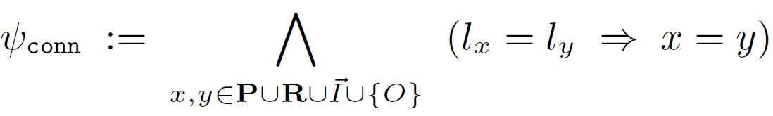

Building the constraints (An Example)
Methods
$$^$$
$$($$
$$^$$
$$→$$
$${\text{φ}}_{spec}(\vec{I}, O)$$
$$)$$
$${\text{ψ}}_{wfp}(L)$$
$${\text{φ}}_{lib}(T)$$
$${\text{ψ}}_{conn}(\vec{I}, O, T, L)$$

Slide 9

Building the constraints (An Example)
Methods
$$^$$
$$($$
$$^$$
$$→$$
$${\text{φ}}_{spec}(\vec{I}, O)$$
$$)$$
$${\text{ψ}}_{wfp}(L)$$
$${\text{φ}}_{lib}(T)$$
$${\text{ψ}}_{conn}(\vec{I}, O, T, L)$$

Slide 10
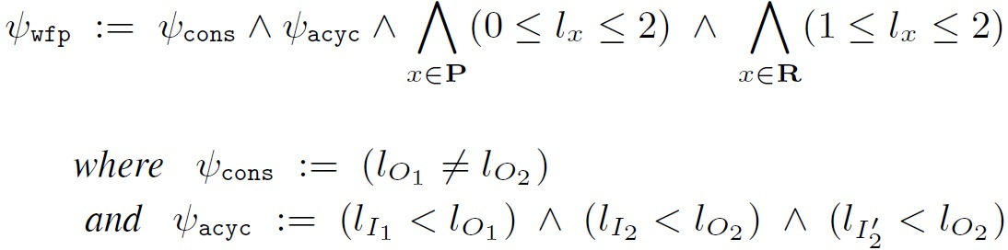

Building the constraints (An Example)
Methods
$$^$$
$$($$
$$^$$
$$→$$
$${\text{φ}}_{spec}(\vec{I}, O)$$
$$)$$
$${\text{ψ}}_{wfp}(L)$$
$${\text{φ}}_{lib}(T)$$
$${\text{ψ}}_{conn}(\vec{I}, O, T, L)$$

Slide 11
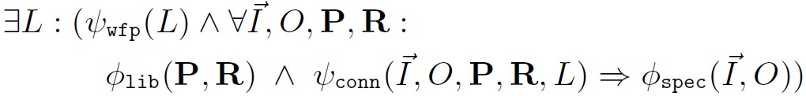
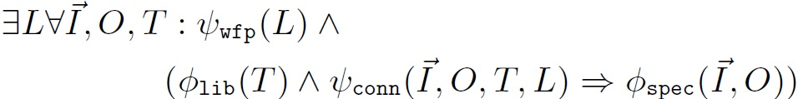
Building the constraints (An Example)
Methods
$$^$$
$$($$
$$^$$
$$→$$
$${\text{φ}}_{spec}(\vec{I}, O)$$
$$)$$
$${\text{ψ}}_{wfp}(L)$$
$${\text{φ}}_{lib}(T)$$
$${\text{ψ}}_{conn}(\vec{I}, O, T, L)$$

Slide 12
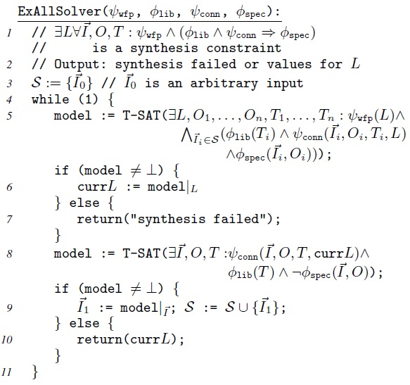
Iterating Through Inputs (Cegis-Based Algorithm)
Methods

Slide 13
OUR WORKS…
Intentions

Slide 14
OUR WORKS…
Intentions

Slide 15
EXAMPLE:
results
Synthesis_Phase_1 Verification_Phase_1
Spec: out == (in | in+1)
X
X
X
X
X
X
ADD
INC
OR
X
INPUT
OUTPUT
X
X
X

Slide 16
EXAMPLE:
results
Synthesis_Phase_1 Verification_Phase_1
Spec: out == (in | in+1)
0
0
0
0
0
0
ADD
INC
OR
0
INPUT
OUTPUT
1
2
3

Slide 17
EXAMPLE:
results
Synthesis_Phase_1 Verification_Phase_1
Spec: out == (in | in+1)
Counter_Examples:
127 → 255
127 → 127
0
0
0
0
0
0
ADD
INC
OR
0
INPUT
OUTPUT
1
2
3

Slide 18
EXAMPLE:
results
Synthesis_Phase_2 Verification_Phase_2
Spec: out == (in | in+1)
Counter_Examples:
127 → 255
0
1
0
1
1
0
ADD
INC
OR
2
INPUT
OUTPUT
2
1
3

Slide 19
EXAMPLE:
results
Synthesis_Phase_2 Verification_Phase_2
Spec: out == (in | in+1)
Counter_Examples:
127 → 255
65 → 67
65 → 131
0
1
0
1
1
0
ADD
INC
OR
2
INPUT
OUTPUT
2
1
3

Slide 20
EXAMPLE:
results
Synthesis_Phase_3 Verification_Phase_3
Spec: out == (in | in+1)
Counter_Examples:
127 → 255
65 → 67
0
1
0
0
1
0
ADD
INC
OR
3
INPUT
OUTPUT
2
1
3

Slide 21
EXAMPLE:
results
Synthesis_Phase_3 Verification_Phase_3
Spec: out == (in | in+1)
Counter_Examples:
127 → 255
65 → 67
0
1
0
0
1
0
ADD
INC
OR
3
INPUT
OUTPUT
2
1
3

Slide 22
EXAMPLE:
results
Synthesis_Phase_3 Verification_Phase_3
Succeed
Spec: out == (in | in+1)
Counter_Examples:
127 → 255
65 → 67
0
1
0
0
1
0
ADD
INC
OR
3
INPUT
OUTPUT
2
1
3

Slide 23
EXAMPLE:
results
Spec: out == in_0 +2*in_1
def f(x0, x1):
v0 = ~x1
v1 = -((unsigned)x0 > (unsigned)x0)
v3 = v1 | x0
v4 = v3 - v0
v5 = 104
v9 = x1 - 1
v10 = v9 + v4
v11 = -((unsigned)v0 <= (unsigned)x1)
v12 = v5 ? v10 : v11
return v12

Slide 24
EXAMPLE: just two ADD function
results
Spec: out == in_0 +2*in_1
def f(x0, x1):
v0 = x1 + x1
v1 = x0 + v0
return v1

Slide 25
EXAMPLE: just and & or function
results
Spec: out == in_0 +2*in_1
def f(x0, x1):
v0 = x1 + x1
v1 = x0 + v0
return v1

