Slide 1

Computer Network
Project
Blockchain over a peer to peer network
Chimezirim Victor EKEMAM
Ignas BARAKAUSKAS
Soumya KUMBAR
Sara Assefa ALEMAYEHU
Date:24/03/2022

Slide 2
Part 1: The Project

Slide 3
Objective Of The Project:
Our goal was to implement a blockchain peer to peer system inspired by Bitcoin.
Tracker: Maintains an updated peers list and uses a multithreading approach to communicate with connected peers.
Peers: network of nodes generating transactions, mining blocks, saving and sharing all of these among themselves.
Cheesechain: growing list of records.

Slide 4
Cheesechain
Implemented in python (Good performance, large ecosystem and resources)
Adopted MVC Architecture
Used Flask server for handling our controllers
Served A GUI via our Peer node (Flask server) for easy visualization and testing
Adopted OOP principles for code readability, scalabilty and abstraction

Slide 5
Peer to Peer networking system
Implemented in python (Good performance, large ecosystem and resources)
Adopted MVC Architecture
Implemented a protocol class for requests and response definition and validation
Tracker class handles interactions between tracker and peers
Peer class handles interactions between peers and between tracker and peers.
Build on the principles of OOP

Slide 6
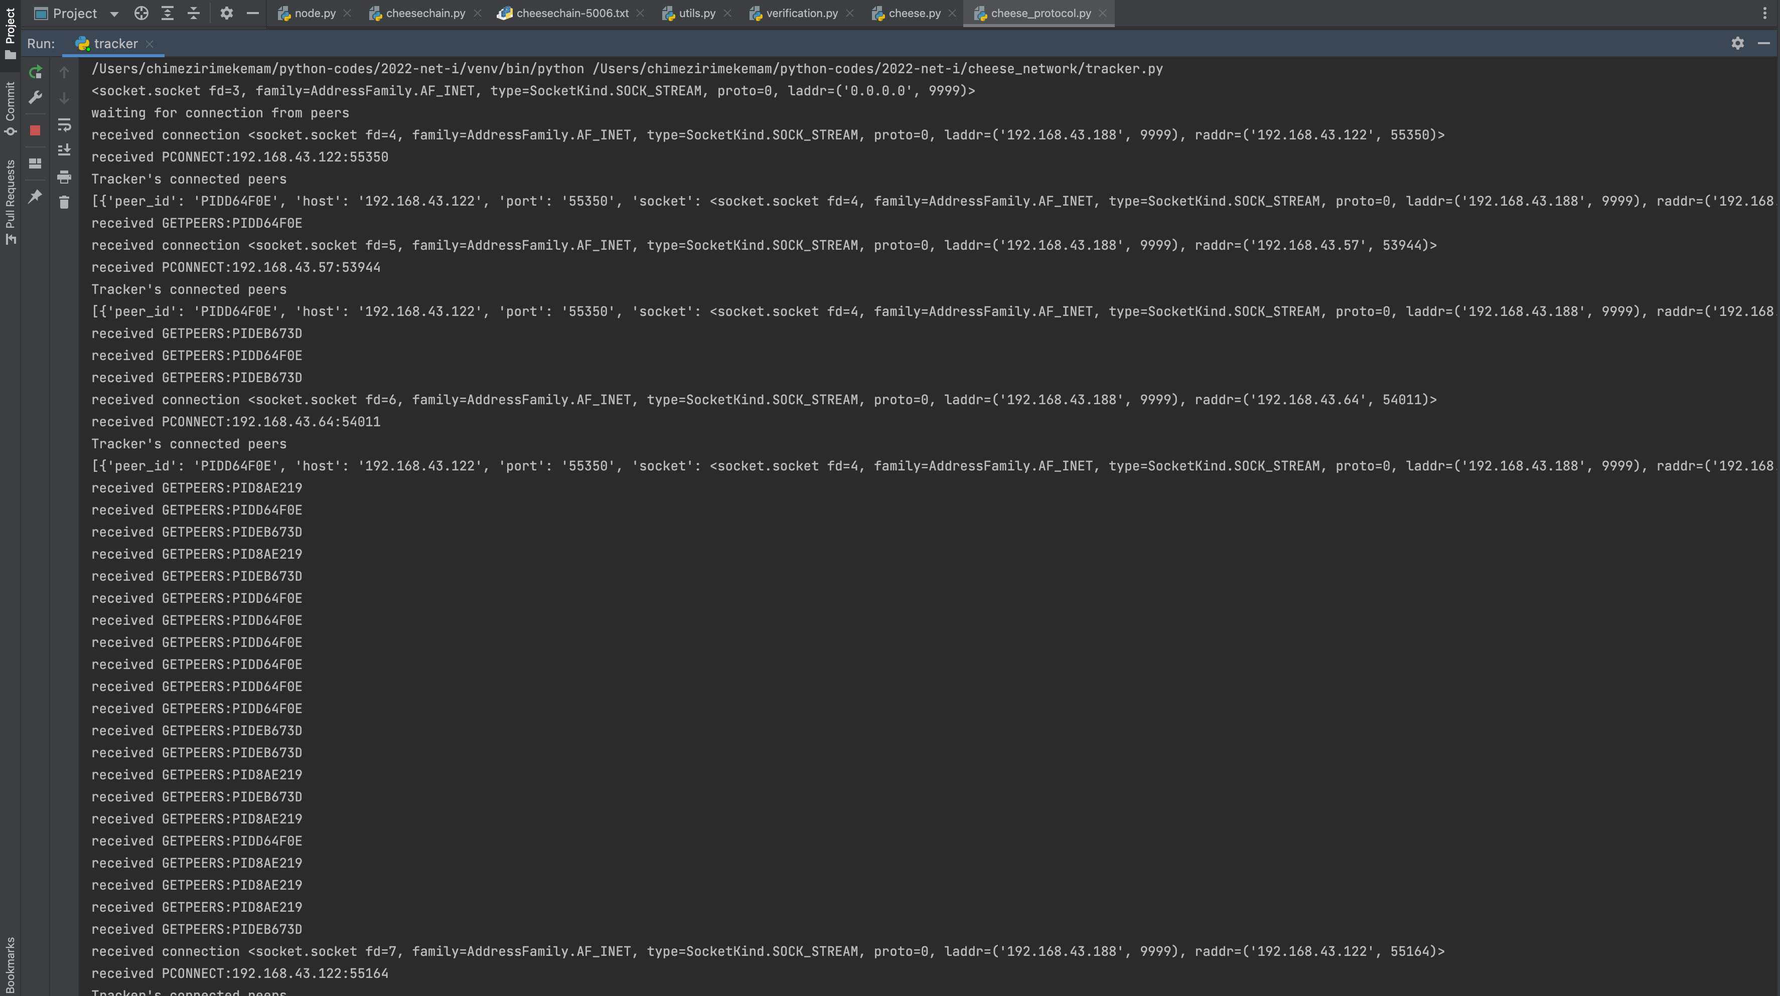
Tracker

Slide 7
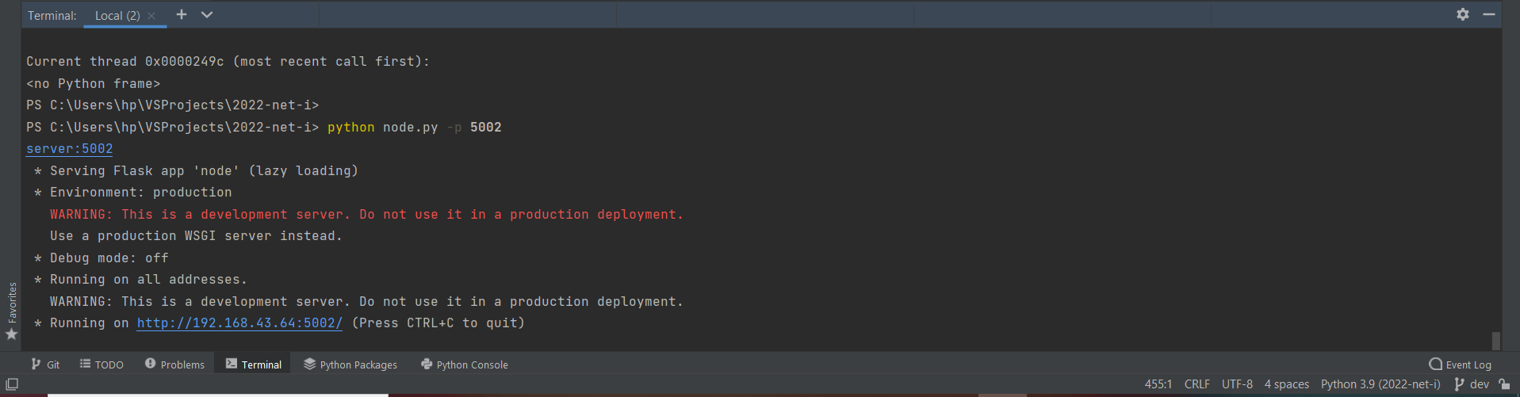
Peer (GUI Server)

Slide 8
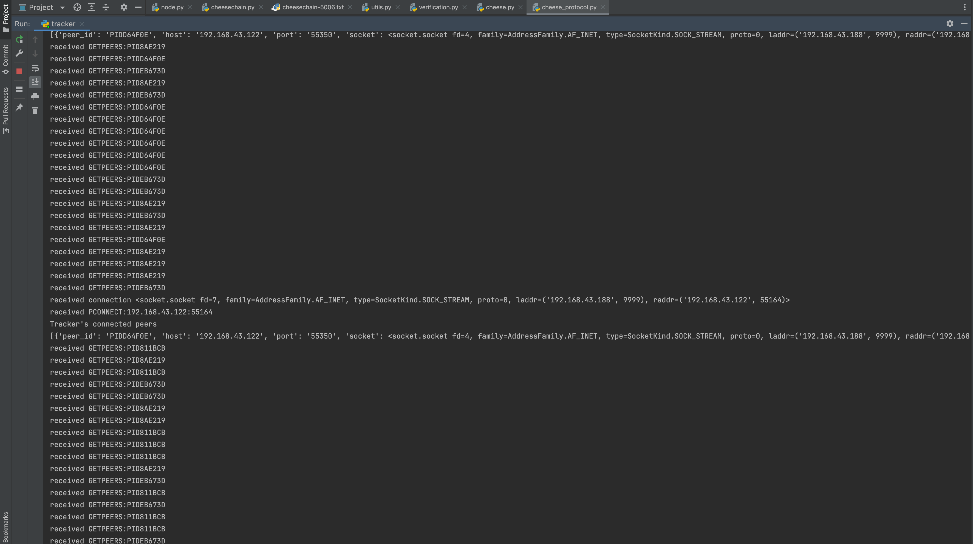
Tracker (Logs)

Slide 9
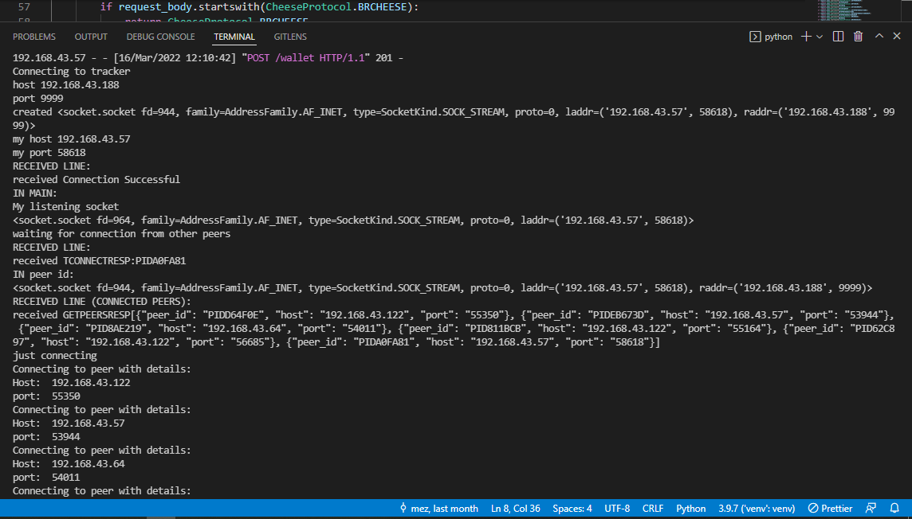
Peer Console:

Slide 10
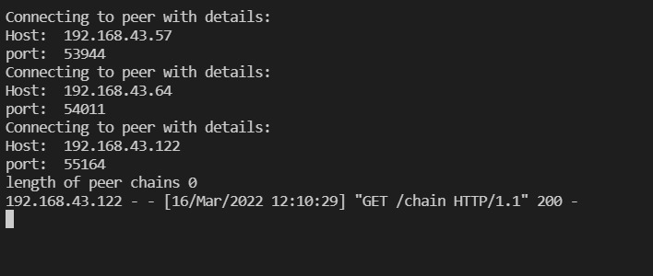
Peer (logs: Connecting to other peers)

Slide 11
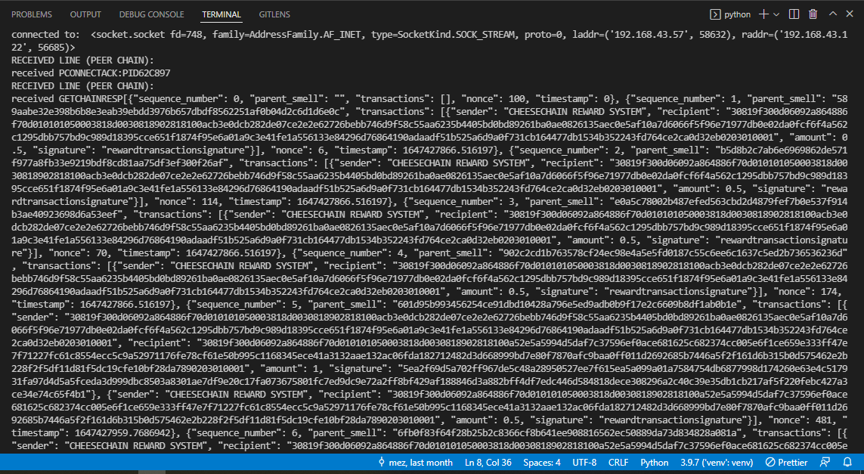
Peer (logs: data exchange)

Slide 12
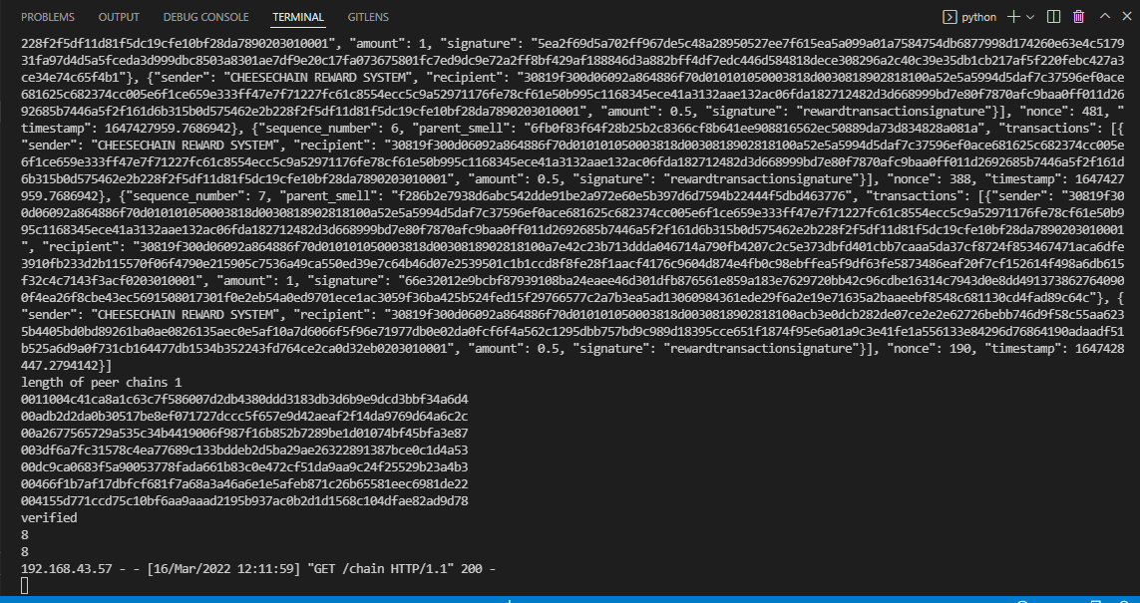
Peer (logs: data exchange)

Slide 13
GUI:
Interface for running and managing a peer
Can create new/load existing wallet
Initiate spinning up a peer node/connect to tracker
load cheesechain and open transactions
create transaction
trigger a mining process

Slide 14
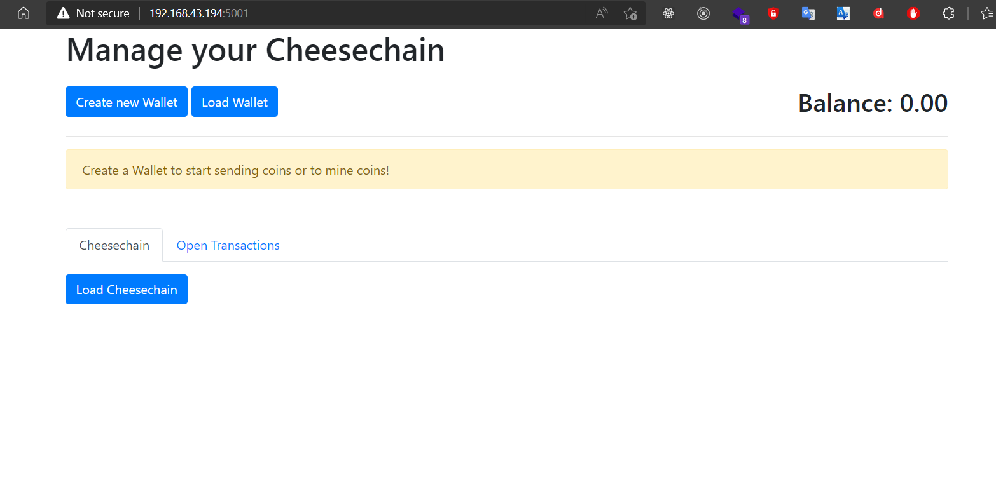
GUI (user journey):

Slide 15
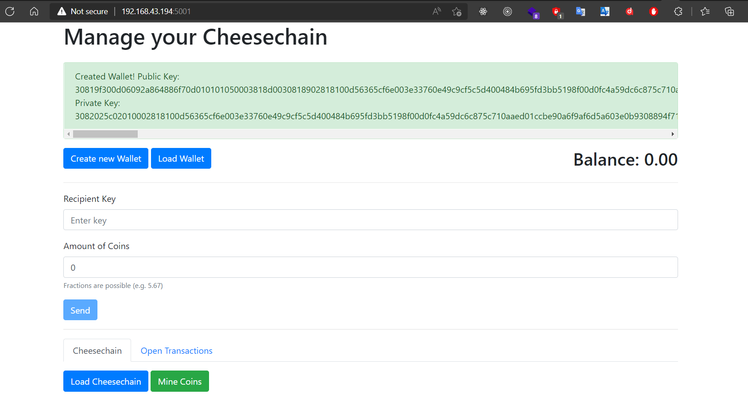
New Wallet Created:

Slide 16
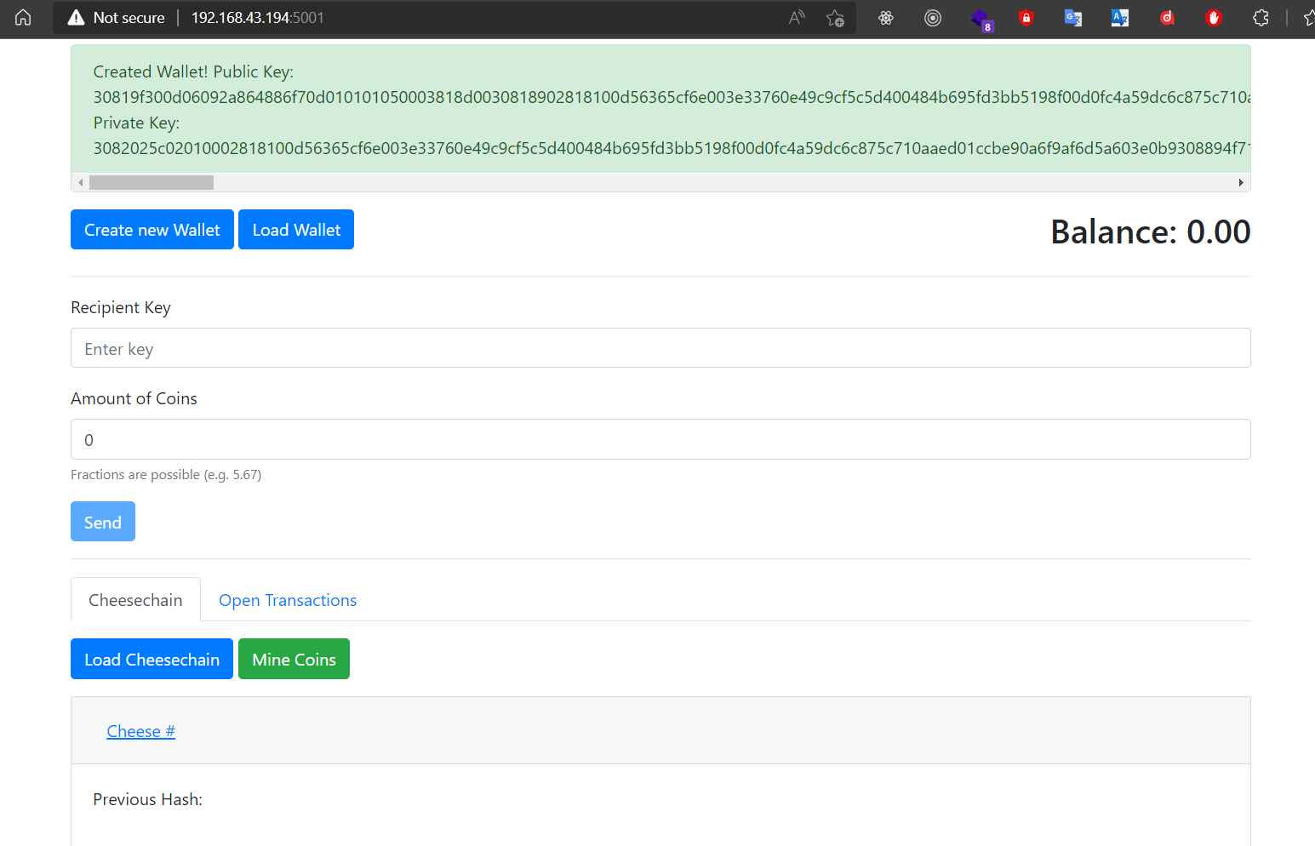
Raclette Cheese:

Slide 17
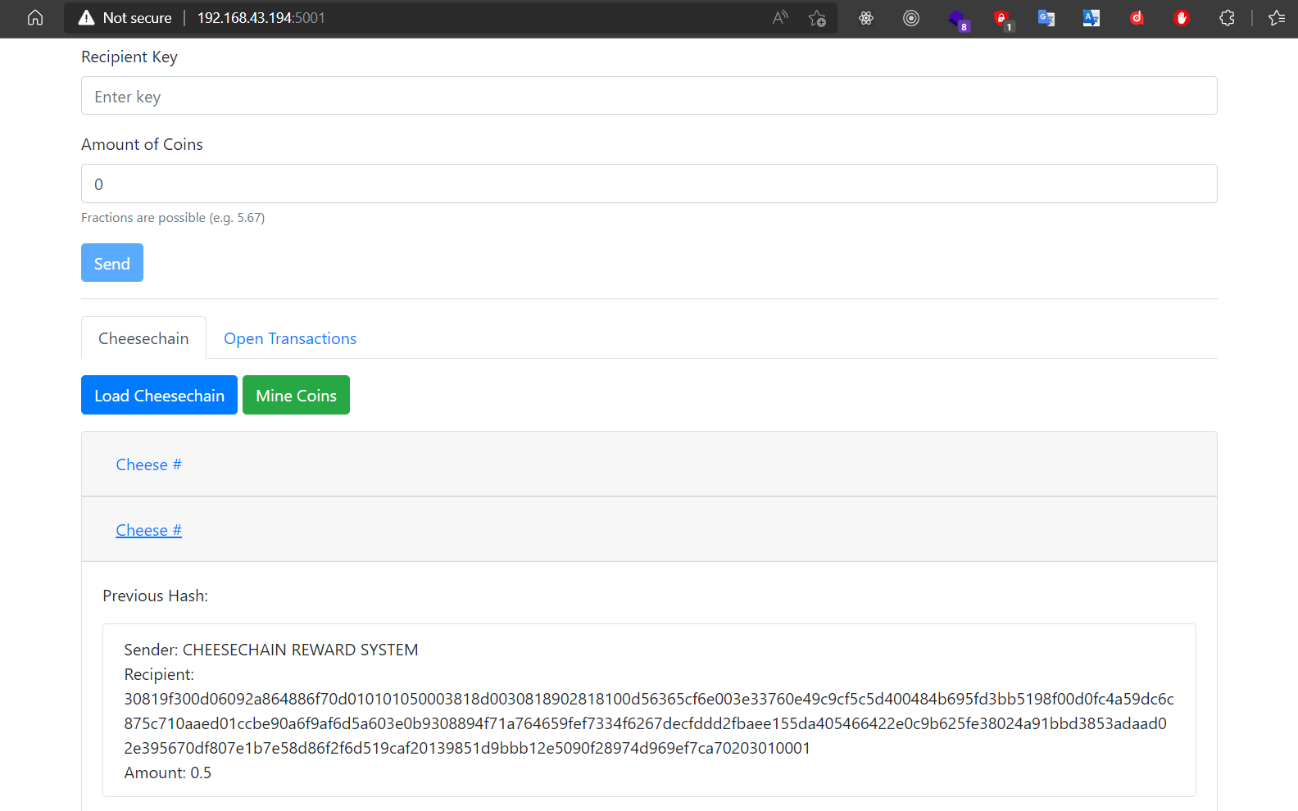
Peer-1 Mines:

Slide 18
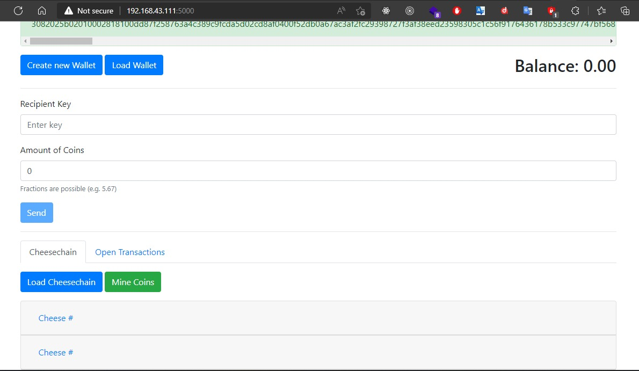
Peer-2 Receives:

Slide 19
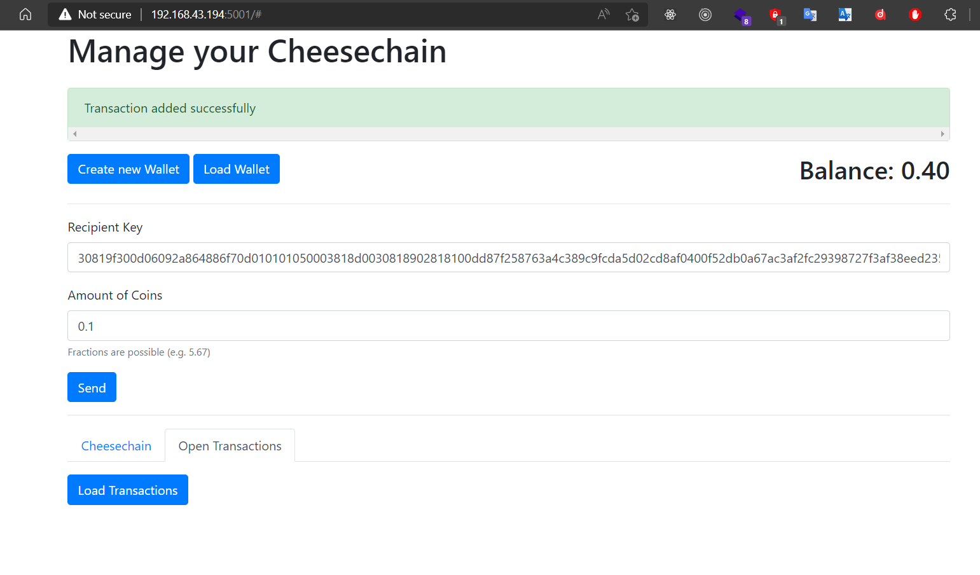
Add Transaction (Peer 1 sends Peer 2 some coins):

Slide 20
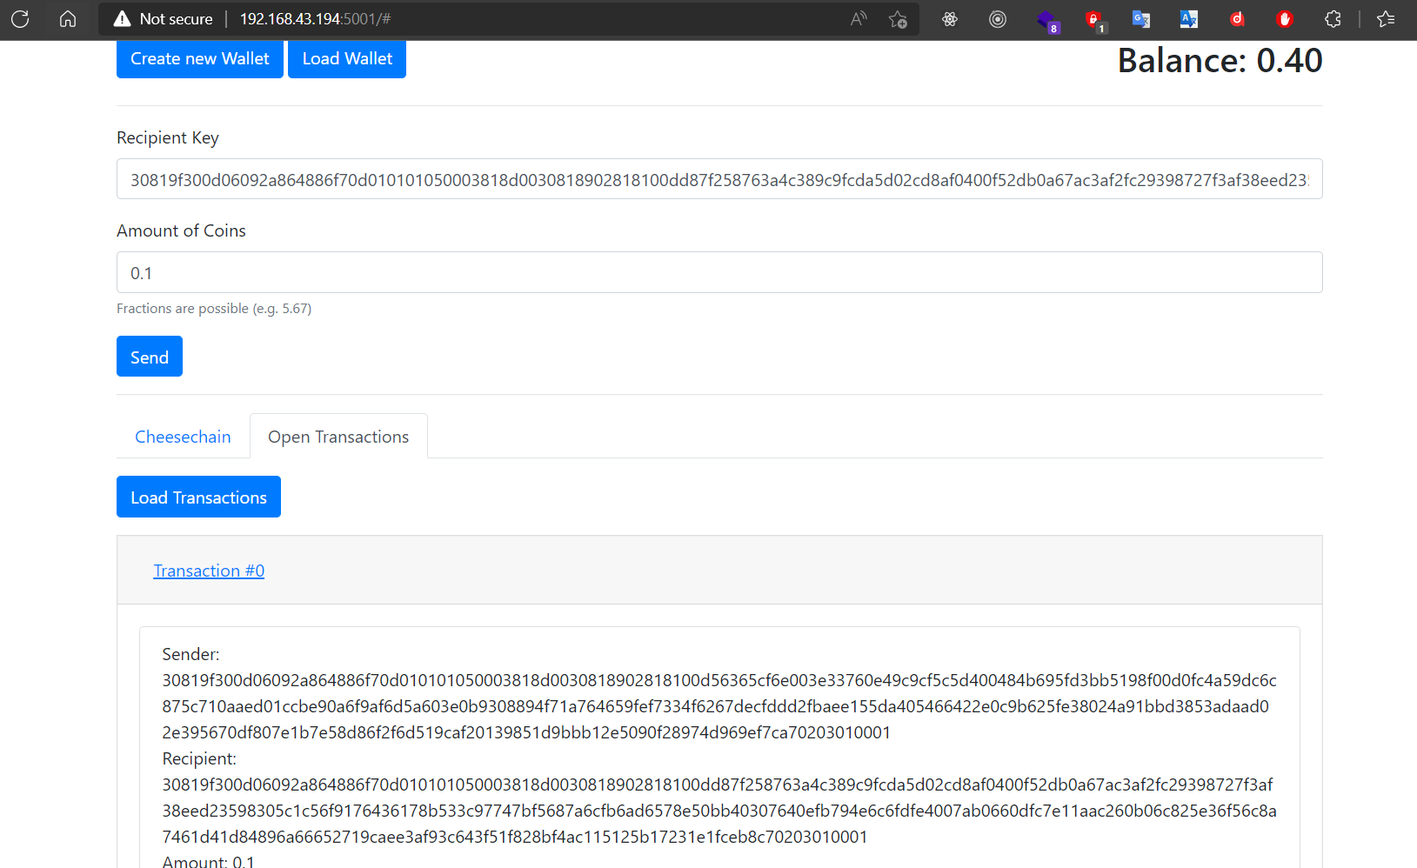
Open Transactions (Transaction Details):

Slide 21
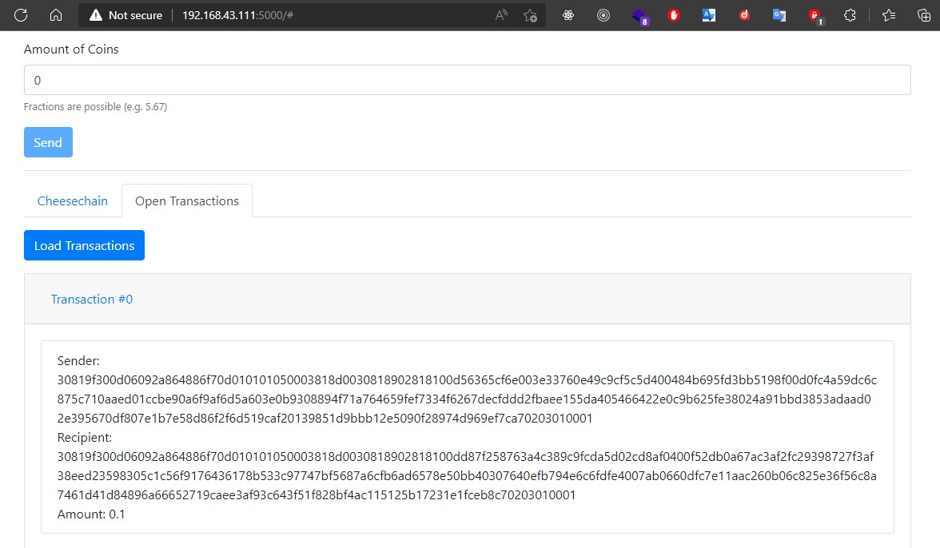
Peer 2 Receives Open transaction(Transaction Details):

Slide 22
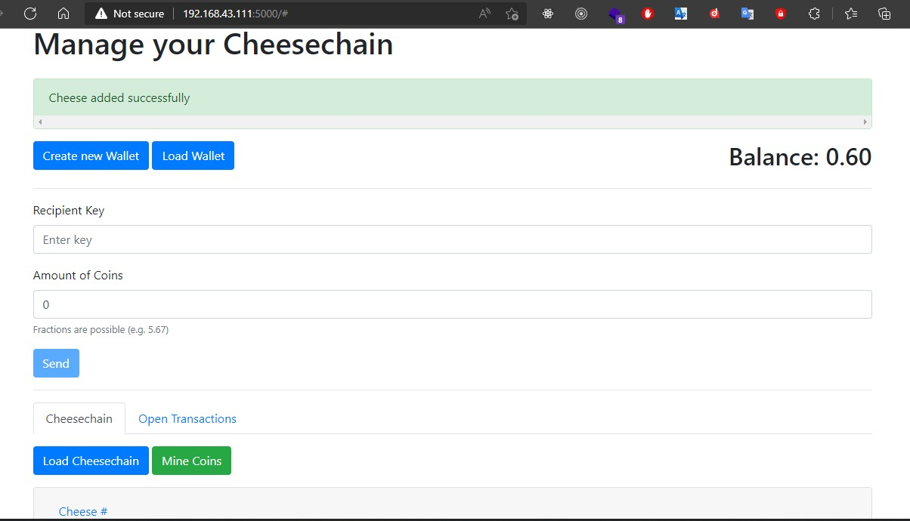
Peer 2 Mines transaction:

Slide 23
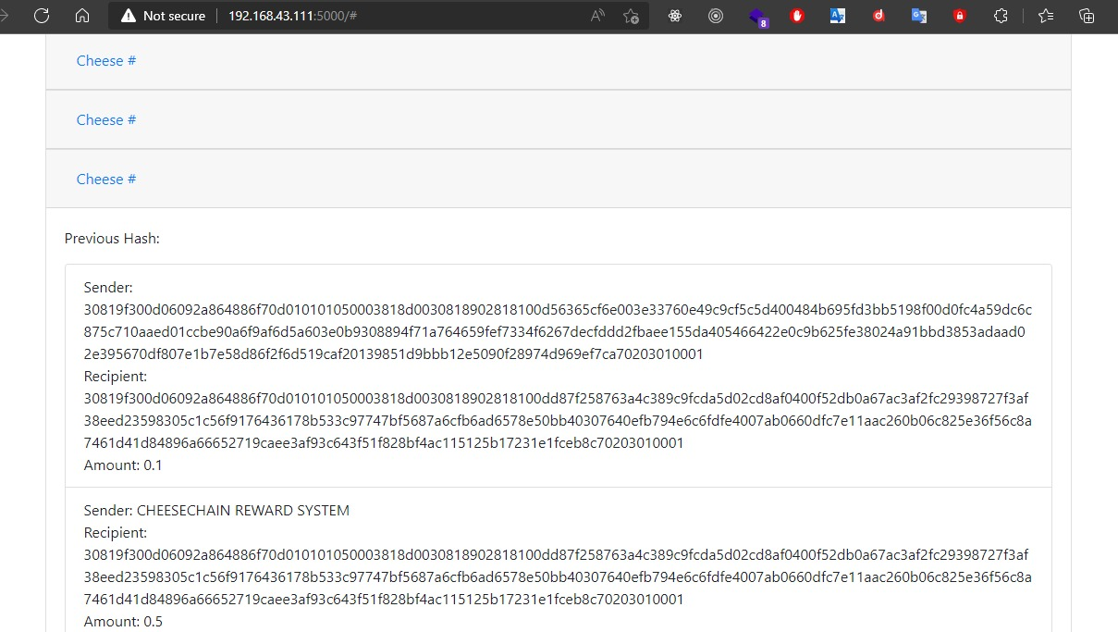
New Cheese Added (Transaction Details):

Slide 24
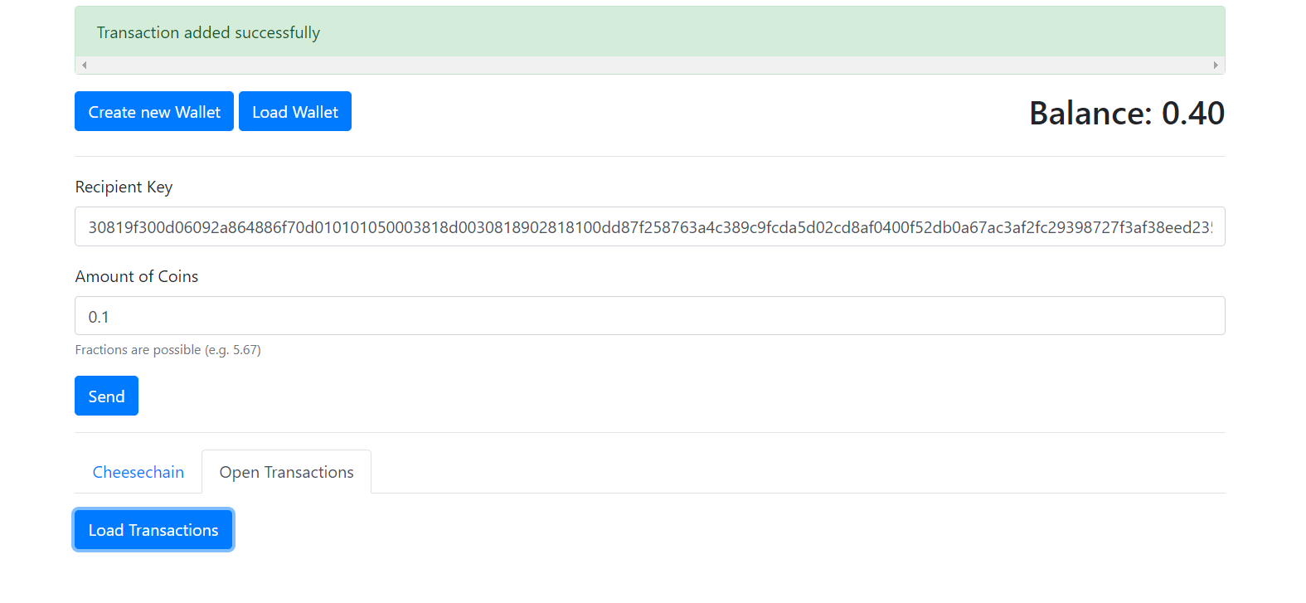
Open Transactions Updated (Peer 1):

Slide 25
DEMO

Slide 26
Part 2: Retrospectives, Evaluation, etc.

Slide 27
Work Done
Team Member | Tasks
Chimezirim Victor EKEMAM | Cheesechain Design and Implementation/GUI, Network Protocol/Tracker & Peer, Integration Testing
Sara Assefa ALEMAYEHU | Cheesechain Debugging and Modification, Documentation (Auto Evaluation, Retrospective), Integration Testing
Ignas BARAKAUSKAS | Cheesechain Debugging and Modifications, Integration Testing, Documentation (Readme.md)
Soumya KUMBAR | Cheesechain Debugging and Modification Unit Testing implementation, Integration Testing

Slide 28
Evaluation
Works Well | Not So Perfect
Tracker: Does the basics, as expected | Some high level exceptions occur in the network communication process which we had not the time to properly handle
Peer: Does the basics, as expected | First peer connected on the network may need to disconnect and reconnect again after other peers may have joined to be able to properly share resources
Cheesechain: Works as it should, always validated, etc. | GUI is not reactive to background changes, so a few clicks a necessary to update data on screen
GUI: Helps in easy visualisation and testing

Slide 29
Retrospectives – Skills/Knowledge gained
Design and implementation network protocols
Understanding of and ability to implement P2P systems
Deep understanding of blockchain technology
Also ability to design an implement solutions on blockchain
Consolidation of skills on concurrent programming and multithreading
Additionally, team collaboration, time management, knowledge sharing

Slide 30
Retrospectives - Issues
Initial design and implementation was challenging
Some high level exceptions were not handled (time factor)
Different level of skillset among team members
Different levels of computing power in different computers in testing (affecting turnaround time)

Slide 31
Retrospectives – Lessons/Takeaways
Early documentation is as important as implementation
Project management tools such as Trello could be beneficial
Always seek help when necessary

Slide 32
THANK YOU!

