Slide 1

Computer Network
Project
Blockchain over a peer to peer network
Chimezirim Victor EKEMAM
Ignas BARAKAUSKAS
Soumya KUMBAR
Sara Assefa ALEMAYEHU
Date:24/03/2022

Slide 2
Blockchain:
Is a digital ledger of transactions maintained by a network of computers in a way that makes it difficult to hack or alter.
The technology offers a secure way for individuals to deal directly with each other.
The growing list of records, called blocks

Slide 3
Peer to Peer networking system:
Is a distributed application architecture that partitions tasks or workloads between peers.
The Cheesecoins network protocol allows full nodes (peers) to collaboratively maintain a peer-to-peer network for block and transaction exchange.
nodes can store the entire blockchain and transactions and serve historical blocks to other nodes.

Slide 4
Objective Of The Project:
Our goal was to implement a blockchain peer to peer system inspired by Bitcoin.
Tracker: Maintains an updated peers list and uses a multithreading approach to communicate with connected peers.
Peers: network of nodes generating transactions, mining blocks, saving and sharing all of these among themselves.
Cheesechain: growing list of records.

Slide 5
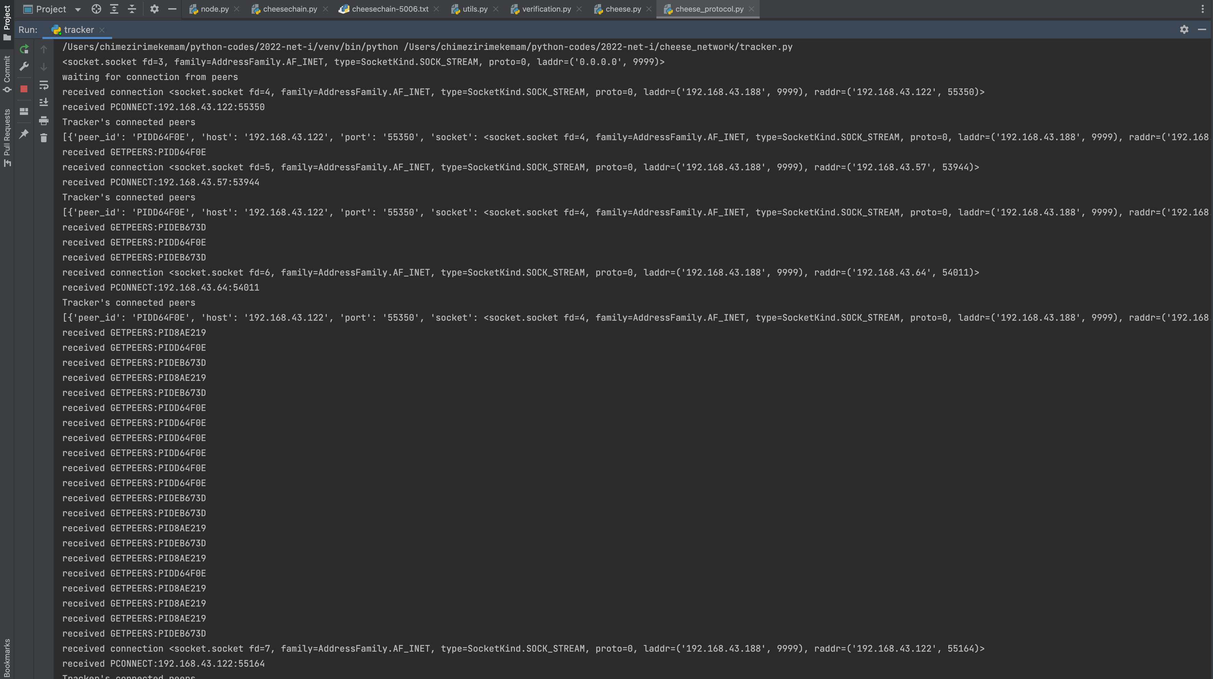
Tracker

Slide 6
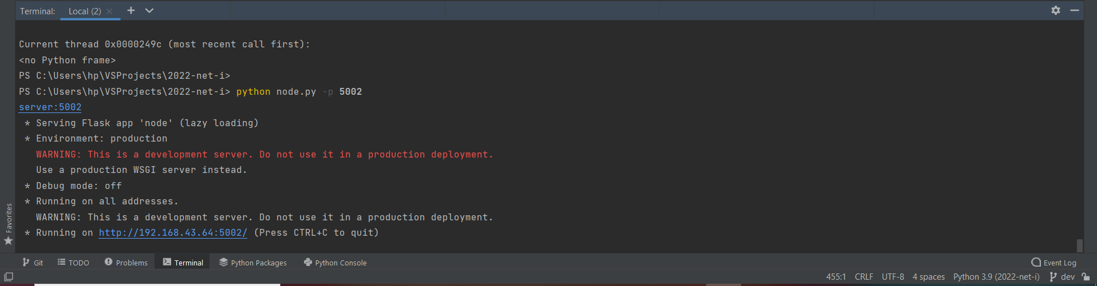
Peer (GUI Server)

Slide 7
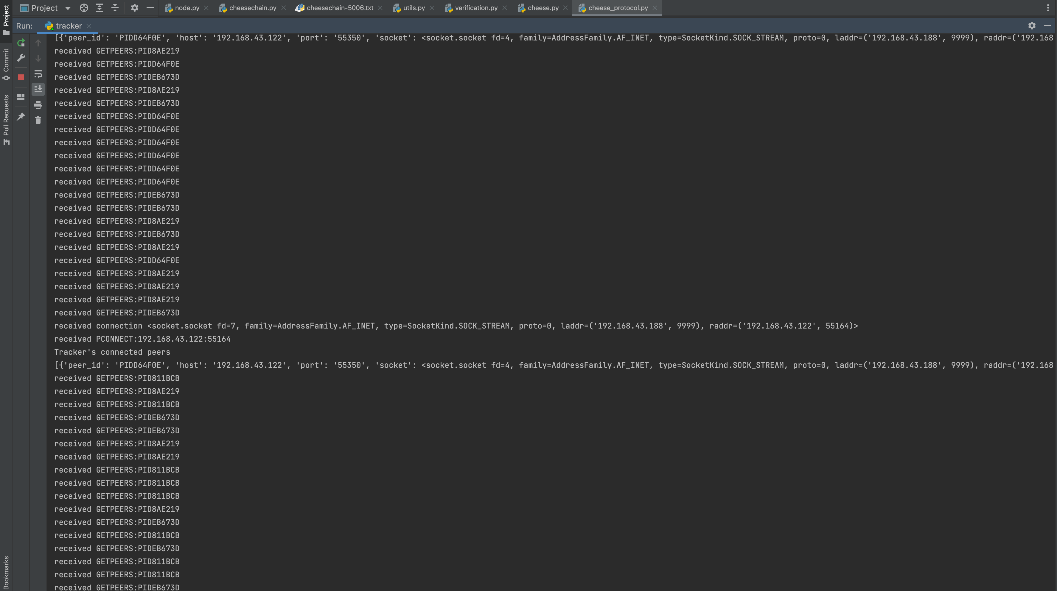
Tracker (Logs)

Slide 8
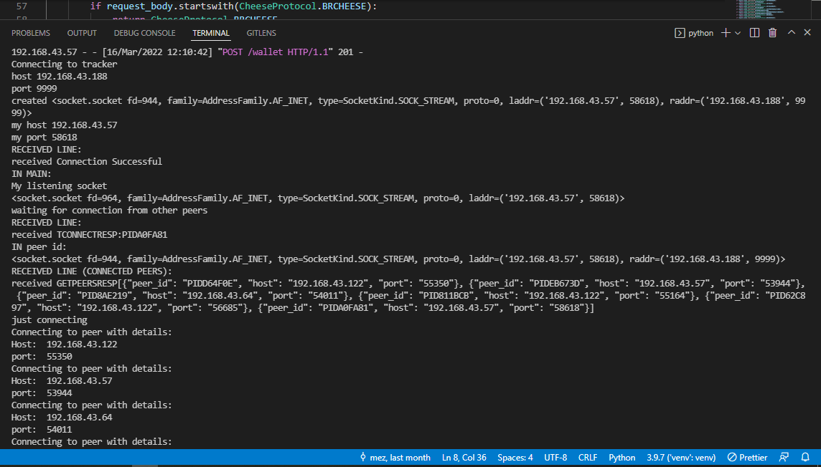
Peer Console:

Slide 9
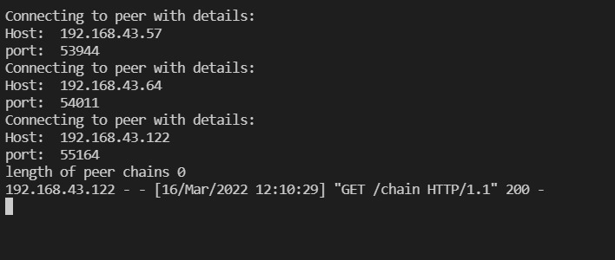
Peer (logs: Connecting to other peers)

Slide 10
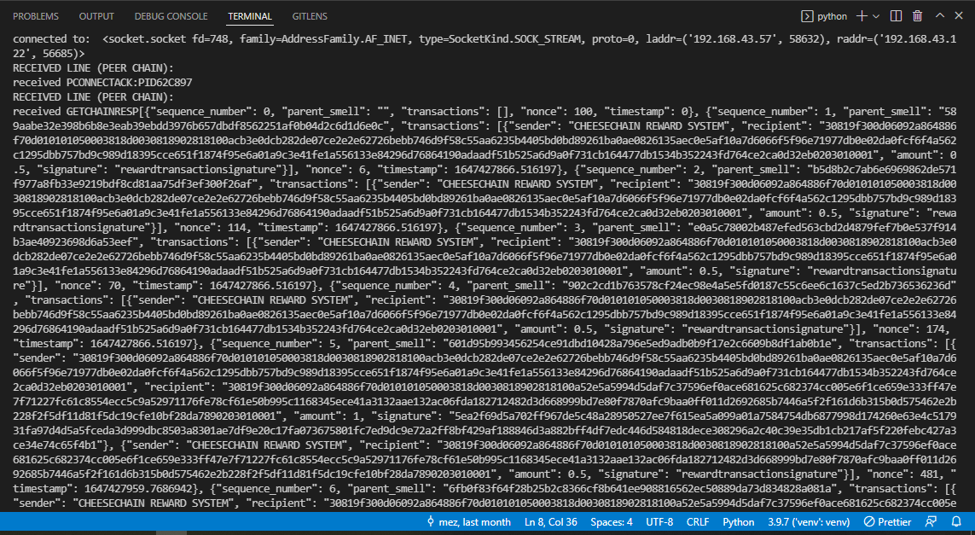
Peer (logs: data exchange)

Slide 11
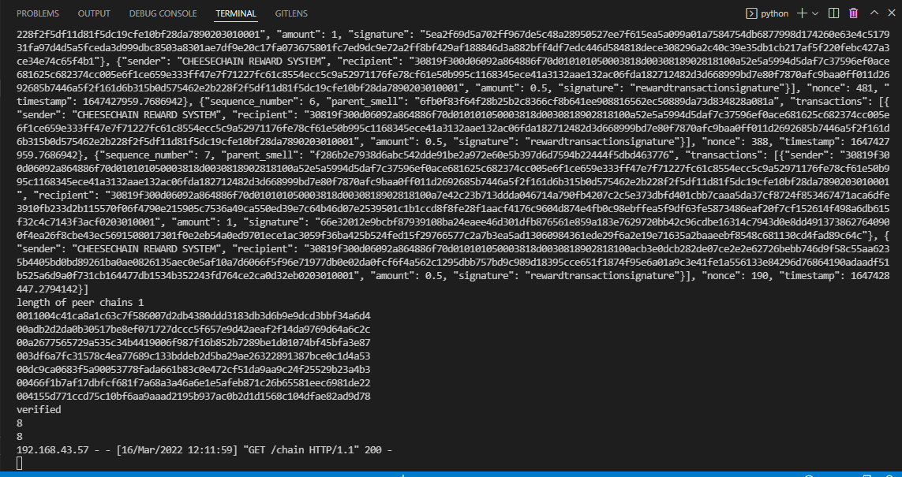
Peer (logs: data exchange)

Slide 12
GUI:
Interface for running and managing a peer
Can create new/load existing wallet
Initiate spinning up a peer node/connect to tracker
load cheesechain and open transactions
create transaction
trigger a mining process

Slide 13
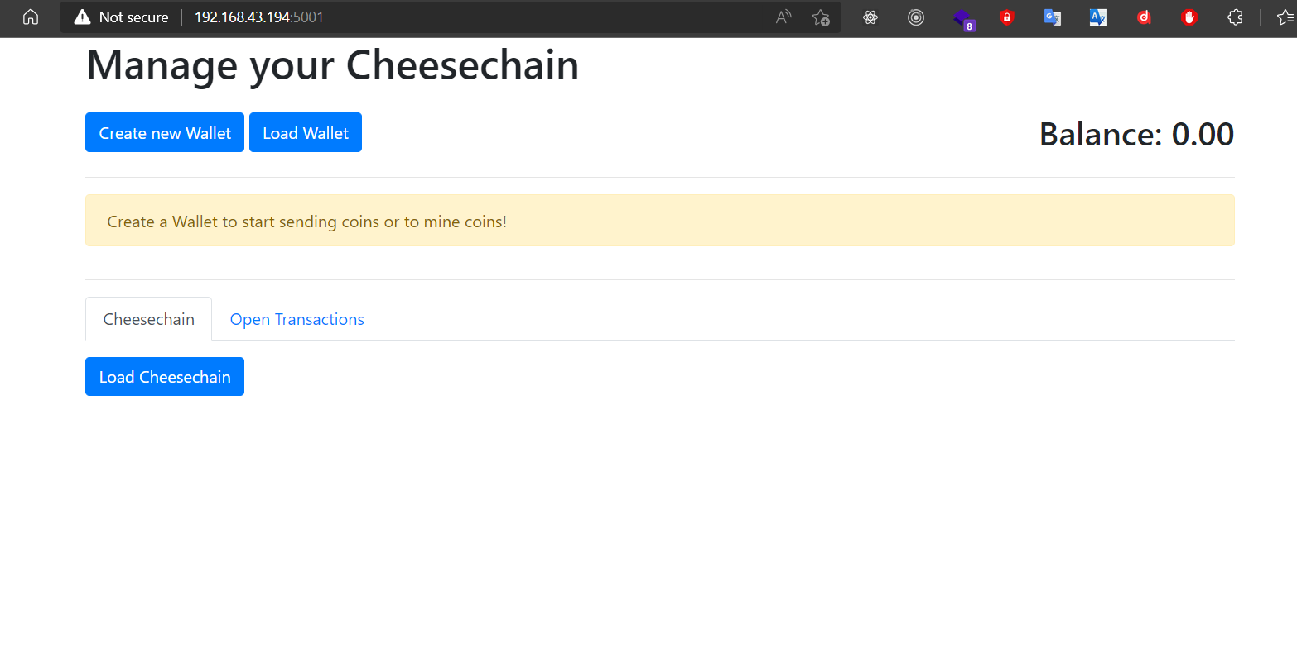
GUI (user journey):

Slide 14
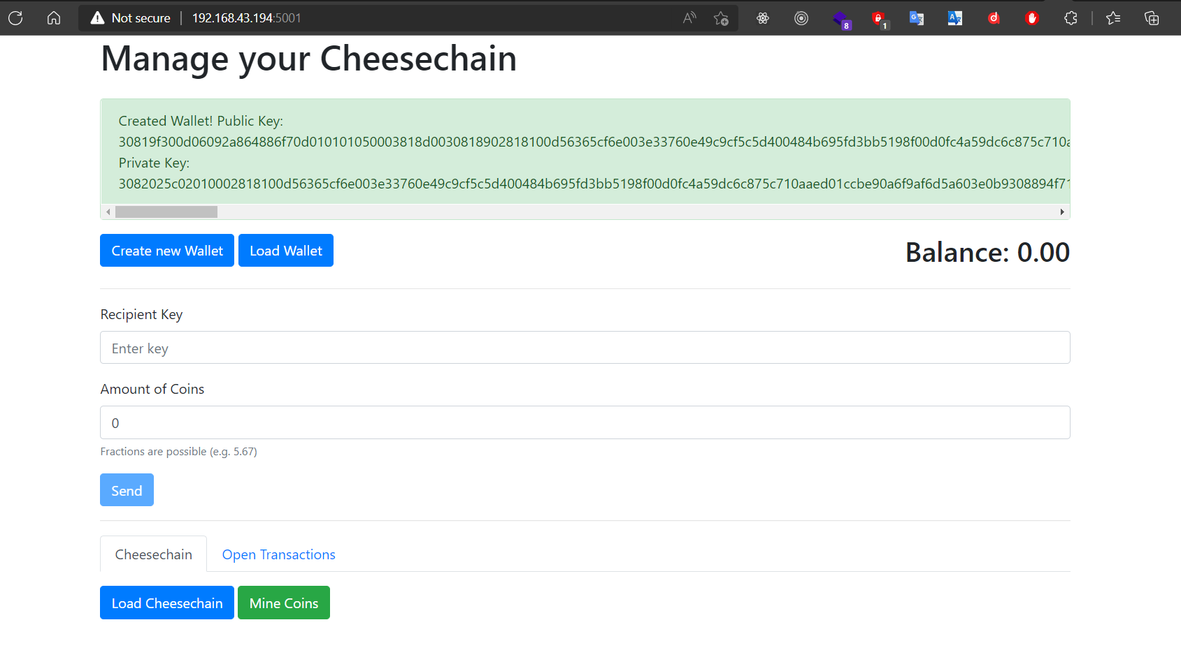
New Wallet Created:

Slide 15
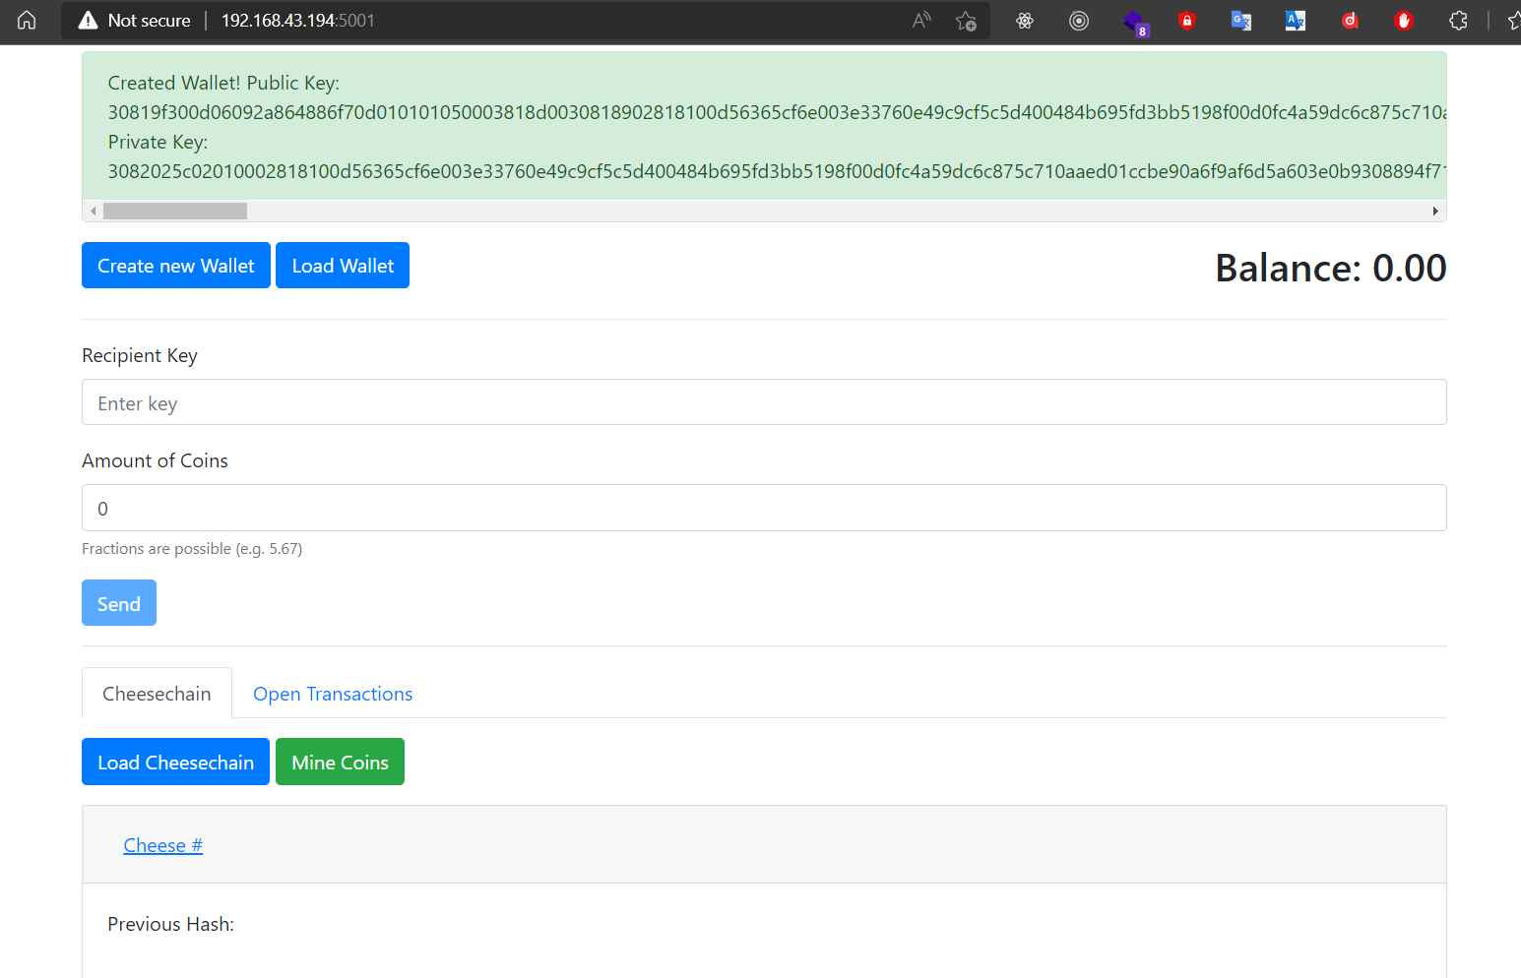
Raclette Cheese:

Slide 16
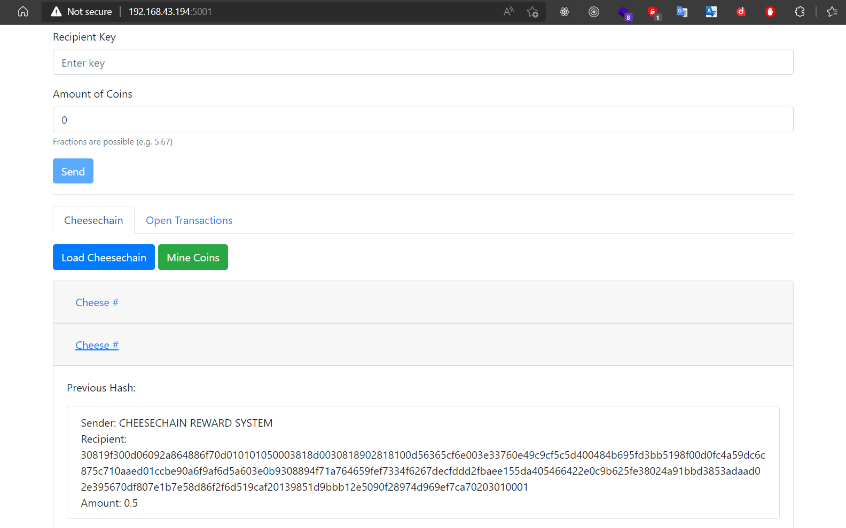
Peer-1 Mines:

Slide 17
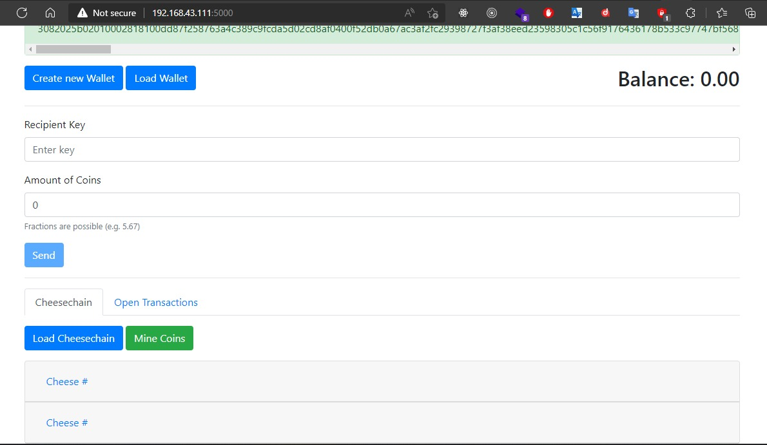
Peer-2 Receives:

Slide 18
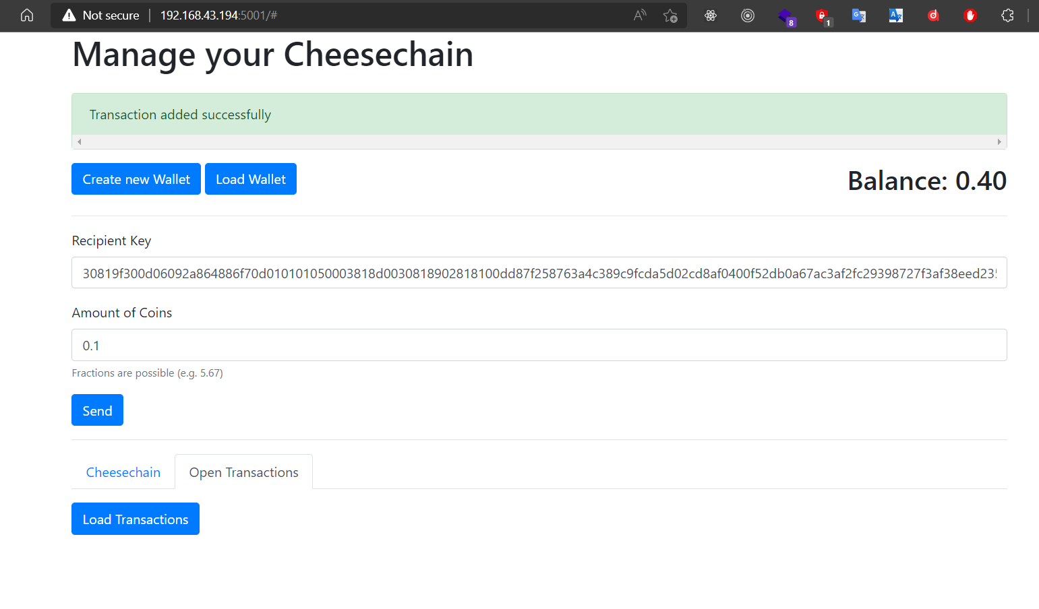
Add Transaction (Peer 1 sends Peer 2 some coins):

Slide 19
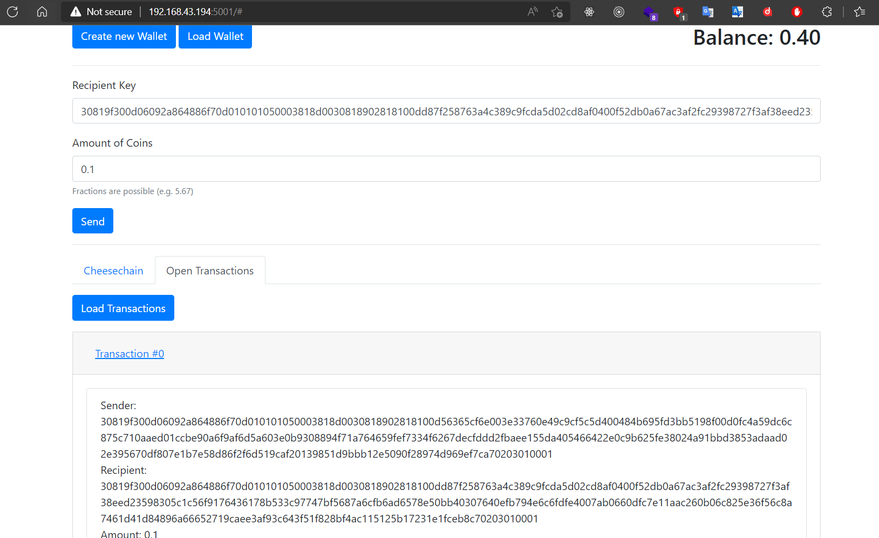
Open Transactions (Transaction Details):

Slide 20
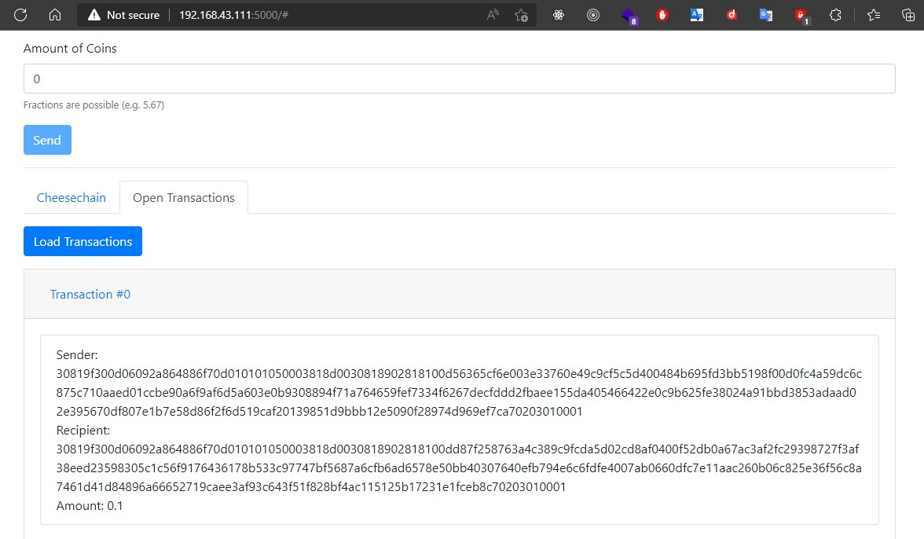
Peer 2 Receives Open transaction(Transaction Details):

Slide 21
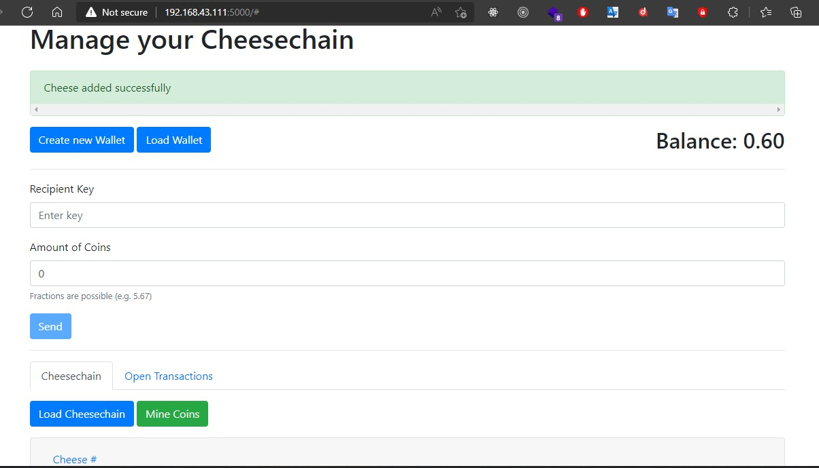
Peer 2 Mines transaction:

Slide 22
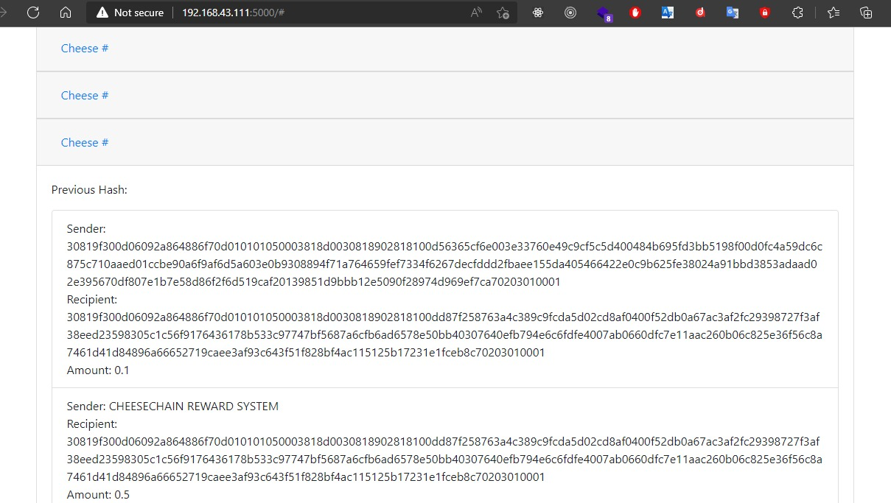
New Cheese Added (Transaction Details):

Slide 23
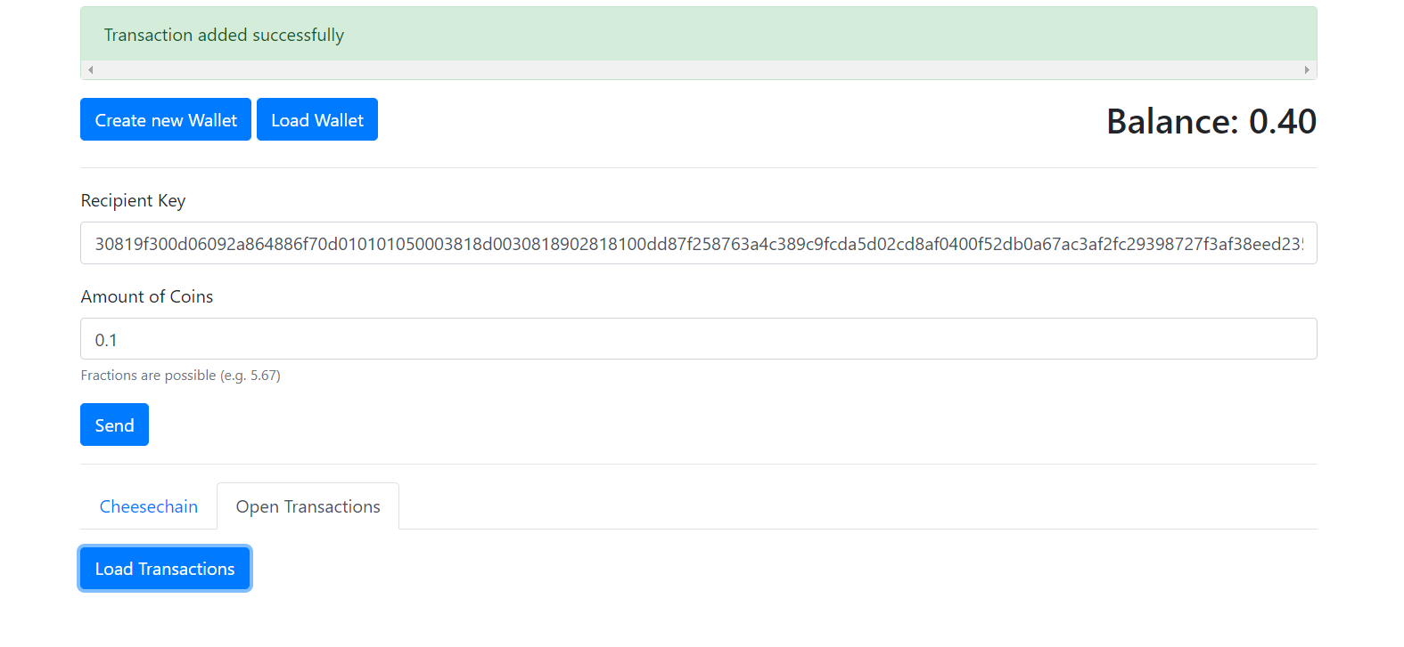
Open Transactions Updated (Peer 1):

Slide 24
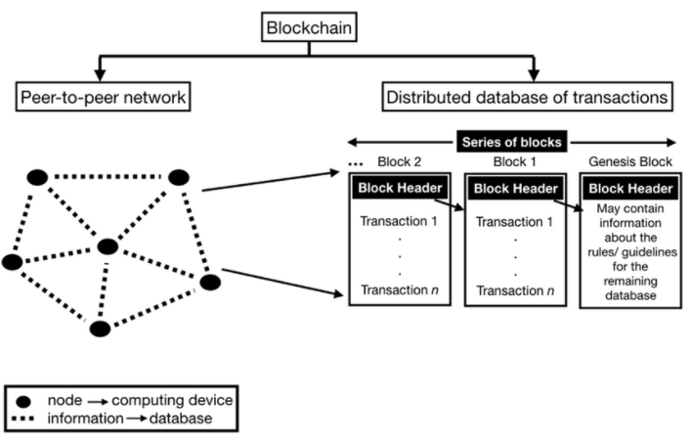
Conclusion:

Slide 25
DEMO

Slide 26
THANK YOU!

