Slide 1
Machine Learning Classification of Benin and Malignant Breast Cancer Tumors Using FNA Digitized Images
Amir Ghaderi
Mezbah Uddin
MSc Data Science and Analytics

Slide 2
Overview
Problem and Goal
Dataset Description
Data Preprocessing
Classifiers
Results
Conclusions

Slide 3
Problem and Goal
Problem
FNA is used to classify breast mass as malignant or benign
25% of cases FNA is inconclusive and surgical biopsy is required
Digitized images are also taken during FNA
Goal
When faced with inconclusive cases, FNA images can be used to classify breast tumors.
Develop a high accuracy classification model

Slide 4
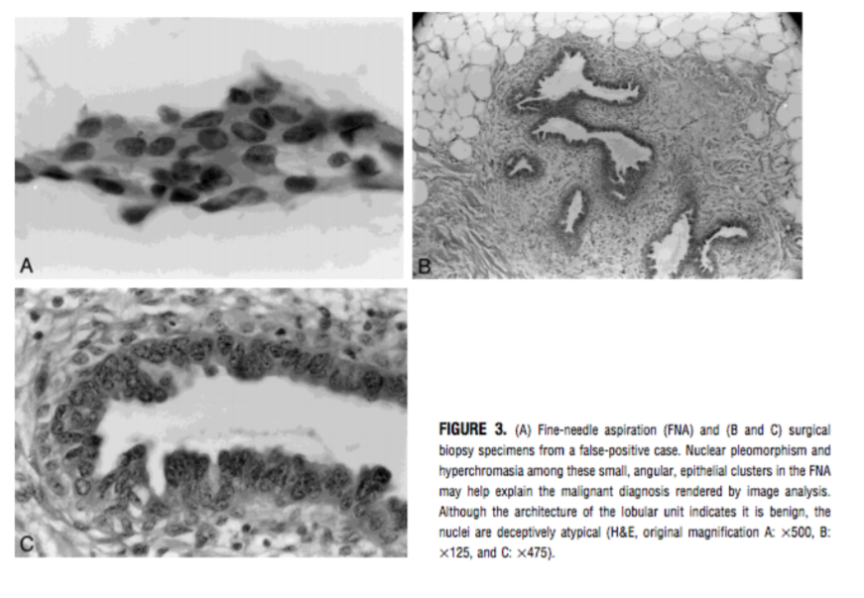
FNA Digitized images: Source UW

Slide 5
Data Set Features
Dataset Source: UCI Machine Learning Repository
569 FNA digitized images
Class distribution: 2 classes, benign(357) & Malignant (212)
10 Features, 32 attributes: radius, texture, perimeter, area, smoothness, compactness, cocavity, concave points, symmetry, fractal dimensions

Slide 6
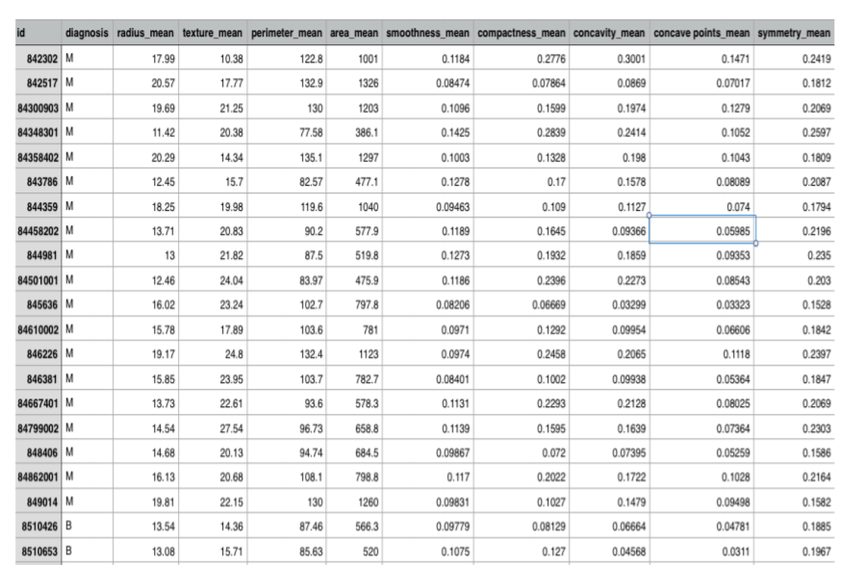
Data Set Preview

Slide 7
Data Preprocessing
Normalization
Correlation Matrix
Curse of Dimensionality
Principle Component analysis
10 Principle Components
95% Cumulative Variance
Class converted to binary and of type factor

Slide 8
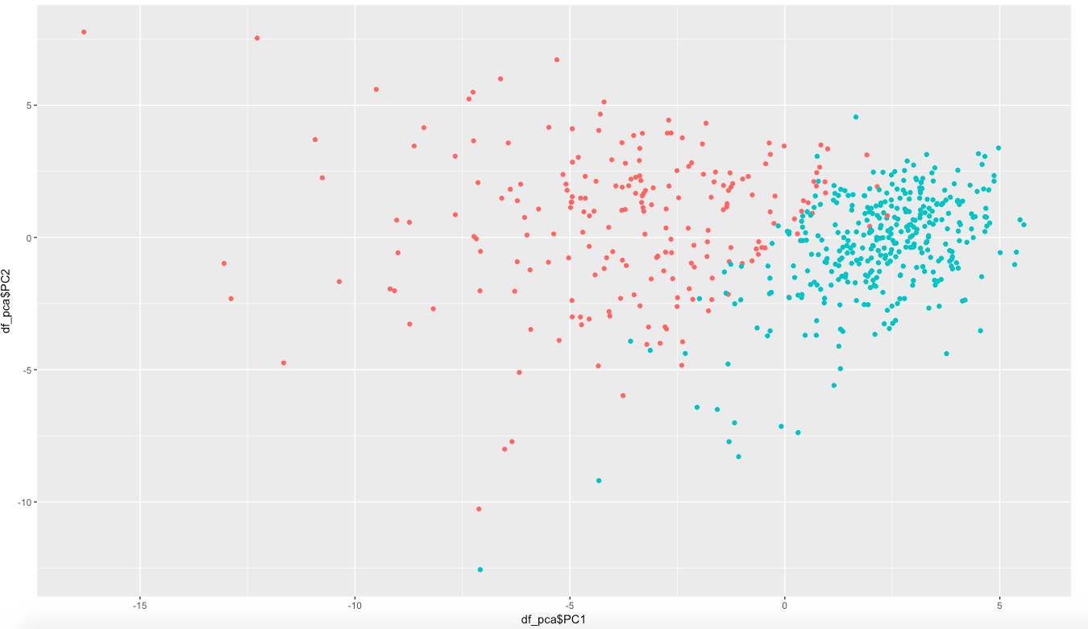
Linearly Separable Classes

Slide 9
Classifiers
Support Vector Machines
Linear, Polynomial, Radial, Sigmoid
K-Nearest-neighbor
k = 1,3,5,11,19,21
Random Forest
Trees = 100, 200, 300, 400
Bagging
Multi Layer Perceptron
5 Fold Cross Vaildation

Slide 10
Support Vector Machines
Linear Does the best with average accuracy with average accuracy of 97.07%
Sigmoid gives lowest average accuracy of 92.63%
 | Fold 1 | Fold 2 | Fold 3 | Fold 4 | Fold 5
Linear | 95.69% | 97.54% | 97.24% | 97.32% | 97.54%
Polynomial | 94.18% | 95.29% | 95.89% | 95.56% | 95.79%
Radial | 95.66% | 96.43% | 95.78% | 96.34% | 96.84%
Sigmoid | 91.9% | 94.12% | 93% | 90.81% | 90.34%

Slide 11
K Nearest Neighbor
K=21 gives the highest accuracy
Sqrt(n)
# of Nearest Neighbor | Accuracy
K=1 | 92.98%
K=3 | 93.85%
K=5 | 95.61%
K=11 | 94.69%
K=19 | 98.24%
K=21 | 98.24%

Slide 12
Random Forest
200 trees gives average accuracy of 96.41%
> 200 trees, model overfits
# of Trees | Fold 1 | Fold 2 | Fold 3 | Fold 4 | Fold 5
100 | 96.47% | 94.6% | 93.77% | 94.86% | 94.91%
200 | 97.15% | 97.5% | 96.67% | 95.63% | 95.08%
300 | 95.46% | 94.27% | 94.7% | 94.74% | 94.38%
400 | 93.97% | 95.24% | 95.84% | 95.40% | 95.26%

Slide 13
Bagging
Average Accuracy of 95.95%
Fold 1 | Fold 2 | Fold 3 | Fold 4 | Fold 5
98.84% | 95.56% | 94.84% | 95.05% | 95.44%

Slide 14
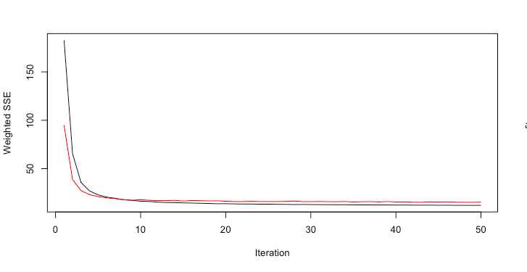
Multi Layer Perceptron (MLP)

Slide 15
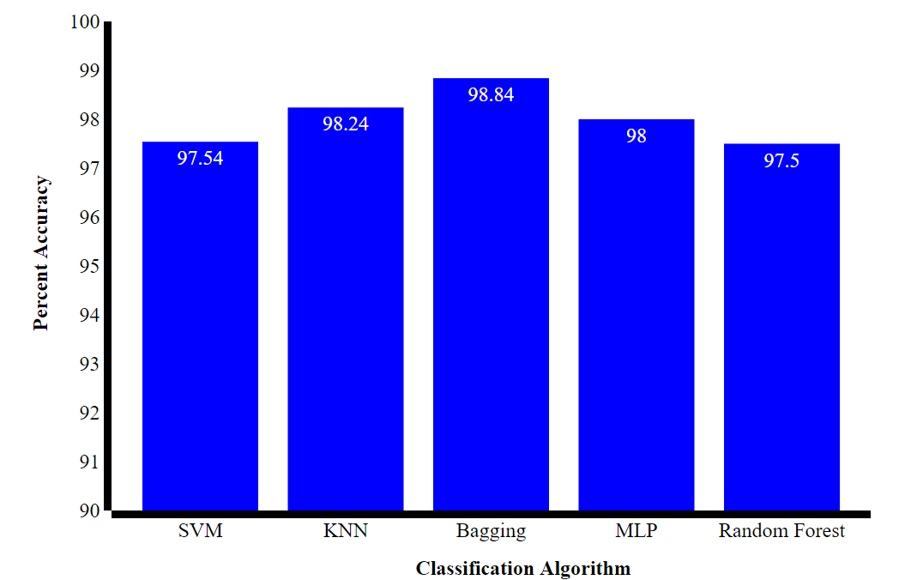
Conclusion

Slide 16
Medical Implications
False Negatives near zero
Should not be used independently as a diagnostic tool
Should be used in conjunction with current procedures

Slide 17

Questions

