Slide 1
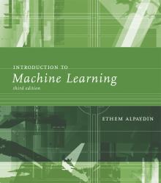
INTRODUCTION TO Machine Learning 3rd Edition
Lecture Slides for
ETHEM ALPAYDIN
© The MIT Press, 2014
alpaydin@boun.edu.tr
http://www.cmpe.boun.edu.tr/~ethem/i2ml3e

Slide 2
CHAPTER 10: Linear Discrimination

Slide 3
Likelihood- vs. Discriminant-based Classification
Likelihood-based: Assume a model for p(x|C_{i}), use Bayes’ rule to calculate P(C_{i}|x)
g_{i}(x) = log P(C_{i}|x)
Discriminant-based: Assume a model for g_{i}(x|Φ_{i}); no density estimation
Estimating the boundaries is enough; no need to accurately estimate the densities inside the boundaries

Slide 4
Linear Discriminant
Linear discriminant:
Advantages:
Simple: O(d) space/computation
Knowledge extraction: Weighted sum of attributes; positive/negative weights, magnitudes (credit scoring)
Optimal when p(x|C_{i}) are Gaussian with shared cov matrix; useful when classes are (almost) linearly separable

Slide 5
Generalized Linear Model
Quadratic discriminant:
Higher-order (product) terms:
Map from x to z using nonlinear basis functions and use a linear discriminant in z-space

Slide 6
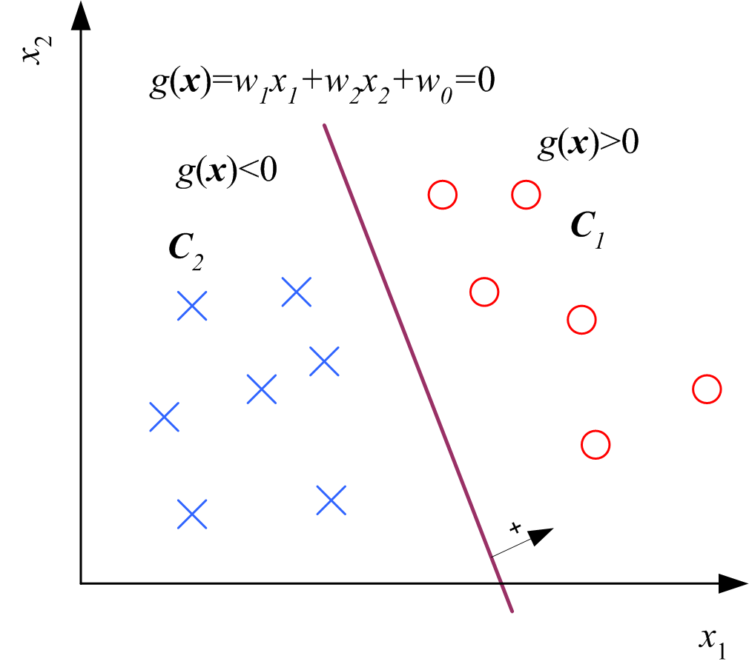
Two Classes

Slide 7
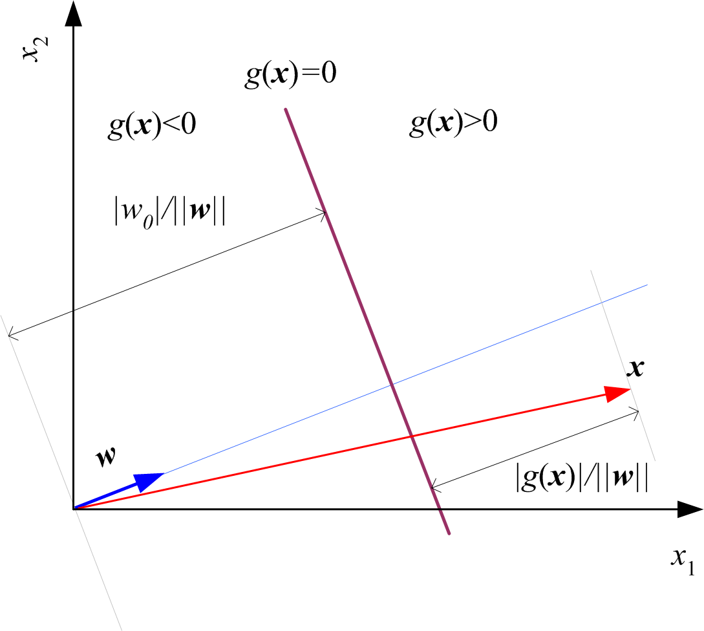
Geometry

Slide 8
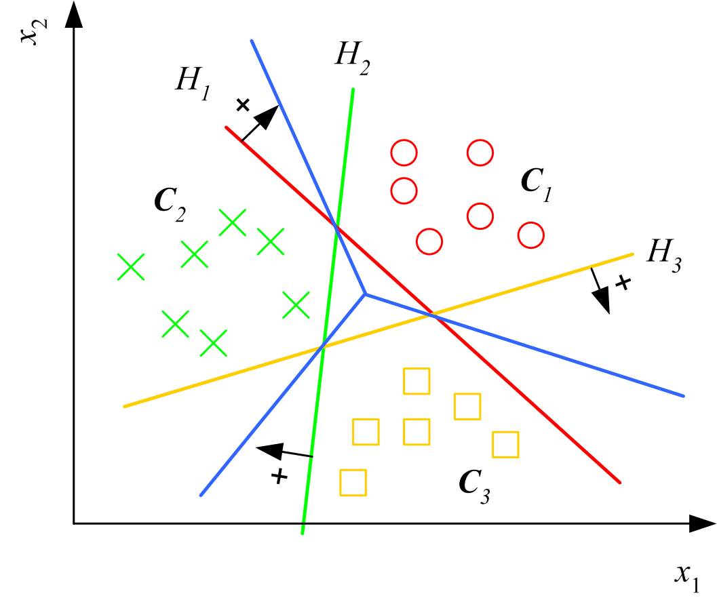
Multiple Classes
Classes are
linearly separable

Slide 9
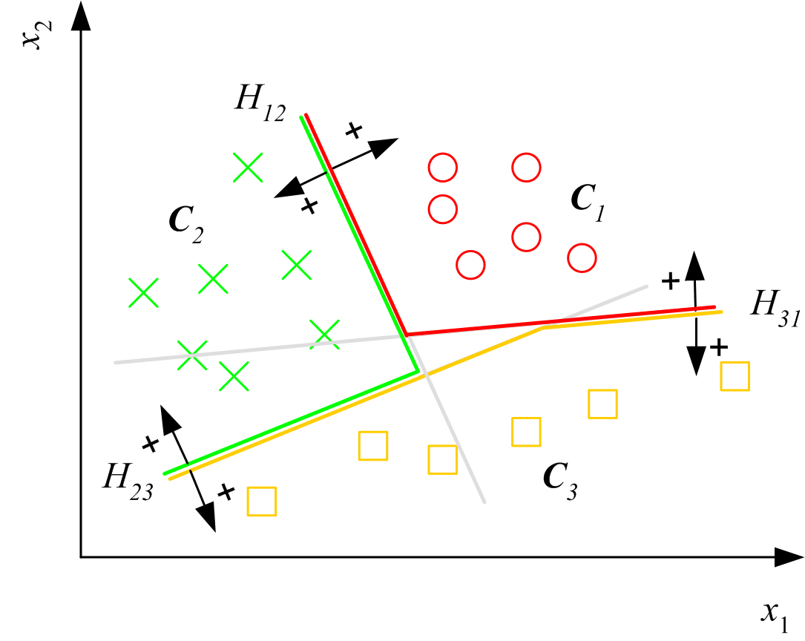
Pairwise Separation

Slide 10
From Discriminants to Posteriors
When p (x | C_{i} ) ~ N ( μ_{i} , ∑)

Slide 12
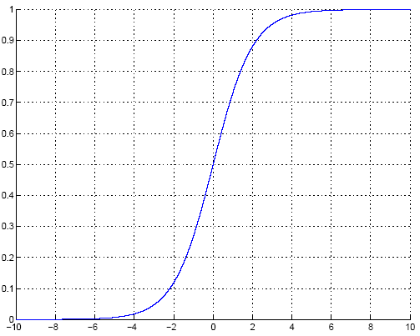
Sigmoid (Logistic) Function

Slide 13
Gradient-Descent
E(w|X) is error with parameters w on sample X
w*=arg min_{w} E(w | X)
Gradient
Gradient-descent:
Starts from random w and updates w iteratively in the negative direction of gradient

Slide 14
Gradient-Descent
E (w^{t})
E (w^{t+1})
w^{t}
w^{t+1}
η

Slide 15
Logistic Discrimination
Two classes: Assume log likelihood ratio is linear

Slide 16
Training: Two Classes

Slide 17
Training: Gradient-Descent

Slide 18
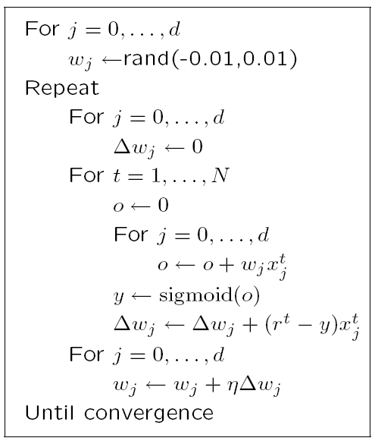

Slide 19
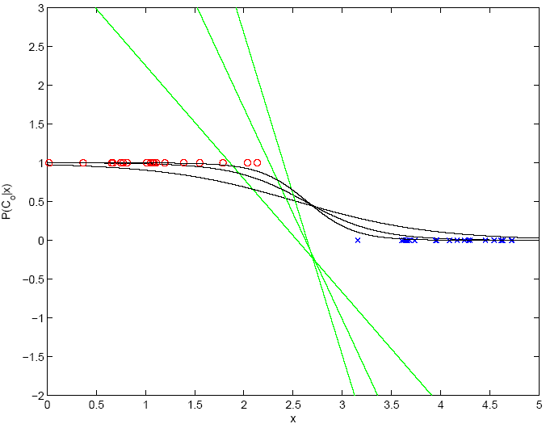
100
1000
10

Slide 20
K>2 Classes
softmax

Slide 21
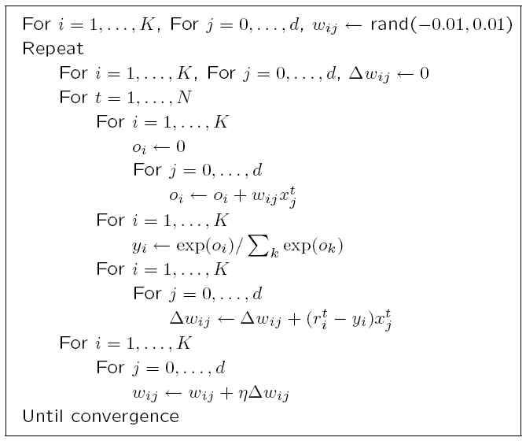

Slide 22
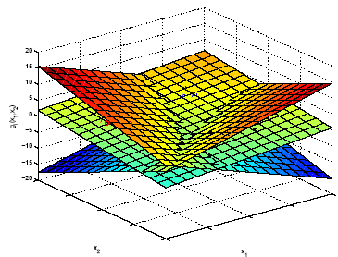
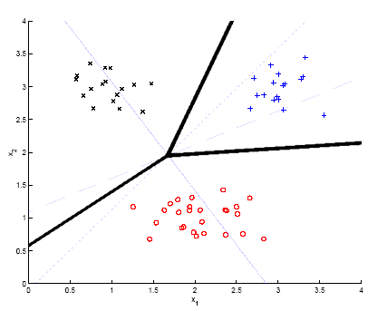
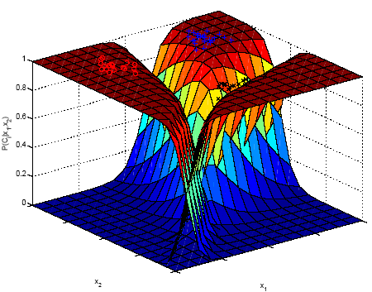
Example

Slide 23
Generalizing the Linear Model
Quadratic:
Sum of basis functions:
where φ(x) are basis functions. Examples:
Hidden units in neural networks (Chapters 11 and 12)
Kernels in SVM (Chapter 13)

Slide 24
Discrimination by Regression
Classes are NOT mutually exclusive and exhaustive

Slide 25
Learning to Rank
Ranking: A different problem than classification or regression
Let us say x^{u} and x^{v} are two instances, e.g., two movies
We prefer u to v implies that g(x^{u})>g(x^{v})
where g(x) is a score function, here linear:
g(x)=w^{T}x
Find a direction w such that we get the desired ranks when instances are projected along w

Slide 26
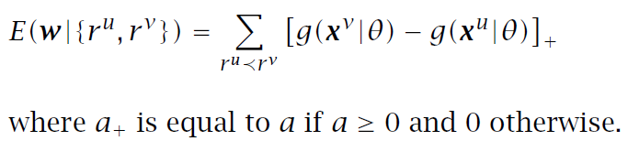
Ranking Error
We prefer u to v implies that g(x^{u})>g(x^{v}), so
error is g(x^{v})-g(x^{u}), if g(x^{u})<g(x^{v})

Slide 27
