Slide 1

INTRODUCTION TO Machine Learning 3rd Edition
Lecture Slides for
ETHEM ALPAYDIN
© The MIT Press, 2014
alpaydin@boun.edu.tr
http://www.cmpe.boun.edu.tr/~ethem/i2ml3e

Slide 2
CHAPTER 11: Multilayer Perceptrons

Slide 3
Neural Networks
Networks of processing units (neurons) with connections (synapses) between them
Large number of neurons: 10¹⁰
Large connectitivity: 10⁵
Parallel processing
Distributed computation/memory
Robust to noise, failures

Slide 4
Understanding the Brain
Levels of analysis (Marr, 1982)
Computational theory
Representation and algorithm
Hardware implementation
Reverse engineering: From hardware to theory
Parallel processing: SIMD vs MIMD
Neural net: SIMD with modifiable local memory
Learning: Update by training/experience

Slide 5
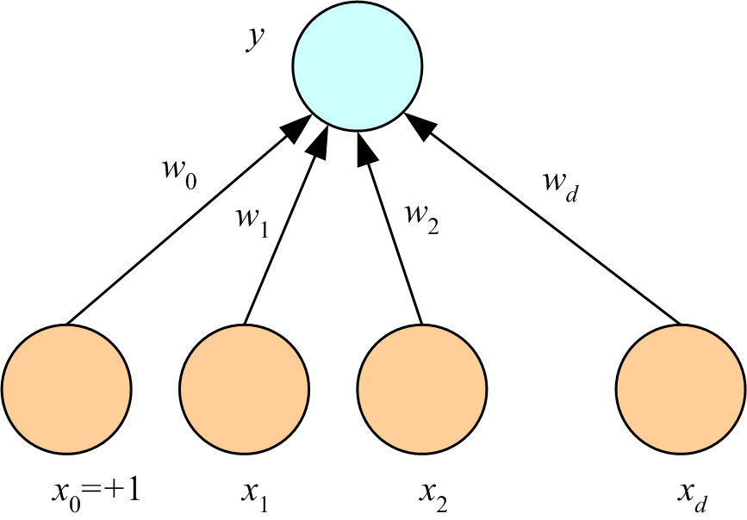
Perceptron
(Rosenblatt, 1962)

Slide 6
What a Perceptron Does
Regression: y=wx+w₀
Classification:y=1(wx+w₀>0)
y
y
s
y
w₀
w
w₀
w
x
w₀
x
x
x₀=+1

Slide 7
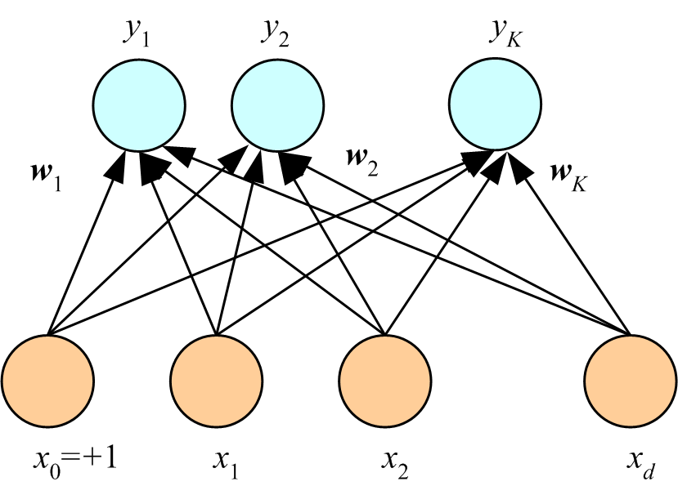
K Outputs
Regression:
Classification:

Slide 8
Training
Online (instances seen one by one) vs batch (whole sample) learning:
No need to store the whole sample
Problem may change in time
Wear and degradation in system components
Stochastic gradient-descent: Update after a single pattern
Generic update rule (LMS rule):

Slide 9
Training a Perceptron: Regression
Regression (Linear output):

Slide 10
Classification
Single sigmoid output
K>2 softmax outputs

Slide 11
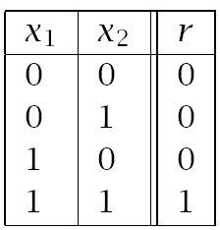
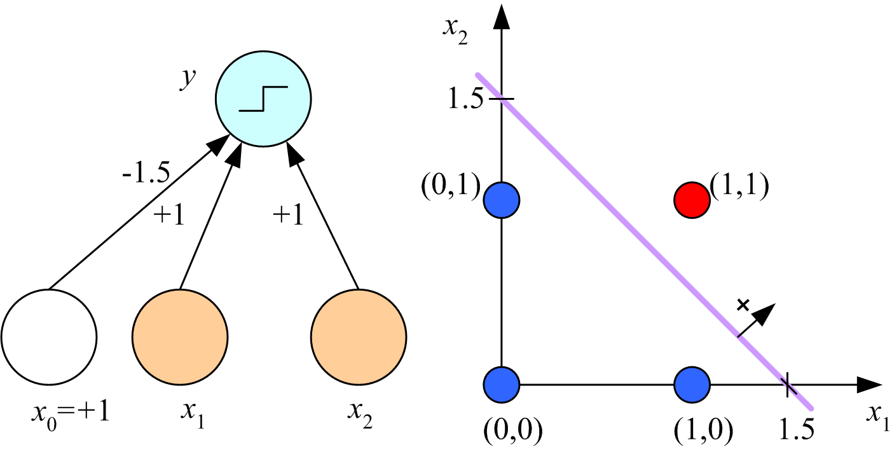
Learning Boolean AND

Slide 12
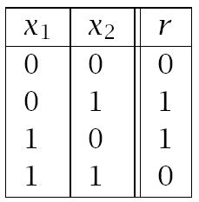
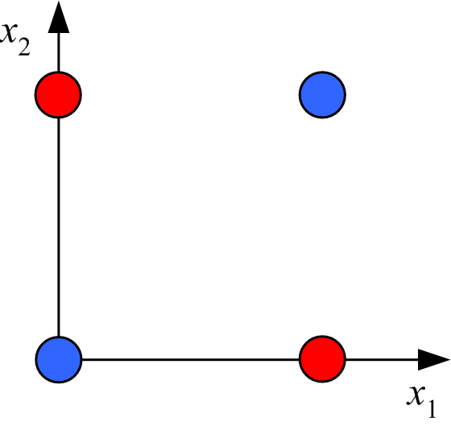
XOR
No w₀, w₁, w₂ satisfy:
(Minsky and Papert, 1969)

Slide 13
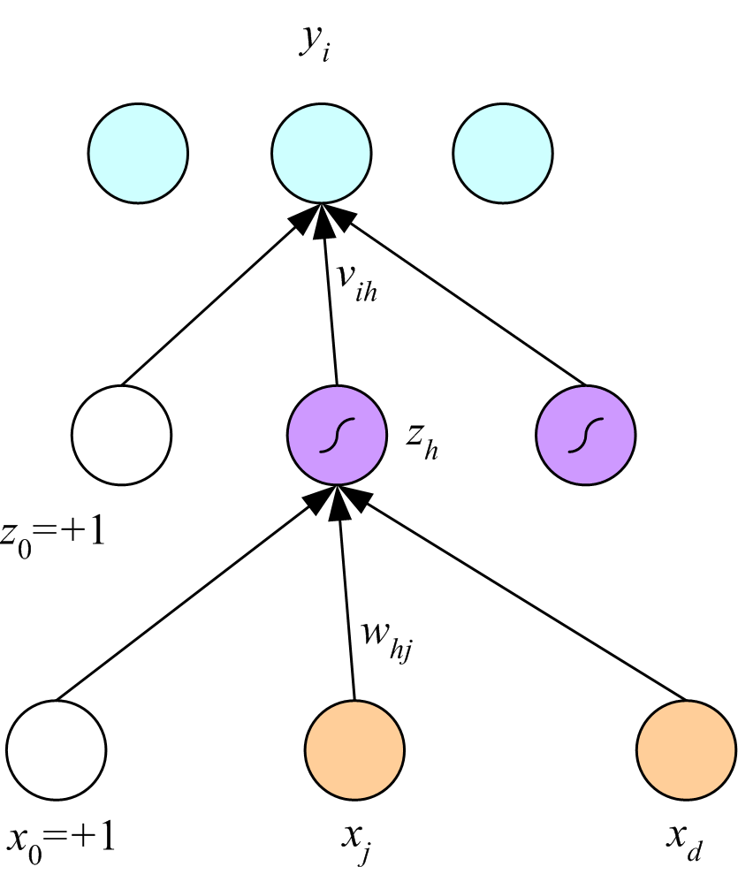
Multilayer Perceptrons
(Rumelhart et al., 1986)

Slide 14
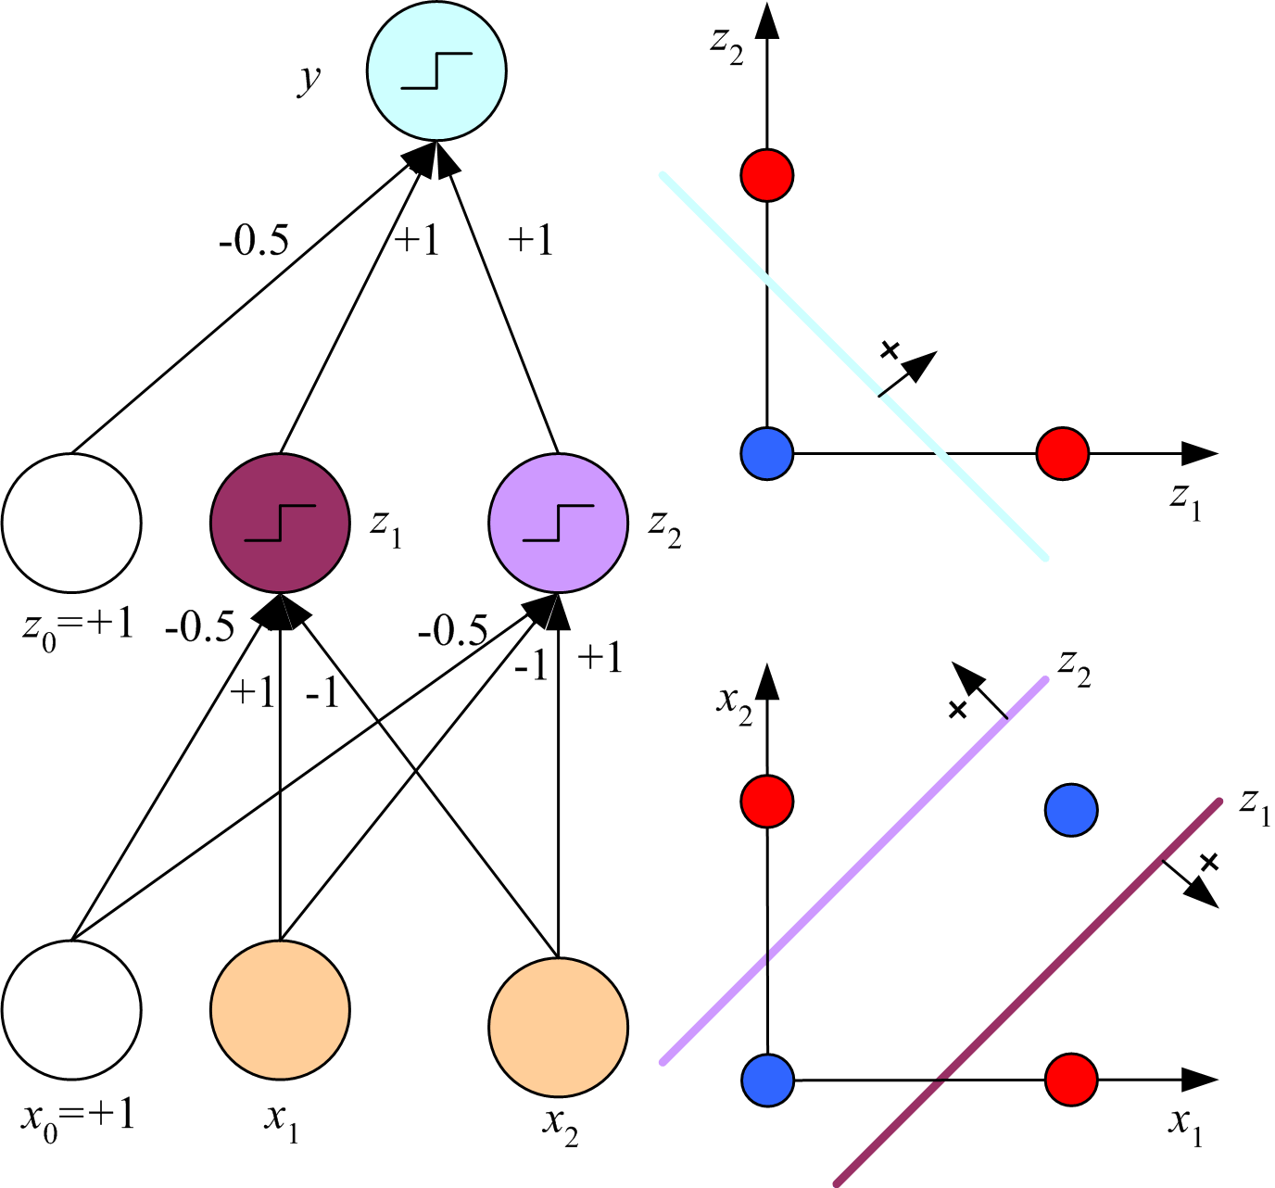
x₁ XOR x₂ = (x₁ AND ~x₂) OR (~x₁ AND x₂)

Slide 15
Backpropagation

Slide 16
Regression
Backward
Forward
x

Slide 17
Regression with Multiple Outputs
y_{i}
v_{ih}
z_{h}
w_{hj}
x_{j}

Slide 18
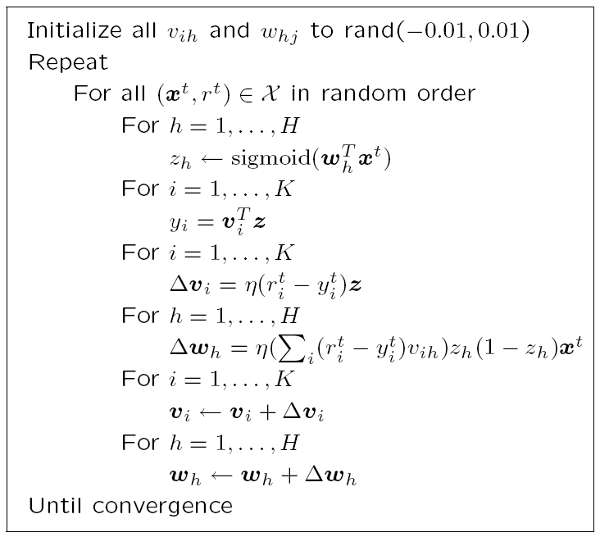

Slide 19
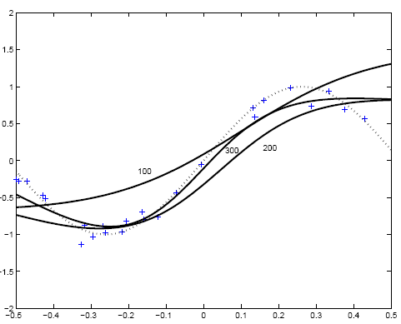
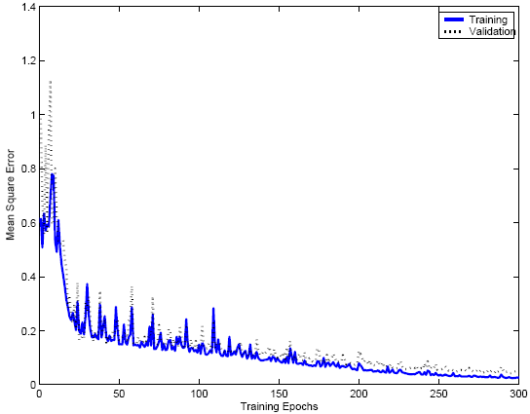

Slide 20
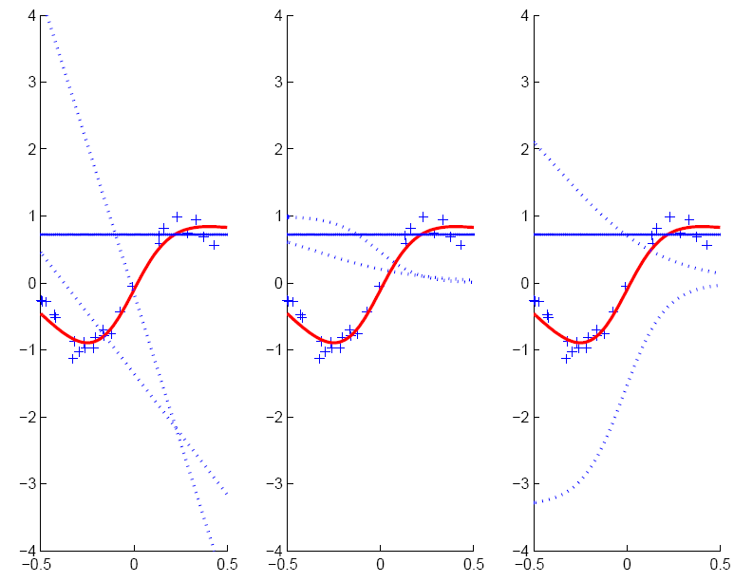
w_{h}x+w₀
v_{h}z_{h}
z_{h}

Slide 21
Two-Class Discrimination
One sigmoid output y^{t} for P(C₁|x^{t}) and
P(C₂|x^{t}) ≡ 1-y^{t}

Slide 22
K>2 Classes

Slide 23
Multiple Hidden Layers
MLP with one hidden layer is a universal approximator (Hornik et al., 1989), but using multiple layers may lead to simpler networks

Slide 24
Improving Convergence
Momentum
Adaptive learning rate

Slide 25
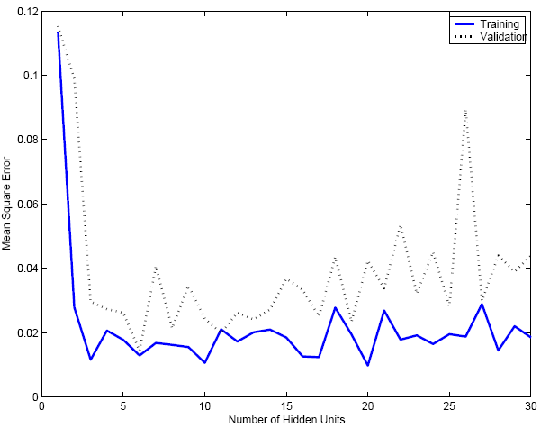
Overfitting/Overtraining
Number of weights: H (d+1)+(H+1)K

Slide 26
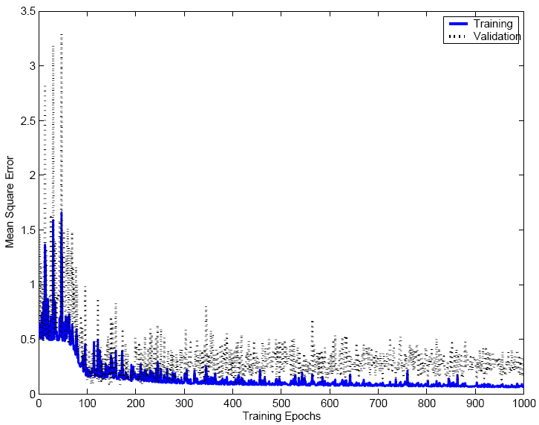

Slide 27
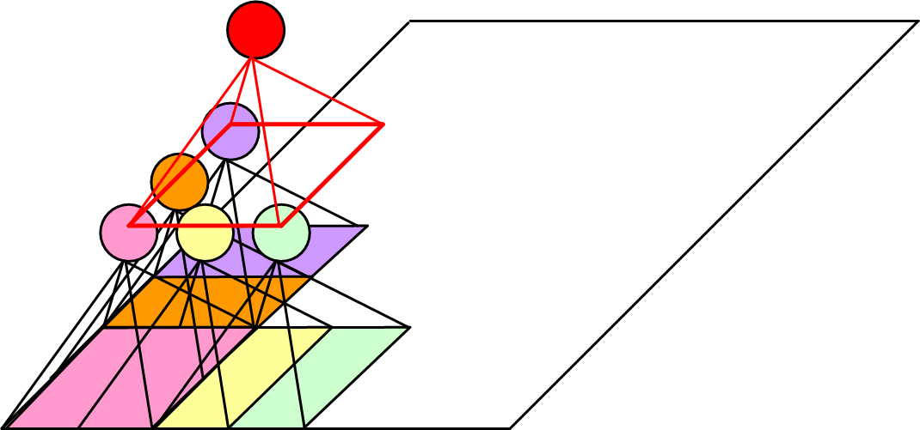
Structured MLP
Convolutional networks (Deep learning)
(Le Cun et al, 1989)

Slide 28
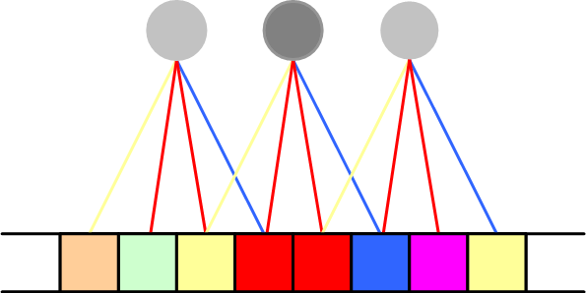
Weight Sharing

Slide 29

Hints
Invariance to translation, rotation, size
Virtual examples
Augmented error: E’=E+λ_{h}E_{h}
If x’ and x are the “same”: E_{h}=[g(x|θ)- g(x’|θ)]²
Approximation hint:
(Abu-Mostafa, 1995)

Slide 30
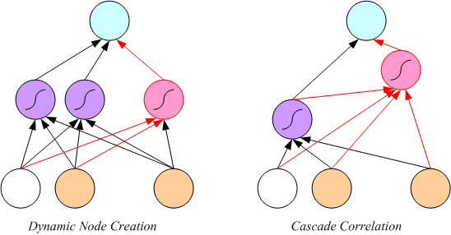
Tuning the Network Size
Destructive
Weight decay:
Constructive
Growing networks
(Ash, 1989)
(Fahlman and Lebiere, 1989)

Slide 31
Bayesian Learning
Consider weights w_{i} as random vars, prior p(w_{i})
Weight decay, ridge regression, regularization
cost=data-misfit + λ complexity
More about Bayesian methods in chapter 14

Slide 32
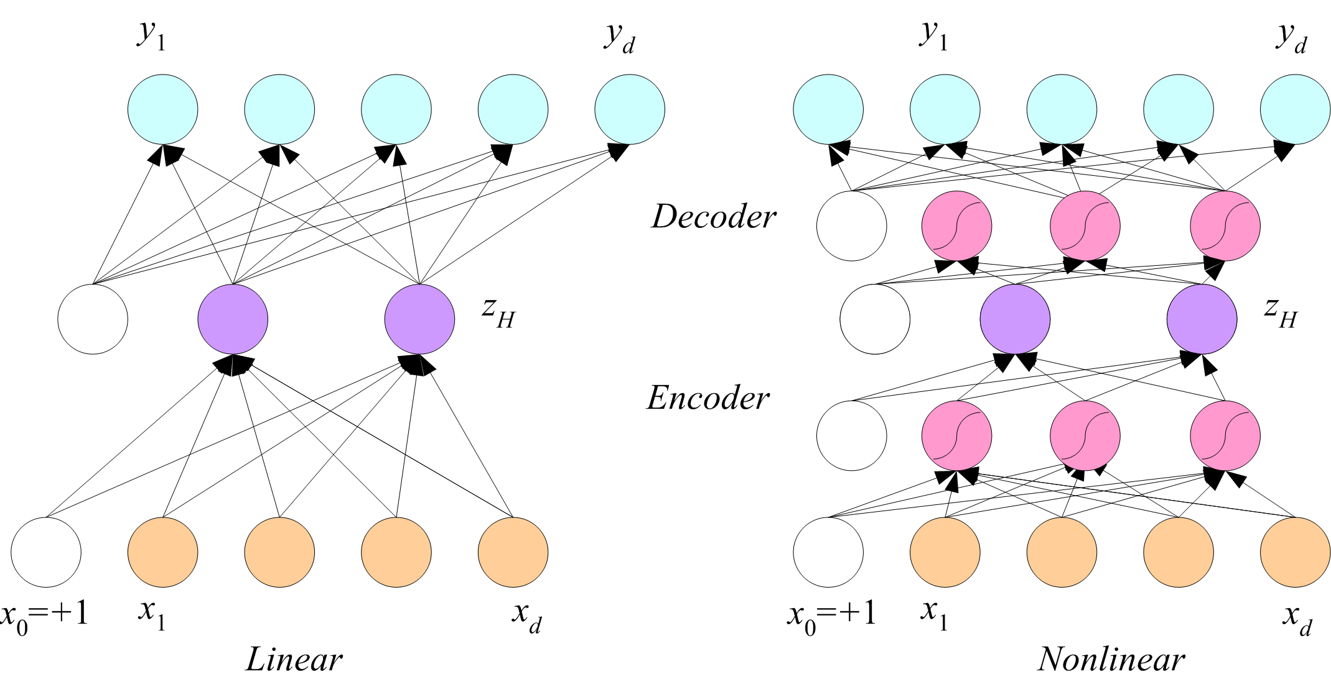
Dimensionality Reduction
Autoencoder networks

Slide 33
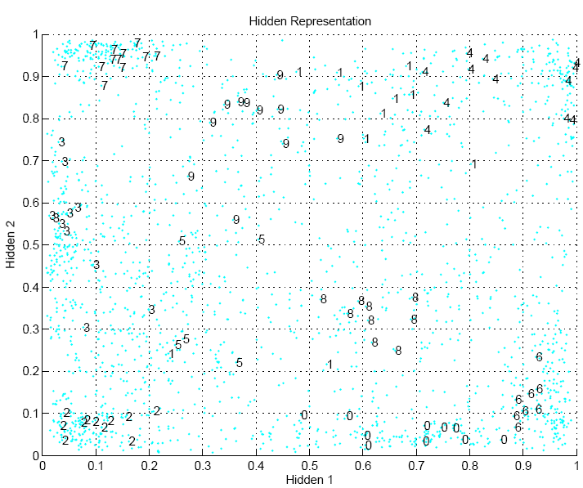

Slide 34
Learning Time
Applications:
Sequence recognition: Speech recognition
Sequence reproduction: Time-series prediction
Sequence association
Network architectures
Time-delay networks (Waibel et al., 1989)
Recurrent networks (Rumelhart et al., 1986)

Slide 35
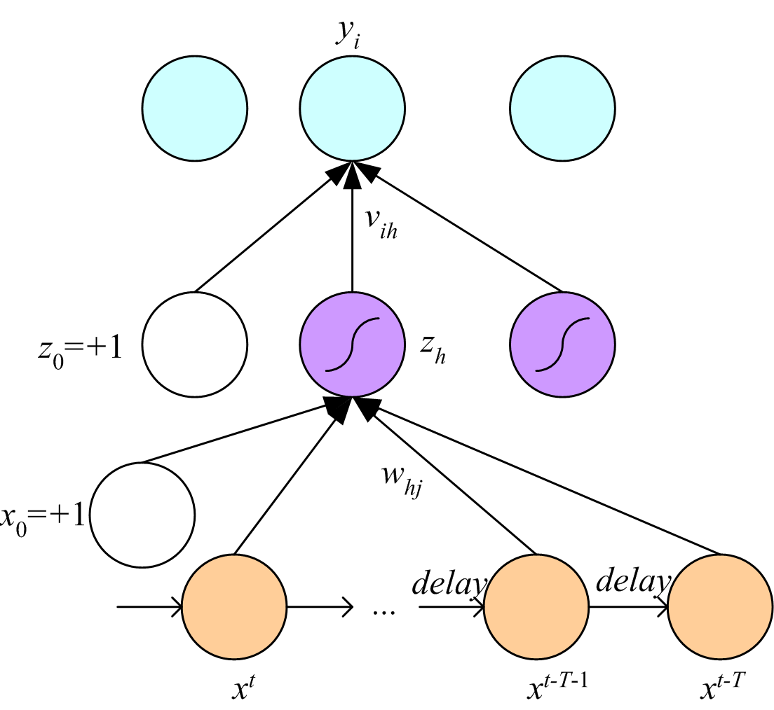
Time-Delay Neural Networks

Slide 36
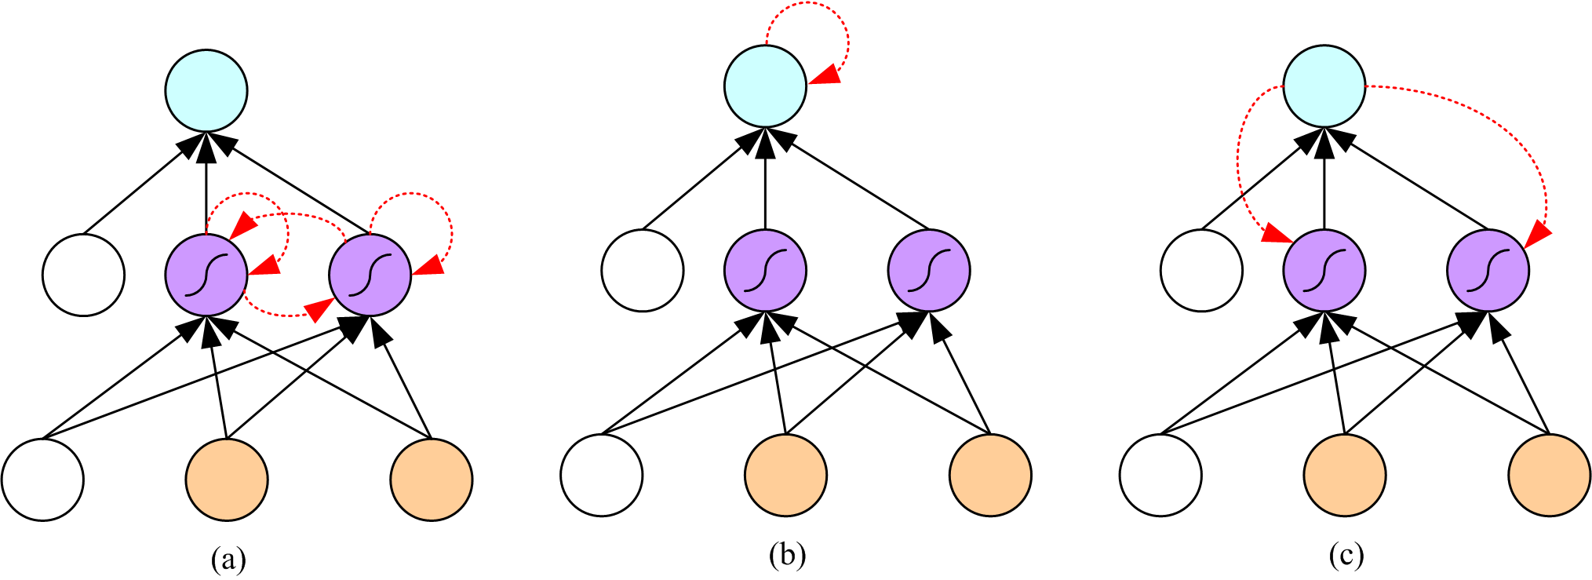
Recurrent Networks

Slide 37
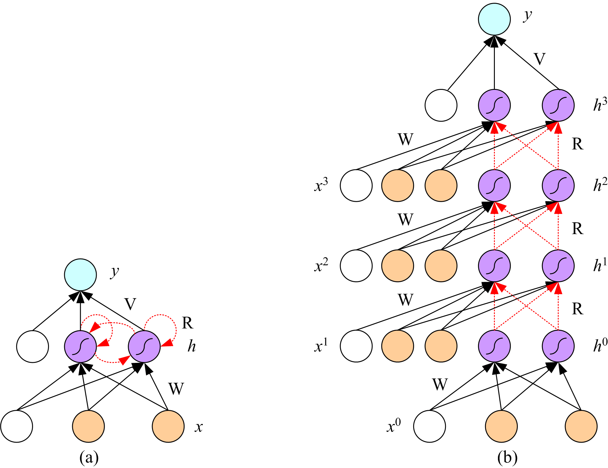
Unfolding in Time

Slide 38
Deep Networks
Layers of feature extraction units
Can have local receptive fields as in convolution networks, or can be fully connected
Can be trained layer by layer using an autoencoder in an unsupervised manner
No need to craft the right features or the right basis functions or the right dimensionality reduction method; learns multiple layers of abstraction all by itself given a lot of data and a lot of computation
Applications in vision, language processing, ...

