Slide 1
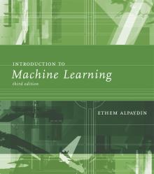
INTRODUCTION TO Machine Learning 3rd Edition
Lecture Slides for
ETHEM ALPAYDIN
© The MIT Press, 2014
alpaydin@boun.edu.tr
http://www.cmpe.boun.edu.tr/~ethem/i2ml3e

Slide 2
CHAPTER 4: Parametric Methods

Slide 3
Parametric Estimation
X = { x^{t} }_{t} where x^{t} ~ p (x)
Parametric estimation:
Assume a form for p (x |θ ) and estimate θ , its sufficient statistics, using X
e.g., N ( μ, σ²) where θ = { μ, σ²}

Slide 4
Maximum Likelihood Estimation
Likelihood of θ given the sample X
l (θ|X) = p (X |θ) = ∏_{t} p (x^{t}|θ)
Log likelihood
L(θ|X) = log l (θ|X) = ∑_{t} log p (x^{t}|θ)
Maximum likelihood estimator (MLE)
θ* = argmax_{θ} L(θ|X)

Slide 5
Examples: Bernoulli/Multinomial
Bernoulli: Two states, failure/success, x in {0,1}
P (x) = p_{o}^{x} (1 – p_{o} ) ^{(1 – x)}
L (p_{o}|X) = log ∏_{t} p_{o}^{xt} (1 – p_{o} ) ^{(1 – xt)}
MLE: p_{o} = ∑_{t} x^{t} / N
Multinomial: K>2 states, x_{i} in {0,1}
P (x₁,x₂,...,x_{K}) = ∏_{i} p_{i}^{xi}
L(p₁,p₂,...,p_{K}|X) = log ∏_{t} ∏_{i} p_{i}^{xit}
MLE: p_{i} = ∑_{t} x_{i}^{t} / N

Slide 6
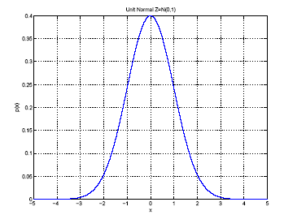
Gaussian (Normal) Distribution
p(x) = N ( μ, σ²)
MLE for μ and σ²:
μ
σ

Slide 7
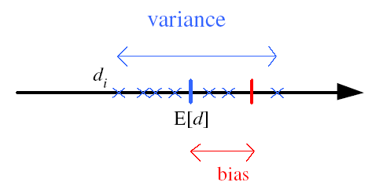
Bias and Variance
Unknown parameter θ
Estimator d_{i} = d (X_{i}) on sample X_{i}
Bias: b_{θ}(d) = E [d] – θ
Variance: E [(d–E [d])²]
Mean square error:
r (d,θ) = E [(d–θ)²]
= (E [d] – θ)² + E [(d–E [d])²]
= Bias² + Variance
θ

Slide 8
Bayes’ Estimator
Treat θ as a random var with prior p (θ)
Bayes’ rule: p (θ|X) = p(X|θ) p(θ) / p(X)
Full: p(x|X) = ∫ p(x|θ) p(θ|X) dθ
Maximum a Posteriori (MAP):
θ_{MAP} = argmax_{θ} p(θ|X)
Maximum Likelihood (ML): θ_{ML} = argmax_{θ} p(X|θ)
Bayes’: θ_{Bayes’} = E[θ|X] = ∫ θ p(θ|X) dθ

Slide 9
Bayes’ Estimator: Example
x^{t} ~ N (θ, σ_{o}²) and θ ~ N ( μ, σ²)
θ_{ML} = m
θ_{MAP} = θ_{Bayes’} =

Slide 10
Parametric Classification

Slide 11
Given the sample
ML estimates are
Discriminant

Slide 12
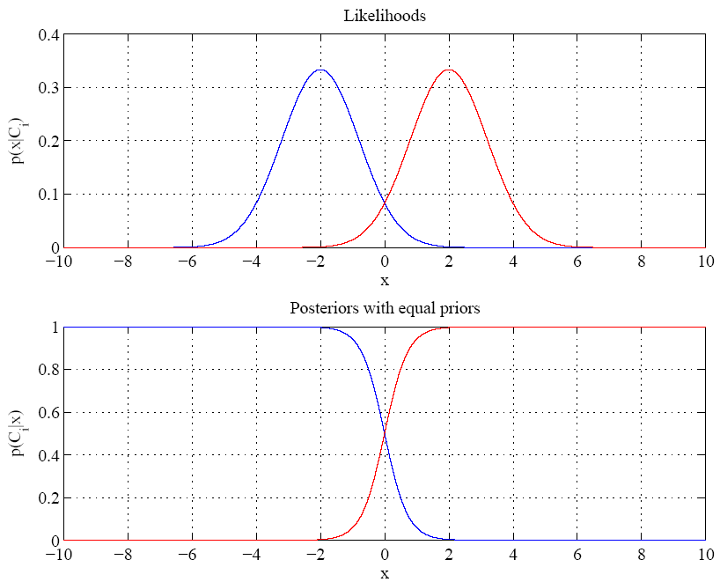
Equal variances
Single boundary at
halfway between means

Slide 13
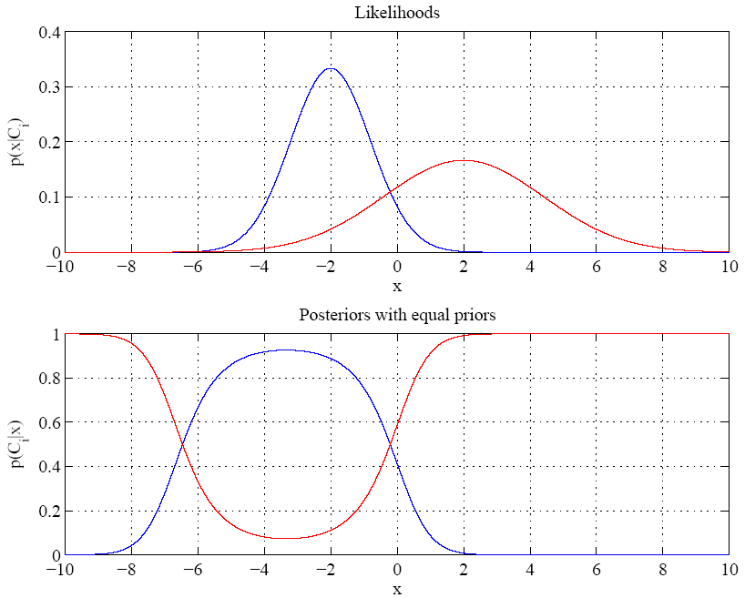
Variances are different
Two boundaries

Slide 14
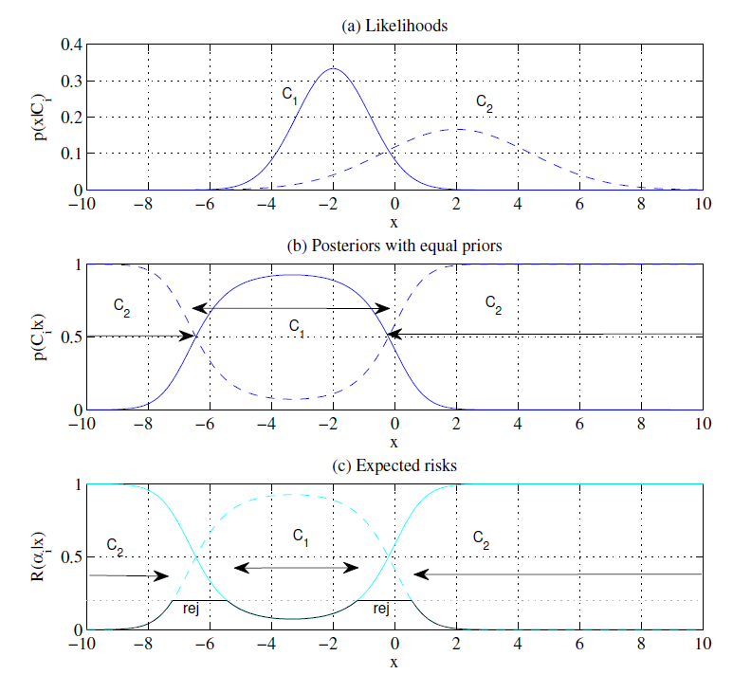

Slide 15
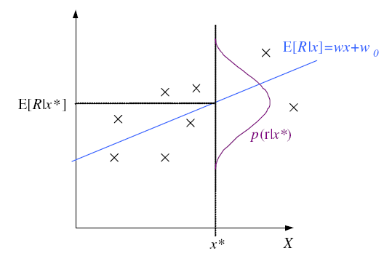
Regression

Slide 16
Regression: From LogL to Error

Slide 17
Linear Regression

Slide 18
Polynomial Regression

Slide 19
Other Error Measures
Square Error:
Relative Square Error:
Absolute Error: E (θ |X) = _{∑t} |r^{t} – g(x^{t}| θ)|
ε-sensitive Error:
E (θ |X) = _{∑ t} 1(|r^{t} – g(x^{t}| θ)|>ε) (|r^{t} – g(x^{t}|θ)| – ε)

Slide 20
Bias and Variance
noise
squared error
bias
variance

Slide 21
Estimating Bias and Variance
M samples X_{i}={x^{t}_{i} , r^{t}_{i}}, i=1,...,M
are used to fit g_{i} (x), i =1,...,M

Slide 22
Bias/Variance Dilemma
Example: g_{i}(x)=2 has no variance and high bias
g_{i}(x)= _{∑t} r^{t}_{i}/N has lower bias with variance
As we increase complexity,
bias decreases (a better fit to data) and
variance increases (fit varies more with data)
Bias/Variance dilemma: (Geman et al., 1992)

Slide 23
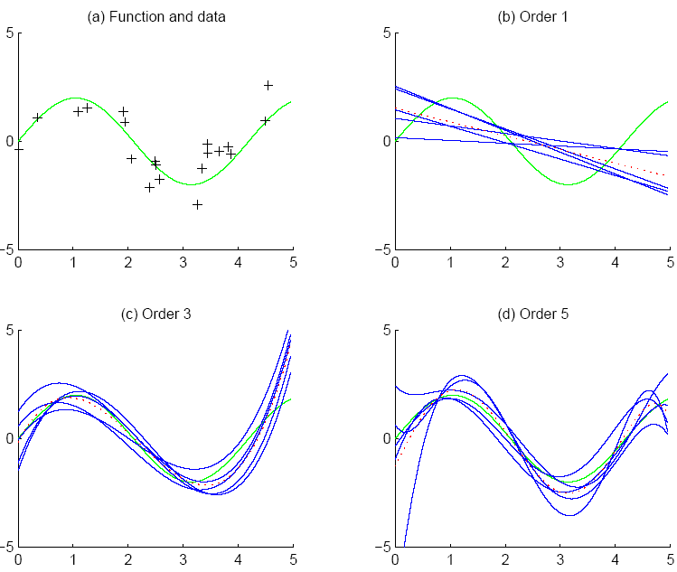
f
f
bias
g_{i}
g
variance

Slide 24
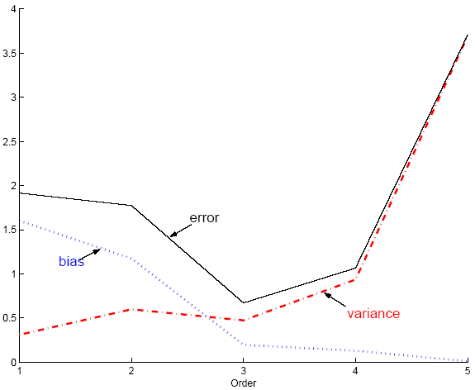
Polynomial Regression
Best fit “min error”

Slide 25
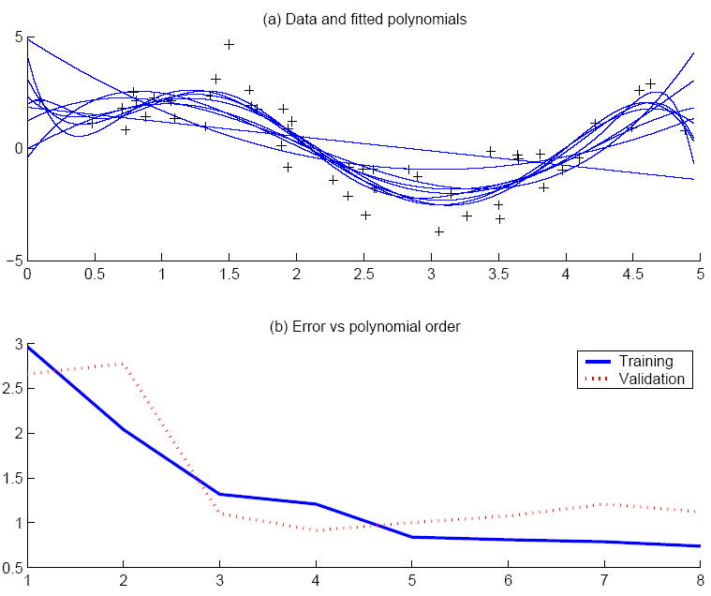
Best fit, “elbow”

Slide 26
Model Selection
Cross-validation: Measure generalization accuracy by testing on data unused during training
Regularization: Penalize complex models
E’=error on data + λ model complexity
Akaike’s information criterion (AIC), Bayesian information criterion (BIC)
Minimum description length (MDL): Kolmogorov complexity, shortest description of data
Structural risk minimization (SRM)

Slide 27
Bayesian Model Selection
Prior on models, p(model)
Regularization, when prior favors simpler models
Bayes, MAP of the posterior, p(model|data)
Average over a number of models with high posterior (voting, ensembles: Chapter 17)

Slide 28
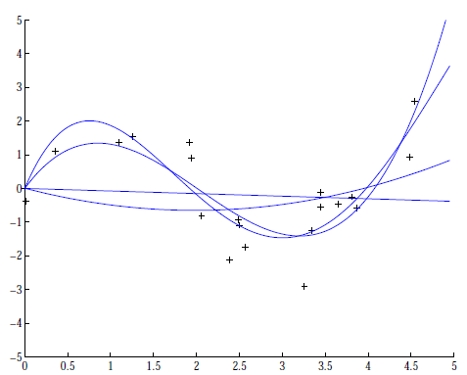
Regression example
Coefficients increase in magnitude as order increases:
1: [-0.0769, 0.0016]
2: [0.1682, -0.6657, 0.0080]
3: [0.4238, -2.5778, 3.4675, -0.0002
4: [-0.1093, 1.4356,
-5.5007, 6.0454, -0.0019]
Regularization (L2):

