Slide 1
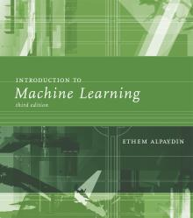
INTRODUCTION TO Machine Learning 3rd Edition
Lecture Slides for
ETHEM ALPAYDIN
© The MIT Press, 2014
alpaydin@boun.edu.tr
http://www.cmpe.boun.edu.tr/~ethem/i2ml3e

Slide 2
CHAPTER 5: Multivariate Methods

Slide 3
Multivariate Data
Multiple measurements (sensors)
d inputs/features/attributes: d-variate
N instances/observations/examples

Slide 4
Multivariate Parameters

Slide 5
Parameter Estimation

Slide 6
Estimation of Missing Values
What to do if certain instances have missing attributes?
Ignore those instances: not a good idea if the sample is small
Use ‘missing’ as an attribute: may give information
Imputation: Fill in the missing value
Mean imputation: Use the most likely value (e.g., mean)
Imputation by regression: Predict based on other attributes

Slide 7
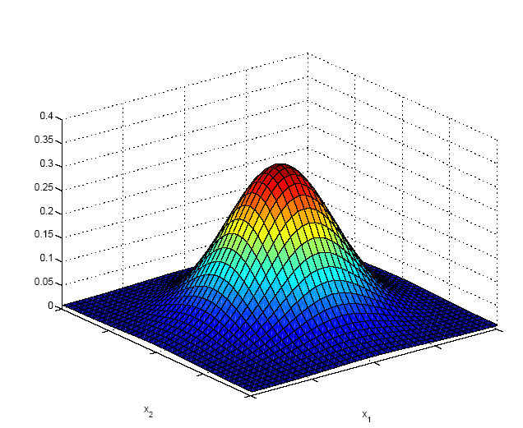
Multivariate Normal Distribution

Slide 8
Multivariate Normal Distribution
Mahalanobis distance: (x – μ)^{T} ∑^{–1} (x – μ)
measures the distance from x to μ in terms of ∑ (normalizes for difference in variances and correlations)
Bivariate: d = 2

Slide 9
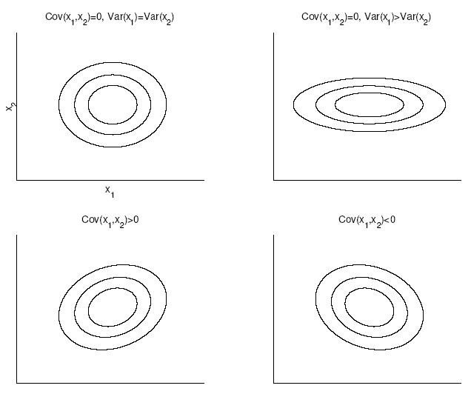
Bivariate Normal

Slide 10
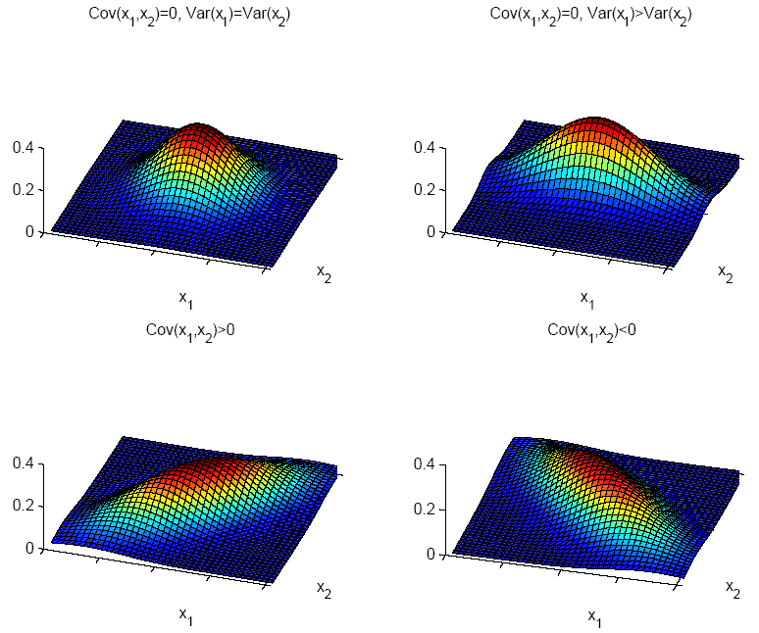

Slide 11
Independent Inputs: Naive Bayes
If x_{i} are independent, offdiagonals of ∑ are 0, Mahalanobis distance reduces to weighted (by 1/σ_{i}) Euclidean distance:
If variances are also equal, reduces to Euclidean distance

Slide 12
Parametric Classification
If p (x | C_{i} ) ~ N ( μ_{i} , ∑_{i} )
Discriminant functions

Slide 13
Estimation of Parameters

Slide 14
Different S_{i}
Quadratic discriminant

Slide 15
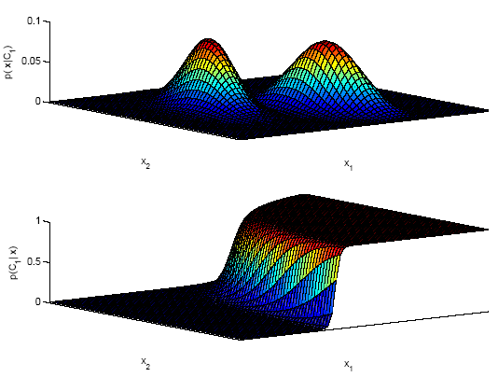
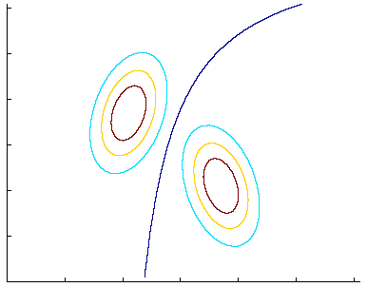
discriminant:
P (C₁|x ) = 0.5
likelihoods
posterior for C₁

Slide 16
Common Covariance Matrix S
Shared common sample covariance S
Discriminant reduces to
which is a linear discriminant

Slide 17
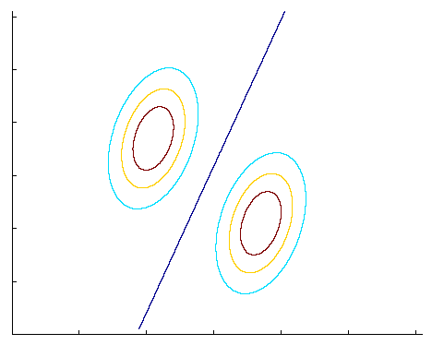
Common Covariance Matrix S

Slide 18
Diagonal S
When x_{j} j = 1,..d, are independent, ∑ is diagonal
p (x|C_{i}) = ∏_{j} p (x_{j} |C_{i}) (Naive Bayes’ assumption)
Classify based on weighted Euclidean distance (in s_{j} units) to the nearest mean

Slide 19
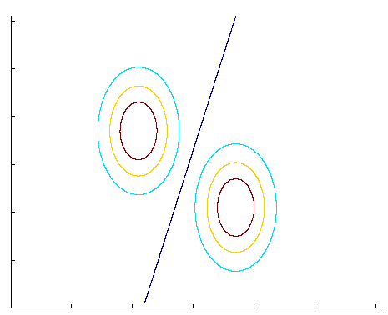
Diagonal S
variances may be
different

Slide 20
Diagonal S, equal variances
Nearest mean classifier: Classify based on Euclidean distance to the nearest mean
Each mean can be considered a prototype or template and this is template matching

Slide 21
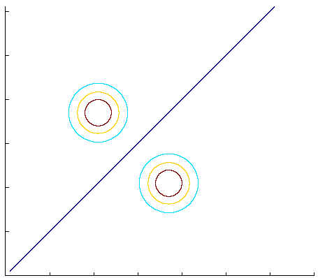
Diagonal S, equal variances
*
?

Slide 22
Model Selection
Assumption | Covariance matrix | No of parameters
Shared, Hyperspheric | S_{i}=S=s²I | 1
Shared, Axis-aligned | S_{i}=S, with s_{ij}=0 | d
Shared, Hyperellipsoidal | S_{i}=S | d(d+1)/2
Different, Hyperellipsoidal | S_{i} | K d(d+1)/2
As we increase complexity (less restricted S), bias decreases and variance increases
Assume simple models (allow some bias) to control variance (regularization)

Slide 23
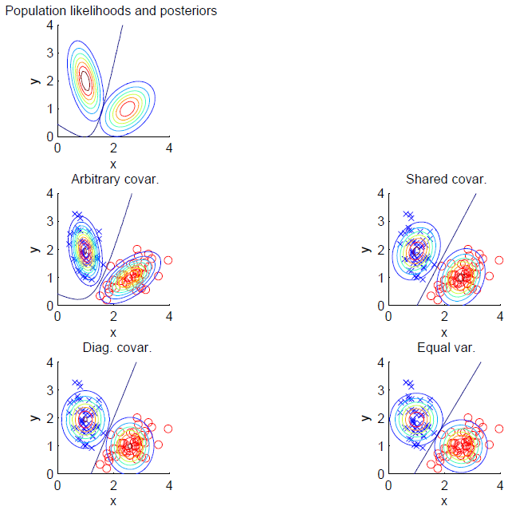

Slide 24
Discrete Features
Binary features:
if x_{j} are independent (Naive Bayes’)
the discriminant is linear
Estimated parameters

Slide 25
Discrete Features
Multinomial (1-of-n_{j}) features: x_{j} Î {v₁, v₂,..., v_{nj}}
if x_{j} are independent

Slide 26
Multivariate Regression
Multivariate linear model
Multivariate polynomial model:
Define new higher-order variables
z₁=x₁, z₂=x₂, z₃=x₁², z₄=x₂², z₅=x₁x₂
and use the linear model in this new z space
(basis functions, kernel trick: Chapter 13)

