Slide 1
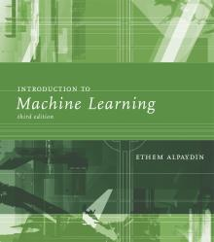
INTRODUCTION TO Machine Learning 3rd Edition
Lecture Slides for
ETHEM ALPAYDIN
© The MIT Press, 2014
alpaydin@boun.edu.tr
http://www.cmpe.boun.edu.tr/~ethem/i2ml3e

Slide 2
CHAPTER 8: Nonparametric Methods

Slide 3
Nonparametric Estimation
Parametric (single global model), semiparametric (small number of local models)
Nonparametric: Similar inputs have similar outputs
Functions (pdf, discriminant, regression) change smoothly
Keep the training data;“let the data speak for itself”
Given x, find a small number of closest training instances and interpolate from these
Aka lazy/memory-based/case-based/instance-based learning

Slide 4
Density Estimation
Given the training set X={x^{t}}_{t} drawn iid from p(x)
Divide data into bins of size h
Histogram:
Naive estimator:
or

Slide 5
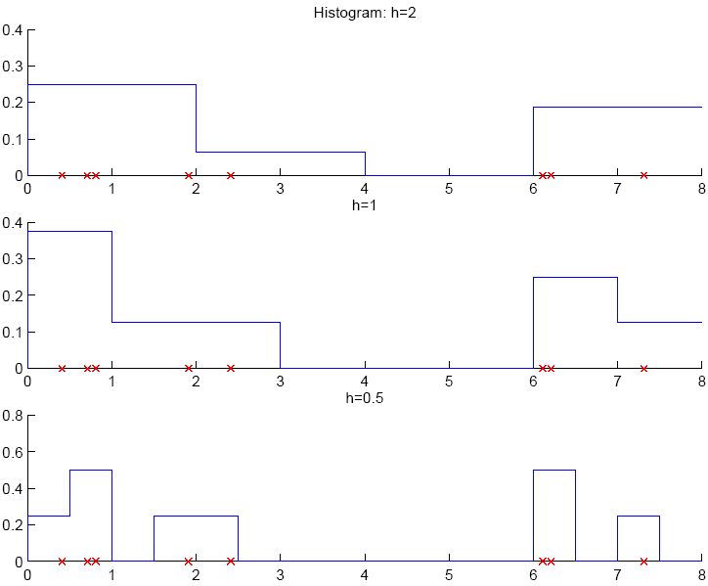

Slide 6
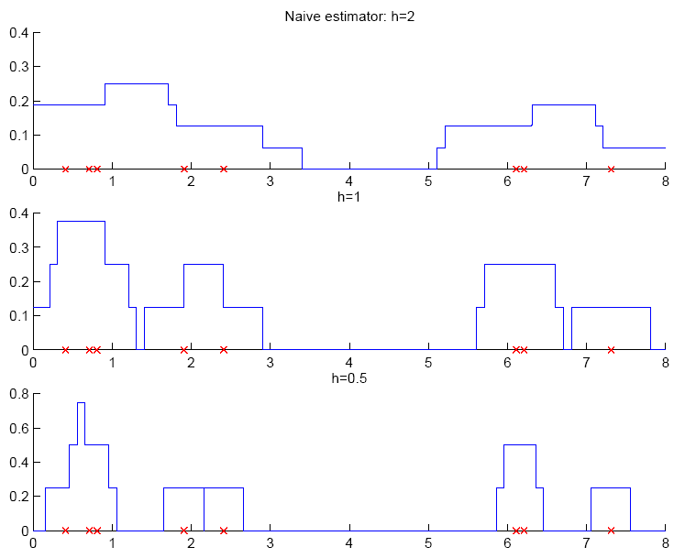

Slide 7
Kernel Estimator
Kernel function, e.g., Gaussian kernel:
Kernel estimator (Parzen windows)

Slide 8
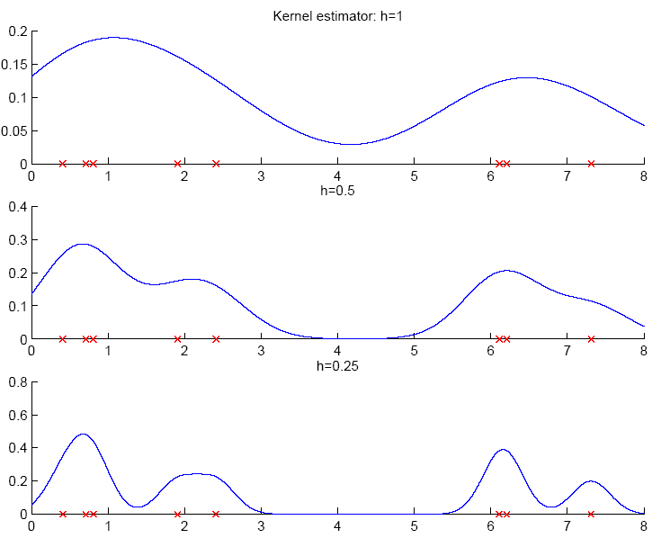

Slide 9
k-Nearest Neighbor Estimator
Instead of fixing bin width h and counting the number of instances, fix the instances (neighbors) k and check bin width
d_{k}(x), distance to kth closest instance to x

Slide 10
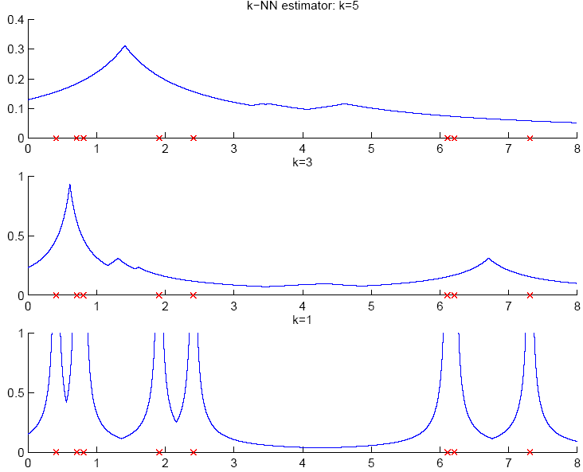

Slide 11
Multivariate Data
Kernel density estimator
Multivariate Gaussian kernel
spheric
ellipsoid

Slide 12
Nonparametric Classification
Estimate p(x|C_{i}) and use Bayes’ rule
Kernel estimator
k-NN estimator

Slide 13
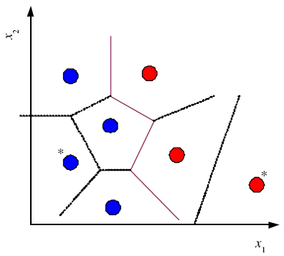
Condensed Nearest Neighbor
Time/space complexity of k-NN is O (N)
Find a subset Z of X that is small and is accurate in classifying X (Hart, 1968)

Slide 14
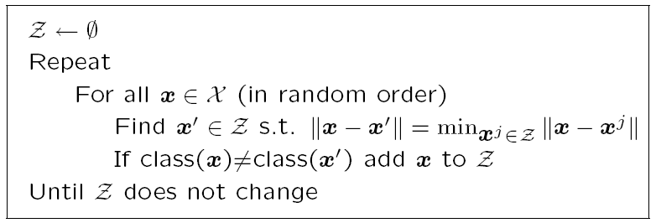
Condensed Nearest Neighbor
Incremental algorithm: Add instance if needed

Slide 15

Distance-based Classification
Find a distance function D(x^{r},x^{s}) such that
if x^{r}and x^{s}belong to the same class, distance is small and if they belong to different classes, distance is large
Assume a parametric model and learn its parameters using data, e.g.,

Slide 16
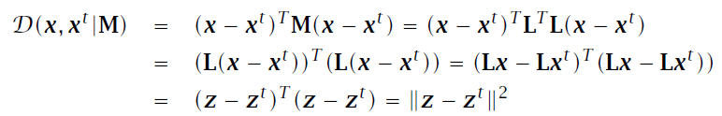
Learning a Distance Function
The three-way relationship between distances, dimensionality reduction, and feature extraction.
M=L^{T}L is dxd and L is kxd
Similarity-based representation using similarity scores
Large-margin nearest neighbor (chapter 13)

Slide 17
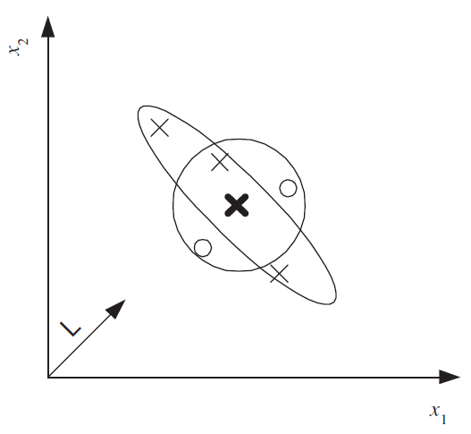
Euclidean distance (circle) is not suitable,
Mahalanobis distance using an M (ellipse) is suitable.
After the data is projected along L, Euclidean distance can be used.

Slide 18
Outlier Detection
Find outlier/novelty points
Not a two-class problem because outliers are very few, of many types, and seldom labeled
Instead, one-class classification problem: Find instances that have low probability
In nonparametric case: Find instances far away from other instances

Slide 19

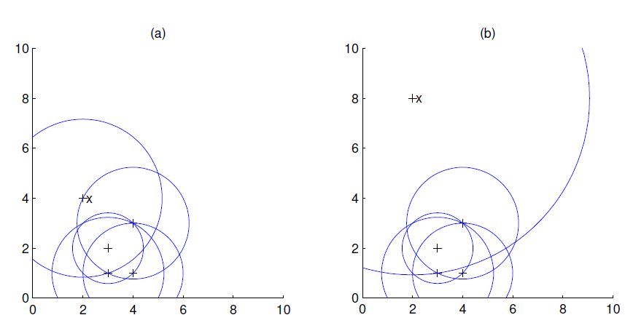
Local Outlier Factor

Slide 20
Nonparametric Regression
Aka smoothing models
Regressogram

Slide 21
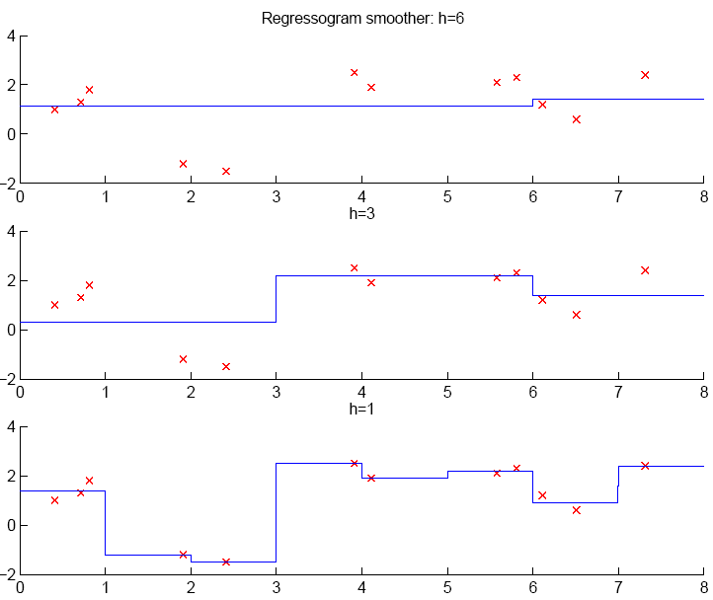

Slide 22
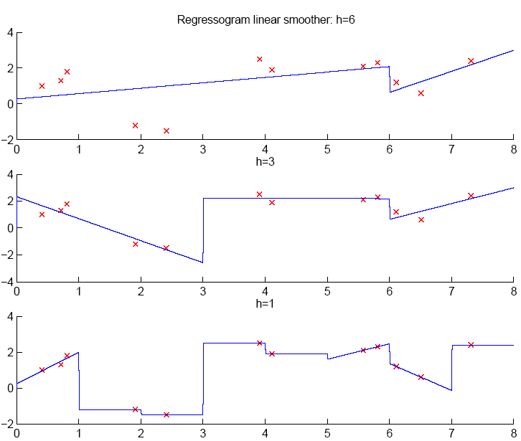

Slide 23
Running Mean/Kernel Smoother
Running mean smoother
Running line smoother
Kernel smoother
where K( ) is Gaussian
Additive models (Hastie and Tibshirani, 1990)

Slide 24
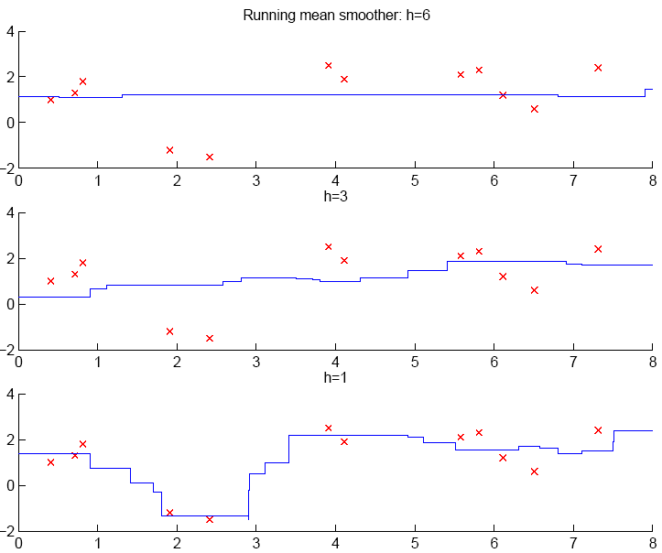

Slide 25
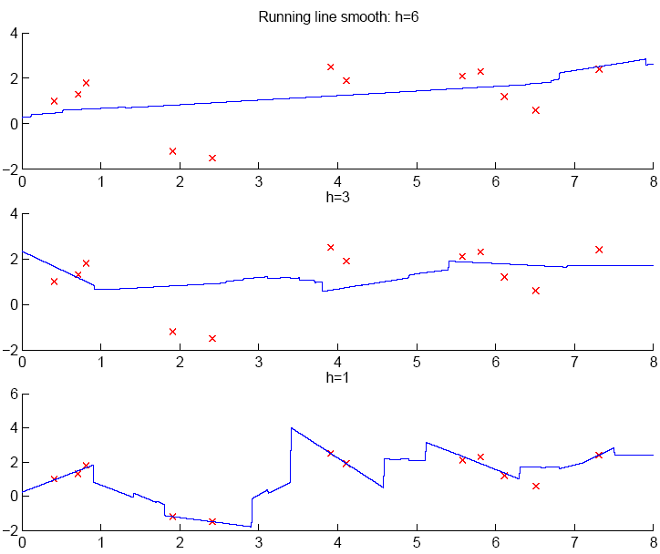

Slide 26
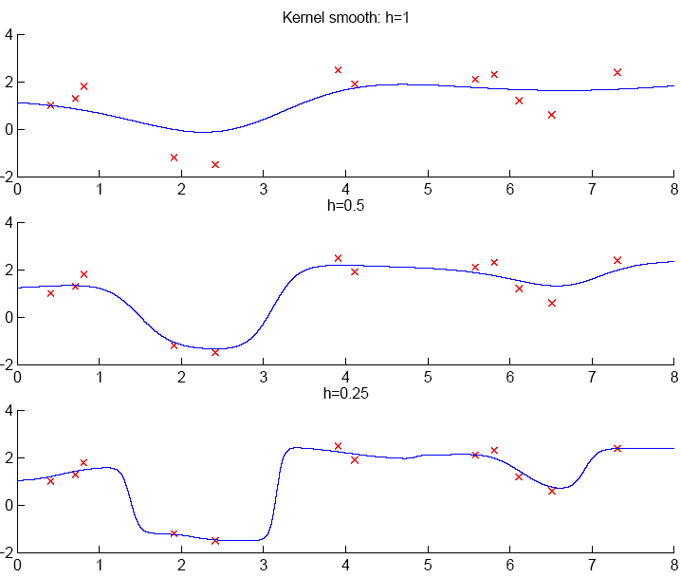

Slide 27
How to Choose k or h ?
When k or h is small, single instances matter; bias is small, variance is large (undersmoothing): High complexity
As k or h increases, we average over more instances and variance decreases but bias increases (oversmoothing): Low complexity
Cross-validation is used to finetune k or h.

Slide 28
