Slide 1

INTRODUCTION TO Machine Learning 3rd Edition
Lecture Slides for
ETHEM ALPAYDIN
© The MIT Press, 2014
alpaydin@boun.edu.tr
http://www.cmpe.boun.edu.tr/~ethem/i2ml3e

Slide 2
CHAPTER 9: Decision Trees

Slide 3
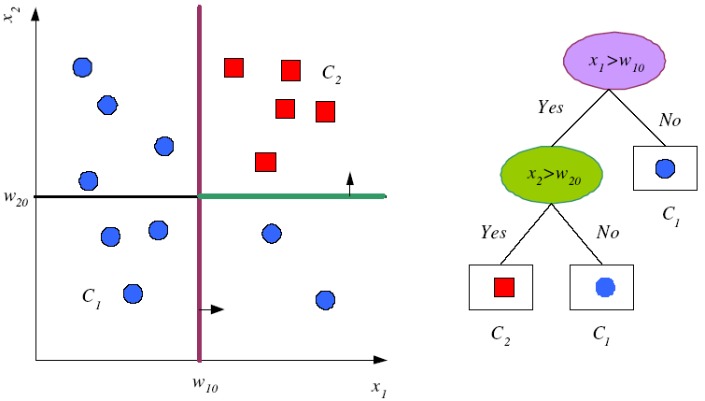
Tree Uses Nodes and Leaves

Slide 4
Divide and Conquer
Internal decision nodes
Univariate: Uses a single attribute, x_{i}
Numeric x_{i} : Binary split : x_{i} > w_{m}
Discrete x_{i} : n-way split for n possible values
Multivariate: Uses all attributes, x
Leaves
Classification: Class labels, or proportions
Regression: Numeric; r average, or local fit
Learning is greedy; find the best split recursively (Breiman et al, 1984; Quinlan, 1986, 1993)

Slide 5
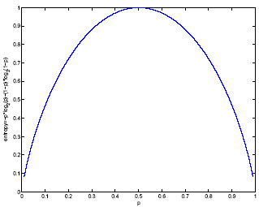
Classification Trees (ID3,CART,C4.5)
For node m, N_{m} instances reach m, N^{i}_{m} belong to C_{i}
Node m is pure if p^{i}_{m} is 0 or 1
Measure of impurity is entropy

Slide 6
Best Split
If node m is pure, generate a leaf and stop, otherwise split and continue recursively
Impurity after split: N_{mj} of N_{m} take branch j. N^{i}_{mj} belong to C_{i}
Find the variable and split that min impurity (among all variables -- and split positions for numeric variables)

Slide 7
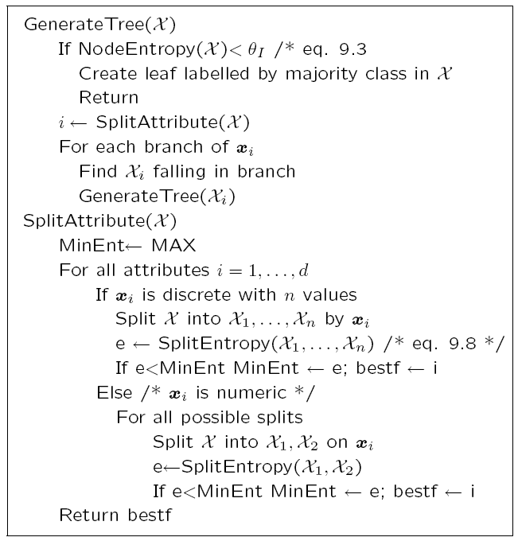

Slide 8
Regression Trees
Error at node m:
After splitting:

Slide 9
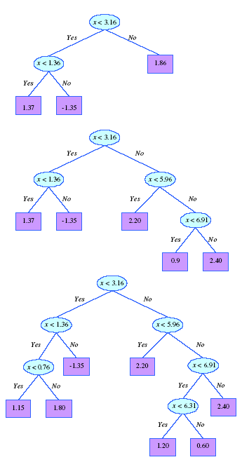
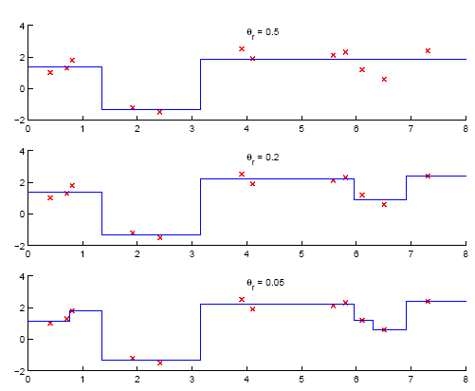
Model Selection in Trees

Slide 10
Pruning Trees
Remove subtrees for better generalization (decrease variance)
Prepruning: Early stopping
Postpruning: Grow the whole tree then prune subtrees that overfit on the pruning set
Prepruning is faster, postpruning is more accurate (requires a separate pruning set)

Slide 11
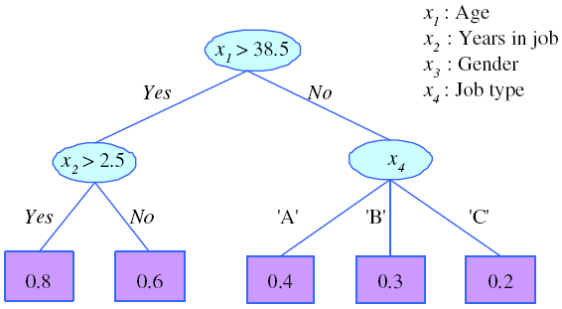
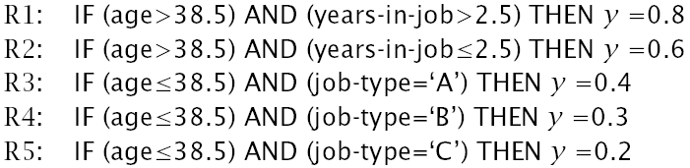
Rule Extraction from Trees
C4.5Rules
(Quinlan, 1993)

Slide 12
Learning Rules
Rule induction is similar to tree induction but
tree induction is breadth-first,
rule induction is depth-first; one rule at a time
Rule set contains rules; rules are conjunctions of terms
Rule covers an example if all terms of the rule evaluate to true for the example
Sequential covering: Generate rules one at a time until all positive examples are covered
IREP (Fürnkrantz and Widmer, 1994), Ripper (Cohen, 1995)

Slide 13
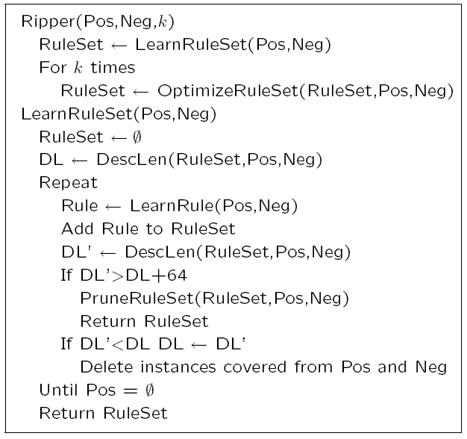

Slide 14
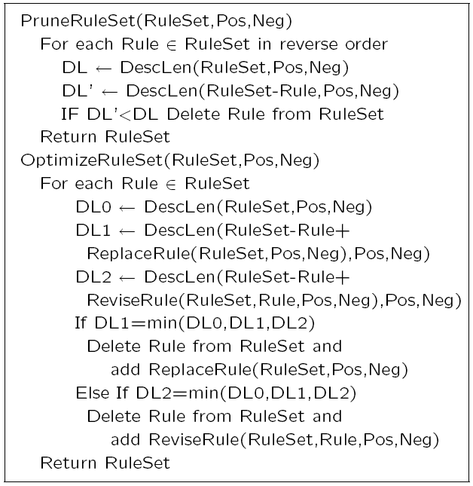

Slide 15
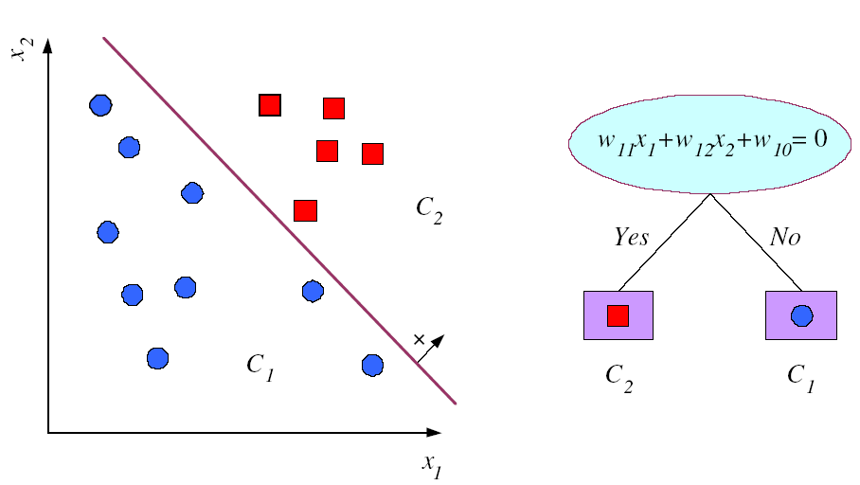
Multivariate Trees

