Slide 1
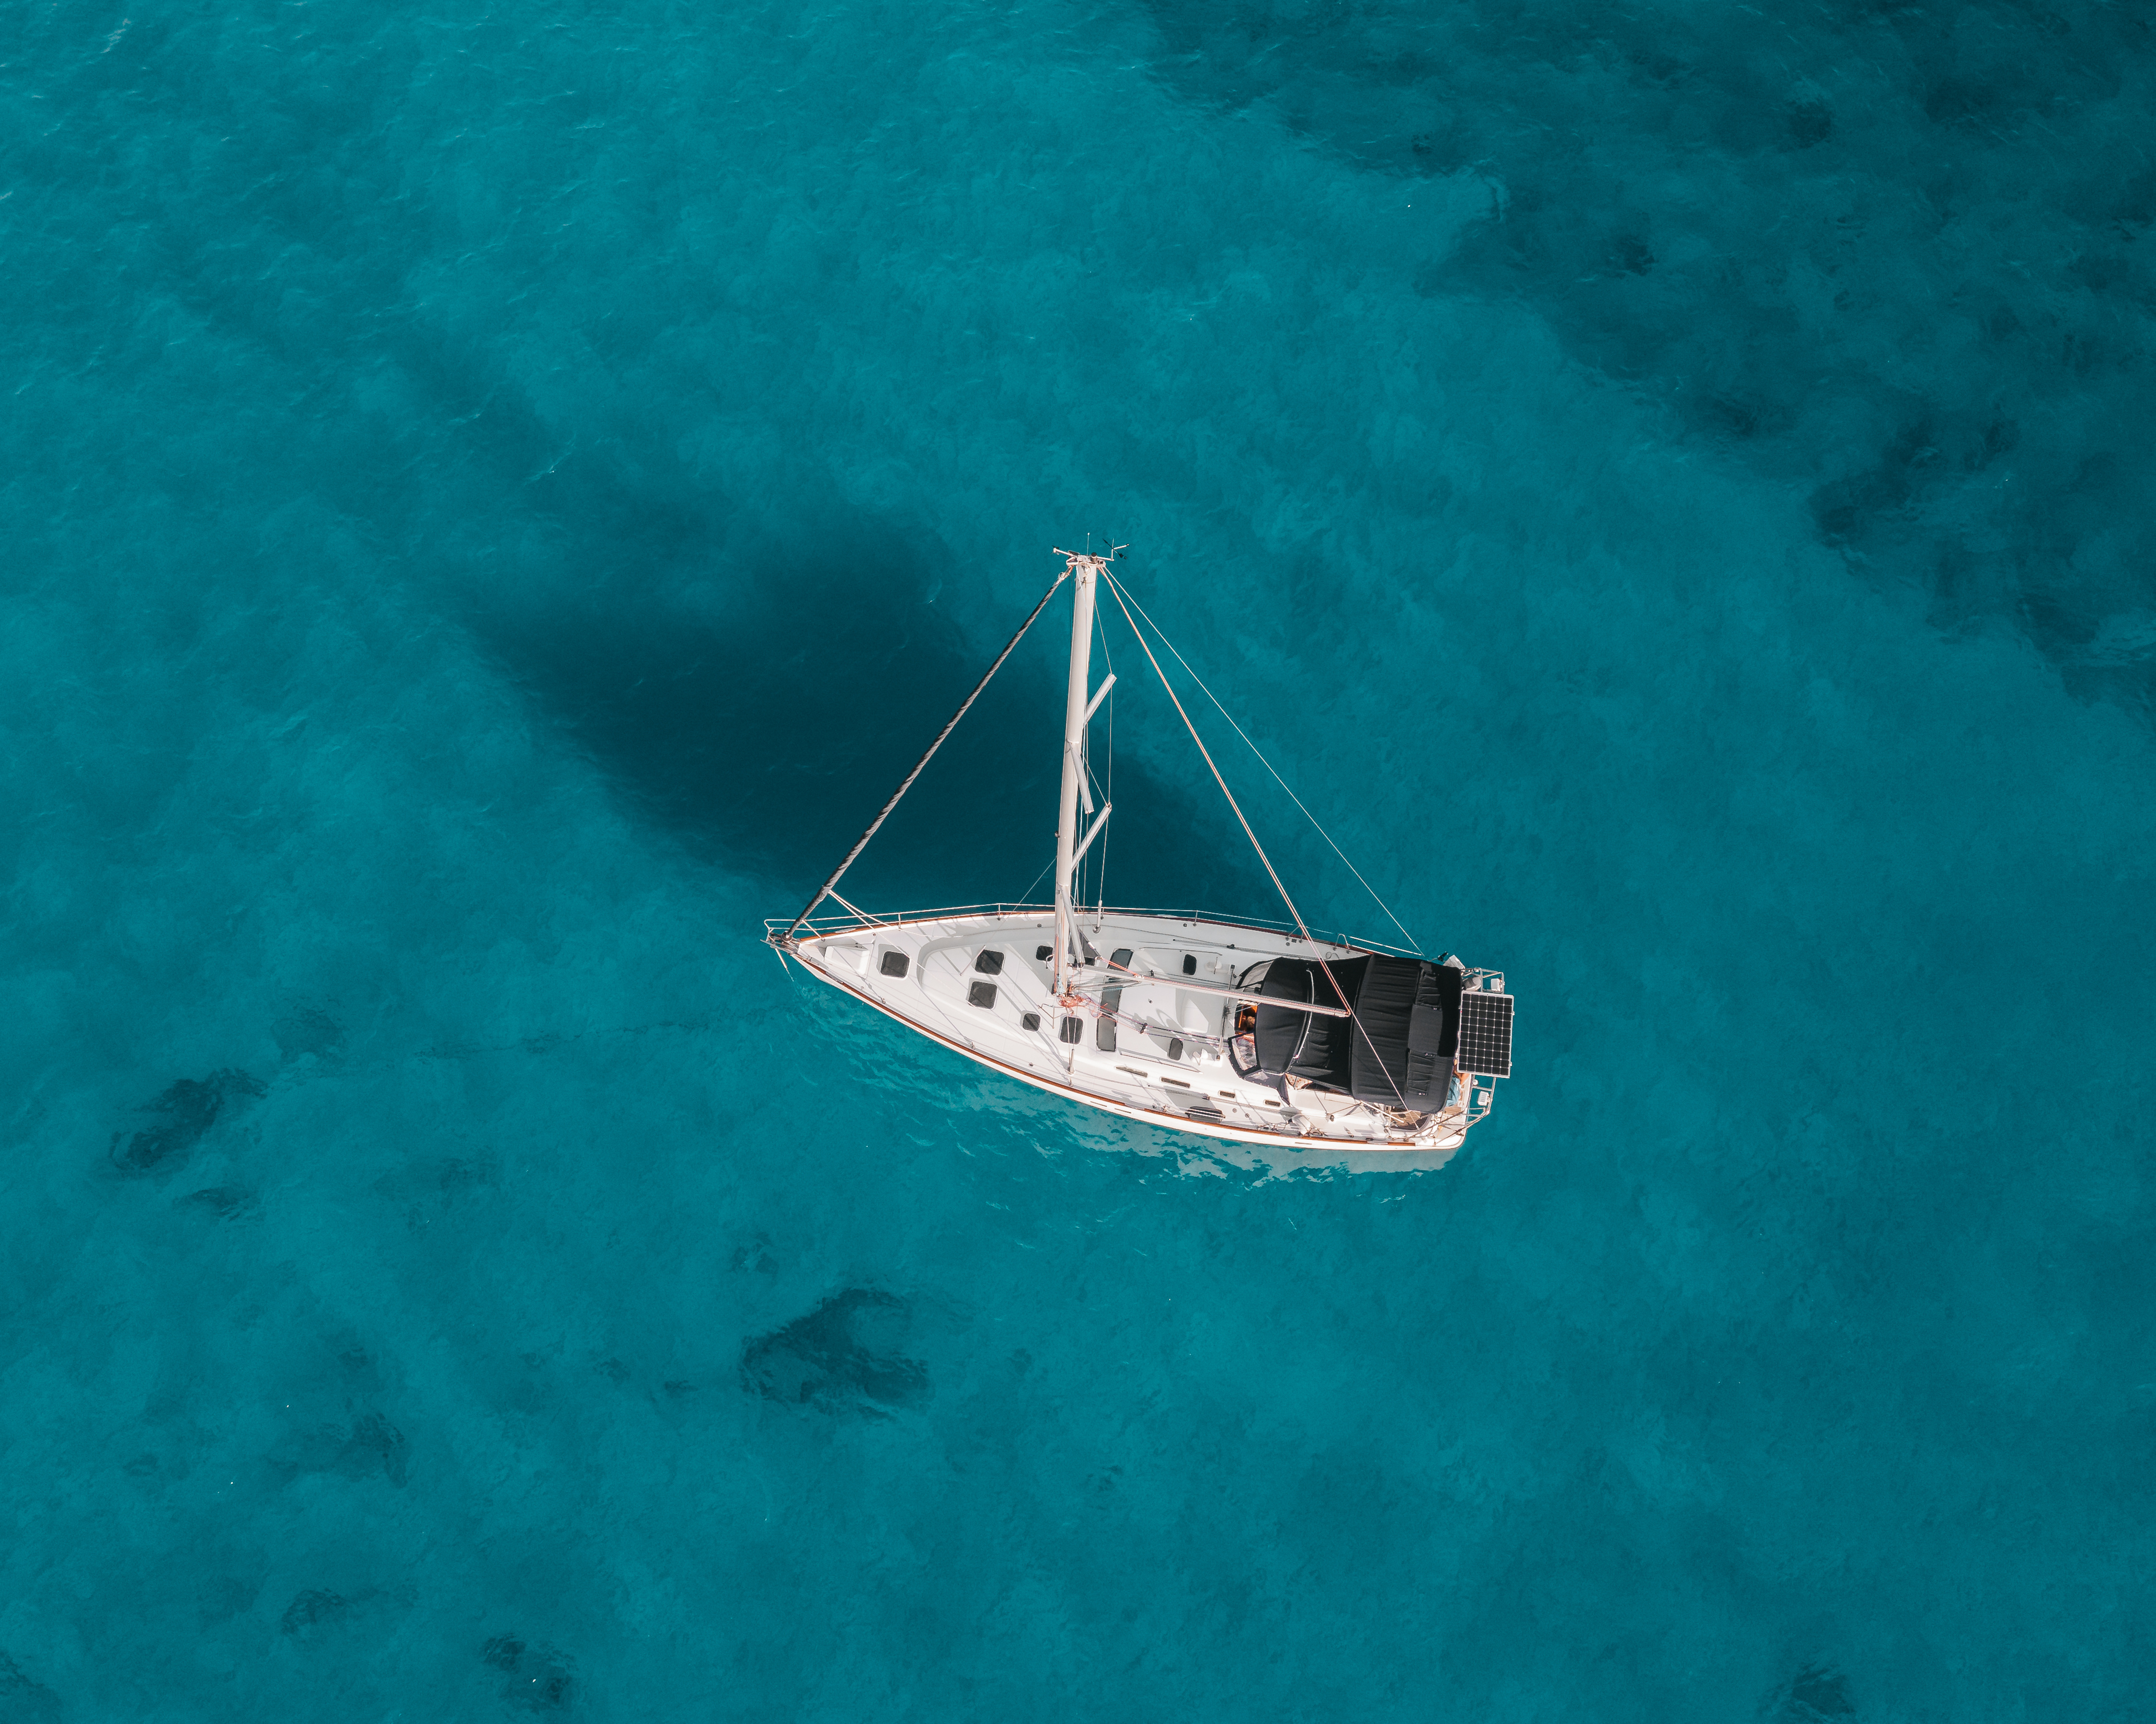
Mezzanzanica Chiara 895530 Nucci Nicolò 945678
SailNet: Multi-Task Frame Classification
Deep Learning Project - 2026

Slide 2
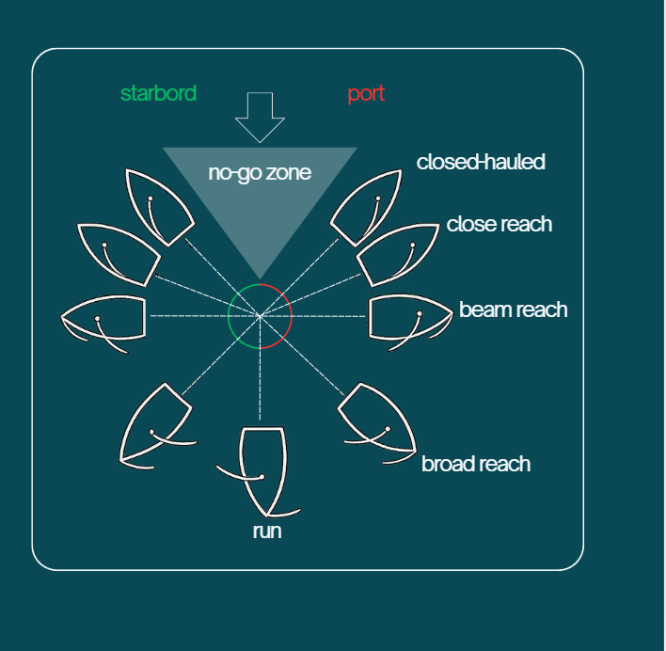
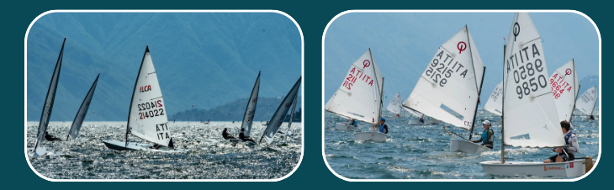
DATA
LABELING
AUGMENTATION
FOCAL LOSS
SHARED STRUCTURES
This dataset consists of 94 sailing videos that were segmented into shorter clips, each containing a single continuous instance of one label combination, to ensure precise annotation.
The footage captures two boat classes, the ILCA and the Optimist, performing maneuvers across three points of sail: no-go zone, closed hauled, and run, on both port and starboard tack, yielding six possible label combinations per boat type.
Ilca
Optimist

Slide 3
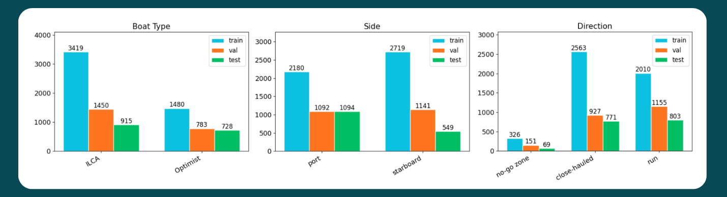
DATA
LABELING
AUGMENTATION
FOCAL LOSS
SHARED STRUCTURES
Frames extraction is at 5 fps, with the exception of no-go zone which was sampled at 15 fps.
Stratified split into train, validation, and test sets to preserve proportionally.
Split operates at the video level rather than the frame level: all frames belonging to a given video appear exclusively in one split. This prevents the model from seeing near-identical frames and artificially inflate validation and test accuracy.

Slide 4

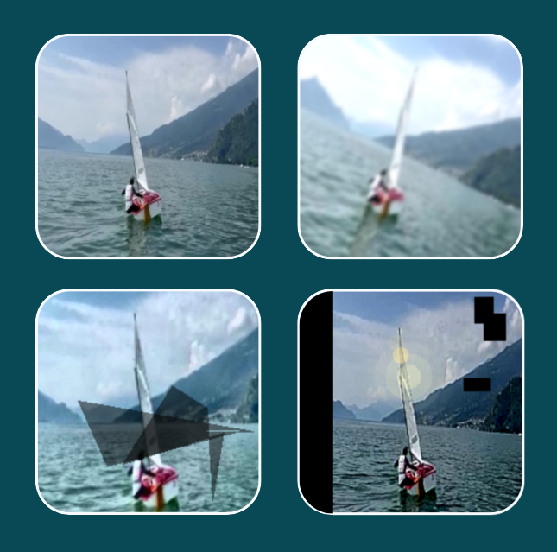
DATA
LABELING
AUGMENTATION
FOCAL LOSS
SHARED STRUCTURES
Albumentations library [1] was chosen for its rich set of
domain-relevant transforms, particularly those simulating sailing-specific conditions such as variable lighting, atmospheric haze, and camera motion.
Augmentation is applied on-the-fly and each original image generates 3 augmented copies. All models share the same augmentation logic and the same deterministic seeds guaranteeing a fair comparison.
The three versions each combine transformations from at least three of the following categories:
  rotation, colour jitter, fog, and motion blur
  perspective distortion, random crop, hue shift and shadow
  affine warp, brightness/contrast, sharpening, sun flare, Gaussian noise, and coarse dropout

Slide 5
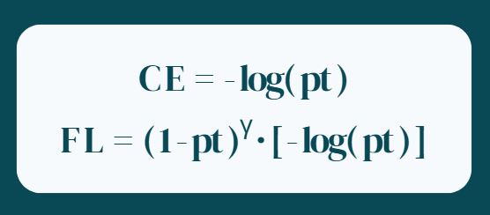
LABELING
AUGMENTATION
FOCAL LOSS
SHARED STRUCTURES
PARALLEL
Standard cross-entropy treats all misclassified examples equally but in datasets with natural class imbalance this leads the model to quickly master the common classes while making little progress on the rare or ambiguous ones.
C E = - log( pt )
γ
F L = ( 1 - pt ) · [ - log( pt ) ]
A solution to this problem is introducing the Focal Loss [2] that modifies
cross-entropy by multiplying it by a dynamic scaling factor: (1 − pt) .
pt is the probability assigned to the correct class. When the model is confident (pt → 1), the factor approaches 0 and the example contributes almost nothing to the gradient. When the model struggles (pt → 0), the factor approaches 1 and the loss behaves like standard cross-entropy. With γ = 2, easy examples are effectively silenced and training focuses on what the model has not yet learned.
Addittionally we apply Label Smoothing [3] (ε = 0.1), true-class targets are softened from 1.0 to 0.9, with the remaining probability distributed equally across all other classes. This prevents the model from becoming overconfident and acts as a regularizer that improves both calibration and generalization.
γ

Slide 6
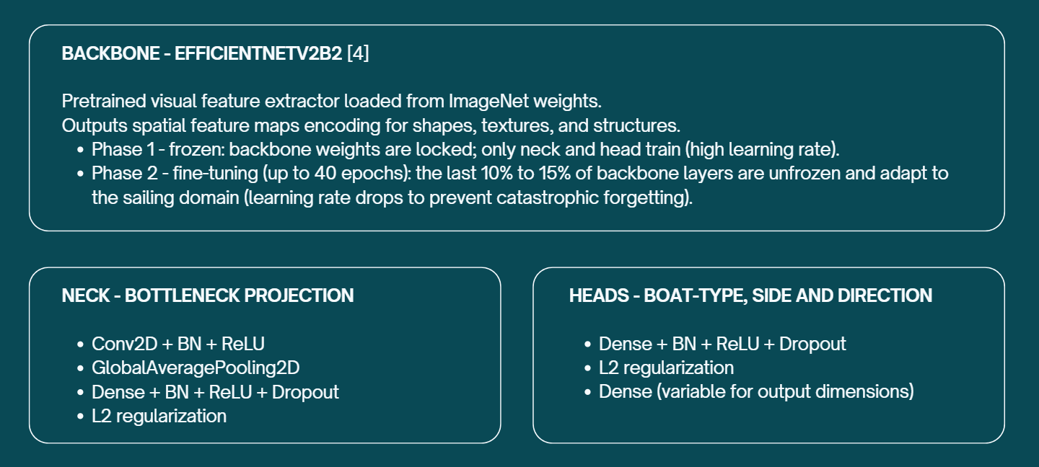
AUGMENTATION
FOCAL LOSS
SHARED STRUCTURES
PARALLEL
CASCADE
BACKBONE - EFFICIENTNETV2B2 [4]
Pretrained visual feature extractor loaded from ImageNet weights.
Outputs spatial feature maps encoding for shapes, textures, and structures.
  Phase 1 - frozen: backbone weights are locked; only neck and head train (high learning rate).
  Phase 2 - fine-tuning (up to 40 epochs): the last 10% to 15% of backbone layers are unfrozen and adapt to the sailing domain (learning rate drops to prevent catastrophic forgetting).
NECK - BOTTLENECK PROJECTION
  Conv2D + BN + ReLU
  GlobalAveragePooling2D
  Dense + BN + ReLU + Dropout
  L2 regularization
HEADS - BOAT-TYPE, SIDE AND DIRECTION
  Dense + BN + ReLU + Dropout
  L2 regularization
  Dense (variable for output dimensions)

Slide 7
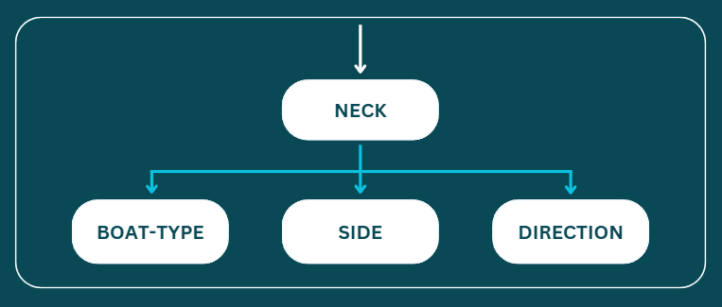
FOCAL LOSS
SHARED STRUCTURES
PARALLEL
CASCADE
HYBRID
SINGLE-HEAD
STRUCTURAL LIMIT:
Since all three tasks receive identical input with no information flowing between branches, the model treats each classification problem as fully independent.
In reality, the tasks are semantically linked: knowing the boat type constrains the plausible set of points of sail, and side (port/starboard) is geometrically correlated with direction.
A parallel architecture cannot exploit these dependencies as any correlation learned is implicit, encoded in the shared weights, rather than explicitly modeled as a directed flow of information from one prediction to the next.
The vector generated by the neck is feed to a single shared Dense layer. As usual this layer is followed by BN + ReLU + Dropout.
The output is sent to three independent softmax heads (one for each classification task).

Slide 8
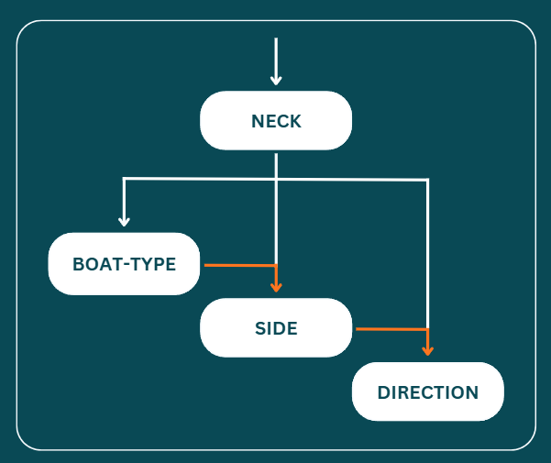
SHARED STRUCTURES
PARALLEL
CASCADE
HYBRID
SPATIAL ATTENTION
TRIPLE-HEAD
The neck vector is fed to a first Dense block that predicts boat type. The resulting logits are concatenated back to the neck vector and passed to a second Dense block for side prediction [5]. The same pattern repeats: side logits are appended before the final Dense block classifies direction.
Each stage therefore receives richer input than the previous one.
STRUCTURAL ADVANTAGE:
Information flows explicitly between tasks and each head
conditions its prediction on all previous outputs, allowing the
model to exploit inter-task dependencies.
The cost is a fixed prediction order: errors in early heads propagate forward and cannot be corrected by later stages.

Slide 9
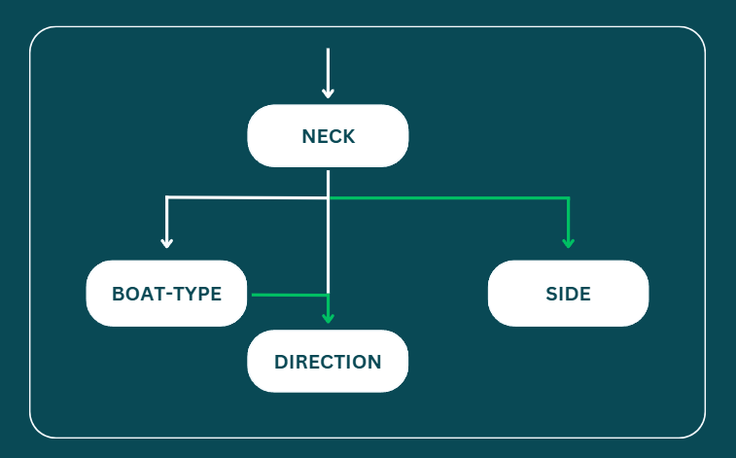
PARALLEL
CASCADE
HYBRID
SPATIAL ATTENTION
EVALUATION
PARALLEL-CASCADE
The neck vector feeds a first Dense block that predicts boat type. Those logits are concatenated to the neck vector and passed to a second Dense block for direction prediction.
Side, however, branches directly from the original neck vector through its own independent Dense block, it receives no information from the two preceding predictions.
STRUCTURAL RATIONALE:
This design follows a visual logic grounded in the nature of the tasks. Boat type influences how a vessel appears at a given point of sail so knowing the boat type provides genuinely useful context for direction prediction. Side, on the other hand, is deliberately kept independent: mirroring an image horizontally does not change the point of sail, meaning tack and direction carry no directional dependency and cascading side into direction would introduce noise.

Slide 10
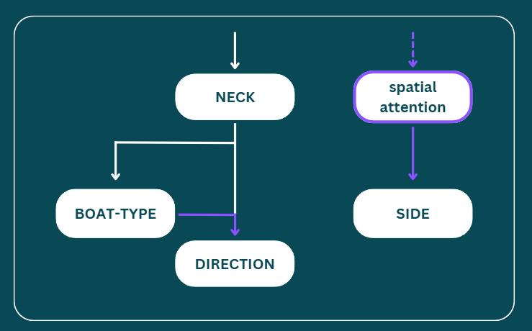
CASCADE
HYBRID
SPATIAL ATTENTION
EVALUATION
FINE TUNING
HYBRID + ATTENTION
The neck vector feeds boat type and direction following the same cascade architecture as te previous model.
The side head, however, bypasses the neck entirely, it reads directly from the raw backbone feature map through a dedicated CBAM-lite [6] spatial attention block, which is then pooled into a vector before its Dense head.
STRUCTURAL RATIONALE:
Port vs starboard requires knowing where in the frame the sail is, not just what features are present globally. The neck's Global Average Pooling discards that spatial information before the side head ever sees it. The CBAM-lite block intercepts the 7×7 feature map before pooling, first gating the 1408 channels to retain only tack-relevant ones, then weighting the spatial grid to amplify the left/right regions where the sail signal lives.

Slide 11
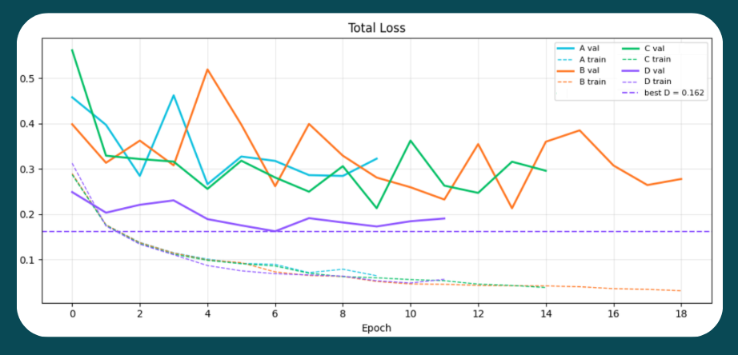
HYBRID
SPATIAL ATTENTION
EVALUATION
FINE TUNING
FUTURE
PERSPECTIVES
Accuracy
Model
A
B
C
D
Boat
0.999
1.000
1.000
0.999
Side
0.703
0.714
0.686
0.816
Dir
0.722
0.778
0.655
0.706
Best model: D
Model D reaches the lowest total validation loss (0.162) and delivers the strongest combined performance: near-perfect boat recognition (0.999), best-in-class side accuracy (0.816), and competitive direction accuracy (0.706), making it the only model that avoids a critical weakness in any single task.

Slide 12
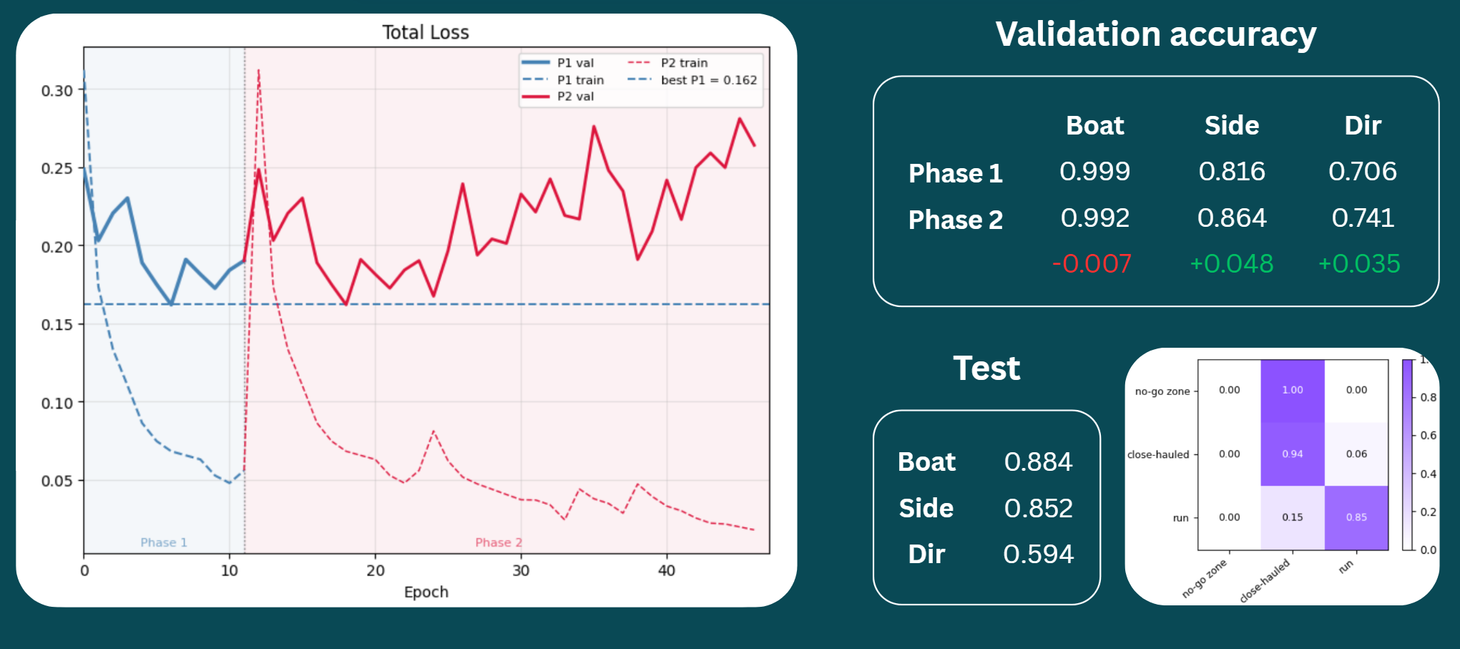
HYBRID
SPATIAL ATTENTION
EVALUATION
FINE TUNING
FUTURE
PERSPECTIVES
Validation accuracy
Phase 1
Phase 2
Boat
0.999
0.992
-0.007
Side
0.816
0.864
+0.048
Dir
0.706
0.741
+0.035
Test
Boat
Side
Dir
0.884
0.852
0.594

Slide 13
HYBRID
SPATIAL ATTENTION
EVALUATION
FINE TUNING
FUTURE PERSPECTIVES
INCREASED TRAINING DATA
  Overfitting on the direction task observed during fine-tuning, where validation loss diverged from training loss
  Limited boat diversity, currently restricted to ILCA and Optimist only
  Coarse point-of-sail taxonomy, currently collapsed into three categories instead of the full six classic points of sail
Temporal Modeling (Video-Level Analysis)
  Frame-level independence, which ignores the motion and continuity inherent in maneuvers like tacks and gybes
  Frame-level noise/flicker in predictions, since each frame is classified in isolation
  Difficulty disambiguating borderline points of sail that are hard to identify from a single static frame but clearer when observed over a sequence

Slide 14
CITATIONS
[1] Buslaev et al. 2018, “Albumentations: fast and flexible image augmentations”
[2] Lin et al. 2017, “Focal Loss for Dense Object Detection”
[3] Szegedy et al. 2016, “Rethinking the Inception Architecture”
[4] Mingxing Tan et al. 2021, “EfficientNetV2: Smaller Models and Faster Training”
[5] Sebastian Ruder et al. 2017, “An Overview of Multi-Task Learning in Deep Neural Networks”
[6] Sanghyun Woo et al. 2018, “CBAM: Convolutional Block Attention Module”

Slide 15
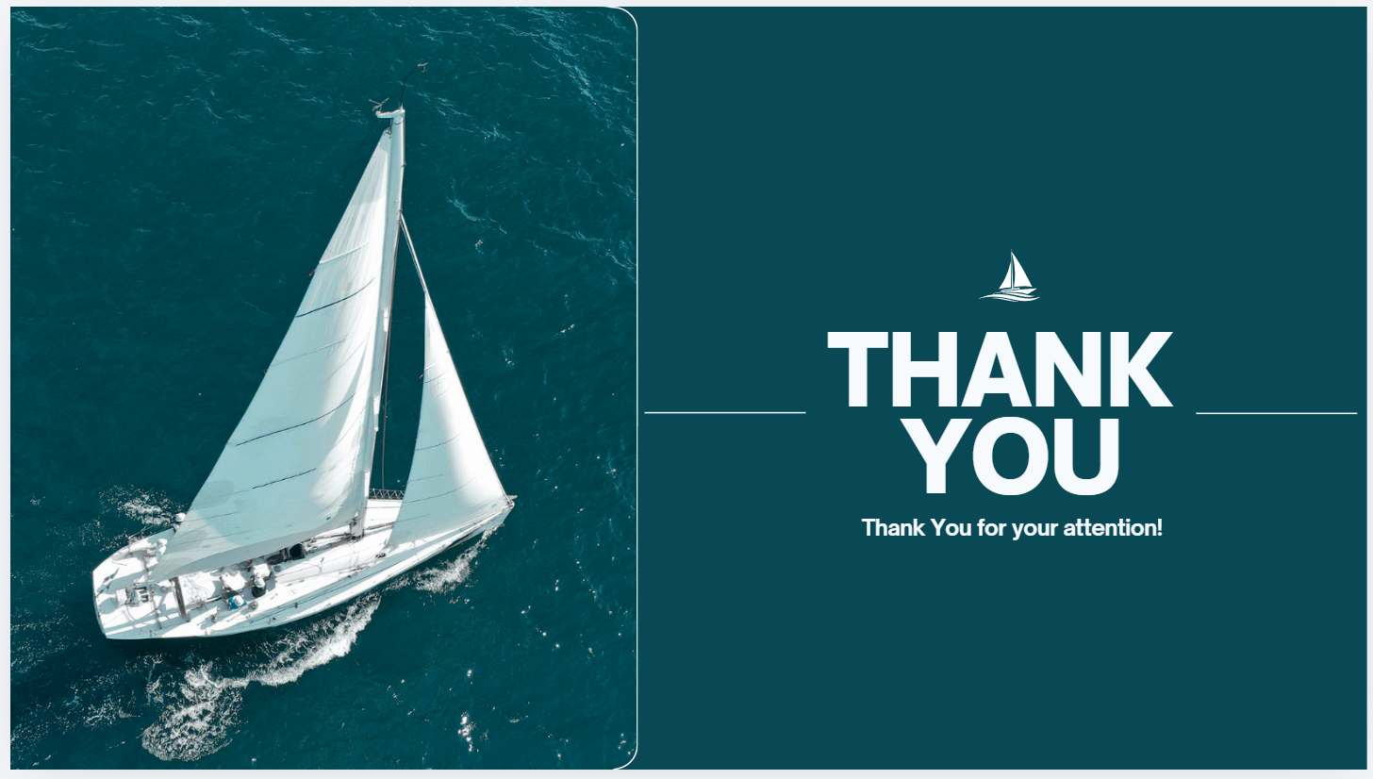
THANK
YOU
Thank You for your attention!

