Slide 1

Other design sketches
α/ρ Network :
  base of “modal formulation” from 2008 to 2015
High-Level Design
  Collection of high-level functions, March 2017
Low Level Design – July 2017
  Class diagram
  Vertical cut : Block formation
  Horizontal cut : Liquid equiibrium

Slide 2
α/ρ Network
Quantum
Interpolation
Quantum
validation
Node / α orbits
Source / ρ(x) = x
and ρ²(x)=x
Number
Table
Private key
use
Liquid
Equilibrium
Sockets / ρ(x) ≠ y and ρ²(x)=x
Document
hashing

Slide 3
High-Level Design – March 2017
Time
Navigator
Web
Interface
Pattern
programming
Process
Builder
Transfert
Editor
Behaviour
biometrics
Source
Integrity
Pattern
Recognition
Network
Security
Word
completion
Human
Recognition
Machine
Society
Ecosystem
Billing
Natural language Analysis
Blockchain
protocols
Hypertext
Engine
Tetris
Structure
Partial
Sharing
Hypertext
Algebra
Electronic data
interchange

Slide 4
High-Level Design – March 2017
Data-driven
graphics
Document
hashing
Number
Table
Page
rendering
Partial
Sharing
Page
construction
Hypertext
Engine
Tetris
Structure
Partial
Sharing
Billing
Numbers
Hypertext
Algebra
Electronic data
interchange
Quantum
validation
Liquid
Equilibrium
Social
Consensus

Slide 5
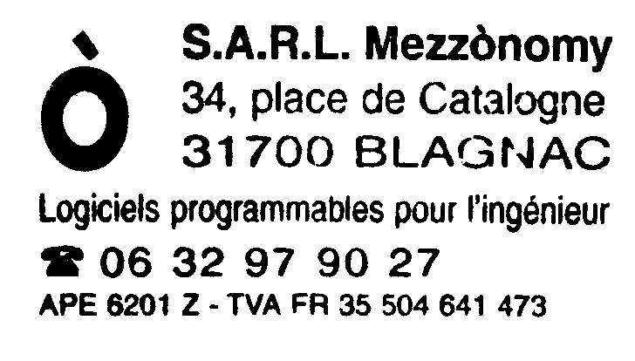
Low Level Design – July 2017
Machine
DAO
Socket
Block
Initial
Test
Uses
Clone
Tree
Covering
STORY
MACHINE
Node
(α,ρ)
1 1
Quantum
Term
User
1 1
Signature
Delegation
Hash
Merkle
Branch
Oracle
Source
Kolmogorov
Compression
Anchor
1 1
Automaton
Tree
Covering
predicate
Part.Sharing
Compiler
Page
IPFS
Application

Slide 6
Low Level Design – July 2017
Source
Unpushed
Quantum
Hypertext
Anchor
Quantum
Liquid
(pushed quantum)
Socket
E2Vnq10PrvU6EPG6vvZpI0KdzGP_hIcLcPMfAaM0R.k
Block
« filename »
MIPTHIcW2RPc4Y_LxkwAf4aUp5zFvB9jRmMKnlL6PcI
solid
Block
3uF1LM.BrO0WkqbyVmcX4kcVd065LEVaNW4tLLxDVvU
Initial

Slide 7
Low Level Design – July 2017
Page
construction
Private key
use
Quantum
validation
Quantum
validation
Append
Liquid
Equilibrium

