Slide 1
Partial sharing and unification
“transclusion” case study :
Xanadu requirements #4 and #5
Pierre Gradit, Michel Vandenberghe
SARL mezzonomy, winter 2016
Every Xanadu server is uniquely and securely identified.
Every Xanadu server can be operated independently or in a network.
Every user is uniquely and securely identified.
Every user can search, retrieve, create and store documents.
Every document can consist of any number of parts each of which may be of any data type.
Every document can contain links of any type including virtual copies ("transclusions") to any other document in the system accessible to its owner.
Links are visible and can be followed from all endpoints.
Permission to link to a document is explicitly granted by the act of publication.
Every document can contain a royalty mechanism at any desired degree of granularity to ensure payment on any portion accessed, including virtual copies ("transclusions") of all or part of the document.
Every document is uniquely and securely identified.
Every document can have secure access controls.
Every document can be rapidly searched, stored and retrieved without user knowledge of where it is physically stored.
Every document is automatically moved to physical storage appropriate to its frequency of access from any given location.
Every document is automatically stored redundantly to maintain availability even in case of a disaster.
Every Xanadu service provider can charge their users at any rate they choose for the storage, retrieval and publishing of documents.
Every transaction is secure and auditable only by the parties to that transaction.
The Xanadu client-server communication protocol is an openly published standard. Third-party software development and integration is encouraged.
Every user can search, retrieve, create and store documents.
Every document can consist of any number of parts each of which may be of any data type.

Slide 2
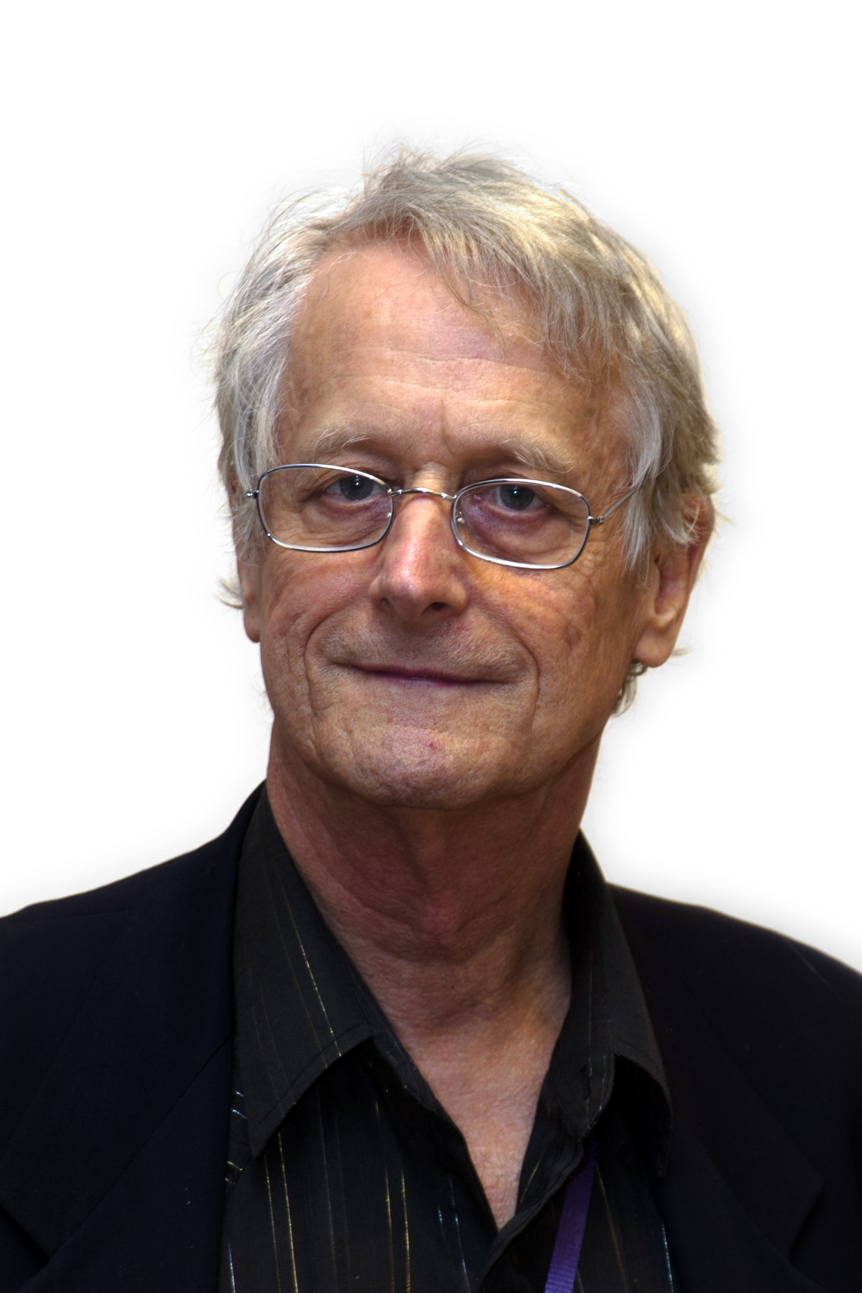
Xanadu document system
#4: Every user can search, retrieve, create and store documents.
#5: Every document can consist of any number of parts each of which may be of any data type.
→ What we call a “platform”
→ Works on unification
CONTRIBUTION UNIT
(c) 2015-2016, sarl mezzònomy
Following persons are granted by sarl mezzònomy
to have contributed to this document:
- Citizen Kane
- Ted Nelson
→ Works on partial sharing

Slide 3
Partial sharing (“transclusions”)
#6: Every document can contain links of any type including virtual copies ("transclusions") to any other document in the system accessible to its owner.
Ownership
#7: Links are visible and can be followed from all endpoints.
#4: Every user can search, retrieve, create and store documents.
#5: Every document can consist of any number of parts each of which may be of any data type.
LINK
→ At the end of the “transclusion” process, both occurrences of the word “document” are linked to the same “object”.
xan:document
xmlns:xan=“https://en.wikipedia.org/wiki/Project_Xanadu”

Slide 4
Unification
#4: Every user can search, retrieve, create and store documents.
#5: Every document can consist of any number of parts each of which may be of any data type.
A document can be searched, retrieved,
created and stored by users
Xanadu
Document
predicates
LINK
A document can consist of any number of
parts each of which may be of any data type
predicates*
predicates
→ Both sentences predicates the “xanadu document”

Slide 5
Partial sharing and unification
Achieving the link:
  By means of “cut'n paste”
  by means of “partial sharing”
  by means of “unification”
Unification is a contribution

Slide 6
Cut'n paste
→ Select the word
#4: Every user can search, retrieve, create and store documents.
→ Ctrl+C
→ Select the word
#5: Every document can consist of any number of parts each of which may be of any data type.
→ Ctrl+V
#5: Every documents can consist of any number of parts each of which may be of any data type.
→ Remove the 's'
#5: Every document can consist of any number of parts each of which may be of any data type.

Slide 7
Cut'n paste
→ Select the word
#4: Every user can search, retrieve, create and store documents.
→ Ctrl+C
→ Select the word
#5: Every document can consist of any number of parts each of which may be of any data type.
→ Ctrl+V
#5: Every documents can consist of any number of parts each of which may be of any data type.
→ Remove the 's'
#5: Every document can consist of any number of parts each of which may be of any data type.
What have
you done ?
Use your human brain to recognize the same word in such different contexts ?

Slide 8
Cut'n paste
→ Select the word
#4: Every user can search, retrieve, create and store documents.
→ Ctrl+C
→ Select the word
#5: Every document can consist of any number of parts each of which may be of any data type.
→ Ctrl+V
#5: Every documents can consist of any number of parts each of which may be of any data type.
→ Remove the 's'
#5: Every document can consist of any number of parts each of which may be of any data type.
What have
you done ?
Nothing!

Slide 9
Cut'n paste
→ Select the word
#4: Every user can search, retrieve, create and store documents.
→ Ctrl+C
→ Select the word
#5: Every document can consist of any number of parts each of which may be of any data type.
→ Ctrl+V
#5: Every documents can consist of any number of parts each of which may be of any data type.
→ Remove the 's'
#5: Every document can consist of any number of parts each of which may be of any data type.
What have
you done ?
Nothing!
You don't use your human
brain to recognize the same.
But you still use cut'n paste for so much things!

Slide 10
Sharing
→ Select the word
#4: Every user can search, retrieve, create and store documents.
→ Ctrl+C
→ Select the word
#5: Every document can consist of any number of parts each of which may be of any data type.
→ Ctrl+V
#5: Every documents can consist of any number of parts each of which may be of any data type.
→ Remove the 's'
#5: Every document can consist of any number of parts each of which may be of any data type.
Behave the same

Slide 11
Global sharing
ALL KNOWN PATENTS
→ Select the word
#4: Every user can search, retrieve, create and store document.
→ Ctrl+C
→ Select the word
#5: Every document can consist of any number of parts each of which may be of any data type.
→ Ctrl+V
#5: Every documents can consist of any number of parts each of which may be of any data type.
→ Remove the 's'
#5: Every document can consist of any number of parts each of which may be of any data type.
Behave the same
at the same time

Slide 12
Partial sharing
PATENT
(20101206)
→ Select the word
#4: Every user can search, retrieve, create and store documents.
→ Ctrl+C
→ Select the word
#5: Every document can consist of any number of parts each of which may be of any data type.
→ Ctrl+V
#5: Every documents can consist of any number of parts each of which may be of any data type.
→ Remove the 's'
#5: Every document can consist of any number of parts each of which may be of any data type.
Behave the same
= store the program
(2011)
→ Write 'documents'
The source is not impacted!
→ Remove the 's'
The target behaves the same!

Slide 13
Unification
→ Select the word
#4: Every user can search, retrieve, create and store documents.
→ Ctrl+C
→ Select the word
#5: Every document can consist of any number of parts each of which may be of any data type.
→ Ctrl+U
#5: Every document can consist of any number of parts each of which may be of any data type.
→ Remove the 's'
#5: Every document can consist of any number of parts each of which may be of any data type.
Diff
= build the program
(2016)
The source is not impacted!
CU → Remove the 's'
The target is not impacted!
They both behave the same!

Slide 14
Deep unification
CONFIDENTIAL
(subject of another patent !)
→ Select the sentence
#4: Every user can search, retrieve, create and store documents.
→ Ctrl+C
→ Select the sentence
#5: Every document can consist of any number of parts each of which may be of any data type.
→ Ctrl+U
#5: Every document can consist of any number of parts each of which may be of any data type.
→ Remove the 's'
#5: Every document can consist of any number of parts each of which may be of any data type.
CU = program
A document can be
searched, retrieved,
created and stored
by users
The source is not impacted!
A document can consist
of any number of parts
each of which may be of
any data type
The target is not impacted!
They both behave the same!

Slide 15
Partial sharing and unification
Achieving the link
Unification is a contribution:
  Contribution has value
  Human is the proof of work

Slide 16
Unification is a contribution
→ Select the sentence
#4: Every user can search, retrieve, create and store documents.
→ Ctrl+C
→ Select the sentence
#5: Every document can consist of any number of parts each of which may be of any data type.
→ Ctrl+U
#5: Every document can consist of any number of parts each of which may be of any data type.
→ Remove the 's'
#5: Every document can consist of any number of parts each of which may be of any data type.
CU = contribution unit
You use your human brain
to recognize the same word
in different contexts!
Each contribution is a program
Interface builds programs
Each click is a program

Slide 17
Contribution has a value
→ Select the sentence
#4: Every user can search, retrieve, create and store documents.
→ Ctrl+C
→ Select the sentence
#5: Every document can consist of any number of parts each of which may be of any data type.
→ Ctrl+U
#5: Every document can consist of any number of parts each of which may be of any data type.
→ Remove the 's'
#5: Every document of parts each of which may be of any data type.
CU = currency unit
Oriented contract ab initio
Non oriented predicates:
- they both behave the same!
- they see each other!
#9: Every document can contain a royalty mechanism at any desired degree of granularity to ensure payment on any portion accessed, including virtual copies ("transclusions") of all or part of the document.
Milano conference – (2015)

Slide 18
Contribution is a coin
→ Select the sentence
#4: Every user can search, retrieve, create and store documents.
→ Ctrl+C
→ Select the sentence
#5: Every document can consist of any number of parts each of which may be of any data type.
→ Ctrl+U
#5: Every document can consist of any number of parts each of which may be of any data type.
→ Remove the 's'
#5: Every document of parts each of which may be of any data type.
Non oriented predicate
BLOCKCHAIN
Non oriented predicate
Non oriented predicate
Trust in Currency Unit
Non oriented predicate
Non oriented predicate
Non oriented predicate

Slide 19




Human is the proof of work
HYPER
DOCUMENT
Data Model
InterfaceTL
Data Model
InterfaceTR
CUTL
CUTR
Data Model
InterfaceBL
CUBL
CUBR
Data Model
InterfaceBR
CU
CU
CU
BLOCKCHAIN
CU
CU
CU

Slide 20
Permission to link
Achieving the link
Unification is a contribution
→ Select the sentence
#4: Every user can search, retrieve, create and store documents.
→ Ctrl+C
→ Select the sentence
#5: Every document can consist of any number of parts each of which may be of any data type.
→ Ctrl+U
#5: Every document can consist of any number of parts each of which may be of any data type.
Data Model
InterfaceTL
Data Model
InterfaceTR
HYPER
DOCUMENT
CUTL
CUTR
CU : they both behave the same!
CU : they see each other!
Data Model
InterfaceBL
CUBL
CUBR
Data Model
InterfaceBR
CU
BLOCKCHAIN
CU
CU
CU
CU

