Slide 1

mezzònomy, pure player in the decentralized economy
The next breath for blockchain
DOCUMENT MEZZONOMY
TOUTE TRANSMISSION EST
SOUMISE A AUTORISATION
ET ENREGISTREE

Slide 2
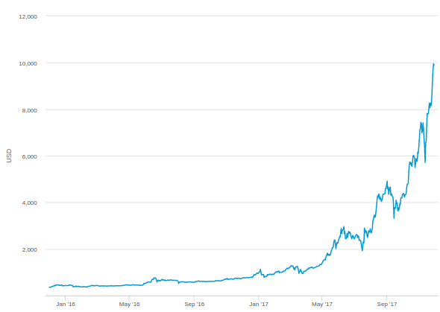

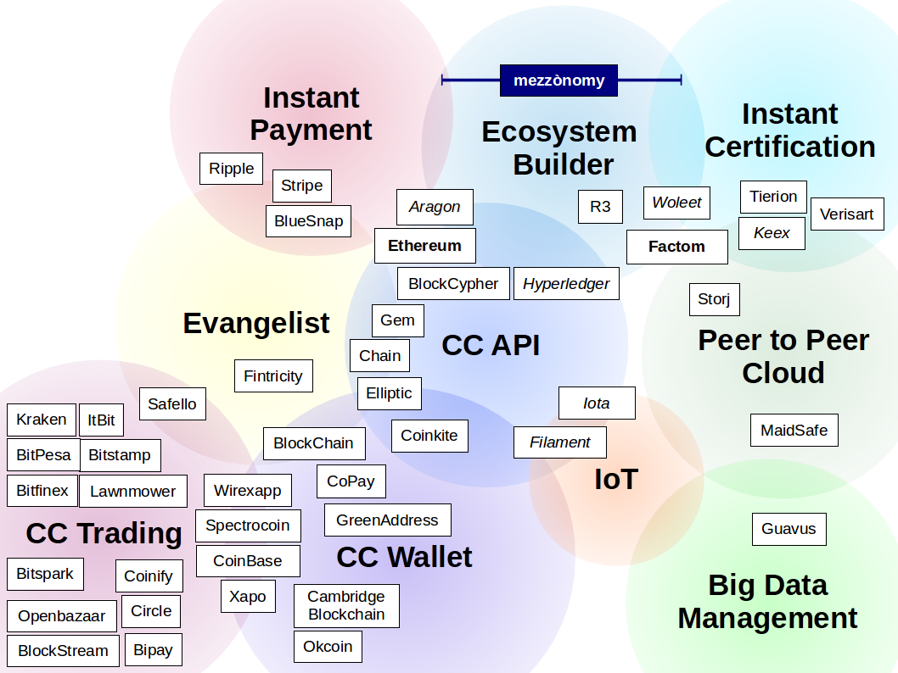
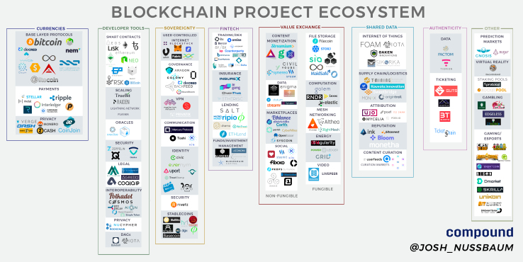
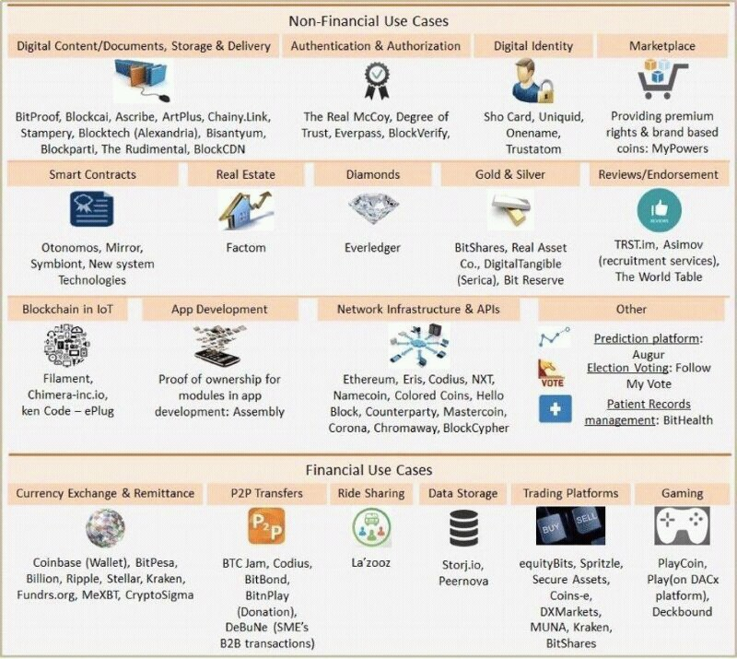
Blockchain hit the roof!
1706.Cartography
1711.Cartography
1707.Cartography

Slide 3













Go to market now!
Decentralized Economy Pure Players
Blockchain
platforms
Stamping
companies
Smart-contracts
providers

Slide 4

Cent Jours
14/11/17
04/04/18

Slide 5

Le rendez-vous des cent-jours
VYV
⠐⠪⣮⠉⢨⣁⢥⠋⣙⣡⢩⠾⢿⣊⡒⡱⣊⣜⡓⢧⢺⡧⡐⢳⡛⡽⡏⣜⣗⡁⡭⢶

Slide 6
Hundreds Road-Map
Functional
Needs
Coverage
100d
NEW ENTRANT
mezzònomy
T0
100d
INCUMBANTS
100d
GO/NOGO
MarketPlace Launch
100d
Flow Reconciliation
SandBox
SYNTYS Grape
DJS
07/07/16
29/11/16
09/06/17
14/11/17
04/04/18
28/09/18
21/03/19
16/09/19
08/03/20

Slide 7
Hundreds Road-Map – People
T0
(delayed)
T0 +100 days
Sandbox
T0+200 days
Composer
T0+300days
Marketplace
Non
Employee
2 Employees
Executive
Associates
(FVI, BHN, MRL)
MVE
DDT
Fellow
Sellers
(FCE, WZI, JDS)
5 Recrutments Planned
FTY
Alert
Alert
Gérant SARL
Majoritaire
(PGT)
09/06/2017
14/11/17
04/04/18
28/09/18
21/03/2019
Ò

Slide 8
Red Alert – Recruiting
T0
The company – Don't miss the opportunity to be in development team of startup founded by a developer aiming to #RampUp the #Blockchain protocol #ToTheUnicorn!
Your job – In charge of development of our #Hypertext kernel and its qualification to the market standards in terms of quality and performance.
The skill-set – Strong knowledge and taste for theoretical computing : compilation, algebra, graph theory, Petri Nets. Fluent use of Java, more likely in a distributed context with heavy peer-to-peer transfer of semi-structured data - XML, JSON. A practice of XML/XSL is appreciated. Expertise in industrialization tools : git configuration management, process-driven methodologies, software metrology. Management and teaching skills may be useful in close future
Recruiting – mezzònomy will recruit three Full-Time-Equivalent on this profile in the next hundred days

Slide 9
Red Alert – IP Alive!
Bonjour monsieur GRADIT,
Nous avons reçu une notification de l’OEB concernant la demande de brevet :
Numéro dépôt : EP11802313.4
Déposée le : 5 décembre 2011
Titre : Procédé de partage d'apprentissage partiel d'une application logicielle
Titulaire : MEZZONOMY
nous informant de la date de délivrance de cette demande, soit le 15 novembre 2017.
Nous vous remercions de nous communiquer dans les meilleurs délais et si possible avant le 16 décembre 2017 la liste des états contractants dans lesquels vous souhaitez engager les procédures de validation.
Nous vous indiquons ci-après la liste des pays désignés pour cette demande de brevet, à savoir :
Allemagne, Albanie, Autriche, Belgique, Bulgarie, Chypre, Danemark, Espagne, Estonie, Finlande, France, Grèce, Hongrie, Croatie, Irlande, Islande, Italie, Lettonie, Lituanie, Luxembourg, Malte, Monaco, L’ex-République Yougoslave de Macédoine, Norvège, Pays-Bas, Pologne, Portugal, République Tchèque, Roumanie, Royaume-Uni, Serbie, Slovénie, Slovaquie, Suède, Saint Marin, Suisse (+ Liechtenstein) et Turquie, dont certains exigent encore des traductions.
Nous vous précisons en outre que, dans la mesure où la désignation de la France sera en vigueur au moment de la délivrance, ce brevet européen y sera automatiquement validé et qu’il se substituera pour la partie commune au brevet français lui ayant servi de priorité.
Dans cette attente, nous vous prions d'agréer, Monsieur, l'expression de nos salutations distinguées.
Sincères salutations,
GRAMMATICO Sophie
Assistante Brevets
Patent Assistant
SCHMIT-CHRETIEN - RAVINA - POUPON deviennent IPSIDE
PICTO IPSIDE_bleu_400
IPSIDE - Innovative IP for Creative Companies
6, impasse Michel Labrousse - 31100 TOULOUSE
Tél. : +33.531 500.022 - Fax : +33.561.166.948
Site Internet : www.ipside.com
IN viadeo google+ twiter wordpress
Toulouse - Paris - Bordeaux - Nantes - Quimper - Montpellier - Brest - Angoulême - Pau
USA - CHINE
Ce courriel est destiné exclusivement au(x) destinataire(s) indiqué(s). Son contenu est strictement confidentiel. En cas d’erreur de destinataire, nous vous remercions d’en avertir immédiatement l’émetteur et de détruire les documents concernés.
Avant d’imprimer, pensez à l’environnement
This e-mail is intended only for the above addressee. It may contain attorney privileged information. If you have received it by error, ou must not copy, distribute, disclose or use any of the enclosed information. Please destroy it and immediately inform the sender.
Before printing, think about the environment.

Slide 10
Workbook to date
T0 > 30/11/2017
Blockchain Pharma pour le Val de Seine
(33k€ + 70k€) – François Versini
Press book: Block Chain Event, Pôle TES à Caen
http://www.voxlog.fr/actualite/2454/la-blockchain-une-opportunite-pour-la-supply-chain
Prospects
  DJS: RH – Cent-jours VYV
  ^{112k€ – Bruno Hamelin}
  DV: IoT – Oracle de banc augmenté
  ^{40k€ – Pierre Gradit}
  IMA: Conseil outillé en intermédiation (avec Digilence)
  ^{~80k€ – William Zanotti}
Suspects
  TNP + … + ... – “meet Ethereum!”
  ^{François Charpe}

Slide 11
04/04/18
Mid Term R&D objectives
Learn by usage with
a lower barrier
DJS
Agreement is more
than smart-contracts
SandBox
Decentralized
and Distributed
Any human input
may be golden data
Smart
Networks
(KT)
Any project has a
common domain name
DV IoT

Slide 12
Three-Layer Platform & XP
T0 > 30/11/2017
MIRZA
CARGO
TED
DJS
Data-driven graphics
User Experience
Distributed
Interfaces
Clip’n View
Interface Interpolation
Copresence
Data Acquisition
Oracle factory
Data Filtering (*)
Quantum Interpolation
Quantum validation
Application interpretor
Story
Machine
Page construction
Partial Sharing
Page rendering
Graph analyser (*)
Liquid Equilibrium
Proof of Process
Social Consensus
Trail Recovery
Story Node
Decentralized
database
Document hashing
Billing Numbers (*)
Number Table
External identity (*)
Source identity
Private key generation
Decentralized file system
Redundant places
GIT interface
Ethereum gateway (*)
PREVIOUS PROTYPES
(*) Functions not explored in previous prototypes

Slide 13
ROAD MAP
DJS
^{T0+}25
^{T0+}100
^{T0+}100
^{T0+}100
^{T0+}50
^{T0+}75
^{T0+}25
^{T0+}50
^{T0+}75
^{T0+}25
^{T0+}50
^{T0+}75
Data-driven graphics
Clip’n View
Interface Interpolation
Copresence
Data Acquisition
Data Filtering (*)
Quantum Interpolation
Quantum validation
Page construction
Partial Sharing
Page rendering
Graph analyser (*)
Liquid Equilibrium
Social Consensus
Trail Recovery
Document hashing
Billing Numbers (*)
Number Table
External identity (*)
Private key generation
Decentralized file system
GIT interface
Ethereum gateway (*)
SandBox
Architect
Regular

Slide 14
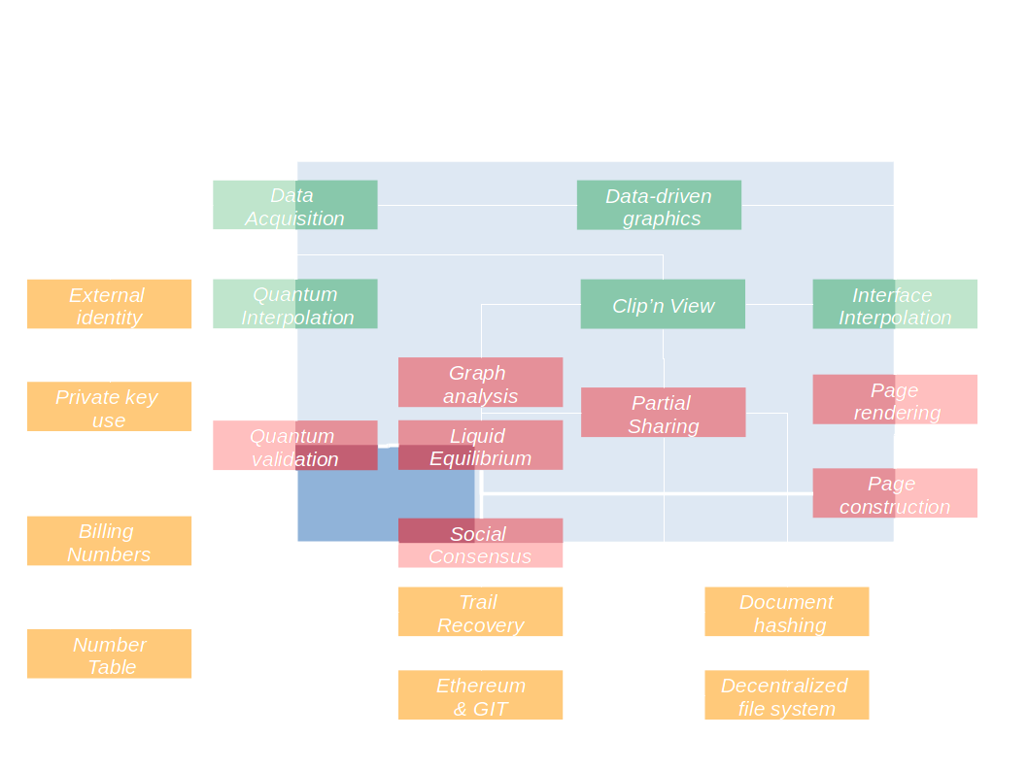
Function Relation Diagram
04/04/18

Slide 15
Meeting in the middle
04/04/18
DJS
SandBox
Smart
Networks
(KT)
04/04/17: US Patent
04/04/18: White Paper
DV IoT

Slide 16
mezzònomy company is a pure player in the decentralized economy.
mezzònomy delivers development tools to incrementally embed any value chain on blockchains.
Data-driven graphics
Clip’n View
Interface Interpolation
Quantum validation
Copresence
Page construction
Data Acquisition
Partial Sharing
Data Filtering
Page rendering
Quantum Interpolation
Graph analyser
External identity
Liquid Equilibrium
Private key generation
Social Consensus
Decentralized file system
Trail Recovery
GIT interface
Document hashing
Ethereum gateway
Billing Numbers
Number Table

Slide 17
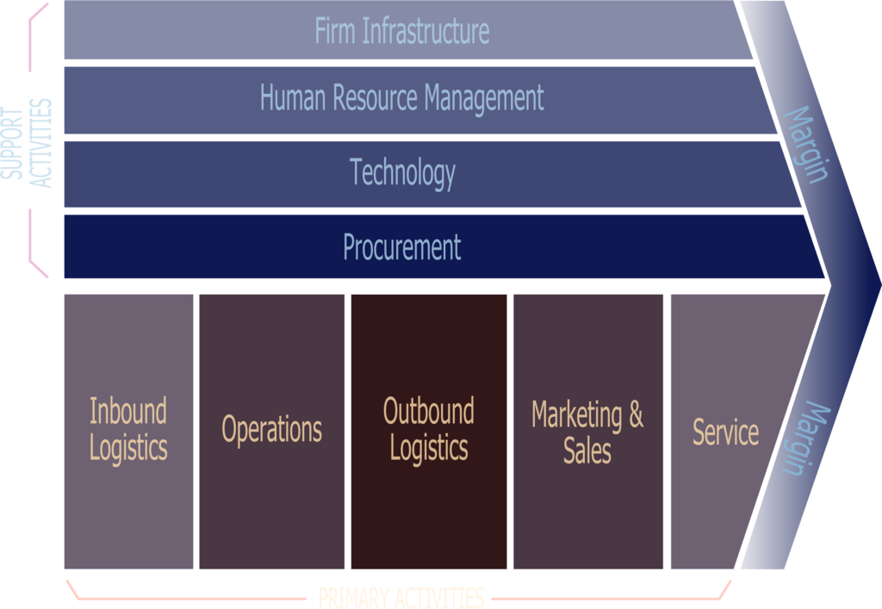
mezzònomy company is a pure player in the decentralized economy.
mezzònomy’s offer includes development tools to incrementally embed any value chain on blockchains.

Slide 18

mezzònomy company is a pure player in the decentralized economy.
mezzònomy’s offer includes development tools to incrementally embed any value chain on blockchains.
mezzònomy W3C compliant technology allow any to design smooth bridges between usage, blockchains and existing information systems.

Slide 19
mezzònomy company is a pure player in the decentralized economy.
mezzònomy’s offer includes development tools to incrementally embed any value chain on blockchains.
mezzònomy W3C compliant technology allow any to design smooth bridges between usage, blockchains and existing information systems.
mezzònomy’s key use cases concern:
Track & Trace
Process Compliance & Agility
Partial Sharing & Compensation
Embedded Billing & Reconciliation

