Slide 1

for technical audience
HOW TO PREVENT WASTEFUL SPENDING IN ONLINE RETAIL BUSINESS ?
Fatih Çağlar
5/23/2024

Slide 2
OUTLINE
Executive Summary
Introduction
Methodology
Results
Conclusion
Appendix

Slide 3
Executive Summary
The organization records each sale through the online storefront in a database with various characteristics. We used this data to identify ways in which the business can cut down on wasteful spending in areas like product inventory, order fulfillment, and marketing.
We have put the data through the ETL, analysis, and preprocessing phases. We have also created:
A classification model to predict whether a customer will be susceptible to churn.
A regression model to predict how much money a customer will spend at the online store.
A clustering model that divides customers into groups based on their shopping behavior.

Slide 4
EXECUTIVE SUMMARY
After training and evaluating our models, we observed strong performance in both classification and regression tasks. Our classification model accurately predicts customer churn with an overall accuracy of 93%, correctly identifying 89% of customers who churn and 95% of customers who do not.
For the monetary value prediction, our regression model explains 99.97% of the variability in customer spending. With an average customer spending of £152, the model achieves a prediction error of just £1.48, which is less than 1% of the mean spending.
Our clustering model provides valuable insights into customer segmentation by grouping customers based on purchase frequency, monetary value, and recency. These insights enable targeted actions to retain the most valuable customers and increase spending among consistent buyers. Additionally, we identified the least spending customer segment and provided recommendations for either increasing their spending through segment-specific initiatives or reducing investment in this group to lower overall company costs.

Slide 5
INTRODUCTION
We used stock descriptions and online retail history data for the ETL process and aggregation. After initial analyses, we cleaned the data, performed feature extraction, and conducted feature engineering to prepare it for training machine learning models. During this stage, we also obtained customer churn and tenure data.
We prepared training and testing sets, trained our models, and evaluated them. Based on the evaluation scores, we made iterative improvements to enhance model performance.

Slide 6
methodology
During the ETL process, we extracted data from the organization’s database, aggregating stock descriptions and online retail history tables. We identified and fixed corrupted or unusable data and performed necessary data type conversions.
In the analysis phase, we first focused on price data. Next, we examined correlations between all numeric variables and their distributions and analyzed time-series data. At the end of the analysis, we corrected any remaining data issues like outliers.
To prepare the dataset for the machine learning process, we generated new features from the existing data and indexed them by customer IDs. We also integrated customer churn and tenure data obtained from the organization’s database.

Slide 7
METHODOLOGY
To create an optimal classification model for predicting customer churn, we set up a pipeline incorporating scaling, dimensionality reduction, and model selection. Using the halving grid search algorithm, we efficiently identified the best pipeline configuration, minimizing computation time. The model was then evaluated using several metrics, including the ROC curve, classification report, and learning curve, to ensure robust performance.
To create the regression model for monetary value prediction we first bootstrapped to create multiple samples and removed the impactful outliers of data. Standard scaling is applied to the feature sets to standardize the data. Several regression models, including Dummy Regressor, Linear Regression, Random Forest Regressor, and XGBoost Regressor, are trained and evaluated using standard evaluation metrics. As before, we evaluated the model using different metrics. Hyperparameter tuning is conducted using both GridSearchCV and RandomizedSearchCV to optimize the model's performance further. The tuned models' predictions are evaluated and compared using the same metrics.

Slide 8
METHODOLOGY
To cluster customer data, we followed a systematic process. First, we standardized the data using the StandardScaler to ensure uniformity in feature scales. Then, we applied the Elbow Method to determine the optimal number of clusters, settling on eight clusters. Next, we employed K-means clustering with the chosen number of clusters and evaluated the model using silhouette analysis. We assessed the clustering results by examining the distribution of customers across clusters and their summary statistics, particularly focusing on key metrics like recency, frequency, and monetary value. Lastly, we visualized the clusters in three dimensions using PCA, providing a comprehensive understanding of customer segmentation.

Slide 9
RESULTS

Slide 10
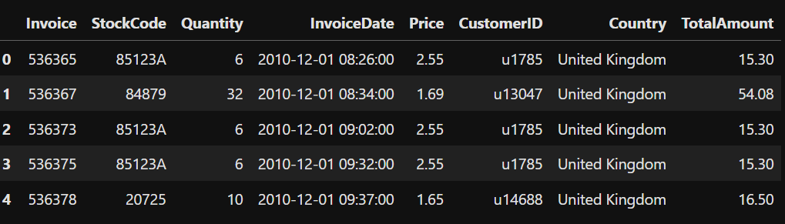
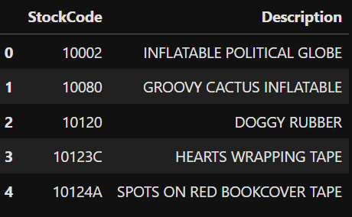
ETL
Online retail history data – 15321 observations for 8 features:
Stock Description data – 3952 observations for 2 features:

Slide 11
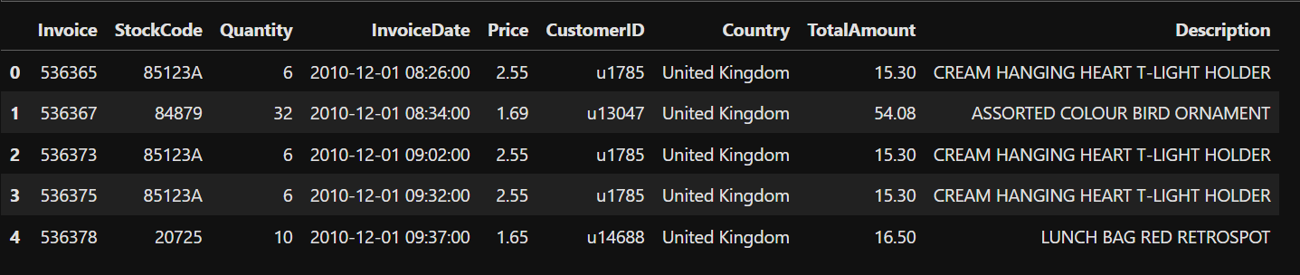
ETL
Aggregated data by left-joining stocks to retails – 17032 observations for 9 features:

Slide 12
ETL
1711 records of unknown description and 115 duplicated records were removed.
Date formats were corrected.
We ended up with 15206 records.

Slide 13
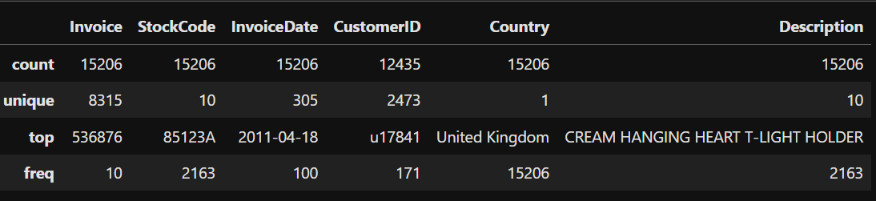
ANALYSIS – INITIAL LOOKS
There are 10 different products sold between Dec 1, 2010 and Dec 9, 2011.
There are 2473 different customers making purchases.
Most purchased product is Cream Hanging Heart T- Light Hodler purchased 2163 times.
There are 68 days at no one purchased anything.

Slide 14
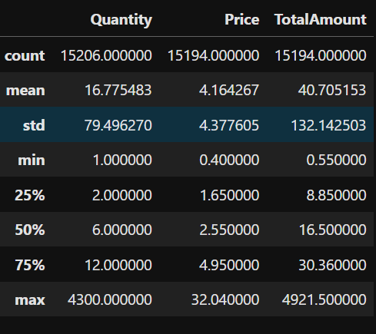
ANALYSIS – INITIAL LOOKS
The distributions for quantity, price and total amount are all right-skewed. The skewness decreases through quantity, total amount and price respectively.
The standard deviations shows that there are many outliers for total amount and quantity.

Slide 15
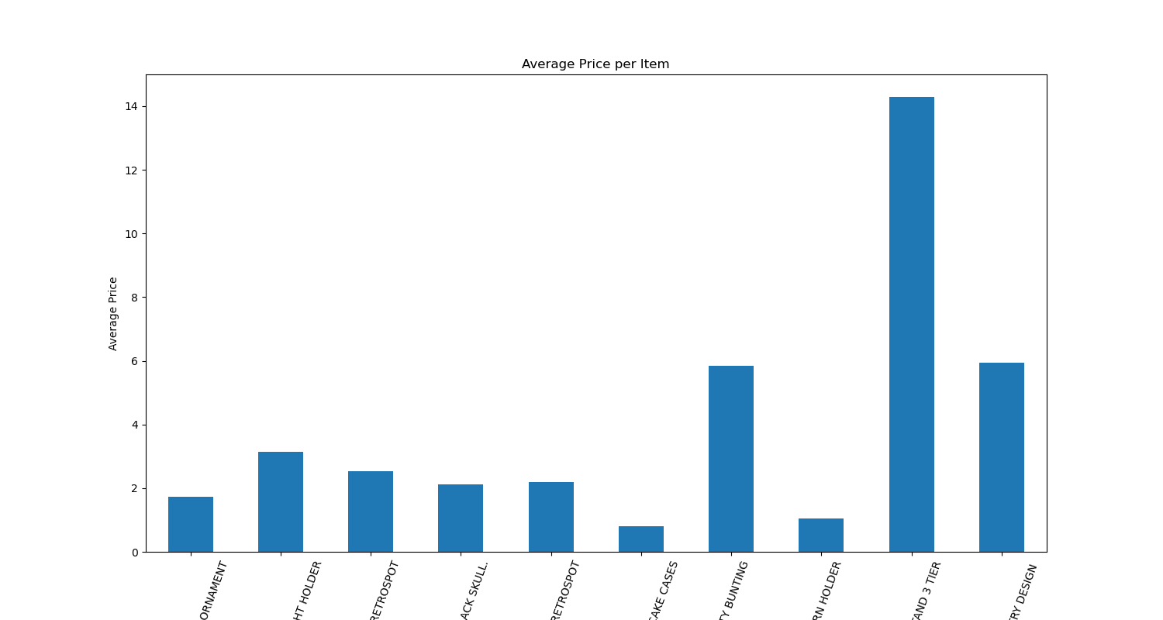
ANALYSIS - INSIGHTS
There are three items significantly more expensive than others.
AVERAGE PRICE PER ITEM

Slide 16
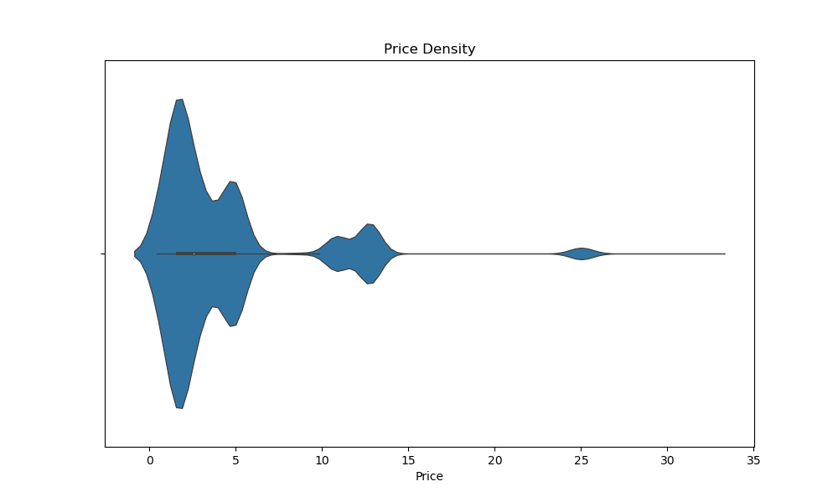
ANALYSIS - INSIGHTS
Price concentrates mainly on the range up to £7.5. The rest is around £10- £15 and £25.
PRICE DENSITY

Slide 17
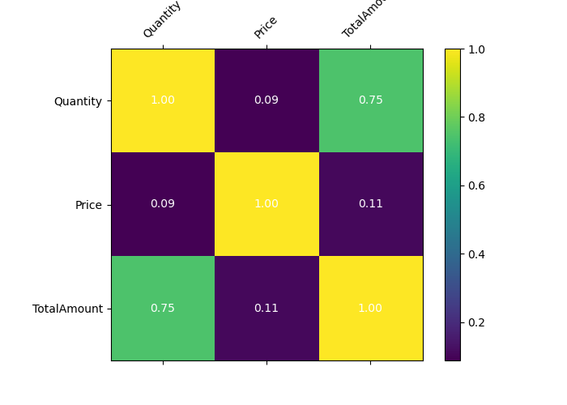
ANALYSIS - INSIGHTS
There is a strong positive relationship between total amount and quantity. There is no any other correlation.
CORRELATION MATRIX

Slide 18
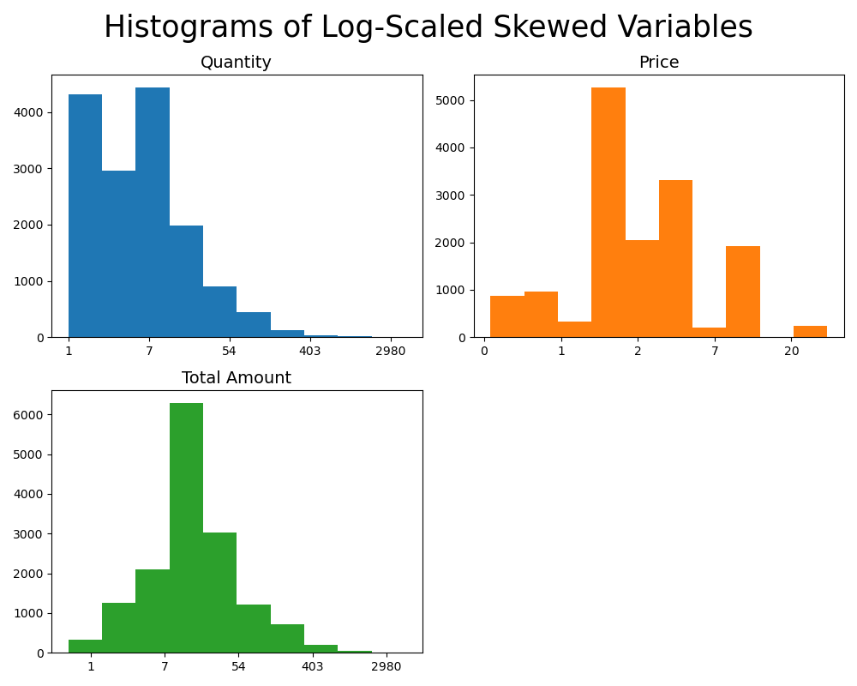
ANALYSIS - INSIGHTS
Getting log-scaled, quantity is still highly right-skewed. Price is distributed moderately normal and total amount is distributed totally normal.
Using Log-Scale to Handle Skewness

Slide 19
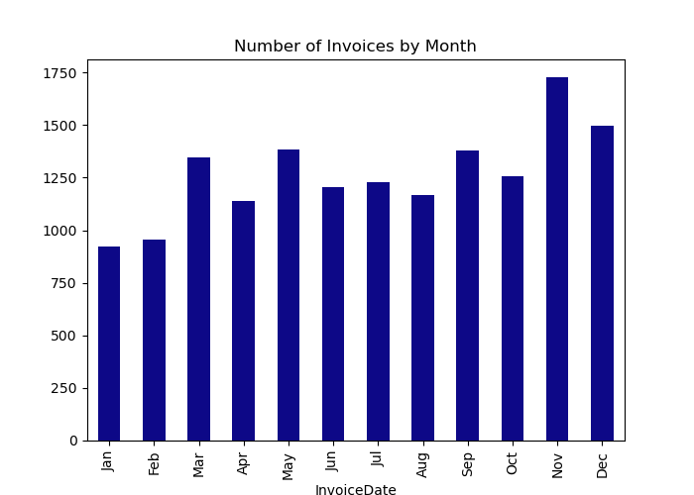
ANALYSIS - INSIGHTS
Highest numbers of invoices take place in November and December whereas the least takes place in January.
MONTHLY INVOICES

Slide 20
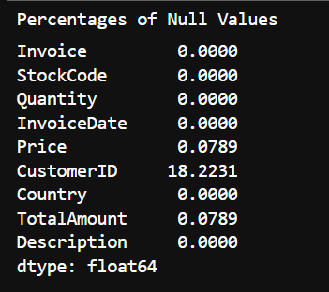
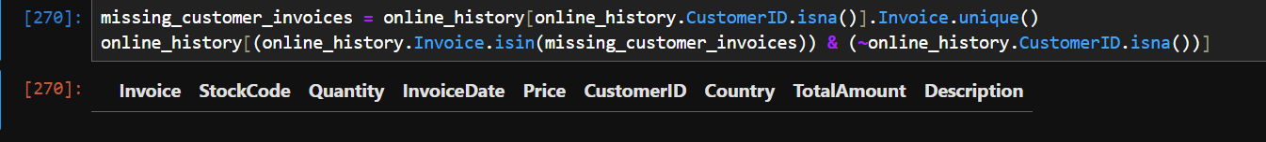
ANALYSIS - PREPROCESSING
The columns with missing values are price, customer id and total amount and the percentages are 0.08%, 18% and 0.08%.
The only clever way to impute customer ids is utilizing invoice numbers but there is no customer id info in remaining rows with same invoice number of rows with missing customer ids. Therefore, we dropped related rows.
As the impact of the rows with missing price or total amount on analysis is very low, we filled them with 0.
12435 invoices remained.
HANDLING MISSING VALUES

Slide 21
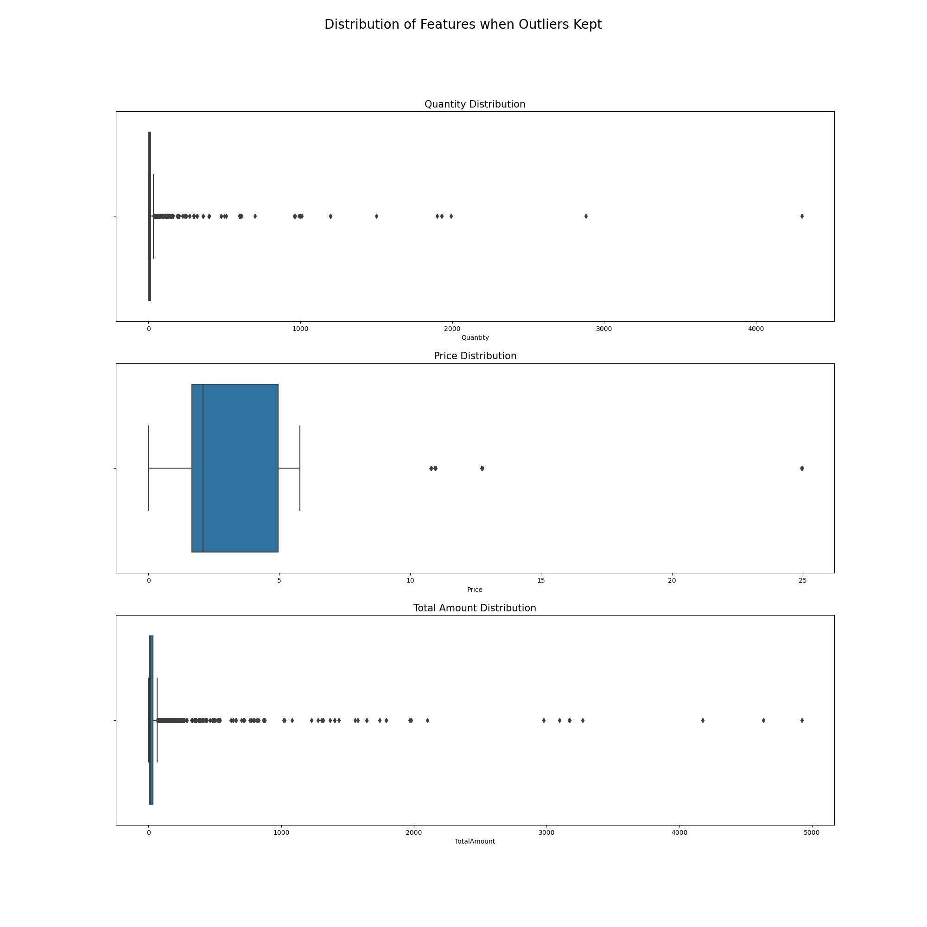
ANALYSIS - PREPROCESSING
DISTRIBUTION OF Quantity, Price & Total Amount When Outliers Kept
REMOVING OUTLIERS

Slide 22
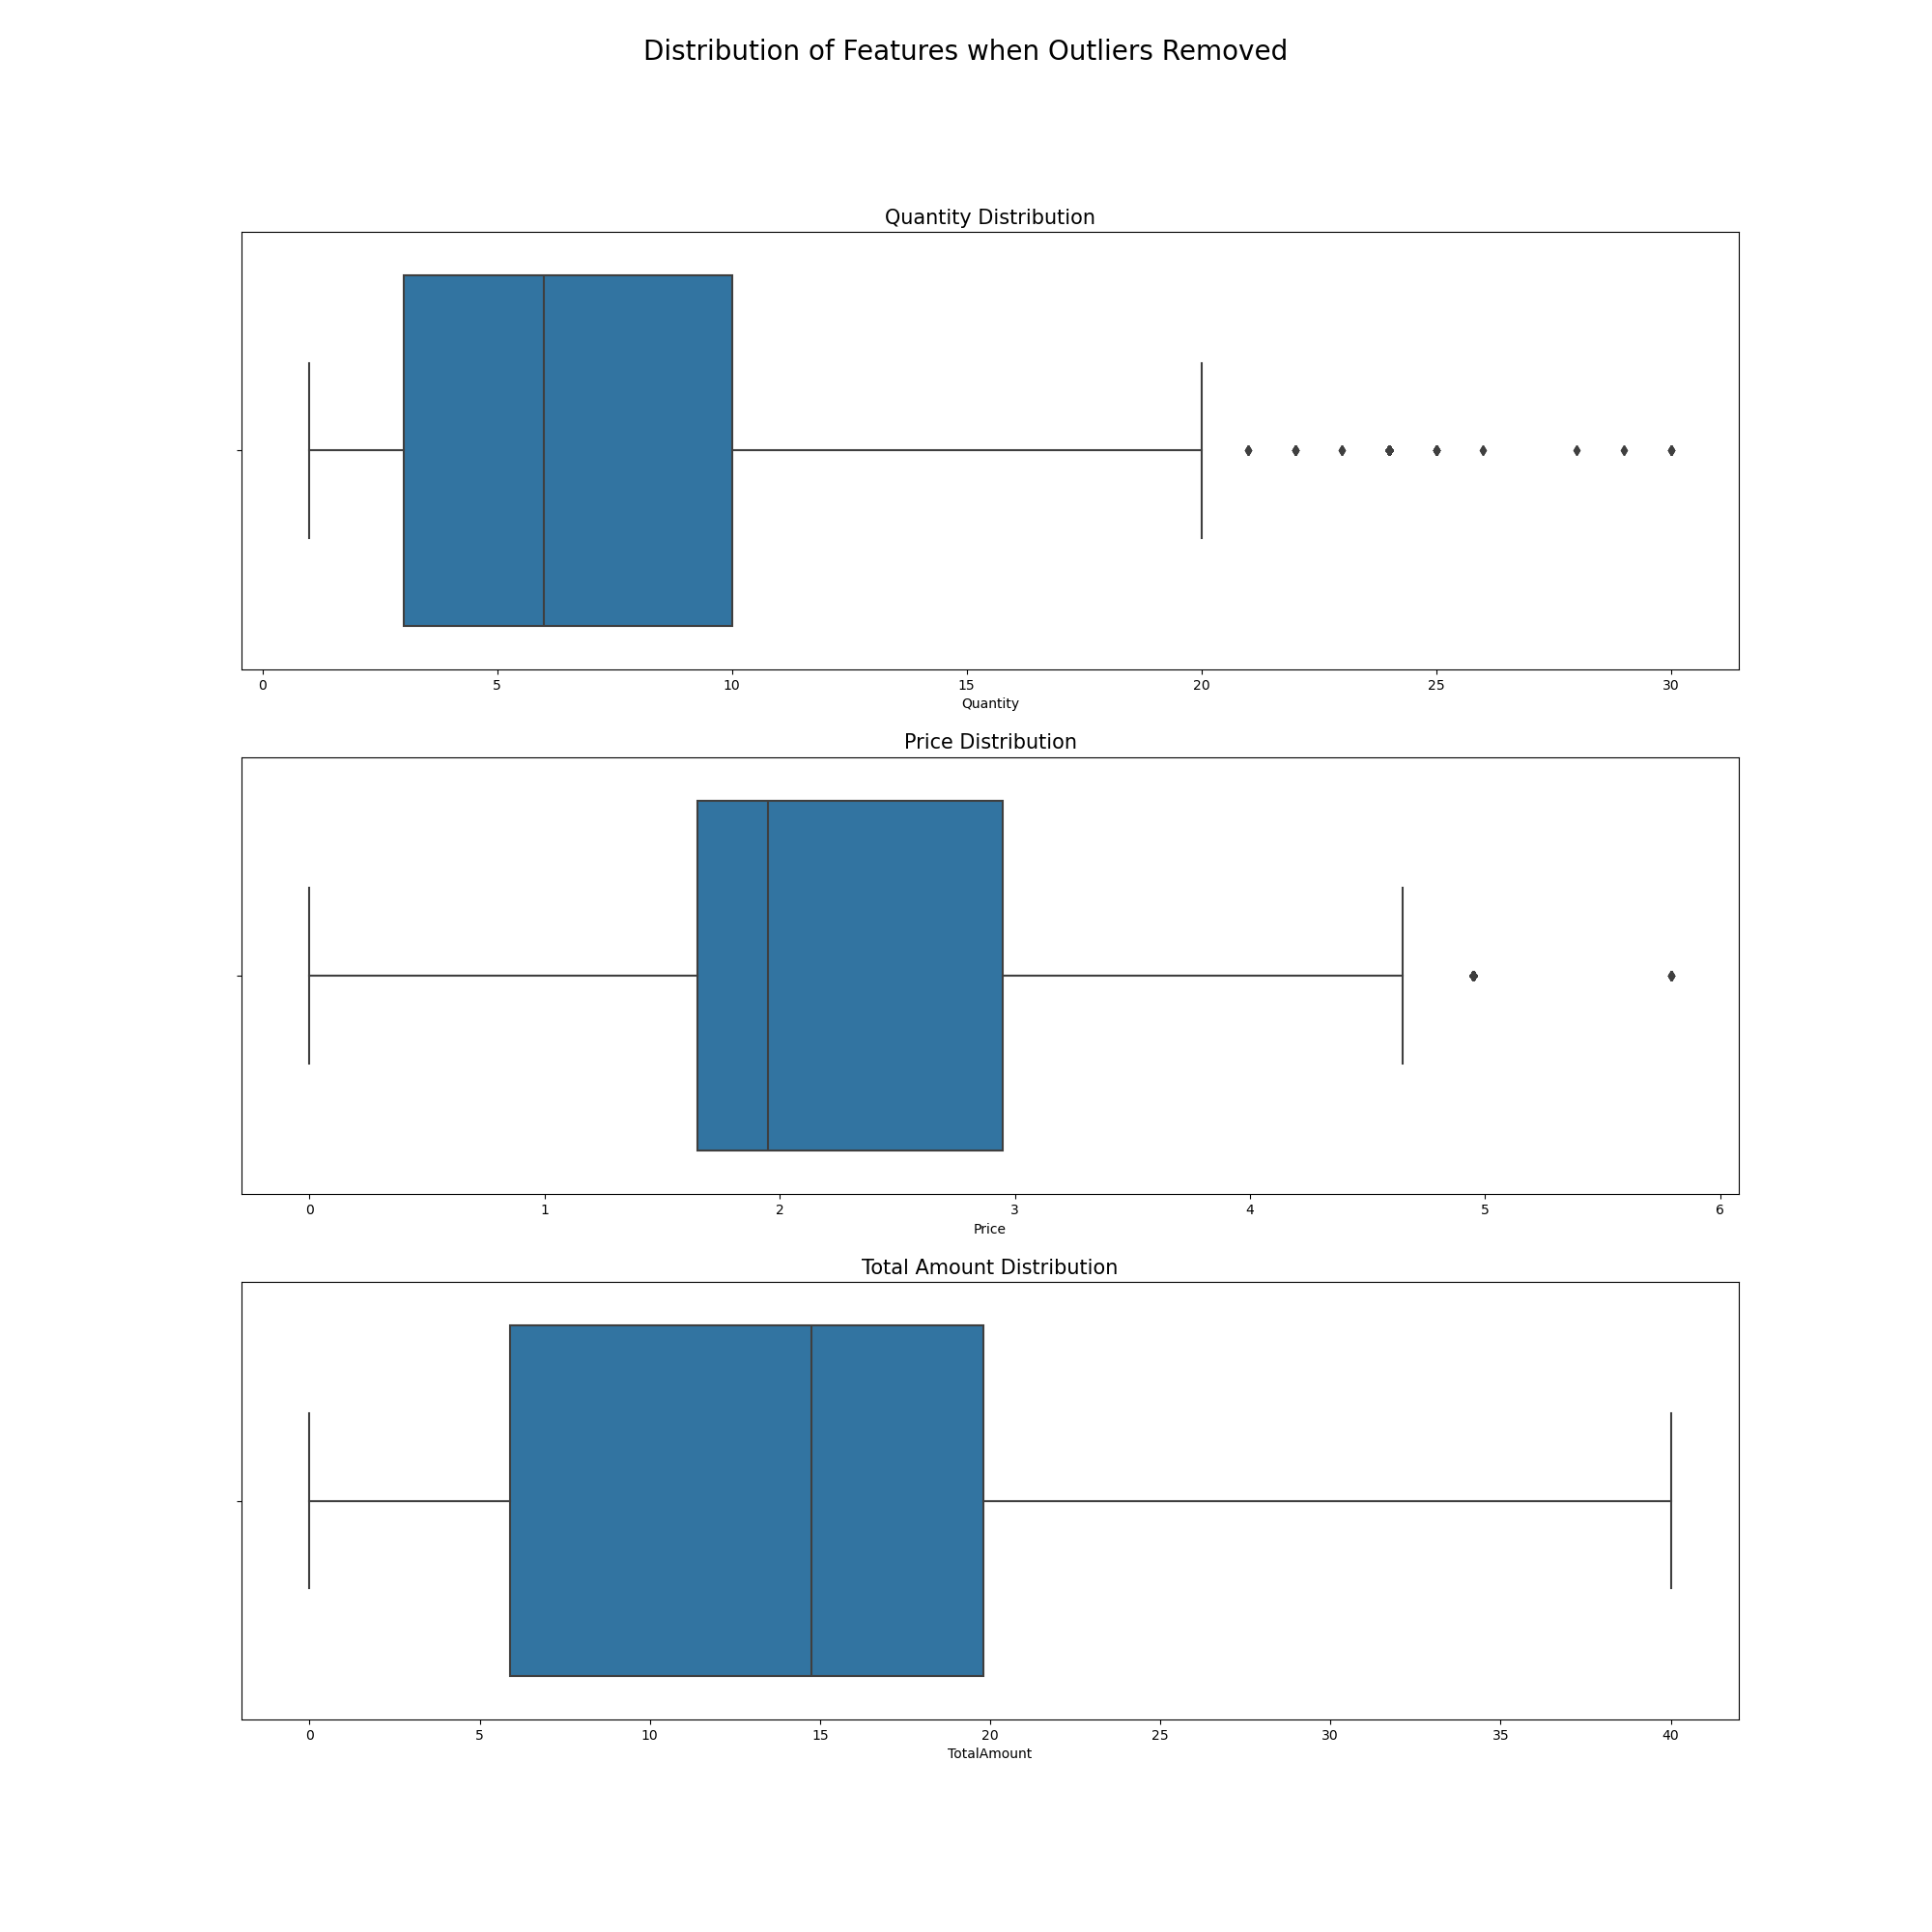
ANALYSIS - PREPROCESSING
DISTRIBUTION OF Quantity, Price & Total Amount When Outliers Removed
9133 rows remained.
REMOVING OUTLIERS

Slide 23
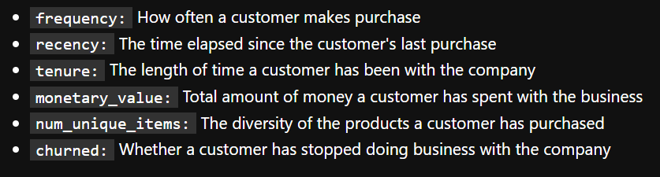
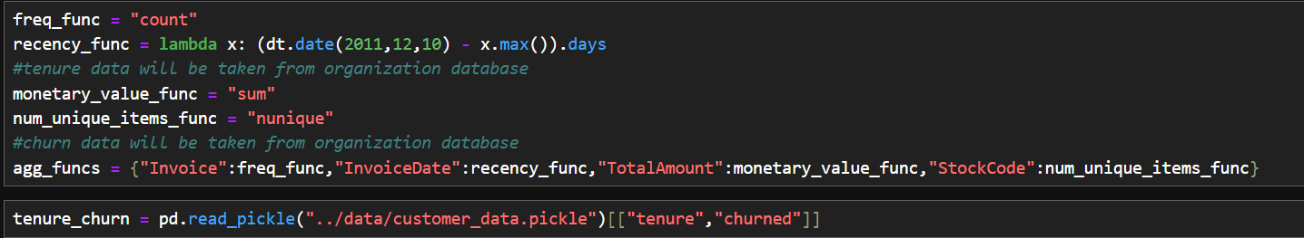
ANALYSIS - PREPROCESSING
To work with more meaningful features when training our models, we extracted new features from our data.
We have taken the tenure and churn data from organization database.
FEATURE EXTRACTION

Slide 24
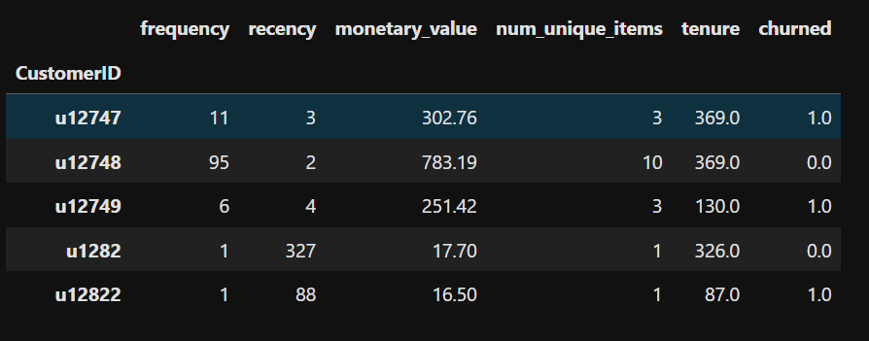
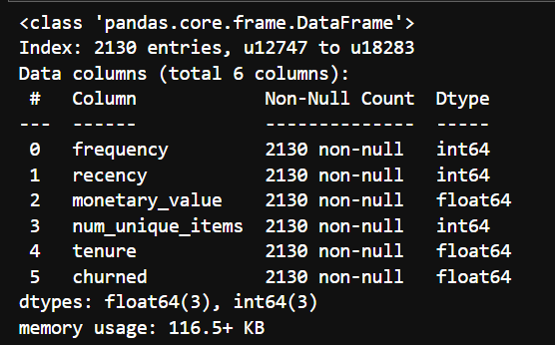
ANALYSIS - PREPROCESSING
FEATURE EXTRACTION

Slide 25
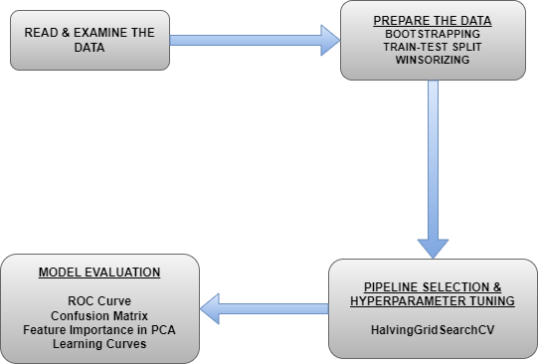
CLASSIFICATION – FLOWCHART

Slide 26
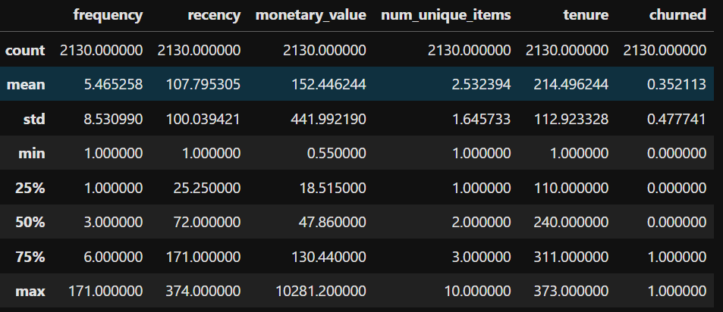
CLASSIFICATION
Customer data has 2130 rows. Monetary value and frequency have so many outliers.
The target data is imbalanced.
READ & EXAMINE THE DATA

Slide 27
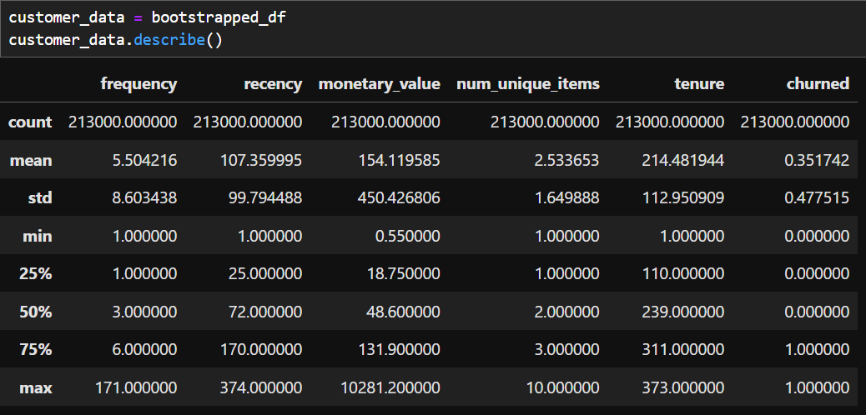
CLASSIFICATION
Bootsrapping increased the number of rows to 213000.
BOOTSTRAPPING

Slide 28
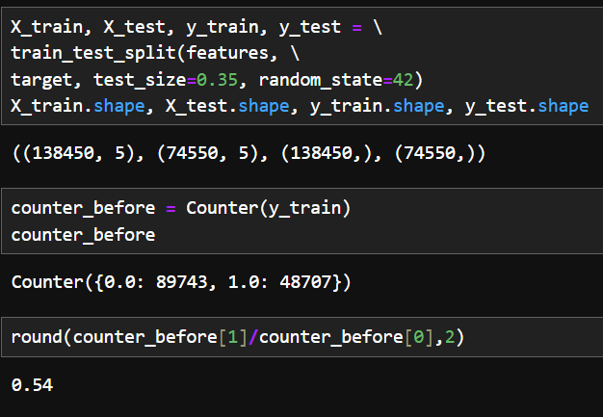
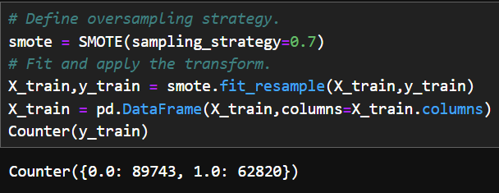
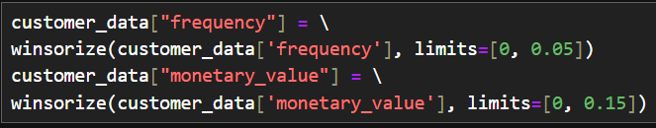
CLASSIFICATION
We used 0.35 test size.
The imbalance ratio was 0.5 before oversampling. We slightly raised it to 0.7.
We winsorized the frequency and monetary value columns whose outliers can have impact.
TRAIN-TEST SPLIT, OVERSAMPLING & WINSORIZING

Slide 29
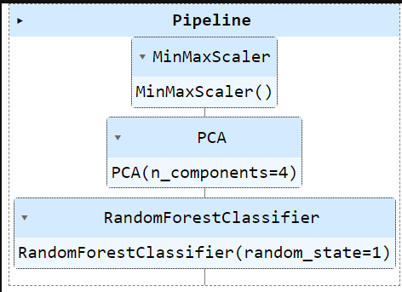
CLASSIFICATION
We conducted grid search with 2 different scalers, PCA and 3 different models, namely, XGB, DecisionTree and RandomForest. Passed the pipeline to the search with different hyperparameters.
The picture shows the best model. Its r2 is 0.993.
MODEL SEARCH & HYPERPARAMETER TUNING USING HALVINGGRIDSEARCHCV

Slide 30
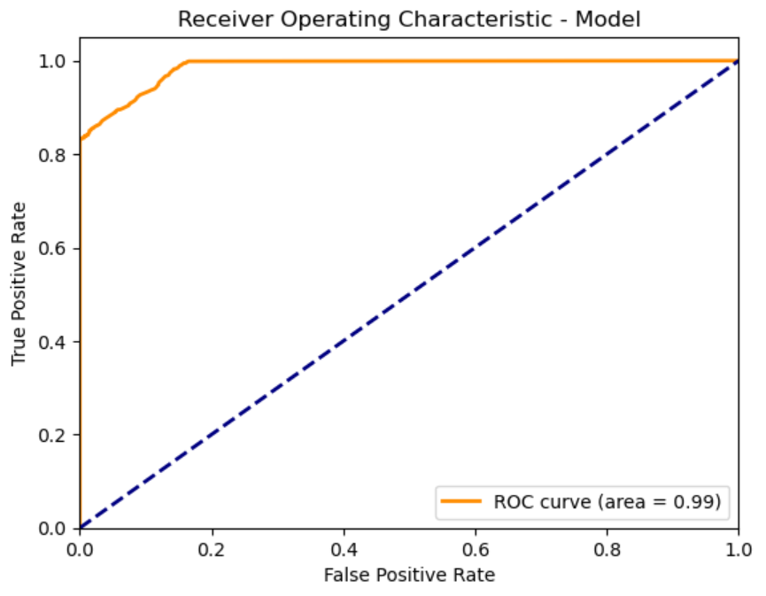
CLASSIFICATION – EVALUATING THE MODEL
Our model performs near-perfect. It’s AUC score is 0.99 and a classification threshold with a 0.1 FPR can be chosen.
ROC CURVE

Slide 31
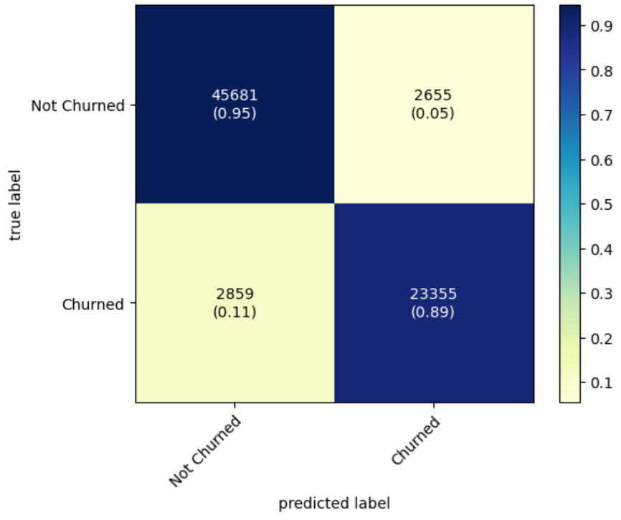
CLASSIFICATION – EVALUATING THE MODEL
Our model performs quite well on both cases. It correctly predicts 89% of customers churned and 95% of customers not churned.
CONFUSION MATRIX

Slide 32
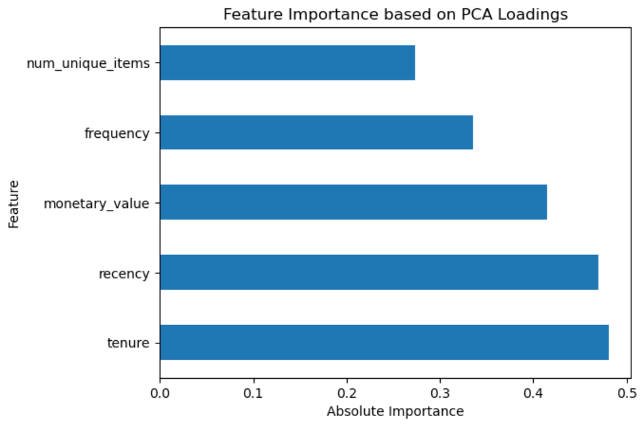
CLASSIFICATION – EVALUATING THE MODEL
The feature most contributing to PCA is tenure.
PCA FEATURE IMPORTANCE

Slide 33
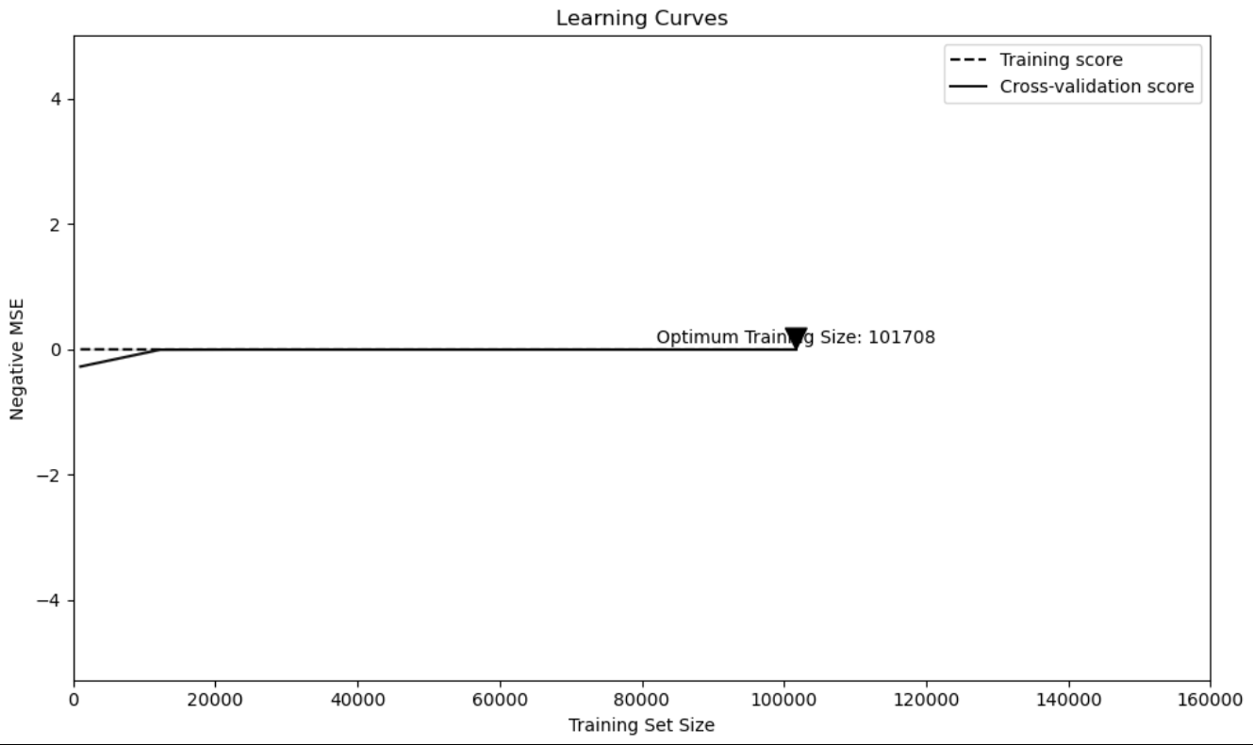
CLASSIFICATION – EVALUATING THE MODEL
The learning curves show that our model is a good fit and does have a suitable capacity for the complexity of the dataset.
LEARNING CURVES

Slide 34
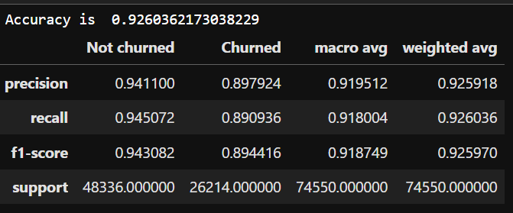
CLASSIFICATION – EVALUATING THE MODEL
Our model strongly performs at predicting churn.
It is slightly better at predicting customers who will not churn.
There is no precision-recall bias.
The model can be used to develop new retention strategies.
CLASSIFICATION REPORT

Slide 35
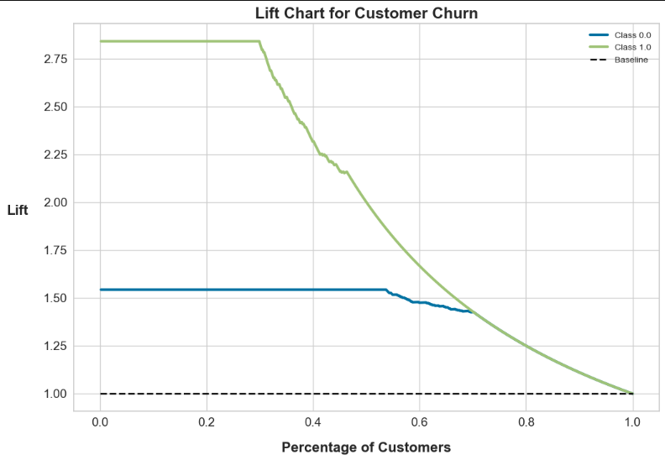
CLASSIFICATION – EVALUATING THE MODEL
Our model is almost 3 times better than random guessing at predicting positive cases ie. churn.
LIFT CHART

Slide 36
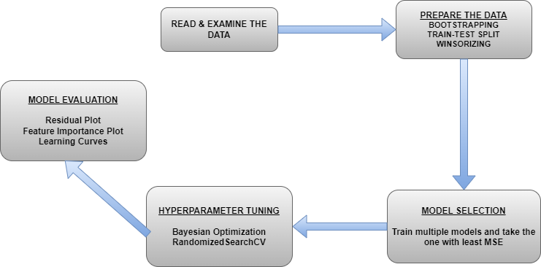
REGRESSION – FLOWCHART

Slide 37
REGRESSION – FIRST STEPS
We used the same data we used in the classification process and to prepare the data for the model, we did same bootstrapping. Since our target is monetary_value we only winsorized frequency. Did the split with test size 0.3. We scaled the data using StandardScaler for Logistic Regression.

Slide 38
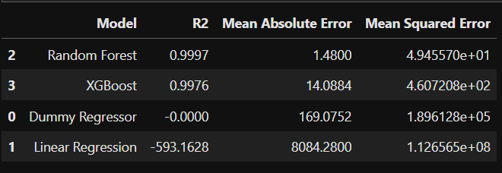
REGRESSION
We trained four different regression models and took the one with least MSE as the best.
MODEL SELECTION

Slide 39
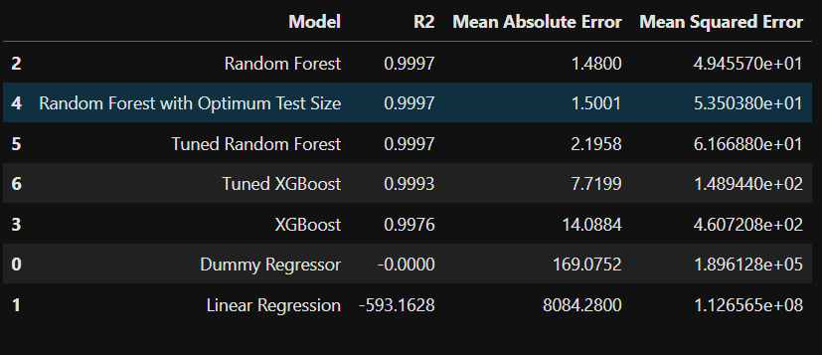
REGRESSION
We tuned the hyperparameters of RF with Bayesian Optimization using hyperopt and tuned those of XGB with RandomizedSearchCV but both didn’t give any better results than RF. Therefore, we selected the RF as best.
HYPERPARAMETER TUNING

Slide 40
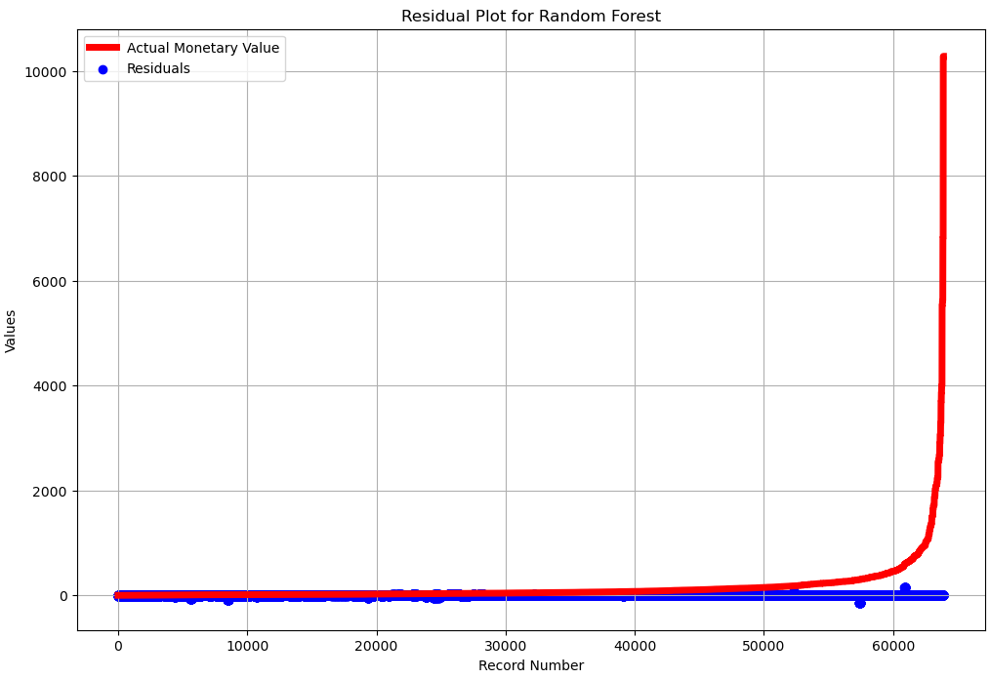
REGRESSION – EVALUATING BEST MODEL
The random distribution of residuals along base line shows that our predictions fits well on test data with low MSE.
RESIDUAL PLOT

Slide 41
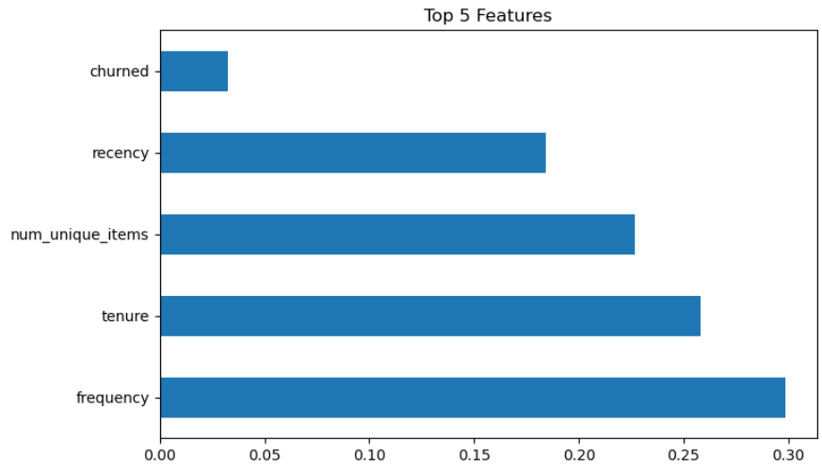
REGRESSION – EVALUATING BEST MODEL
Most important feature for regression task is frequency.
FEATURE IMPORTANCE PLOT

Slide 42
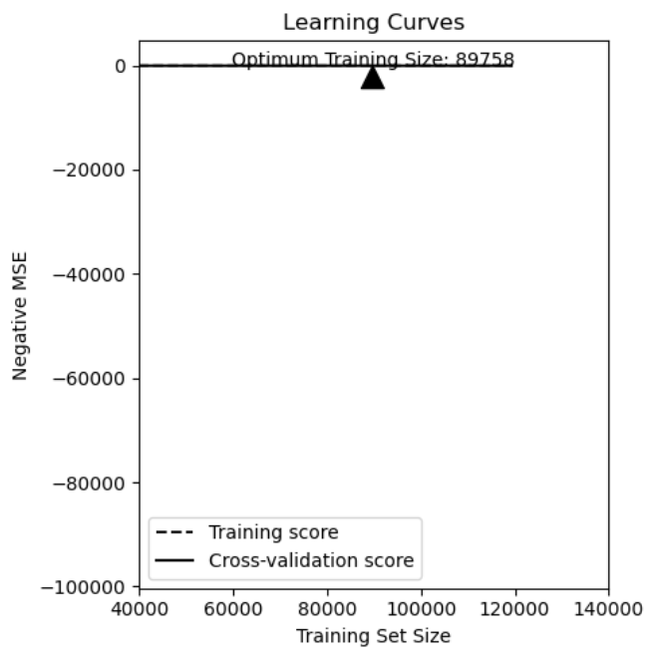
REGRESSION – EVALUATING BEST MODEL
Learning curves show that our training and cv scores fit well after some size of training data.
LEARNING CURVES

Slide 43
REGRESSION – EVALUATING BEST MODEL
Learning curves show that our training and cv scores fit well after some size of training data.
LEARNING CURVES

Slide 44

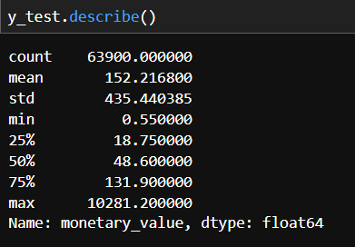
REGRESSION – EVALUATING BEST MODEL
R-2 of our model is near to perfect.
MAE is less than 1% of the mean of the test set. This is a low error rate.
MSE is 49.46 which says RMSE is close to 7.2. This is also a good score given the range of data.
INTERPRETING THE SCORES

Slide 45
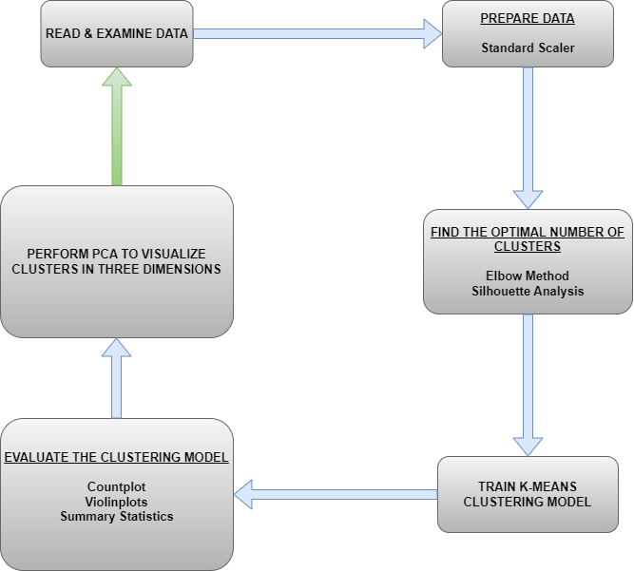
CLUSTERING - FLOWCHART

Slide 46
Clusterıng – ınıtıal steps
We read and examined the same customer data as before.
We scaled the data using StandardScaler.

Slide 47
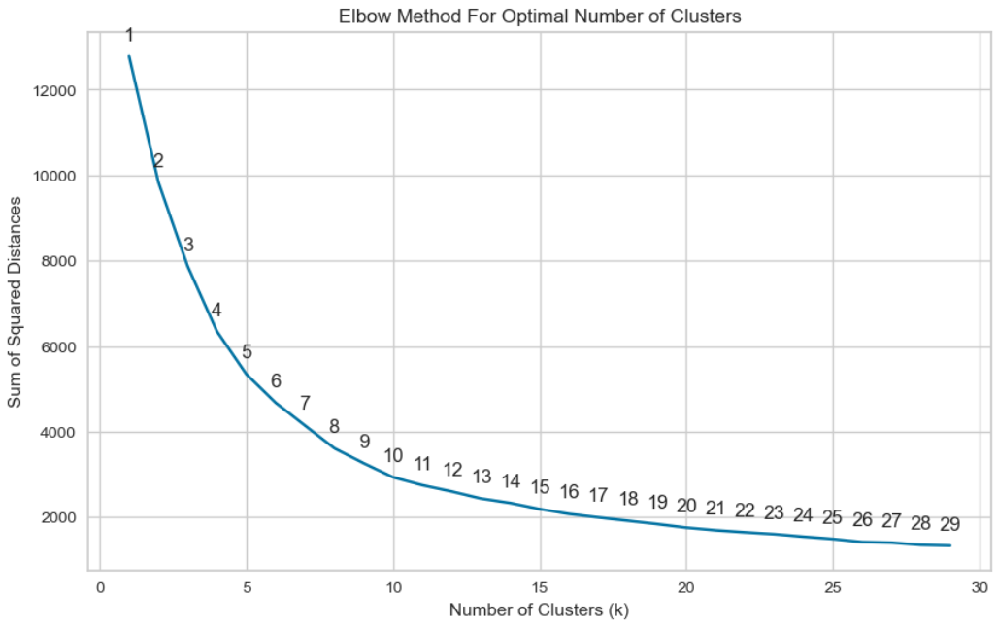
Clusterıng – find optimal number of clusters
It looks like that the optimal number of clusters is around 8.
ELBOW METHOD

Slide 48
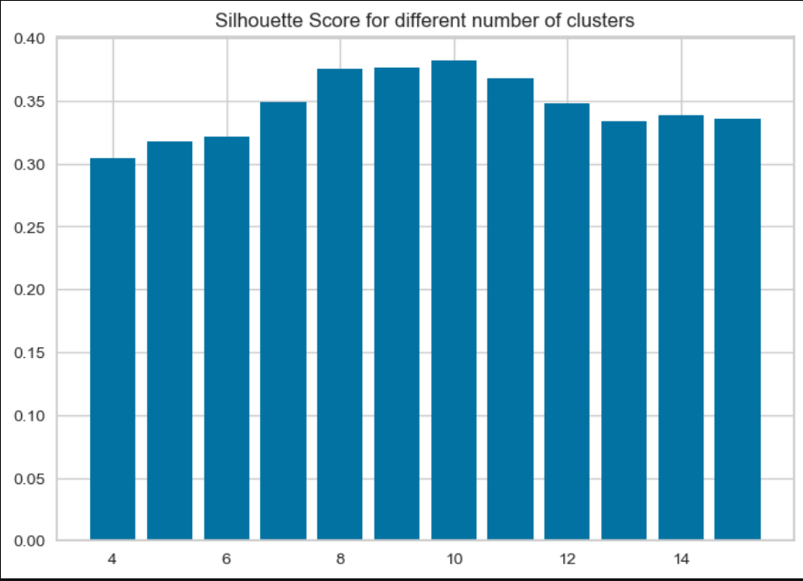
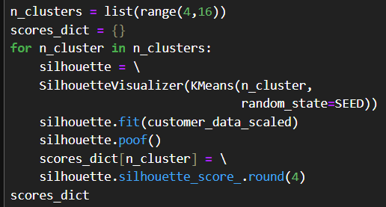
Clusterıng – find optimal number of clusters
For clarity, we take it one further step and perform silhouette analysis.
The one with highest score is 10 but we choose 8 for not to end up with too many useless clusters.
ELBOW METHOD

Slide 49
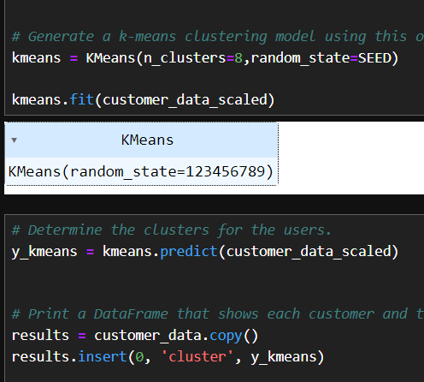
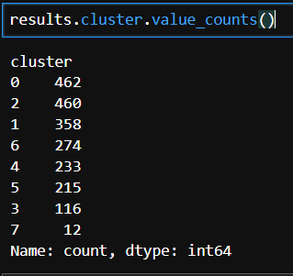
Clusterıng
We trained the model using 8 clusters and inserted the results to the data.
TRAIN THE MODEL

Slide 50
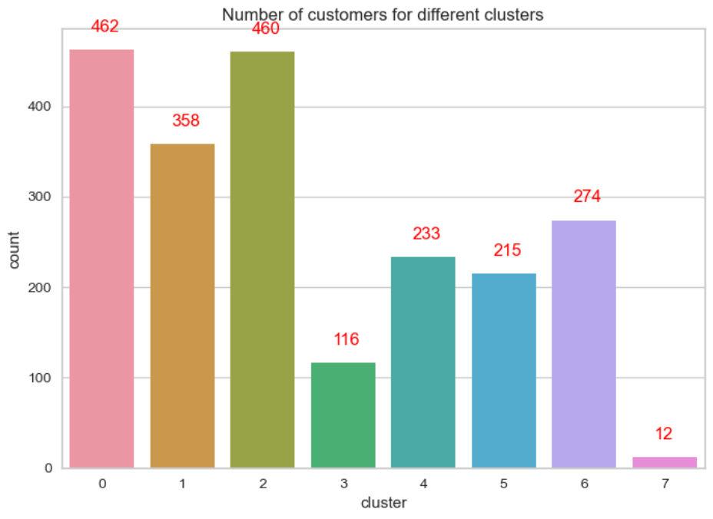
Clusterıng – EVALUATE THE MODEL
Most number of customers are in clusters 0-2-1 and least number of customers are in 7-3.
COUNTPLOT

Slide 51
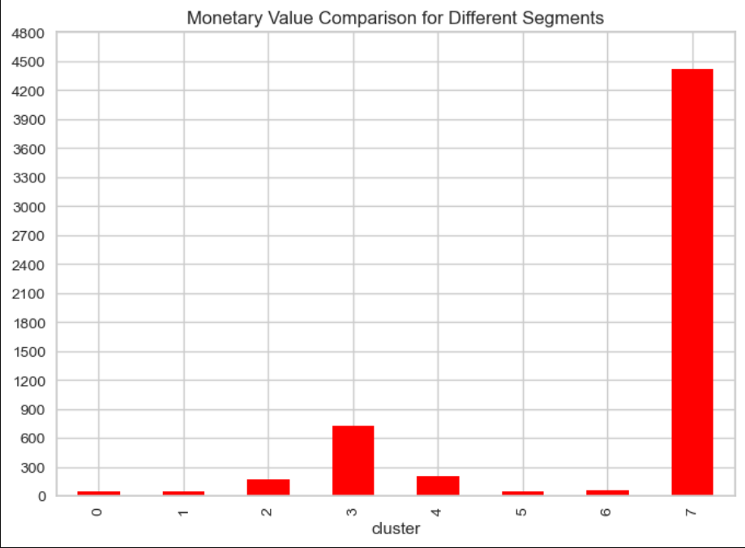
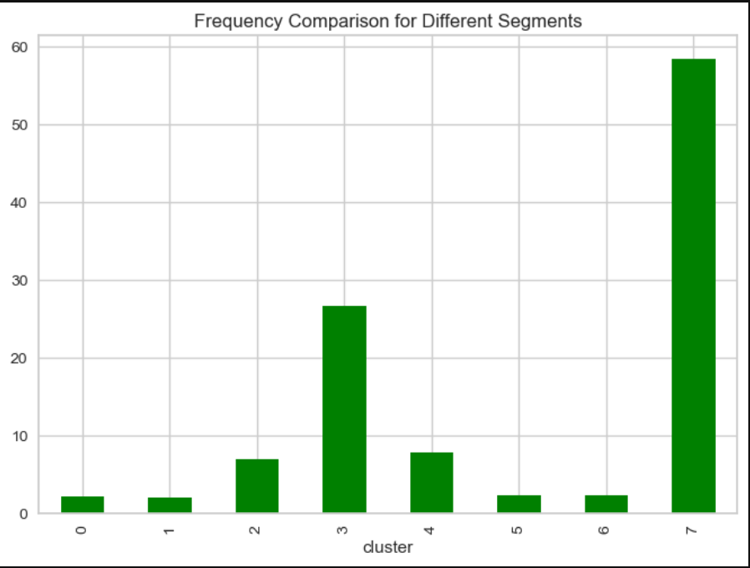
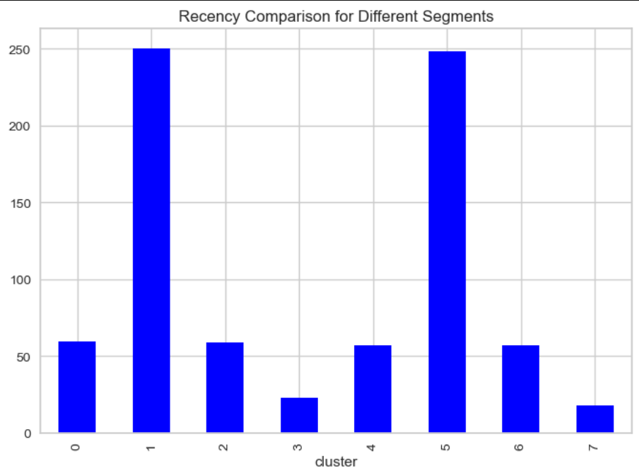
Clusterıng – EVALUATE THE MODEL
From the comparisons, we see a further segmentation:
Clusters 3-7: Highest spending, highest frequency, lowest recency
Clusters 2-4: Moderate spending, moderate frequency, moderate recency
Clusters 0-6: Lowest spending, lowest frequency, moderate recency
Clusters 1-5: Lowest spending, lowest frequency, highest recency
COMPARING MEANS USING BARPLOTS

Slide 52
CLUSTERING – EVALUATE THE MODEL comparing recency, frequency & monetary value densıtıes using vıolınplots

Slide 53
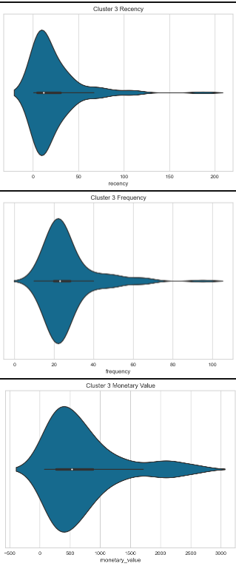
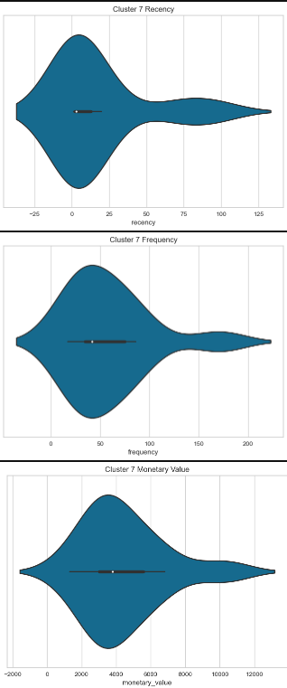


3
7
2
4

Slide 54




0
6
1
5

Slide 55
Clusterıng – EVALUATE THE MODEL
The violinplots verify our segmentations.
Clusters 3 & 7 includes most valuable customers. These customers can be made more satisfied by some additional perks.
Clusters 2 & 4 is the consistent customer mass of the store. Spending of these group can be increased by some ads & campaigns. Emails, some cards by which they can use shopping cards or collaborations with some other brands can be applied on this segment.
Clusters 0,6 & 1,5 are the ones with least contribution to monetary gains. Their mean spending is nearly 1/7 of the mean of other clusters combined. These are newer customers compared to others. More specific actions can be done about these:
Location-specific ad & campaigns
Product-specific ad & campaigns
The shopping times of these customers can be tracked and actions can be taken for those periods.
The businesses of competitors in the related regions can be analyzed.
If products bought by lowest recency segment are unique to that segment or belongs that with highest proportion they can be simply removed to decrease spending by the store.
CONCLUSIONS FROM COMPARISON

Slide 56

Clusterıng – EVALUATE THE MODEL
By following Cattell’s scree test, we choose 2-D PCA because the first bend occurs at 2.
PCA
-
SCREE PLOT

Slide 57

Clusterıng – EVALUATE THE MODEL
As we see in PCA plot, segments can be taken as 3&7, 2&4 and 1&5&0&6. Another choice is that 7, 3, 2&4, 1&5 and 0&6. Some other combinations can be taken into account of course. This choice relates with different aspects of business-decision makings and needs further analysis in terms of business costs.
PERFORM PCA

Slide 58
CONCLUSION

Slide 59
Our project goal was to create three machine learning models to predict customer churn and spending and provide a customer segmentation for business purposes.
There are 3 main customer segmentations to treat differently.
The heaviest customer activity happens during fall term most of the gain comes from customer segments 3&7.
Our prediction models have some limitations and biases. The data should be increased and further optimizations could be processed on model. Some validation techniques omitted because of time concerns and this brings some misleading scores.
Overall, our models can be beneficial with some little improvements.

Slide 60
APPENDIX
GitHub Repo
Evaluating Classification Models: 1 2 3
Imbalanced Classification: 1
Overfitting: 1
Hyperopt: 1
Lift Charts: 1
ML Pipelines: 1 2
PCA: 1 2 3

Slide 61
THANK YOU

