Slide 1







Analyzing Programming Realm
Fatih Çağlar
5/22/2024

Slide 2



OUTLINE
Executive Summary
Introduction
Methodology
Results
Visualization – Charts
Dashboard
Discussion
Findings & Implications
Conclusion
Appendix

Slide 3

EXECUTIVE SUMMARY
We aim to analyze the trends between developers and job postings at this project.
Some questions:
What is the distribution of the compensations of developers?
How other features are correlated with age?
How is gender affected on compensation?
The findings can be used to inform educational programs, developer training initiatives, and recruitment strategies.

Slide 4

INTRODUCTION
We mainly focus on Stackoverflow survey data.
The null value proportions for columns is tolerable.
There are 11552 observations for 85 different features.
The mean age for developers is 31.
The developers are from 135 different countries and most of them are from United States and India.

Slide 5

METHODOLOGY
We acquired the data using Github jobs API, web scraping and Stackoverflow 2019 Developer Survey. We cleaned and transformed the data for analysis.
Data Wrangling:
Dropped duplicates
Imputed missing values
Normalized data
Exploratory Data Analysis
Comparisons using gender, age & annual Compensation
Data Visualizations & Dashboards
Visualized trends over programming languages, databases, web frameworks, countries and more other features.

Slide 6
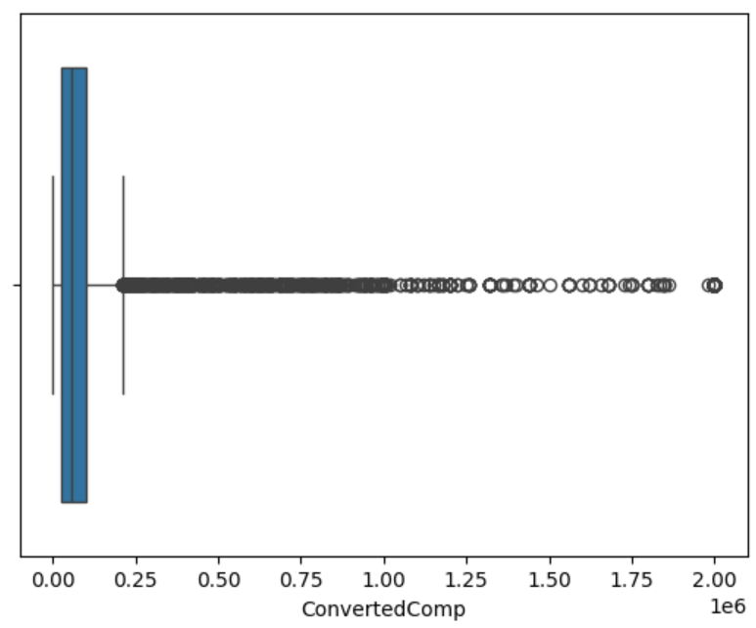
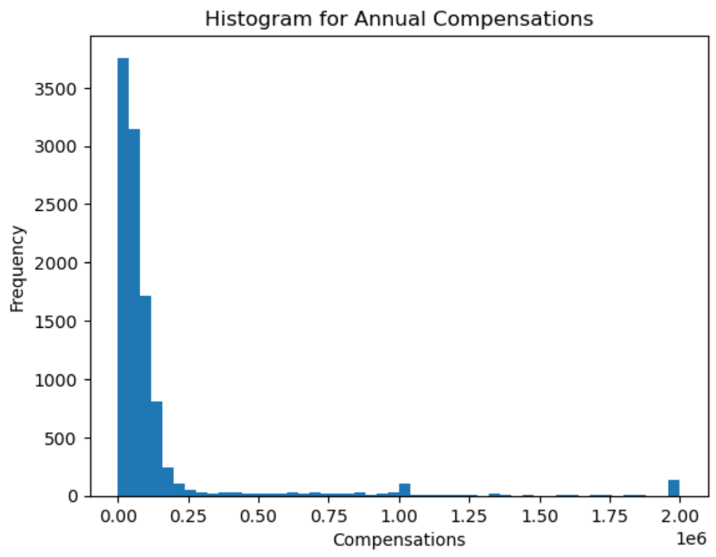
RESULTS – Salary Distribution
The distribution of annual compensations is highly right-skewed and there are so many outliers. Median compensation is $58k and mean compensation $132k as a result of this skewness.

Slide 7
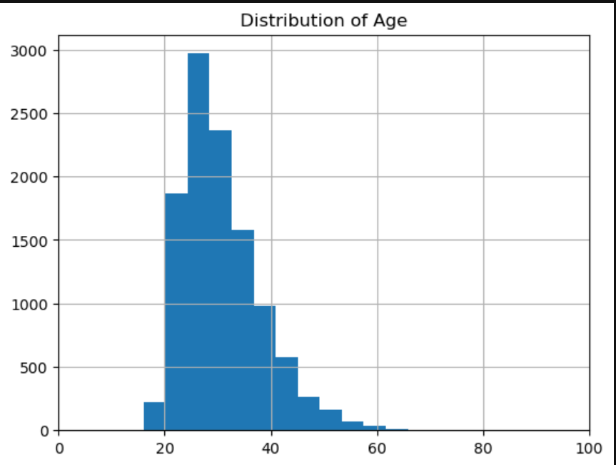
RESULTS – Age Distribution
Median age is 25 and distribution of age is slightly right-skewed.

Slide 8
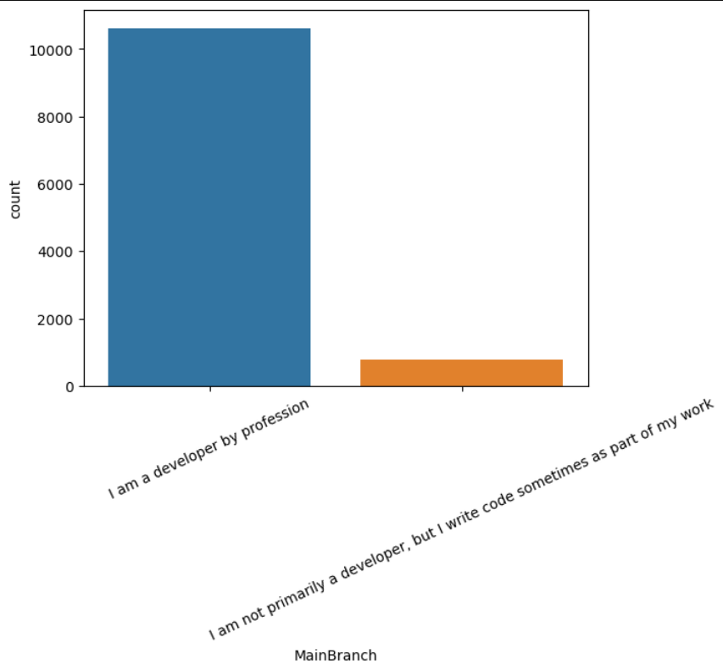
RESULTS – Main Branches
The number of developers using Stackoverflow are nearly ten times greater than users from other branches

Slide 9
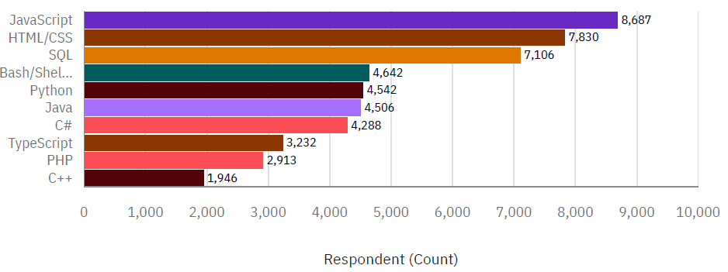
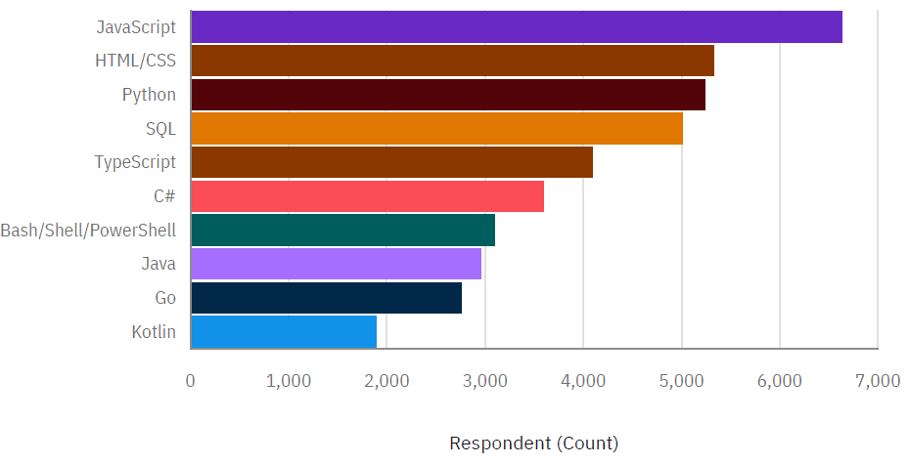
PROGRAMMING LANGUAGE TRENDS
Current Year
Next Year

Slide 10
PROGRAMMING LANGUAGE TRENDS - FINDINGS & IMPLICATIONS
Javascript,HTML/CSS and SQL are the top 2 languages used in 2019 and desired to use in 2020. Python & SQL comes right after.
C++ & PHP are least used languages out of top 10 and do not exist in top 10 desired languages for 2020.
The data suggests a move towards web-based technologies and away from traditional desktop applications.

Slide 11
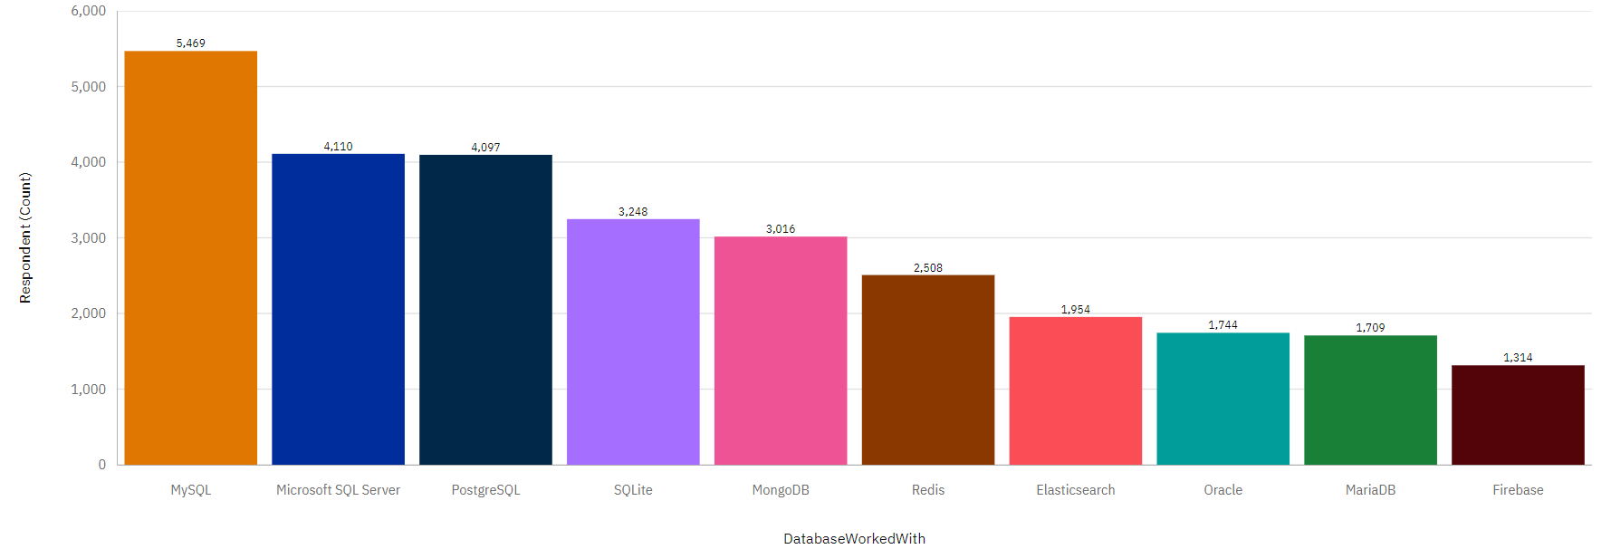
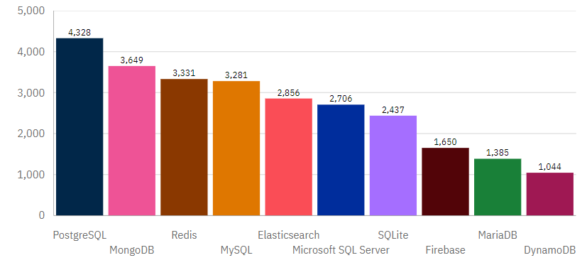
DATABASE TRENDS
Current Year
Next Year

Slide 12
DATABASE TRENDS - FINDINGS & IMPLICATIONS
MySQL is most used database in 2019 but losing its popularity for next year.
MongoDB and Redis are gaining popularity while SQL servers stay behind except PostgreSQL.
PostgreSQL's leading position suggests a potential shift towards more scalable and feature-rich database solutions.
NoSQL databases are desired to use by developers.

Slide 13

DASHBOARD
https://github.com/mf-caglar/ibm-data-analyst-capstone/blob/main/Survey_Dashboard.pdf

Slide 14
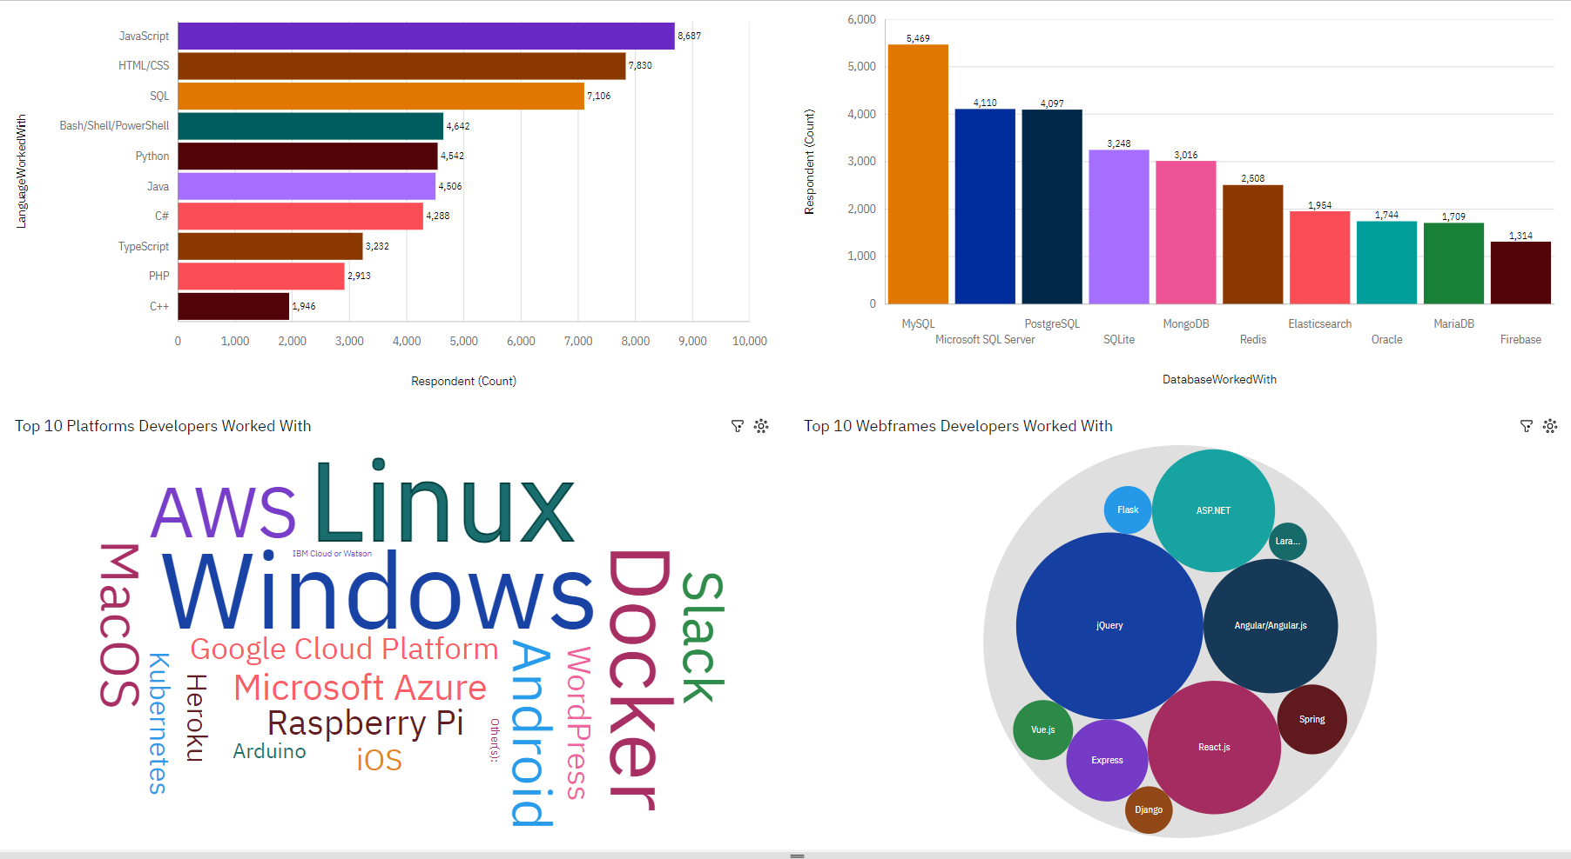
DASHBOARD TAB 1

Slide 15
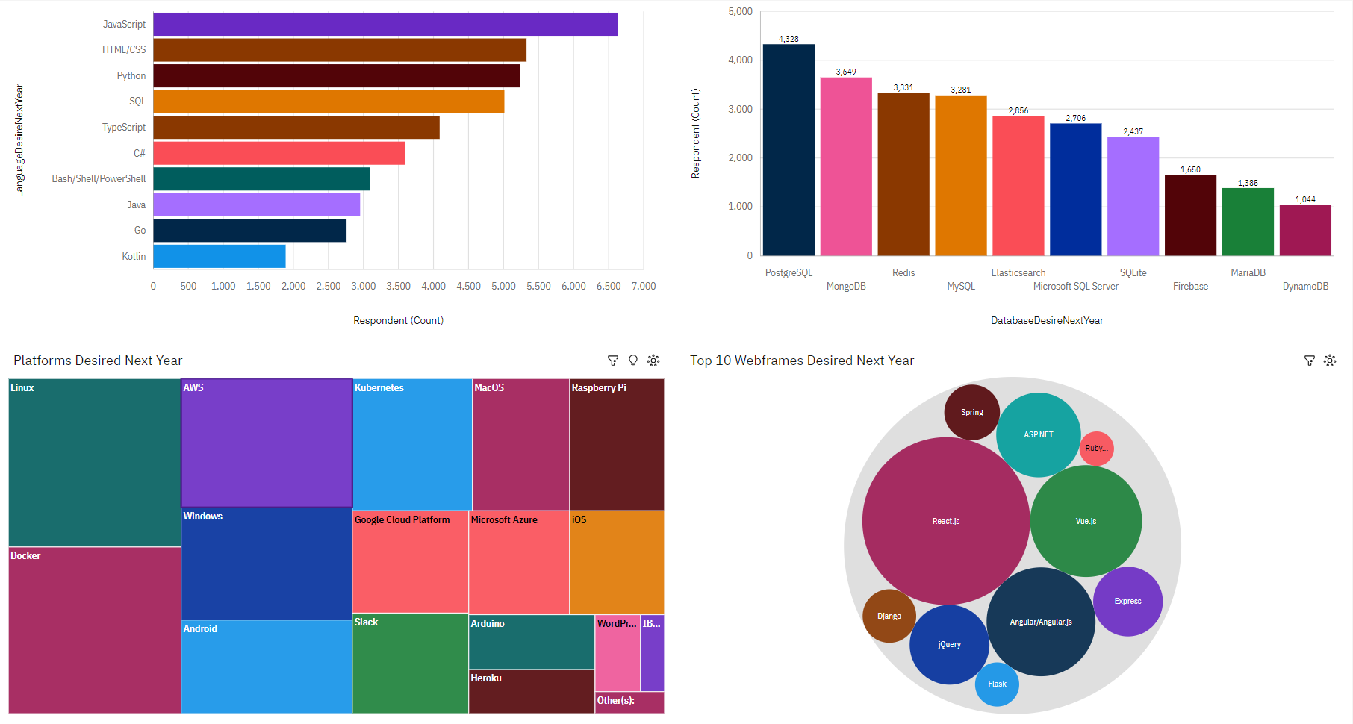
DASHBOARD TAB 2

Slide 16
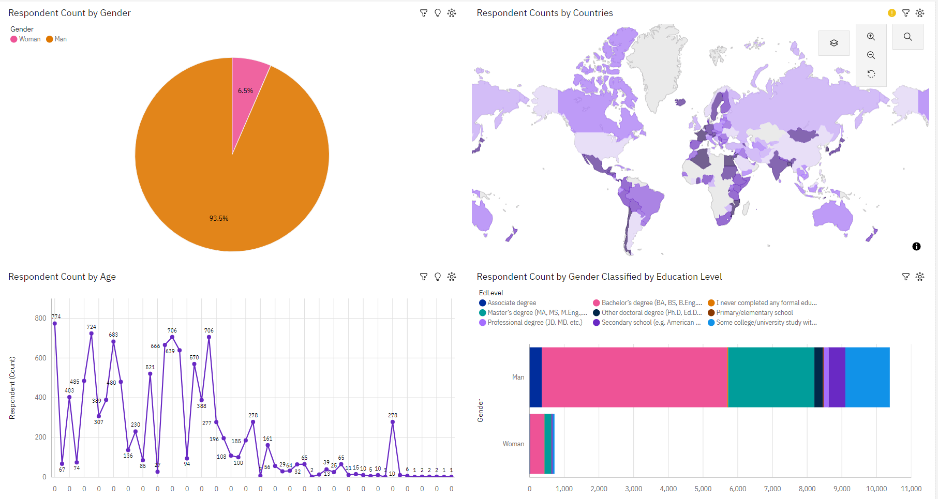
DASHBOARD TAB 3

Slide 17
DISCUSSION

Slide 18
OVERALL FINDINGS & IMPLICATIONS
The number of male developers are 15 times greater than the number of female developers.
On average, male developers earn more than females. But their median are very close.
90% of developers have a college degree or at a higher education level.
There is a gender gap and gender pay gap in tech industry. But this is because of the outliers in the compensations of male developers.
Getting a degree is a standard between developers.

Slide 19

CONCLUSION
Imbalanced compensation distribution
Young developers are more than middle-aged ones.
Gender pay gap on average
JavaScript, HTML/CSS, and SQL are most popular languages. Python’s popularity is rapidly increasing.

Slide 20
JOB POSTINGS
The fewest jobs are in Austin, while the most jobs are in Washington DC and Detroit.

Slide 21
POPULAR LANGUAGES
Swift and Python are the languages with the highest pay, while PHP and SQL are with the lowest.

Slide 22
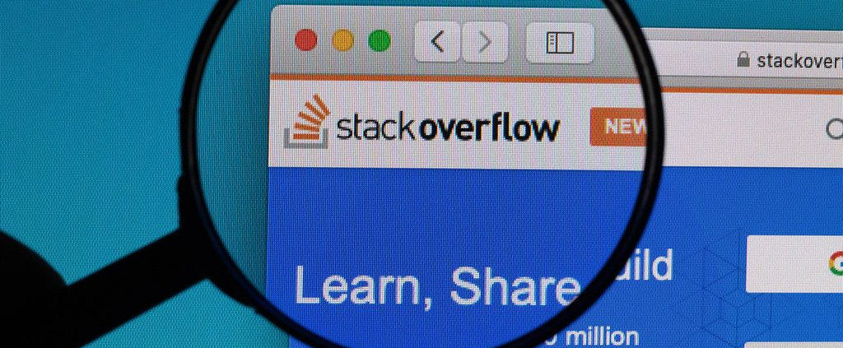
THANK YOU
This Photo by Unknown Author is licensed under CC BY

