Slide 1
Saudi Arabia
Defense Localization
Analysis
50%
Vision 2030 Target
Assessing Progress Toward 50% Defense Localization by 2030
24.89%
GAMI Reported (2024)
RCEL 506 — Applied Statistics and Data Science for Engineering Leaders
Rice University | Mohammed Farran | April 2026
Final Presentation

Slide 2
Midterm Corrections
Before → After: What Changed
Issue
Midterm
Final
Data frequency
Annual only (25 points)
Monthly (180 points) ✓
Units
SIPRI TIV vs USD — mismatch
USD vs USD — fixed ✓
Scope
Multi-country (SA + Turkey + Korea)
Saudi Arabia only — focused ✓
ML model
No model built yet
3 models: Rolling Mean, LR, Prophet ✓
Evaluation
No metrics reported
R², RMSE, MAE, Residual plots ✓
Proxy variable
1 − (TIV/USD) — unreliable ratio
Arms USD / Spending USD — clean ✓

Slide 3
Business Problem & Goal
Assessing Saudi Arabia's Progress Toward 50% Defense Localization by 2030
GAMI / MoD
SAMI / Suppliers
National Policy
Monitor localization progress and steer defense programs with data.
Identify procurement gaps and build local capabilities strategically.
Cut foreign dependency, retain economic value inside Saudi Arabia.
4%
24.89%
50%
6 yrs
2018 Localization
2024 Localization
2030 Target
Remaining to 2030

Slide 4
Data Sources & Methodology
Data Sources
Methodology
UN Comtrade
Target Variable
Mirror data — exports to Saudi Arabia
HS Chapter 93 (Arms & Ammunition only)
Monthly | 2010–2024 | USD
Import Dependency % = (Arms Imports / Military Spending) × 100
Train / Test Split
Dataset
Jan 2010 – Dec 2024 (180 months)
SIPRI
Military Expenditure Database
Constant 2024 USD Millions
Annual ÷ 12 → Monthly | 2010–2024
Train
Jan 2011 – Dec 2022 (144 months)
Test
Jan 2023 – Dec 2024 (24 months)
Why Jan 2011? The Lag_12 feature requires 12 months of lookback data. The first 12 rows of 2010 have no prior-year values and are dropped during feature engineering.
⚠ Saudi Arabia does not self-report arms data.
Mirror data = exports reported by trading partners.

Slide 5
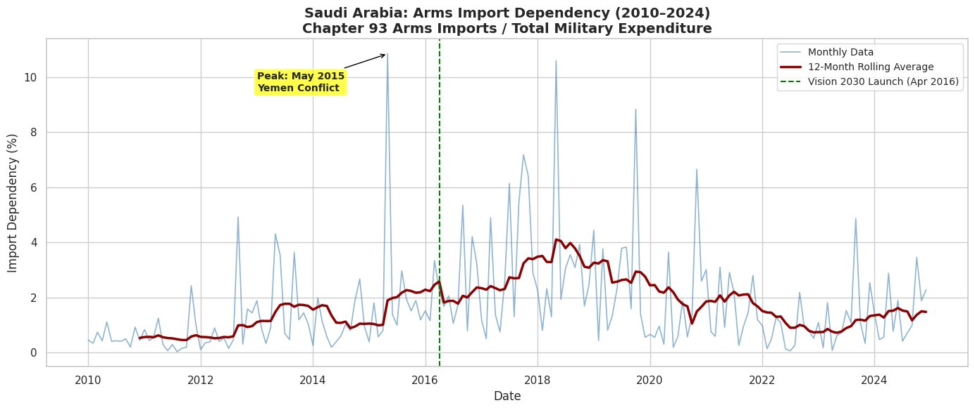
Historical Trend (2010–2024)
Peak: 10.85%
Vision 2030 Launch
Dec 2024: 2.29%
May 2015 — Yemen Conflict
April 2016 — policy shift
77.4% reduction from peak

Slide 6
3 Models: Approach & Rationale
01
02
03
Rolling Mean
Linear Regression
Prophet
Naive Baseline
ML Baseline
Advanced Time Series Model
▸ Predicts next month = average of last 12 months
▸ Supervised ML model covered in class
▸ Time series model by Facebook/Meta
▸ No machine learning — pure historical average
▸ Features: Year, Month, Lag_1, Lag_3, Lag_12
▸ Recommended by professor for this problem
▸ Sets the minimum performance bar any model must beat
▸ Rolling_3 and Rolling_12 moving averages
▸ Automatically learns trend + yearly seasonality
▸ Required by rubric as naive baseline comparison
▸ Equation: y = m₁X₁ + m₂X₂ + ... + b
▸ Used for long-term forecast to 2030

Slide 7
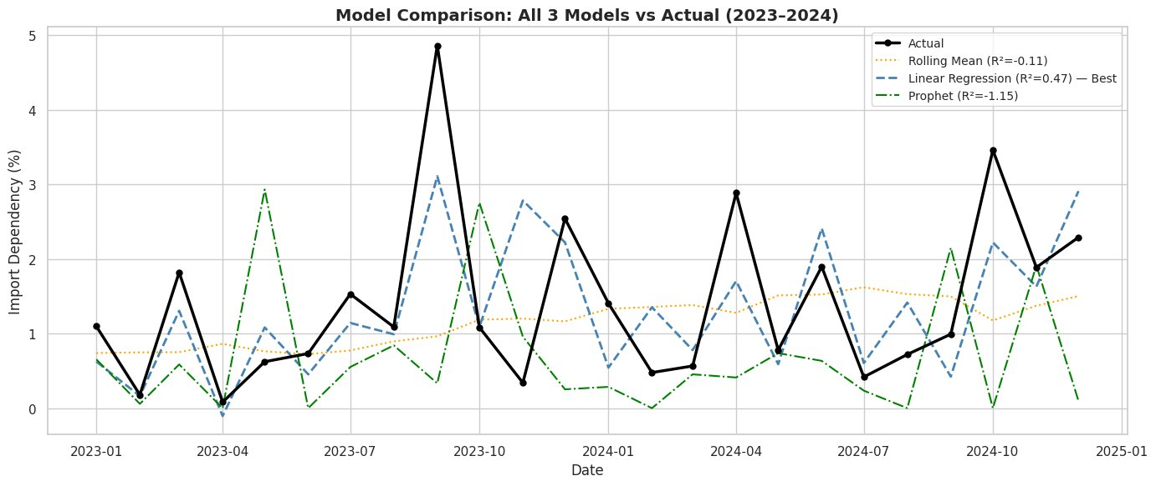
Model Results & Comparison
Model | R² | RMSE | MAE
Rolling Mean | -0.11 | 1.19% | 0.86%
Linear Reg ✓ | 0.47 | 0.82% | 0.60%
Prophet | -1.15 | 1.65% | 1.19%
Business Interpretation
R² = 0.47 — Linear Regression explains 47% of the variation in arms import dependency. The remaining 53% reflects unpredictable geopolitical events, bulk shipment timing, and reporting delays. RMSE = 0.82% — Average prediction error of 0.82 percentage points — sufficient precision for strategic defense procurement planning.
MAE = 0.60% — Mean absolute error of 0.60 percentage points, confirming consistent model accuracy with no extreme outliers

Slide 8
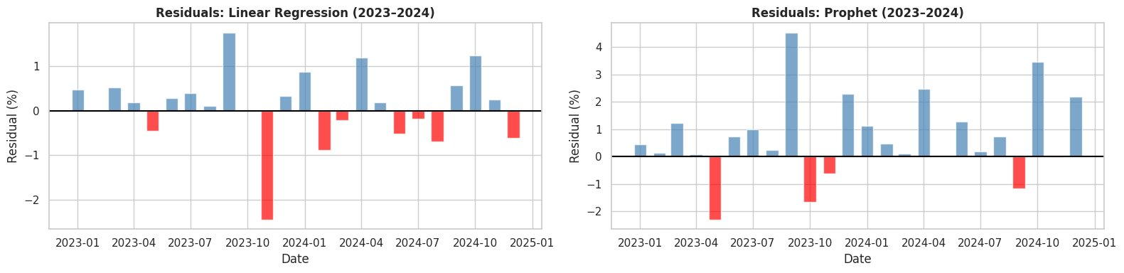
Residual Analysis
Residual = Actual − Predicted | Blue = Underestimated | Red = Overestimated
Linear Regression — Best Model
Prophet — Structural Limitation
✓ Bars randomly mixed — no systematic pattern ✓ Mean residual = 0.096% ≈ zero — no bias ✓ RMSE = 0.82% — solid prediction accuracy
✗ Mostly blue bars — systematic underestimation ✗ Mean residual = 0.71% — consistently biased → 2015 Yemen spike distorted Prophet's trend learning

Slide 9
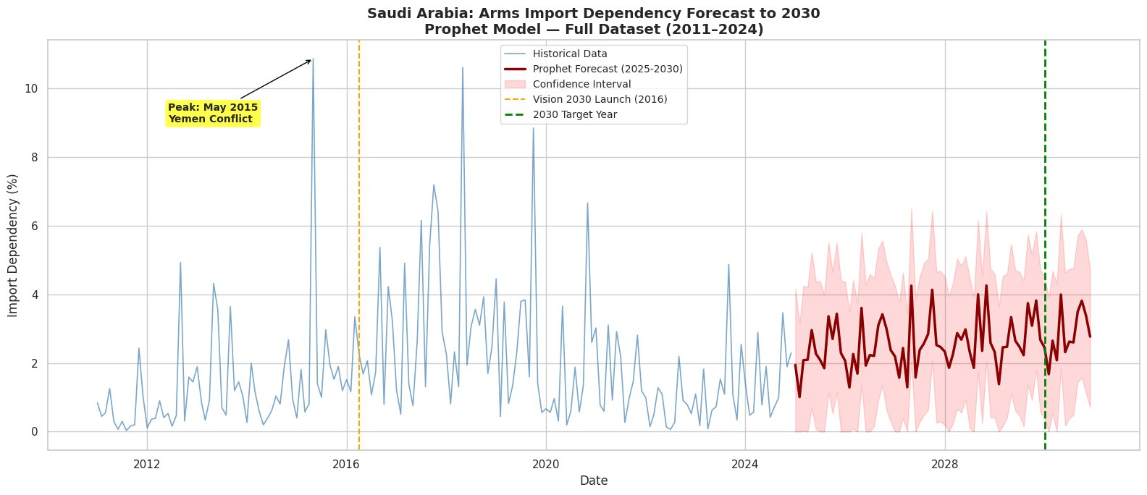
Forecast to 2030 & Conclusion
10.85%
Peak (May 2015)
2.29%
Dec 2024 (Actual)
~2.45%
Forecast Jan 2030
77.4%
Conclusion:
Reduction from peak
Saudi Arabia's arms import dependency declined 77.4% from its 2015 peak of 10.85% to 2.29% by December 2024.
The Prophet forecast projects this ratio remaining stable and low through 2030 (~2.45%), consistent with GAMI's official localization progress from 4% (2018) to 24.89% (2024).
Saudi Arabia is on a positive trajectory toward its 50% goal, though the target remains ambitious.

Slide 10
Thank You
GitHub Repository
github.com/mf111-debug/
RCEL506-Saudi-Defense-Localization
Questions & Code Audit
Mohammed Farran
Rice University — RCEL 506
April 2026
Final Results
Rolling Mean
R² = -0.11
Linear Reg ✓
R² = 0.47
Prophet
R² = -1.15
Mohammed Farran | RCEL 506 | Rice University | April 2026

