Slide 1






DATA ANALYTICS PROJECT
Hotel Analytics
Bookings, Guests & Revenue: From Database to Interactive Dashboard
Excel
SQL Server
Python
Power BI
Prepared by Mohamed Fathy

Slide 2




01
OVERVIEW
Project Overview
Goal: understand hotel performance and find decisions that raise revenue and cut cancellations.
100
5,000
20,000
192.2M
ROOMS
GUESTS
BOOKINGS
TOTAL REVENUE
DATA MODEL: STAR SCHEMA
WORKFLOW
guests
bookings
rooms
1
Excel
Initial review and pivot table summaries
5,000 rows
20,000 rows
100 rows
2
SQL Server
Database build, quality checks and analysis
3
Python
Cleaning, analysis and exploratory charts
payments
reviews
Power BI
4
25,000 rows
15,000 rows
Interactive dashboard for decision makers

Slide 3
02
TOOLKIT
Tools and What Each One Did
Each tool played a different role in the analysis journey
Excel
SQL Server
Python
Power BI
INITIAL REVIEW
DATABASE
CLEANING AND ANALYSIS
DASHBOARD
5 data sheets: bookings, guests, rooms, payments, reviews
Pivot tables for KPIs: 192.2M revenue, 20K bookings
Gender split, revenue by year, top countries
Top 10 guests by spending
The hotel database: 5 tables with primary keys
BULK INSERT to load the CSV files
4 foreign keys linking the tables
11 quality checks and 10 analytical queries
Read 5 CSV files into Pandas
Checked duplicates and missing values
Analysis with groupby and merge
9 charts with Matplotlib and Seaborn
4 many-to-one relationships in the data model
4 calculated columns and 8 DAX measures
Home page plus 2 report pages
KPI cards, charts and slicers

Slide 4



03
SQL SERVER
SQL Server: Build, Validate, Analyze
3 scripts: table creation, analytical queries and data quality checks
5
11
10
DATABASE BUILD
DATA QUALITY CHECKS
ANALYTICAL QUERIES
5 tables with suitable data types
A primary key on every table
BULK INSERT to load the CSV files
4 foreign keys keep relationships valid
Constraint check via INFORMATION_SCHEMA
Duplicate guest IDs and NULLs in bookings
Check-out dates before check-in
num_nights vs. the date difference
Booking date after check-in date
Ratings outside 1 to 5
Guests above room capacity
Orphan keys across 4 relationships
Total revenue, bookings, average booking
Monthly revenue trend
Top 5 room types by revenue
Channel performance and cancellation rate
Top 10 guests and top 10 countries
High-value guests using a CTE
Monthly revenue growth using LAG()
7,329
36.6%
Finding: no duplicates, NULLs or invalid dates. But 7,329 bookings (36.6%) list more guests than the room's maximum occupancy. This must be reviewed before any occupancy analysis.

Slide 5
04
PYTHON
Python: Loading and Preparing Data
Pandas, NumPy, Matplotlib and Seaborn, working in Google Colab
Python | Google Colab
1
Load the data
Read 5 CSV files (sep=";") in Google Colab: bookings, guests, payments, reviews, rooms
bookings = pd.read_csv("/content/bookings.csv",
sep=";")
bookings.shape
bookings.info()
bookings.describe()
bookings.isna().sum()
bookings.duplicated().sum()
bookings["booking_date"] = pd.to_datetime(
bookings["booking_date"], dayfirst=True)
2
First look
head(), shape, info(), columns and dtypes for every table
3
Summary statistics
describe() on each table
4
Quality checks
isna().sum() and duplicated().sum() on each table
5
Date conversion
pd.to_datetime(dayfirst=True) on booking_date, then group by year and month
Result: 0 missing values and 0 duplicate rows in all 5 tables

Slide 6



ANALYSISCODEKEY RESULTFINDING
05
PYTHON ANALYSIS
Python: Analysis and Results
Seven analysis areas, with results computed from the same data
ANALYSIS
CODE
KEY
FINDING
Revenue
sum() · mean() · groupby(year, month)
192.2M
Total 192.2M, average booking 9.6K, peak month Oct 2023 (19.7M)
Bookings
count() · groupby(status) · groupby(year)
20K
20K bookings; 2024 is the highest year with 9,350; the five statuses are about equal (~4K each)
Cancellation
groupby(channel) → (status == "Cancelled").mean()
20.2%
Overall rate 20.2%; highest Travel Agent (21.4%), lowest Walk-in (19.6%)
Room types
merge(rooms, bookings) → groupby(room_type)
45.4M
Deluxe is highest at 45.4M (4,792 bookings); Double is lowest at 31.1M
Booking channels
groupby(booking_channel) → count, sum, mean
32.8M
Website is highest at 32.8M; channels are close (31.4M to 32.8M)
Guests
merge(guests, bookings) → groupby(guest_id)
≈159K
Top guest ≈ 159K; average spend per guest ≈ 39K; top country Korea (40 guests)
Correlation
bookings.corr(numeric_only=True) + heatmap
0.74
Only strong correlation: num_nights with total_amount = 0.74

Slide 7
06
PYTHON VISUALIZATIONS
Python: Visualizations
9 charts built with Matplotlib and Seaborn; three of them are shown here
Revenue by room type (M)
Cancellation rate by channel (%)
Monthly revenue by booking date (M)
Oct 2023: 19.7M
Deluxe and Suite lead; Double is the lowest at 31.1M.
Channels are close: from 19.6% (Walk-in, Booking.com) to 21.4% (Travel Agent).
Peak in Oct 2023 (19.7M), then a steady fall. By check-in date revenue is steadier: 64.8M in 2024 and 63.3M in 2025.

Slide 8
07
DATA MODEL
Data Model
Entity relationship diagram: one fact table, two dimensions and two child tables
Relationships: 4 many-to-one (1 → *)
Fact table: bookings holds every booking detail.
Dimensions: guests and rooms.
Child tables: payments and reviews, linked to each booking.
Relationships: 4 many-to-one, filtering from the one side to the many side.
Calculated columns: Age, Age Group, lead_time, stay_category.
8 DAX measures: total_booking_value, total_bookings, total_guests, total_rooms, avg_booking_value, avg_room_price, avg_rating, cancellation_rate.
DIMENSION
FACT
DIMENSION
guests
1
*
bookings
*
1
rooms
5,000 rows
20,000 rows
100 rows
CHILD
CHILD
payments
reviews
25,000 rows
15,000 rows
Why it matters: a filter on country, room type or channel flows through every visual.

Slide 9
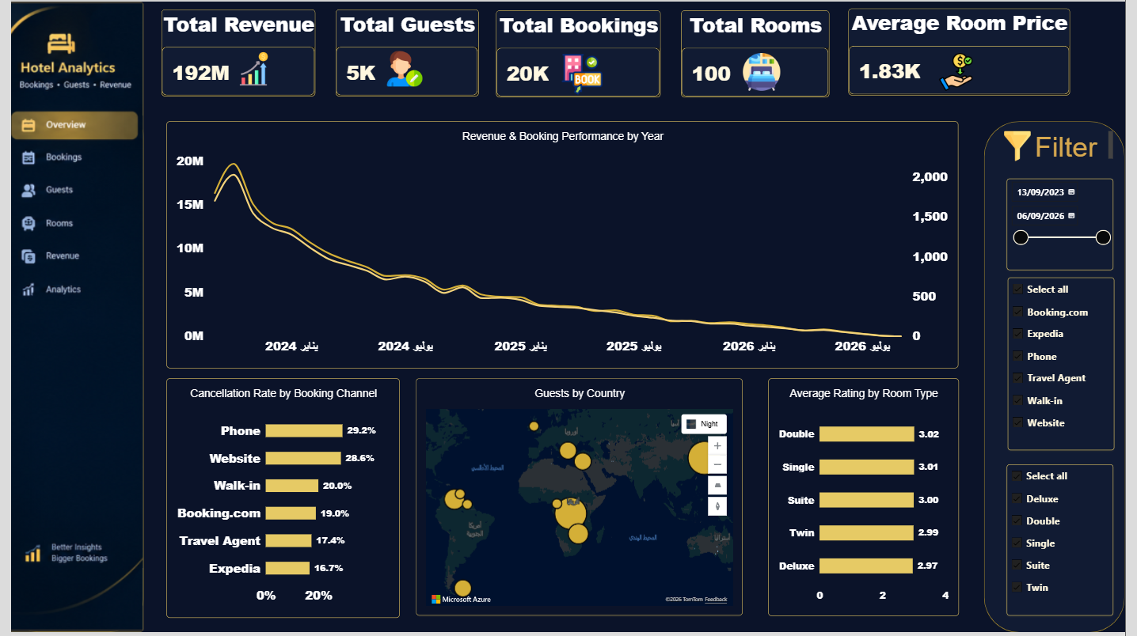



08
POWER BI
Power BI: Overview Page
A quick picture of hotel performance
KPI cards (5)
Revenue 192M, guests 5K, bookings 20K, rooms 100 and average room price 1.83K.
Revenue and bookings by year (line)
Revenue peaks in 2024 at 90M (9.4K bookings), then declines.
Cancellation rate by channel (bar)
Phone (29.2%) and Website (28.6%) are highest.
Guests by country (map)
Shows where guests come from, to target campaigns.
Gender split (donut)
Balanced: 2.5K female and 2.5K male (about 50% each).
Average rating by room type (bar)
All room types are close to 3.0 (2.97 to 3.02).
Takeaway: by booking date, revenue falls after 2024. By check-in date, 2025 = 63.3M, so read both views before judging performance.
Filters (date, channel, room type)
Slice any period, channel or room type; every visual updates.

Slide 10
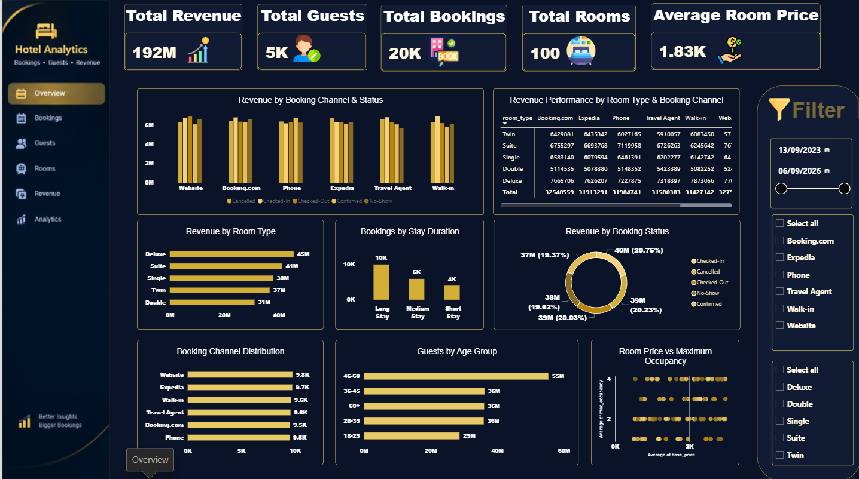

09
POWER BI DETAILS
Power BI: Revenue and Details Page
Revenue by channel, room type, stay duration and age group
Revenue by channel and status (columns)
Shows revenue at risk from cancellations and no-shows.
Revenue by room type (bar)
Deluxe leads with 45M; Double is lowest at 31M.
Bookings by stay duration (column)
Long stays 10K, medium 6K, short 4K (about 50%, 30%, 20%).
Room type by channel (matrix)
Finds the best combinations for pricing and distribution.
Revenue by booking status (donut)
Five statuses, each about 19.4% to 20.8% of revenue.
Booking channel distribution (bar)
Website 9.8K down to Phone 9.5K: very balanced.
Guests by age group (bar)
The largest group is 46 to 60 years old (1,435 guests).
Takeaway: revenue is spread evenly across channels (31.4M to 32.8M) and room types, so there is no dependence on a single channel. A healthy sign.
Room price vs capacity (scatter)
The link is weak (correlation 0.18).

Slide 11
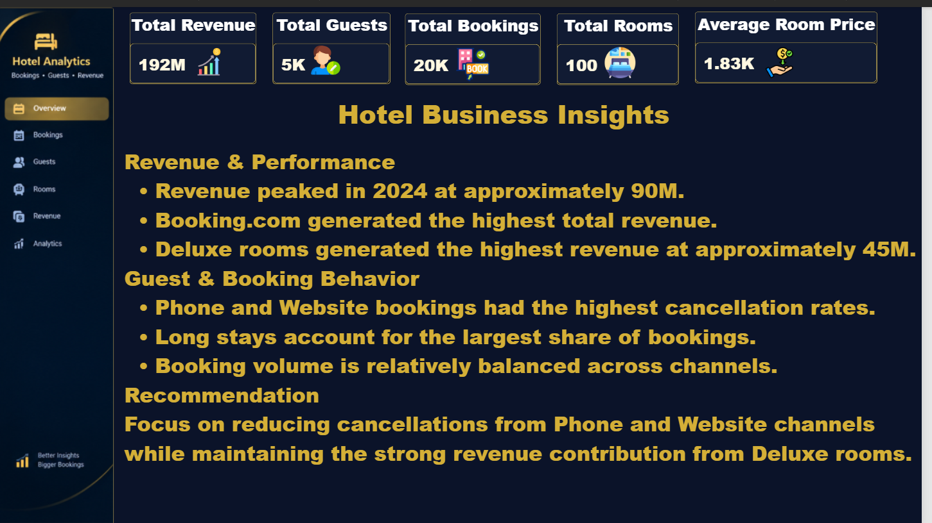
10
POWER BI INSIGHTS
Power BI: Business Insights Page
Hotel performance + revenue intelligence + decision support
REVENUE & PERFORMANCE
Revenue peaked in 2024 at approximately 90M.
Booking.com generated the highest total revenue.
Deluxe rooms generated the highest revenue at approximately 45M.
GUEST & BOOKING BEHAVIOR
Phone and Website bookings had the highest cancellation rates.
Long stays account for the largest share of bookings.
Booking volume is relatively balanced across channels.
Recommendation: focus on reducing cancellations from Phone and Website channels while maintaining the strong revenue contribution from Deluxe rooms.

Slide 12

11
CONCLUSION
Key Findings and Recommendations
What the analysis shows and what to do next
39.9%
76.6M
115.6M
of bookings are Cancelled or No-Show
of the 192.2M total sits in those bookings
effective revenue after excluding them
KEY FINDINGS
RECOMMENDATIONS
1
Define "effective revenue" in Power BI: exclude Cancelled and No-Show.
2
Analyze seasonality by check_in_date as well as booking date.
The drop in 2025 and 2026 comes from booking dates: by check-in date, revenue is 63.3M and 44.4M.
7,329 bookings (36.6%) list more guests than room capacity: a data quality issue.
Performance is balanced across channels and rooms; Deluxe and Suite lead; the average rating is 3.0 out of 5.
3
Review room capacity rules before relying on occupancy analysis.
4
Cut cancellations with advance deposits, especially for Travel Agent (21.4%).
5
Build loyalty programs for top guests.
6
Rank top guests by guest_id in Power BI, not by name (top guest: Angela Green, 159K).

