Slide 1







Coursera Capstone Project
MAISHA FARZANA
16th May 2021

Slide 2



OUTLINE
Executive Summary
Introduction
Methodology
Results
Visualization – Charts
Dashboard
Discussion
Findings & Implications
Conclusion
Appendix

Slide 3

EXECUTIVE SUMMARY
This report is done based on future skill requirements as well as changing technologies on the data that has been collected from various sources and identify trends for this year's report on emerging skills
Current Technology trends seems to have no major changes, but few of them shows slight changes over the years.
Languages that are web-based are still very much desired, but easy to learn languages like Python are starting to be much more popular
Structured databases are still going strong, but non-structured cloud databases are gaining in popularity
Development for handheld devices applications and systems seems to be growing steadily
Job postings that require C language is far more than any other language requested
There are significantly less women in the IT industries than men.

Slide 4

INTRODUCTION
In order to keep pace with changing technologies and remain competitive, we must regularly analyzes data to help identify future skill requirements.
The task is to collect data from various sources and identify trends for this year's report on emerging skills.
Job postings
Training portals
Surveys
Questions that the analysis seeks to answer:
What are the top programming languages in demand?
What are the top database skills in demand?
What are the popular IDEs?

Slide 5

METHODOLOGY
Web Scraping
Extract information from a given web site
Write the scraped data into a csv file
Website: "https://cf-courses-data.s3.us.cloud-object-storage.appdomain.cloud/IBM-DA0321EN-SkillsNetwork/labs/datasets/Programming_Languages.html"
Collecting Data using API
Collect job data from GitHub Jobs API
Store the collected data into an excel spreadsheet.
Data Wrangling
Identify and remove duplicate values in the dataset
Identify missing values and filling them out in the dataset
Normalize the dataset
Data visualization
Presenting the dataset in a easy to understand visual format
Ex. Dashboard

Slide 6
RESULTS
The results compiled in:
Programming Language Trends
Findings and Implications
Database Trends
Findings and Implications
Visualization of the findings in a dashboard with 3 tabs
Tab 1: Current Technology Uses
Tab 2: Future Technology Trends
Tab 3: Survey Demographics

Slide 7
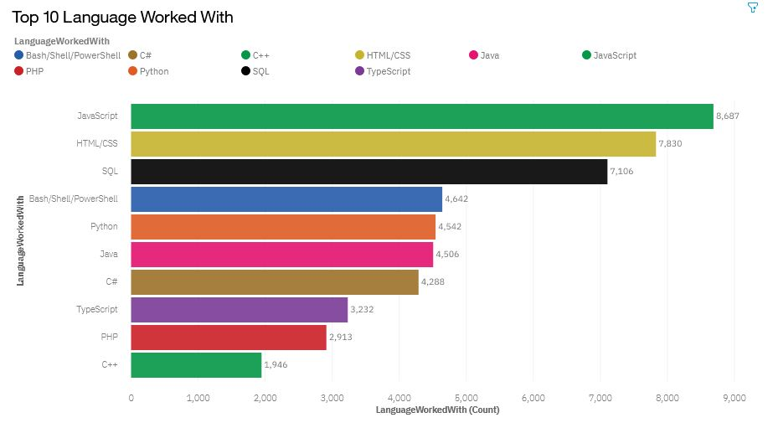
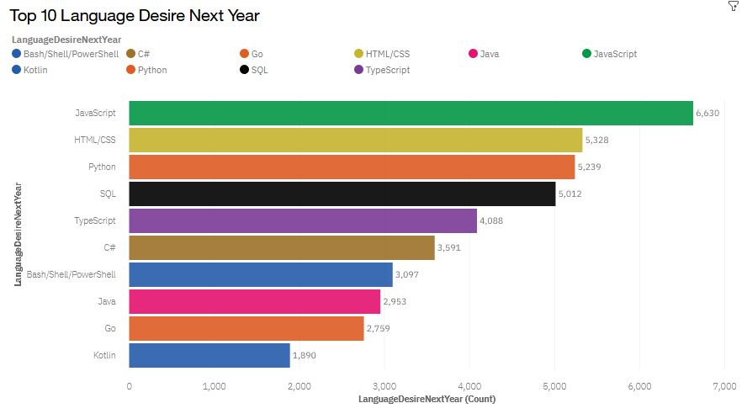
PROGRAMMING LANGUAGE TRENDS
Current Year
Next Year

Slide 8
PROGRAMMING LANGUAGE TRENDS - FINDINGS & IMPLICATIONS
Findings
HTML and JavaScript are the most used and desired programming languages
Python is a greatly desired programming language
PHP is not a Language that is desired much for the future
Implications
Languages related to web pages continue to be in high demand
Python users are greatly desired and will increase in the future
PHP, while still in use, is starting to fall out of favor with programmers

Slide 9
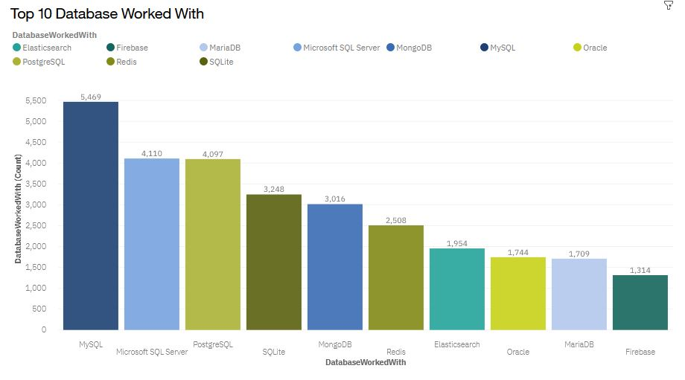
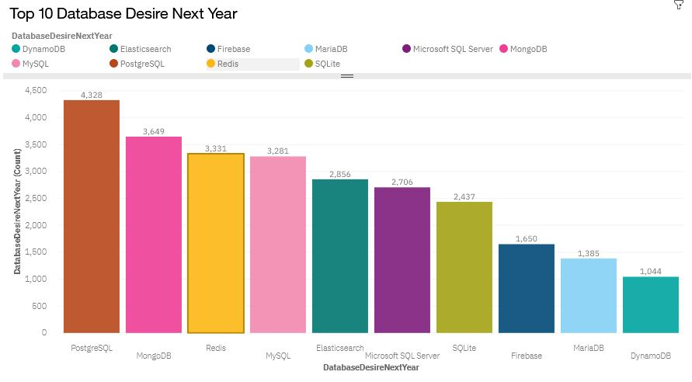
DATABASE TRENDS
Current Year
Next Year

Slide 10
DATABASE TRENDS - FINDINGS & IMPLICATIONS
Findings
MySQL is the most used database, but is starting to be less desired
MongoDB is decently used, but more programmers are desiring it
Oracle has a decent amount of uses, but is slowing going out of use
Implications
Structured Database uses are still going strong, but are starting to fall out of favor
Cloud-based non-structured databases such as MongoDB are getting more recognition and more used
Oracle, while still in use, is less desired for commercial use and hiring prospects

Slide 11

DASHBOARD
The permanent link of the read-only view of the Cognos dashboard:
https://dataplatform.cloud.ibm.com/dashboards/c66e8ef5-820f-4971-9501-fa755e3f7c79/view/5825eb7a2e8a1fc86bf3d4e4079a7f53743e245ae3bbd25085877b4907357597f06a4195c87c4908df435460a7ec135fce

Slide 12
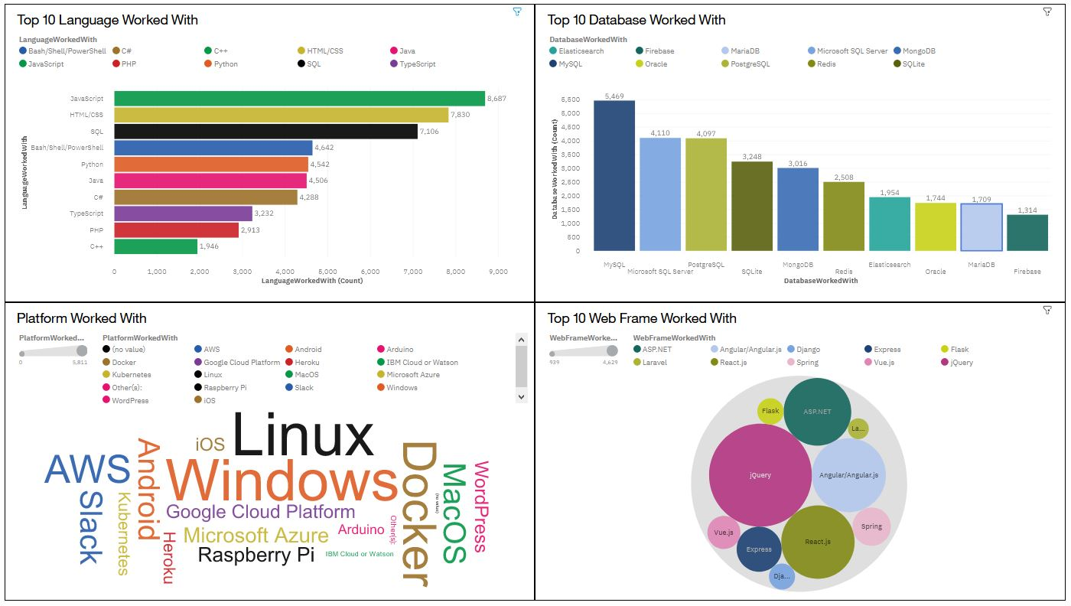
DASHBOARD TAB 1

Slide 13
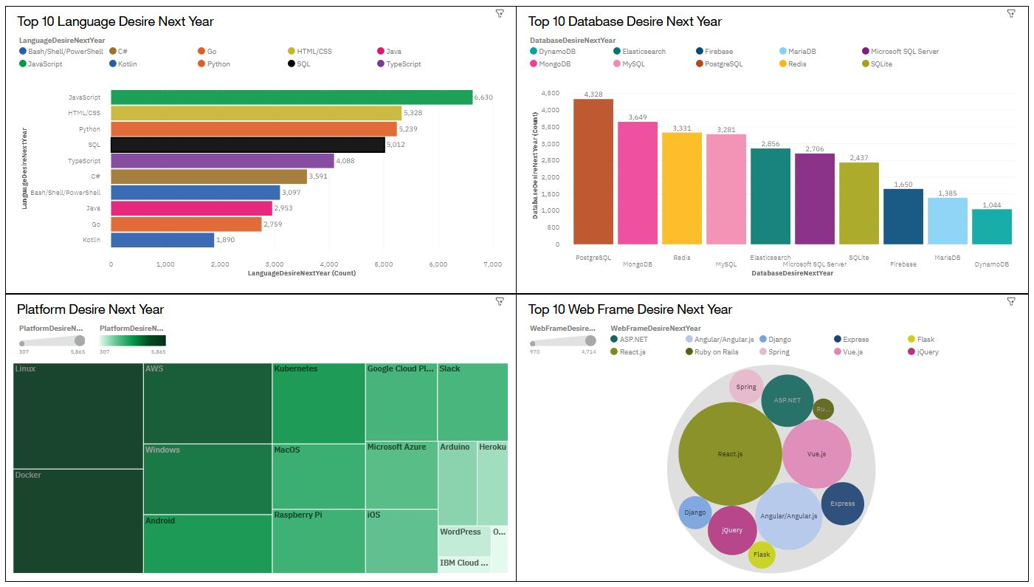
DASHBOARD TAB 2

Slide 14
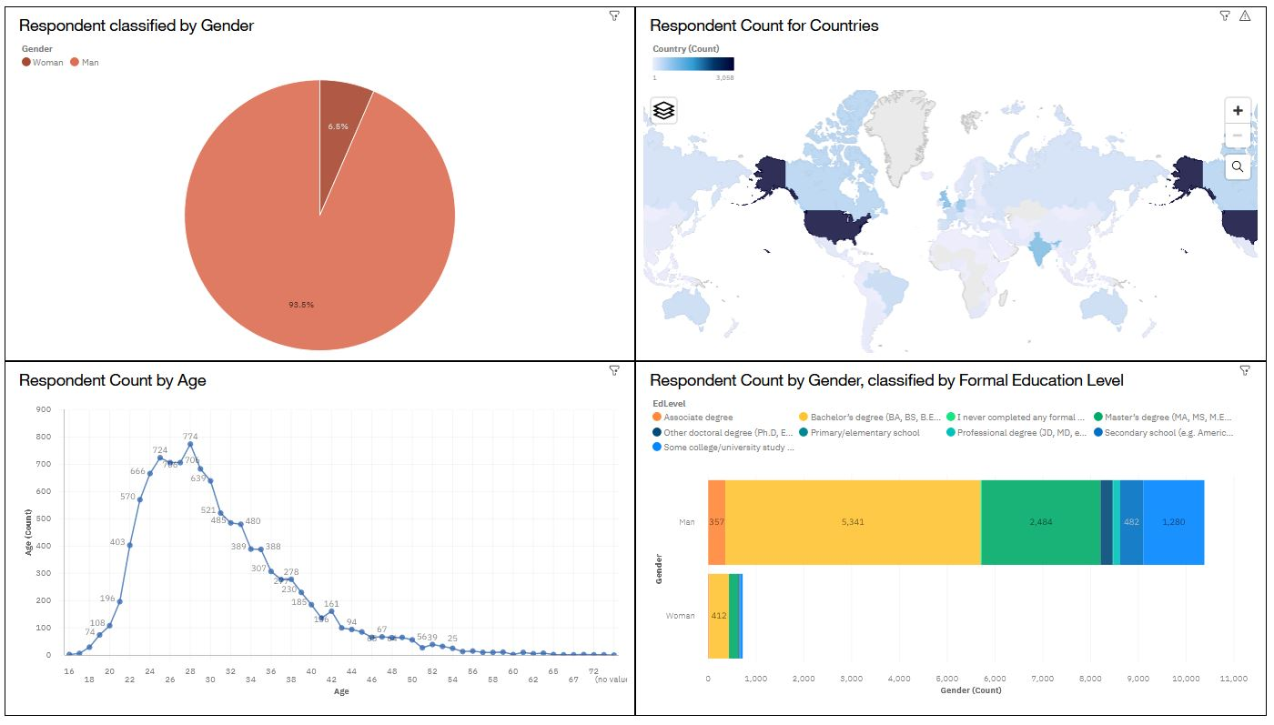
DASHBOARD TAB 3

Slide 15
DISCUSSION
How can more women get more into the IT industry?
What benefits of Cloud-based non-structured databases are increasing its popularity?
Why is the web frame React with JavaScript gaining so much popularity?

Slide 16
OVERALL FINDINGS & IMPLICATIONS
Findings
Android is well-used platform to develop on, and is getting more popular
SQL databases are still going strong and widely desired, but non-structured databases are getting more recognition
Most of the respondents are males in their mid 20s to late 30s, and live in the US
Implications
Platforms that are on handheld devices are very popular, and will continue to be so in the future
Cloud-based non-structured databases are getting more popular as the data gathered increases
The Tech industry is mostly dominated by men, and the US is still a technological giant leading the world

Slide 17

CONCLUSION
Web-based languages (e.g. JavaScript, HTML/CSS) continue to be highly used and desired by programmers.
Structured Database uses are still going strong, but are starting to fall out of use in favor of Cloud-based non-structured databases such as MongoDB. This will only continue as more large volumes of data needs to be stored and processed
Windows and Mac web frame IDEs are still highly desired, though android IDEs are gaining popularity as more people start to use handheld devices.
Unlike the trends we see with programmers, there are far more job postings for C# than any other language
The IT industry is dominated by men. That won't change in the near future.

Slide 18

APPENDIX
GitHub Job Postings
Popular Languages

Slide 19
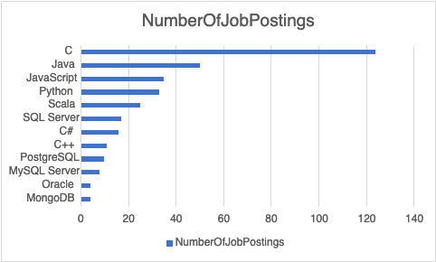
GITHUB JOB POSTINGS

Slide 20
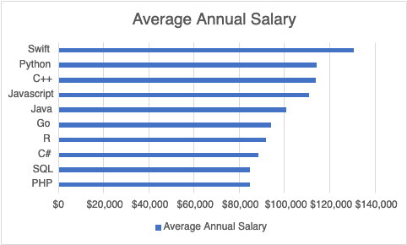
POPULAR LANGUAGES

