Slide 1






Home Tools Rental
introduction
Motivation
Requirements
Design
Team Members
Conclusion

Slide 2
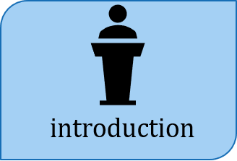

Slide 3
“Home Tools Rental” is an application that creates an environment where people can offer their tools for renting and allows the user to search for the tool he\she needs and rent it. The app will mostly be used by neighbors since it’s easier to take and return tools if the user has rented it from a neighbor, and this will be done via the user’s location.

Slide 4



Goals
Importance

Slide 5
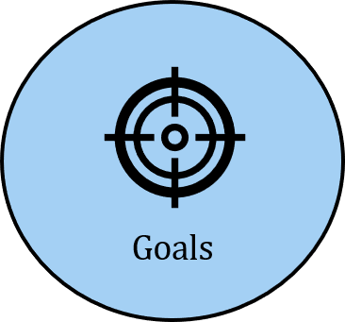

Slide 6
Decrease the expenses of buying tools.
Make a safe and reliable environment for neighbors to rent tools.
Attain some benefit of old tools instead of disposing them.

Slide 7
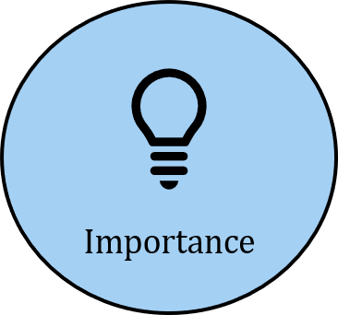

Slide 8
Save money and time.
Build a community of neighbors.
Provides a secure transaction.
Test a tool before investing in one.

Slide 9
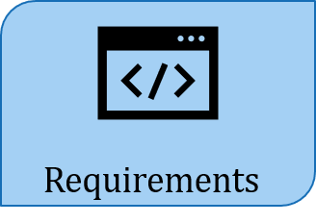

Account creation
Function#1
Functional Requirements
Tool search
Function#2
Input verification
Non-Functional Requirement
Offer a tool
Function#3

Slide 10
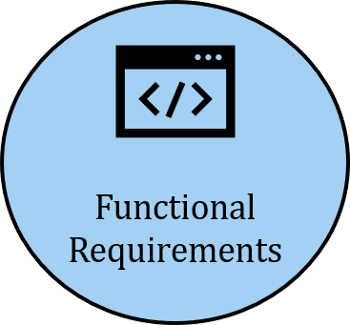

Slide 11
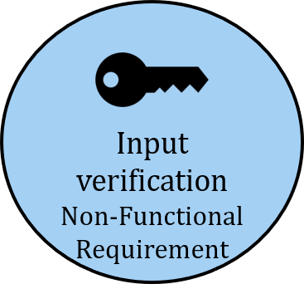

Slide 12
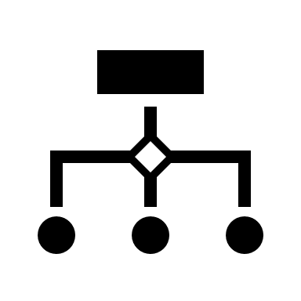
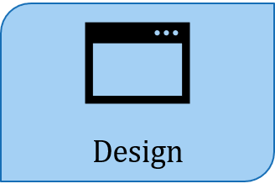
Flow-Chart Diagram
User Interface

Slide 13
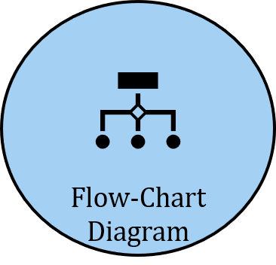

Slide 14

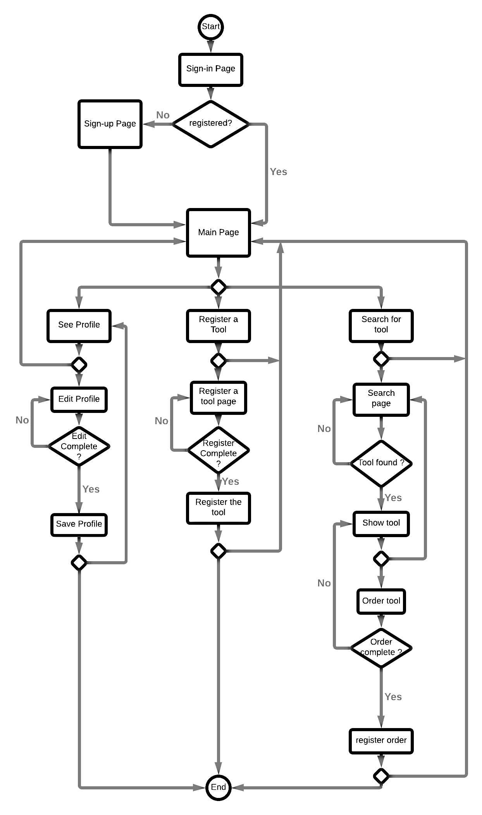

Slide 15
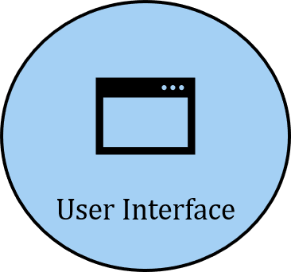

Slide 16
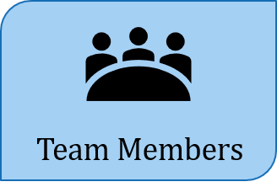

Slide 17
Team Member | Contributions | GitHub profile | HTR GitHub page
Abdulmalik Alsheddi | Worked on FR and non-FR requirements and implementation. | https://github.com/AbdulmalikSH | https://github.com/mfaghunaim439/Home_Tools_Rental
Mohamed Ghunaim | Organized and finished Presentation slides. | https://github.com/mfaghunaim439
Abdulaziz AlBarrak | Worked and implemented GUI. | https://github.com/abdulazizAlbarrak
Abdulaziz AlOthman | Organized and finished Presentation slides. | https://github.com/abduLaziz-9
For the full contributions please visit the HTR page.

Slide 18

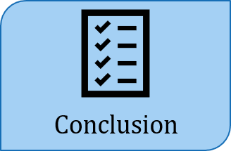

Future work
Summary

Slide 19
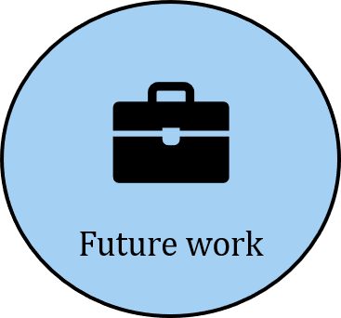

Slide 20
Develop the application into other platforms.
Support different languages to spread the application further.
Add different features such as in application private messages.

Slide 21
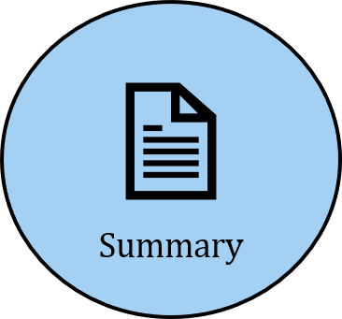

Slide 22
To summarise, we’ve shown the motivation, requirements, and design of the application. The application aims to decrease expenses and provide a reliable environment to do so. We displayed some of the functional and non-functional requirements. This is but a prototype of the of the project. We hope to expand and add more features with time.

Slide 23
Thank you for listening, any questions?

