Slide 1
Introduction to TensorFlow
Fahad Akbar

Slide 2
What we will be learning today ?
Neural Nets:
Definitions
Terminologies
How it works
TensorFlow TensorFlow Play Ground Coding
Supervised Structured Data Case

Slide 3
What is TensorFlow ?
If you don’t already know it…
It is a framework/API
Developed by Google
To train Neural Networks
To solve machine learning problems

Slide 4
What are Neural Nets?
Terminologies
Input/output Layers
Hidden Layers
Neurons/Nodes
Parameters
Forward Propagation
Backward Propagation
Activation Functions
Loss Function
Optimization Function
Batch Size
Epochs
Learning Rate
Regularization
The Idea
What is a Neural Net
How it works

Slide 5

What is a Neural Net & How They Work
Boris Hanin: A Famous Professor, Deep Learning Researcher & Practitioner at Princeton University & Facebook
“Wo don’t really know” ☺
But if you guys still insist….

Slide 6
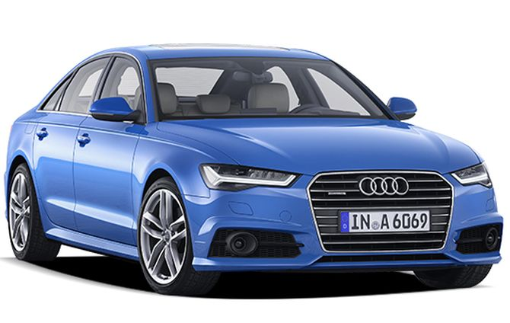
What is a Neural Net & How They Work
NN is a :
Mathematical Model
Mimic Human Brain
Learning and Decision making Pattern
Human brain works by accreting (putting together) smaller abstractions (ideas) into larger ones.

Slide 7
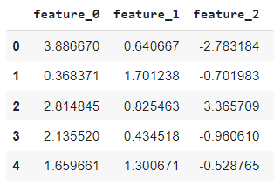
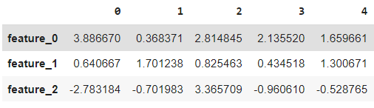

What is a Neural Net & How They Work
Mathematical Model ??
Before I go there Imagine a typical Data Set !
Because I want to mess with your head!

Slide 8
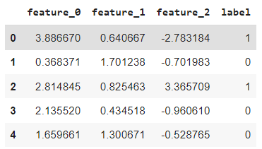
What is a Neural Net & How They Work
Mathematical Model ??
What if I tell you that you already know it …
Remember Logistic Regression?
y_hat = a + b*feature_0 + c* feature_1 + d* feature_2
This is the very basic element of a NN

Slide 9
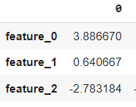

What is a Neural Net & How They Work
Mathematical Model ??
Logistic Regression Equation
For simplicity, take one sample
a
feature_0 =3.88
feature _1=0.64
feature_2=-2.78
b
c
y = 0.99
d
A Very Simply & Basic Neural Net Structure !
Neural Nets at an atomic level….

Slide 10
What is a Neural Net & How They Work
Mathematical Model ??
Parameters
For simplicity, take one sample
Input Layer
a
feature_0 =3.88
feature _1=0.64
feature_2=-2.78
Output Layer
b
c
y = 0.99
d
Terminology Alert !
Boxes are called “Layers”
Elements inside the boxes are ”Neurons”
a, b, c, d are ”parameters”

Slide 11
What is a Neural Net & How They Work
Mathematical Model ??
Parameters
For simplicity, take one sample
Input Layer
a
feature_0 =3.88
feature _1=0.64
feature_2=-2.78
Output Layer
b
c
y = 0.99
d
Another Terminology Alert !
You have feature values & have parameter values - -> learn y_hat - - > “Forward Propagation”
You have y values & have feature values - -> learn parameter - - > “Backward Propagation”

Slide 12
What is a Neural Net & How They Work
The Process
The goal is to find the best fitting parameters,
iteratively!
a
[0.92]
- {0.78}
= [0.14]
SAMPLE 1
Parameters = random(4)
for one_sample in training_data:
forward_propagation()
backward_propagation()
Parameters =adjust_parameters(Parameters)
feature_0 =3.88
feature _1=0.64
Feature_2=-2.78
b
[0.82]
-{0.03}
= [0.79]
Y_hat= .05
Vs
y= 1
[1.3]
-{0.15}
= [1.15]
c
print (signal)
Signal: How far is our prediction from reality
[0.75]
-{2.5}
= [-1.75]
d
Adjust Parameters:
Calculate derivatives for a, b, c & d AND adjust them

Slide 13
What is a Neural Net & How They Work
The Process
The goal is to find the best fitting parameters,
iteratively!
a
[0.14]
- {0.10}
= [0.04]
SAMPLE 2
Parameters = random(4)
for one_sample in training_data:
forward_propagation()
backward_propagation()
Parameters =adjust_parameters(Parameters)
feature_0 =0.37
feature _1=1.70
Feature_2=-.70
b
[0.79]
-{0.05}
= [0.74]
Y_hat= .25
Vs
y= 0
[1.15]
-{0.15}
= [1.00]
c
print (signal)
Signal: How far is our prediction from reality
[-1.75]
-{0.5}
= [2.25]
d
Adjust Parameters:
Calculate derivatives for a, b, c & d AND adjust them
Keep repeating until you go through all training data, sample by sample !

Slide 14
What is a Neural Net & How They Work
Terminology Alert!
The Process
The goal is to find the best fitting parameters,
iteratively!
a
[0.14]
- {0.10}
= [0.04]
SAMPLE 2
Parameters = random(4)
for one_sample in training_data:
forward_propagation()
backward_propagation()
Parameters =adjust_parameters(Parameters)
feature_0 =0.37
feature _1=1.70
Feature_2=-.70
Loss Function
b
[0.79]
-{0.05}
= [0.74]
Y_hat= .25
Vs
y= 0
[1.15]
-{0.15}
= [1.00]
c
print (signal)
Signal: How far is our prediction from reality
[-1.75]
-{0.5}
= [2.25]
d
Epoch
Optimization Function
Adjust Parameters:
Calculate derivatives for a, b, c & d AND adjust them
Keep repeating until you go through all training data, sample by sample !

Slide 15
What is a Neural Net & How They Work
Terminology Alert!
The Process
where the loss is at minimum
The goal is to find the best fitting parameters,
iteratively!
a
[0.14]
- {0.10}
= [0.04]
Parameters = random(4)
for one_sample in training_data:
forward_propagation()
backward_propagation()
Parameters =adjust_parameters(Parameters)
Loss Function
b
[0.79]
-{0.05}
= [0.74]
How many epochs, is 1 enough?
Epoch 1 | Loss = 0.51
Epoch 2 | Loss = 0.44
Epoch 3 | Loss = 0.42
Epoch 4 | Loss = 0.41
Epoch 5 | Loss = 0.41
Epoch 6 | Loss = 0.43
Y_hat= .25
Vs
y= 0
[1.15]
-{0.15}
= [1.00]
c
print (signal)
Signal: How far is our prediction from reality
[-1.75]
-{0.5}
= [2.25]
d
Epoch
Optimization Function
Adjust Parameters:
Calculate derivatives for a, b, c & d AND adjust them
Keep repeating until you go through all training data, sample by sample !

Slide 16
What is a Neural Net & How They Work
Learning Rate
Alpha = 0.01
- {0.10} * 0.01 = {0.001}
The goal is to minimize the loss,
iteratively
a
[0.14]
- {0.10}
= [0.04]
SAMPLE 2
feature_0 =0.37
feature _1=1.70
Feature_2=-.70
b
[0.79]
-{0.05}
= [0.74]
Y_hat= .25
Vs
y= 0
[1.15]
-{0.15}
= [1.00]
c
Signal: How far is our prediction from reality
[-1.75]
-{0.5}
= [2.25]
d
Adjust Parameters:
Calculate derivatives for a, b, c & d AND adjust them

Slide 17
What is a Neural Net & How They Work
Batch Size
We can Start training on Entire Data !
Remember the loop we ran : for every sample - - > FP - -> BP?
Instead of full data, we process batches of N samples!!!
Turns out there is a way you can avoid that loop and run things is PARALLEL
That is possible through MATRIX MULTIPLICATION
Forward Propagation Example
Data
Parameters
Output
 | 0 | 1 | 2 | 3 | 4
feature_0 | 3.88 | 0.36 | 2.81 | 2.13 | 1.65
feature_1 | 0.64 | 1.70 | 0.82 | 0.43 | 1.30
feature_2 | -2.7 | -0.70 | 3.36 | -0.96 | -0.52
Feature_0_coff | 0.24
Feature_1_coff | 1.2
Feature_2_coff | 3.2

Slide 18
What is a Neural Net & How They Work
Deep Neural Net
Contains more Layers & more Neurons !!!
Hidden Layer!!!
feature_0 =3.88
feature _1=0.64
Feature_2=-2.78
a
b
i
You can keep on adding layers and neurons…. !!!!
c
y = 0.99
d
y = 0.99
feature_0 =3.88
feature _1=0.64
Feature_2=-2.78
a
y = 0.95
j
f
g
h

Slide 19
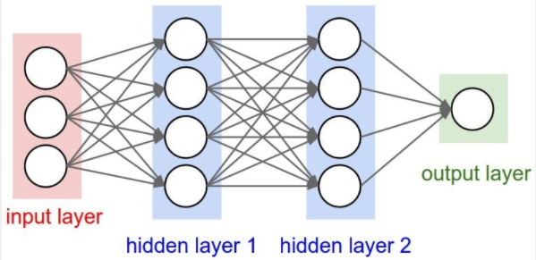
What is a Neural Net & How They Work
Deep Neural Net

Slide 20
What is a Neural Net & How They Work
Activation Functions
Combination of multiple Linear Regressions is still ….. linear
Activation Functions: e.g. ReLU
0 if output < 0 else output
y = 1.23
=
y = 1.23
y = -2.39
=
y = 0
Activation Functions make the outputs NONLINEAR

Slide 21
What is a Neural Net & How They Work
Activation Functions
Activation Functions: are deployed at layer’s level
Input layer: no activation functions
Hidden layers: any activation function
Output layer: depends upon the ML use case
Regression: Linear AF
Binary Classification: Sigmoid AF
Multi Class Classification: Softmax AF

Slide 22
What are Neural Nets?
Terminologies
Input/output Layers
Hidden Layers
Neurons/Nodes
Parameters
Forward Propagation
Backward Propagation
Activation Functions
Loss Function
Optimization Function
Batch Size
Epochs
Learning Rate
Regularization

Slide 23
Tensor Flow: Play Ground
Check This Out

Slide 24
Tensor Flow:
Let’s Go Coding !
Binary Classification
Structured Data

