Slide 1

Applied Software Project Management
Estimation

Slide 2
What is estimation?
The project manager must set expectations about the time required to complete the software.
And that Expectation must be realistic to meet the client satisfaction.

Slide 3
Elements of a Sound Estimate
To generate a sound estimate, a project manager must have:
  A work breakdown structure (WBS), or a list of tasks
  An effort estimate for each task
  A list of assumptions which were necessary for making the estimate
  Consensus among the project team that the estimate is accurate

Slide 4
Wideband Delphi
Wideband Delphi is a process that a team can use to generate an estimate
  The project manager chooses an estimation team, and gains consensus among that team on the results.
  Wideband Delphi is a repeatable estimation process because it consists of a straightforward set of steps that can be performed the same way each time.

Slide 5
The Wideband Delphi Process
Step 1: Choose the team
  The project manager selects the estimation team and a moderator.
  The team should consist of 3 to 7 project team members.
    The moderator should be familiar with the Delphi process, but should not have a stake in the outcome of the session.
    If possible, the project manager should not be the moderator because he should ideally be part of the estimation team.
http://www.stellman-greene.com

Slide 6
The Wideband Delphi Process
Step 2: Kickoff Meeting
  The project manager must make sure that each team member understands the Delphi process, and have a clear understanding of project background and needs.
  The team brainstorms and writes down assumptions.
  The team generates a WBS with 10-20 tasks.
  The team agrees on a unit of estimation.

Slide 7
The Wideband Delphi Process
Step 3: Individual Preparation
  Each team member independently generates a set of preparation results.
  For each task, the team member writes down an estimate for the effort required to complete the task.

Slide 8
The Wideband Delphi Process
Step 4: Estimation Session
  During the estimation session, the team comes to a consensus on the effort required for each task in the WBS.
  Each team member fills out an estimation.
  During each estimation team member anonymously revises her estimates based on a group discussion

Slide 9
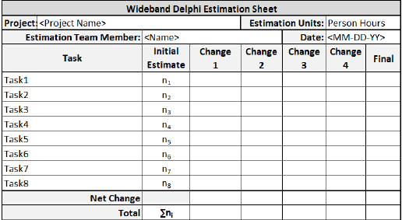
Estimation form

Slide 10
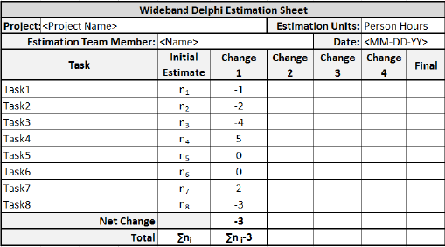

Slide 11
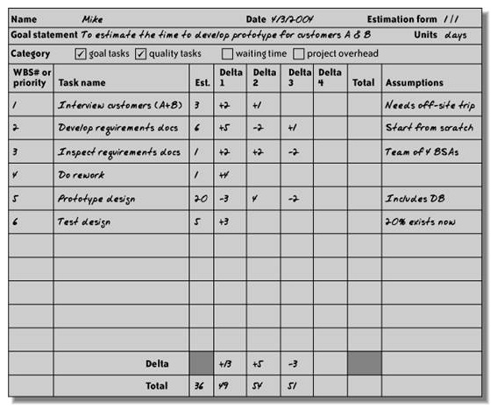
Sample Form:
http://www.stellman-greene.com

Slide 12
Given slides covered half steps of Delphi technique remaining half steps will be covered after mid-1

