Slide 1
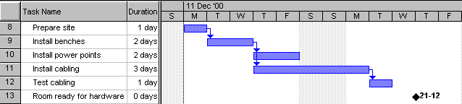
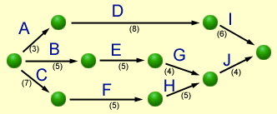
Having Fun with
Gantt

Slide 2
What are they?
Gantt chart are “CPM” (Critical Path Method) tools to:
manage the tasks involved in big and complex projects
let project managers organise time, people, equipment and money
ensure the right people and equipment are in the right place and the right time
allow managers to monitor the progress of a project

Slide 3
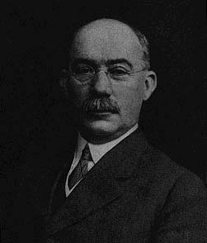
Gantt
Charts
Gantt
Charts
Henry Laurence Gantt (1861-1919)

Slide 4
Gantt Basics
Basically, a timeline with tasks that can be connected to each other
Note the spelling!
It is not all-capitals!
Can be created with simple tools like Excel, but specialised tools like Microsoft Project make life easier

Slide 5
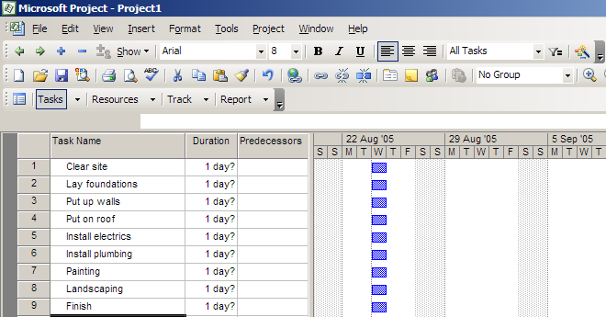
Making a Gantt chart
Step 1 – list the tasks in the project

Slide 6
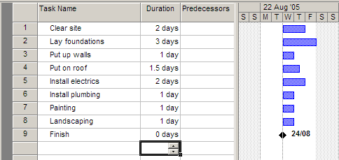
Making a Gantt chart
Step 2 – add task durations

Slide 7
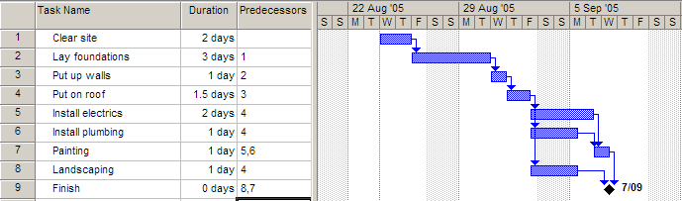
Making a Gantt chart
Step 3 – add dependencies (which tasks cannot start before another task finishes)

Slide 8
Notes
The arrows indicate dependencies.
Task 1 is a predecessor of task 2 – i.e. task 2 cannot start before task 1 ends.
Task 3 is dependent on task 2. Task 7 is dependent on two other tasks
Electrics, plumbing and landscaping are concurrent tasks and can happen at the same time, so they overlap on the chart. All 3 can start after task 4 ends.
Painting must wait for both electrics and plumbing to be finished.
Task 9 has zero duration, and is a milestone

Slide 9
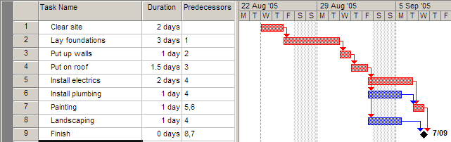
Making a Gantt chart
Step 4 – find the critical path
The critical path is the sequence of tasks from beginning to end that takes the shortest time to complete.
Any task on the critical path is called a critical task.
No critical task can have its duration changed without affecting the end date of the project.

Slide 10
MS Project can work out the critical path for you!
The length of the critical path is the sum of the lengths of all critical tasks (the red tasks 1,2,3,4,5,7) which is 2+3+1+1.5+2+1 = 10.5 days.
In other words, the minimum amount of time required to get all tasks completed is 10.5 days
The other tasks (6,8) can each run over-time before affecting the end date of the project

Slide 11
The amount of time a task can be extended before it affects other tasks is called slack (or float).
Float = Late Start – Early Start OR Late Finish – Early Finish
Task 6 can take an extra day and a half before it affects the project’s end date, so each has 1.5 day’s slack.

Slide 12
Critical tasks, by definition, can have NO slack.
Thus if you are ever asked, “Can the duration of a critical task be changed without affecting the end date of the project?”, the answer is always NO!

