Slide 1

Work Breakdown Structure (WBS)

Slide 2
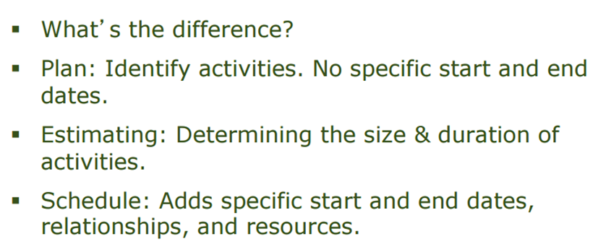
Project Management

Slide 3
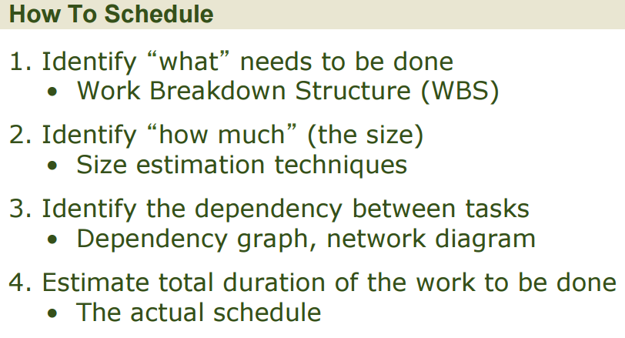
Why is it needed?

Slide 4
Introduction to WBS
Dividing complex projects to simpler and manageable tasks is the process identified as Work Breakdown Structure (WBS).
Usually, the project managers use this method for simplifying the project execution.
The WBS is a deliverable-oriented hierarchy of decomposed project components that organises and defines the total scope of the project.
These chunks can be easily supervised and estimated.
Work Package: A group of related tasks that are defined at the same level within a work breakdown structure.
4

Slide 5
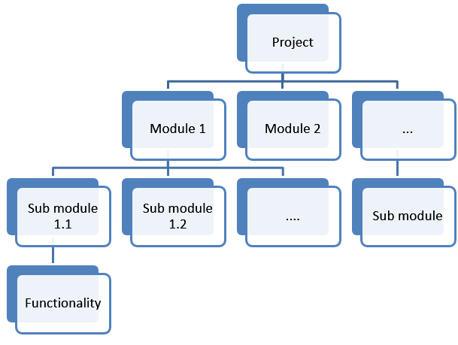

Slide 6
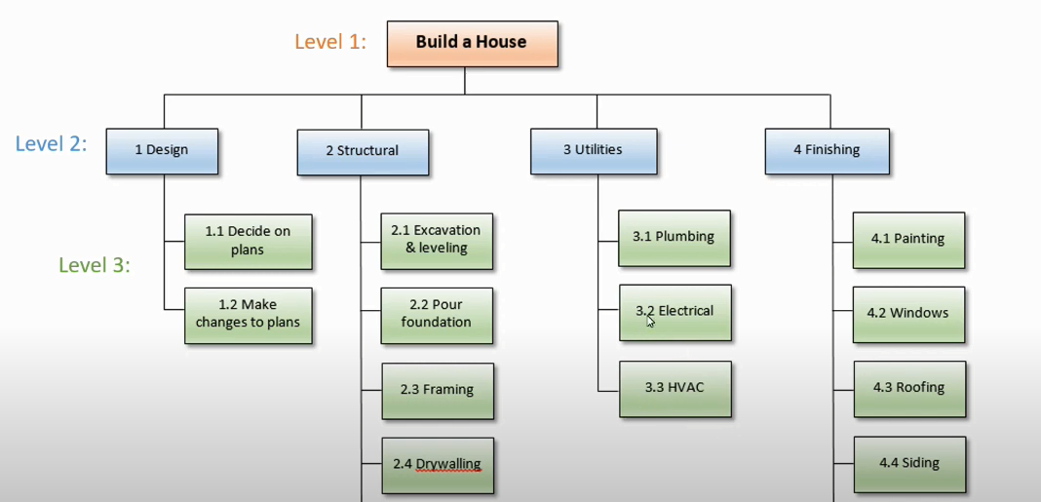
Example Template

Slide 7
Practice Scenario:
Draw a Work breakdown structure and you can assume sub-task on your own
Suppose you and your friends is planning a camping trip and there are some activities you need to address for a successful trip. Firstly, you need to prepare a camping site so that it’s got protected from animal visit and rainy stormy weather and also protection from criminal’s activities, after that arrangement for supplies and equipment to provide necessary medical first aid and food items for survival. Make sure your camp should be mosquito free, now it time to pack your suitcase and list down all the necessary work packages.

Slide 8
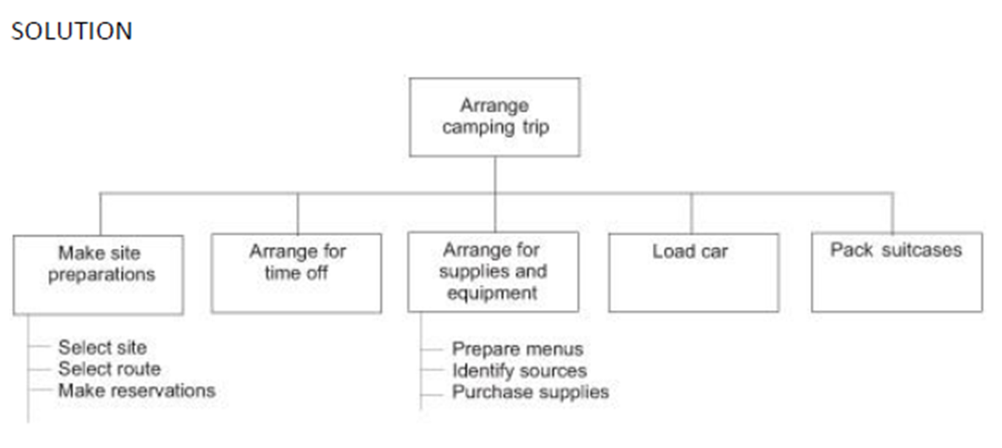

Slide 9
When should we develop WBS?
Once the project Scope is agreed (finalized) then before starting the project we need to plan various components (activities) of software development project.

Slide 10
WBS helps manager
Facilitates evaluation of cost, time, and technical performance of the organization on a project.
Provides management with information appropriate to each organizational level.
Helps organization to project responsibilities to organizational units and individuals
Helps manager plan, schedule, and budget.
Defines communication channels and assists in coordinating the various project elements.
10

Slide 11
WBS Formats
2 Formats
Outline (Indented Format)
Graphical Tree (Organizational Chart)

Slide 12
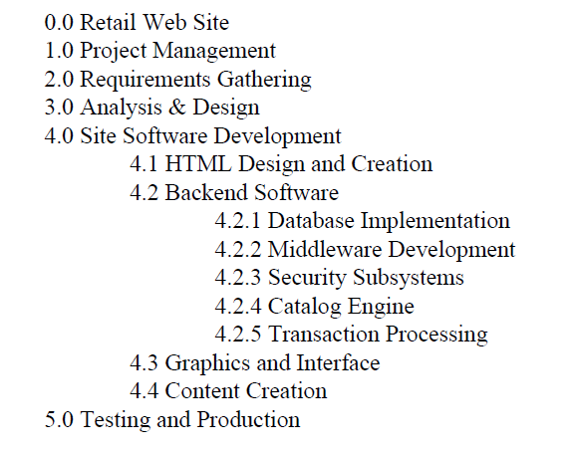
Displaying the WBS Example of outlined WBS.
12

Slide 13
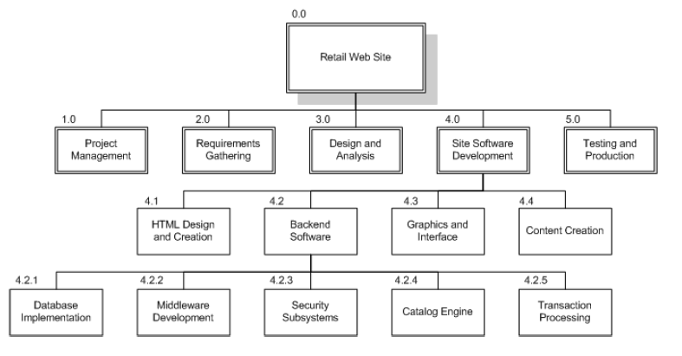
Displaying the WBS Example of Chart WBS.
13

Slide 14
Pitfalls
There are common pitfalls to creating a WBS. If you can keep these few possible, you and your team will be much more successful at creating a useful and accurate Work Breakdown Structure.
Level of Work Package Detail
Deliverables Not Activities or Tasks
WBS is not a Plan or Schedule
WBS is not an Organizational Hierarchy
14

Slide 15
Example WBS
Redecorate Room
Prepare materials
Buy paint
Buy a ladder
Buy brushes/rollers
Buy wallpaper remover
Prepare room
Remove old wallpaper
Remove detachable decorations
Cover floor with old newspapers
Cover electrical outlets/switches with tape
Cover furniture with sheets
Paint the room
Clean up the room
Dispose or store left over paint
Clean brushes/rollers
Dispose of old newspapers
Remove covers
WBS

Slide 16
END
16

