Slide 1

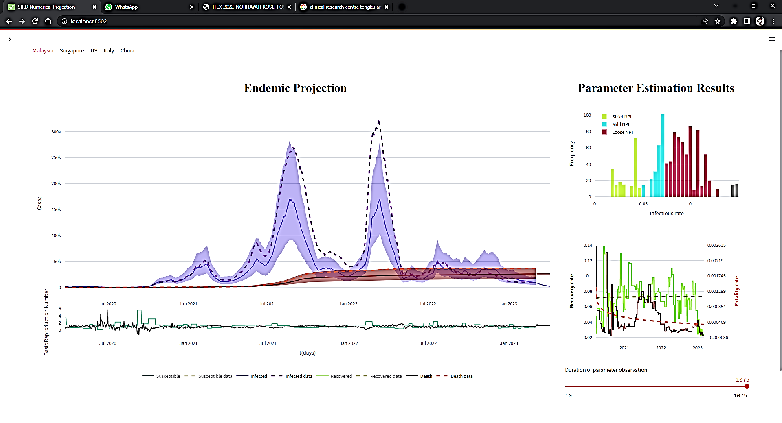
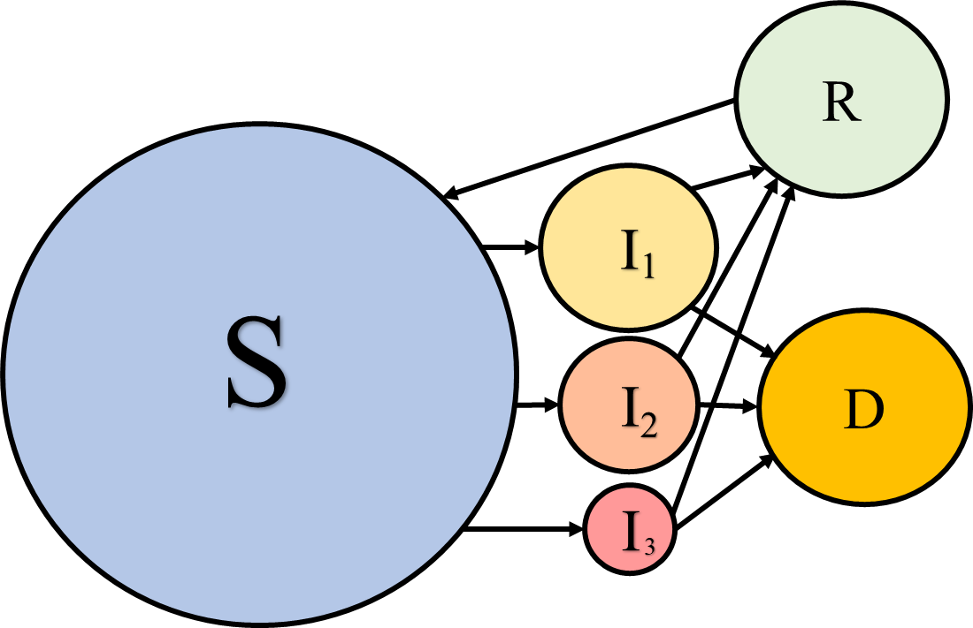
Pandemic Simulations
Legends
legends
legends
legends
legends
legends
legends
legends
Infectious rate Distribution
Recovery rate trends

Slide 2
NPI Planner (Prediction Simulations)
User input
date
type
date
type
date
type
date
type
date
type
Infectious b1
date
type
date
type
Proportion p1
date
type
recovery r1
date
type
date
type
fatality d1

