Slide 1

Getting Started
Day 1

Slide 2

FYI 2
Pre Test & Post Test
URL Pre-Test
https://forms.gle/FQnbeZ49yQh8DMUVA

Slide 3

Requirement
Nodejs v14 (recommended v16 )
Code Editor: Visual Studio Code or other
Fake API
https://jsonplaceholder.typicode.com/posts

Slide 4
Apa itu
Kerangka Kerja React JS / React Framework yang siap production ( Production Ready )

Slide 5
Kenapa Perlu Menggunakan NextJS ?
Mudah untuk setup project
Routing Yang mudah
Performa yang baik menggunakan code spliting, client-side navigation dan prefetching
Easy to deploy
SEO Friendly
Pre – Rendering
SSG ( Static Site Generation )
SSR ( Server Side Rendering )

Slide 6

Kenapa Perlu Menggunakan NextJS ?
NEXT JS
Initial Load: Pre-Rendering HTML is Display
Hydration: Menampilkan Componen reactJS yang interactive

Slide 7

Kenapa Perlu Menggunakan NextJS ?
REACTJS
Initial Load: Pre-Rendering HTML is Display
Hydration: Menampilkan Componen reactJS yang interactive

Slide 8
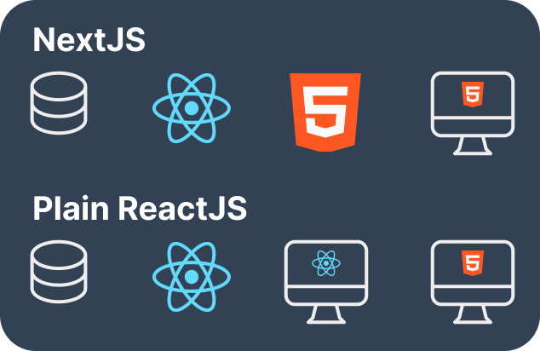
Kenapa Perlu Menggunakan NextJS ?
Pre-Rendering ( SSG / SSR )

Slide 9
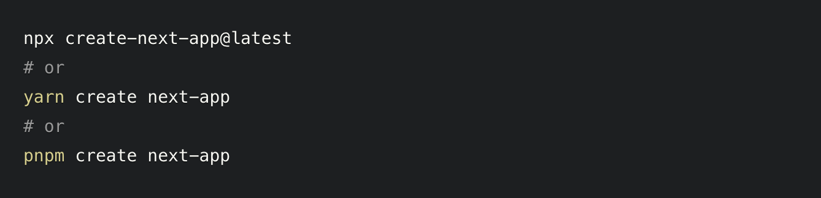
Membuat Project NextJS

Slide 10
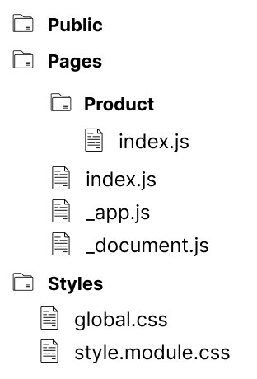
A Scallable Structure Folder in NextJS

Slide 11
File Default Next.js
_app.js
_document.js

Slide 12
Configuration Nextjs
Next.config.js
Tailwind.config.js
Postcss.config.js

Slide 13
Routing dan Navigation
Static Route
Dynamic Route

Slide 14
Data Fetching
SSG ( Static Site Generation )
SSR ( Server Side Rendering )
CSR ( Client Side Rendering )

Slide 15
Component (reuseable) & Declare Properties
Package used => ( prop-types )
Command => ``` npm install prop-types ```

Slide 16


Slide 17
Component Layout
Membuat Layout Page
Templating User Interface berdasarkan route
Declare Properties
Adding children

Slide 18
Running APP and use tailwindcss
Bundle First CSS
Watch CSS

Slide 19

Syntactically Awesome Style Sheet

Slide 20

Perbandingan SASS dengan CSS

Slide 21
Metodologi BEM ( Block, Element, Modifier )
Variable
Nested
Mixin
Extends
Function
Loop / Each

Slide 22
Metodologi BEM ( Block, Element, Modifier )
Variable
Nested
Mixin
Extends
Function
Loop / Each

Slide 23
Getting Started
Day 2

Slide 24
Optimasi & Performance
Image Optimization
Code Spliting
Lazy Load

Slide 26
Next API
``` npm install next-connect ```

Slide 27
Intergration API
``` npm install axios```
Client Side
Server Side

Slide 28
Request Validation API
Version ^2.2.1
``` npm install next-joi ```
``` npm install joi ```
Version ^17.7.1

Slide 29
Authentication
With Next-Auth
``` npm install next-auth ```
Sessions
JWT

Slide 30
Middleware
Private Route
Check Session / token Login

Slide 31
Type ORM Prisma
Private Route
Check Session / token Login

Slide 32
CRUD in TypeORM
Create / Save data to database
Read
Update
Delete

Slide 33
CRUD in TypeORM
Create / Save data to database
Read
Update
Delete

Slide 34
CRUD in TypeORM
Create / Save data to database
Read
Update
Delete

