Slide 1
Welcome to CoderGirl!
Winter 2020 Data Science Cohort

Slide 2

instructor Introductions
Mentor: Michelle Faits
TA: Julie Heck

Slide 3
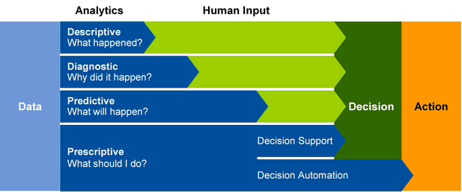
What is Data Science?

Slide 4
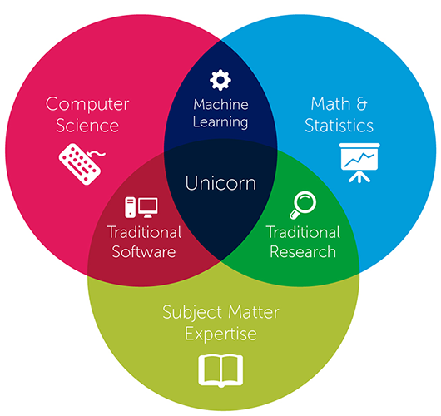
Who is a data scientist?

Slide 5
Designing a data Science career
Traits:
Constant Pursuit of Learning
Insatiable Curiosity
Ability to Prioritize
Impact Drive Mindset
Practical
Healthy Skepticism
Competencies:
Business Acumen
Business Analysis
Problem Solving
Storytelling
Business Communication
Project Management

Slide 6
Class Tools
Slack
Workspace: codergirljan2020.slack.com
Channel: #datascience
Canvas
Submission for:
Github
Central repository for in class assignments, homeworks
Online Learning
Python - HackerRank
Machine Learning - Google ML Crash Course
Applied Machine Learning - Kaggle
https://github.com/LaunchCoderGirlSTL/Data-Science-Assignments
Homework
In-Class assignment
CoderGirl Attendance

Slide 7
Class Structure
Every Wednesday 5:30-8:30pm
Self Attendance Check In
Canvas submission
In Class Activity
Due Fridays 8pm
Homework
Due Wednesdays 5:30pm

Slide 8
What to expect from this class
Introduction to Data Science
Python/Programming, Math, Statistics, Machine Learning
Designed to prepare you for a Data Science entry-level position
Out-of-class reading and programming, in-class lectures and review
Lectures will assume you’ve done the homework
Challenging material
Don’t panic! It isn’t unusual if some of the material is difficult at first
LaunchCode resources – you get out of it what you put into it
Mentor availability
Best to reach Michelle through slack. I’ll try to respond within 24 hours

Slide 9
Syllabus
Programming in Python (8 weeks)
Python
Pandas
Statistics
Machine Learning (13 weeks)
Loss Functions
Overfitting/Underfitting
Supervised/Unsupervised Learning
Applications in Machine Learning (3 weeks)
Your 1st Data Science Project!

Slide 10
What we expect from you
Attendance
Effort outside of class (~10-15 hours/week)
Keep up with the class pace
If you fall behind, it’s your responsibility to catch up in a timely manner
If you are behind, it’s better if you keep coming to class!
Participation – Share ideas and experiences
In Class
On Slack
There are no stupid questions
Ask. Someone else probably wants to know too!
Community
We strongly encourage study groups outside class!
Respect for others and an encouraging learning environment

Slide 11
Introductions!
Suggestions:
Name
Background – School or work, Data Science experience?
Where in STL do you call home?
Family? Fur Family?
What do you do now?
Why Data Science?
What are your goals completing this program?

Slide 12
Next up
https://github.com/LaunchCoderGirlSTL/Data-Science-Assignments
In-class: Unix Shell, due Saturday
Homework: Intro to Python, Git
Due before class next week

Slide 13
First in-class assignment!
Using the Unix Shell and Command Line Interfaces (CLI)
What is a CLI?
Way of interacting with and controlling your computer with text
Why is it useful?
Can schedule/automate tasks
Can replace clicking-based tasks
Will encounter this at work, e.g. Github

Slide 14
First in-class assignment!
Using CLIs
Different CLI interfaces
Homework is focused on Bash Shell
Microsoft comes with CMD
macOS uses Zsh?
Different CLI interfaces may have slightly different commands
I use CMD, Git Bash, Visual Studio Code

