Slide 1

Key insights of chips category
Presented by Muhammad fakhir – June 2025

Slide 2
Prioritize Mainstream segment customers to Boost Chips Sales.
Task-1: Customer Segments and their purchase behavior
The Mainstream segment represents the largest customer base in the market, offering greater sales potential than other segments.
Mainstream Customers Show Strong Engagement with Chips Category.
Top 3 chips products identified for mainstream young singles/couples segment.
175g Packs, Especially Thin’s Brand, Are Strongly Preferred Across Multiple Segments.

Slide 3
The Mainstream segment represents the largest customer base in the market, offering greater sales potential than other segments.
The Mainstream segment has the highest number of customers (19,149), more than Budget (17,587) and Premium (13,034).
Within this segment, subcategories young singles/couples and retirees contribute the most to chips sales.
Prioritizing this segment can yield higher overall sales due to volume.

Slide 4
Mainstream customers drive the most sales, especially young singles / couples
Mainstream makes up largest customer segments(39%)
Young singles/couples are top sales contributor

Slide 5
Mainstream Customers Show Strong Engagement with Chips Category.
18.77% of mainstream customers purchase chips.
They allocate 17.24% of their grocery spending to chips products.
This indicates chips are a high-priority item for this segment, not just an occasional purchase.

Slide 6
Top 3 Chips Products for Mainstream Young Singles/Couples Identified.
Doritos Corn Chips Cheese Supreme – accounts for 8.21% of total transactions among this segment.
Doritos Corn Chips Original – makes up 8.07% of transactions, showing strong brand loyalty.
Smith’s Crinkle Chips Salt & Vinegar – contributes 7.82% of transactions, indicating a preference for bold flavors
Together, these top 3 products make up over 24% of all chips transactions by Mainstream Young Singles/Couples — highlighting clear favorites to focus marketing efforts on.

Slide 7
Top 3 identified chips showing the greatest number of transaction made

Slide 8
175g Packs, Especially Thin’s Brand, Are Strongly Preferred Across Multiple Segments
170g–175g packs make up over 63% of purchases in the young singles/couples segment.
Thin’s 175g packs are highly preferred by both Mainstream customers and Retirees.
Focusing on this pack size and brand can maximize cross-segment impact.

Slide 9
The layout trial conducted in stores 77, 86, and 88 was successful, showing improved sales performance and customer engagement.
Task-2: Trial stores performances and control stores performances
Control stores 233, 155, and 237 were identified as the best matches for trial stores 77, 86, and 88, respectively.
Trial layout led to significant increase in chips sales
Trial layout was also effective in bringing more customers across all trial stores.

Slide 10
Control stores 233, 155, and 237 were identified as the best matches for trial stores 77, 86, and 88, respectively.
These control stores closely matched their corresponding trial stores in monthly sales and customer numbers
Pre-trial sales patterns were highly similar between control and trial stores
(Graphs of sales comparison and customers comparison of each trial store with it’s corresponding control stores in pre –trial period are shown in appendix . )

Slide 11
Trial layout led to significant increase in chips sales
The new layout resulted in a statistically significant uplift in chips sales (p-value < 0.05).
Sales increased by 21% overall across all trial stores compared to control stores.
This demonstrates the trial’s effectiveness in driving sales.
The trial layout should be implemented across all stores to boost chips sales.

Slide 15
Trial layout was also effective in bringing more customers across all trial stores.
The trial led to a statistically significant increase in customer numbers during all three trial months (Feb–Apr, p-value < 0.05).
Customer count increased by 16.25% across trial stores.
The trial is effective and should be implemented across all stores to gain more customers.

Slide 19
THE END

Slide 20
APPENDIX

Slide 21
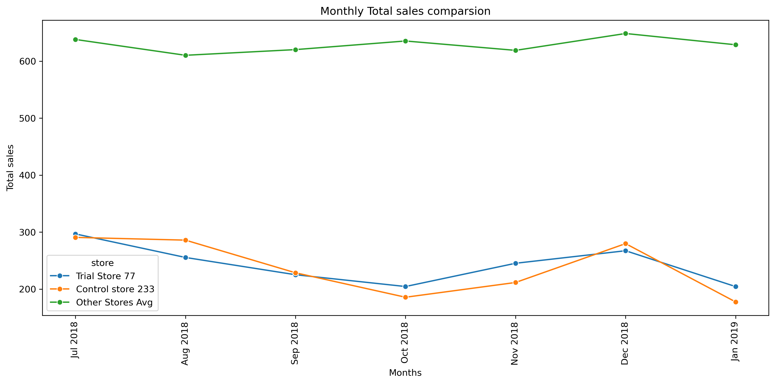

Slide 22
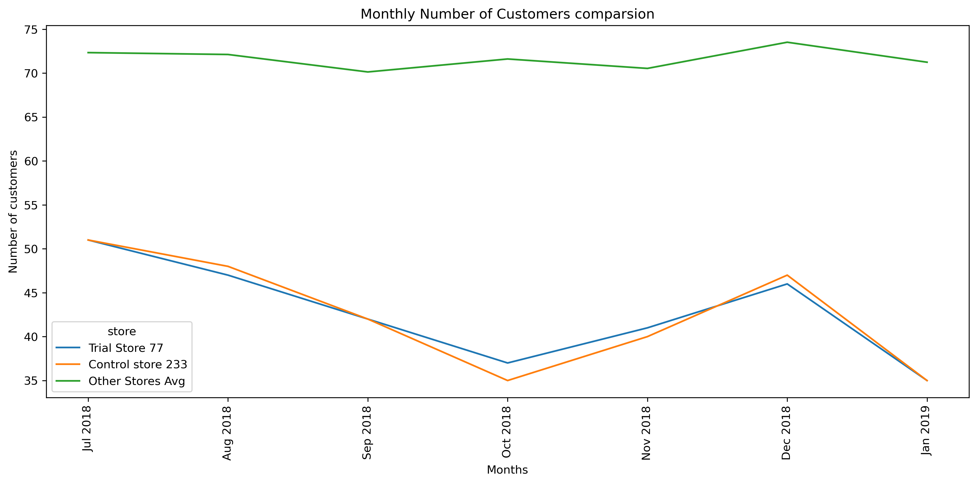

Slide 23
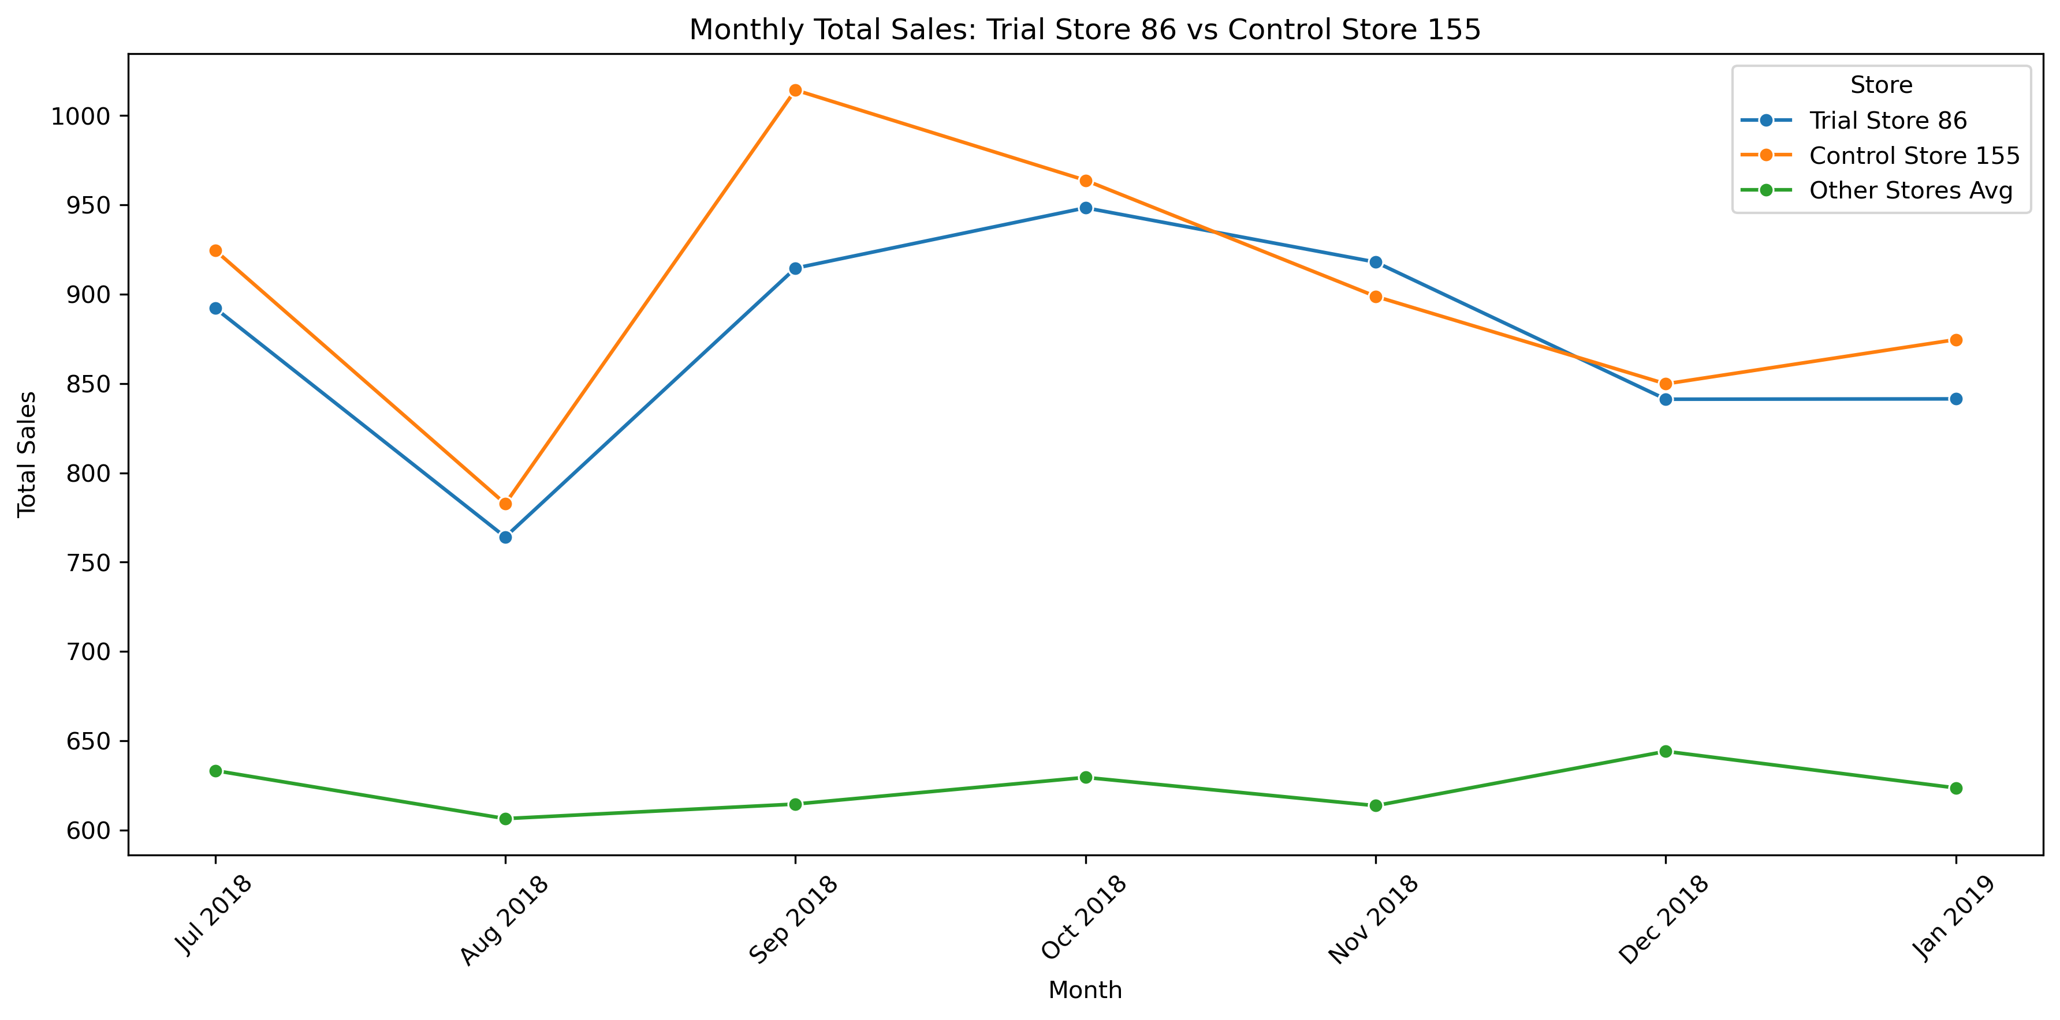

Slide 24
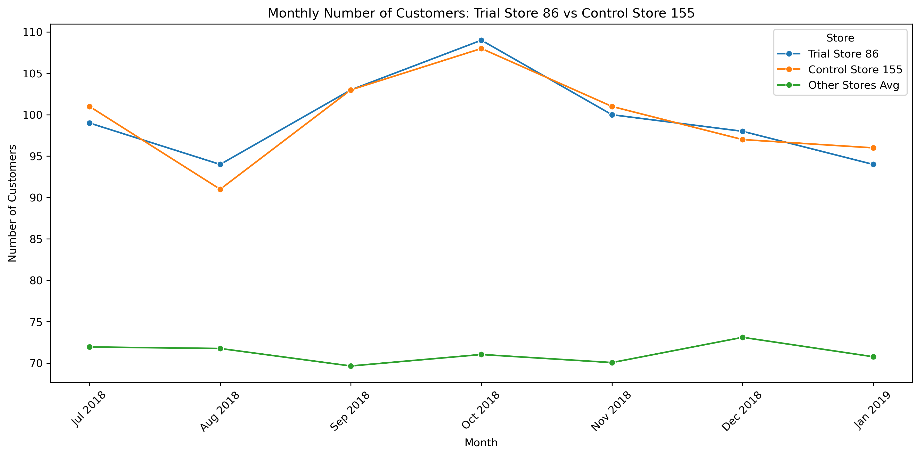

Slide 25
