Slide 1
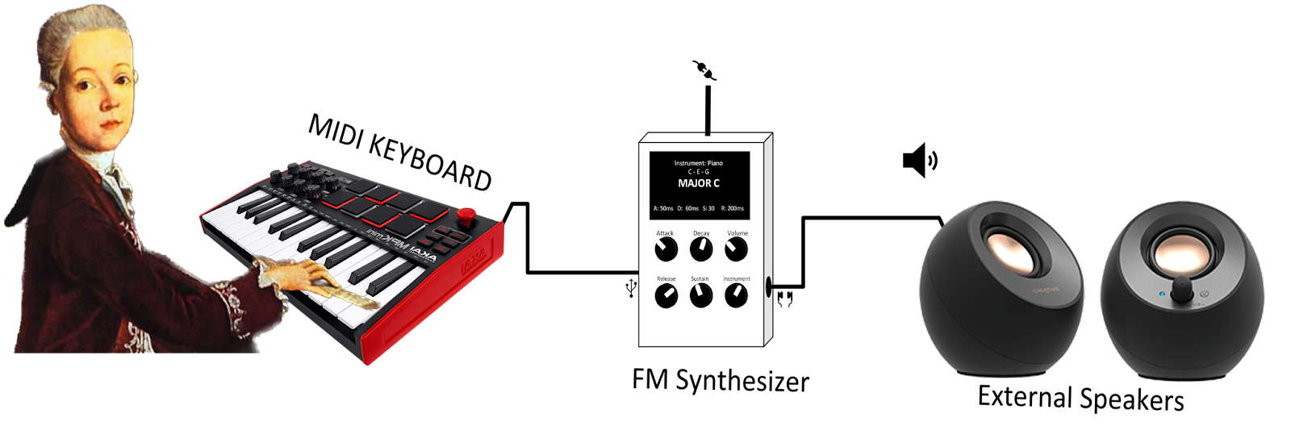
TEAM 9 FM MUSIC SYNTHESIZER IN FPGA

Slide 2
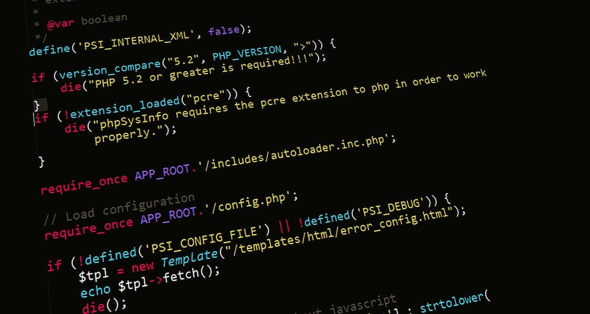
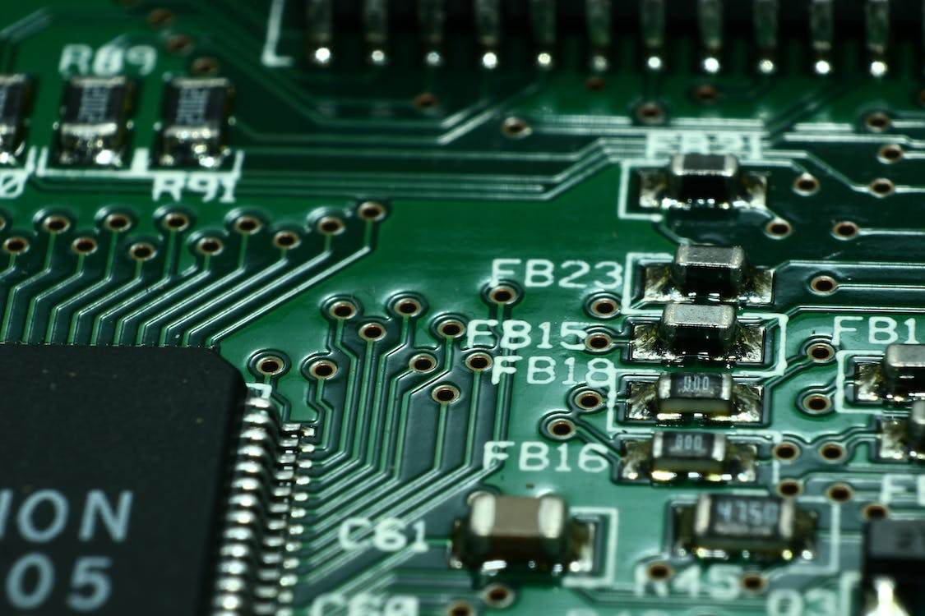
introductions
Tiber Hernandez – CompE
Elisha Reese – CompE
Andres Medina – EE
Tharaa Rahhal – EE
Abdullah Altawheed – EE
Michael Fallon – EE

Slide 3
System Description 1
GRAPHIC SHOWING APPROX SIZE AND DIMENSIONS AS WELL AS ANY UI COMPONENTS
Use case
Phsysical description

Slide 4
System Description 2
GRAPHIC SHOWING MINIZED BOARD AND APPROXIMATION OF PCB IMPLEMENTATION
Technologies used
Why these technologies
Why FPGA over microcontroller?
Why MIDI over some other interface?
What will be on PCB?

Slide 5
System Description 3
EMBEDDED SYSTEMS BLOCK DIAGRAM

Slide 6
System Description 4
FPGA BLOCK DIAGRAM

Slide 7
System test
Scope for all PCB components and expected values
Debug mode in IDE to see values written into memory map from processor
Spectrum Analyzer for analog signal frequency response
Prof. Dorr using synth at gig
GRAPHIC SHOWING SCOPES AND ANALYZERS IN ACTION

Slide 8
Key technological challenges - embedded
Utilizing Xilinx proprietary IDE
Porting over Arduino code/functions to bare-metal processor
Parsing MIDI data
OTHER
MAYBE A TECHNICAL GRAPHIC LISTING MIDI BAUD RATE OR SOMETHING LIKE THAT

Slide 9
Key technological challenges - ELECTRICAL
Developing power supply for components
Design Low Pass filter
Integrating DAC into PCB
Mounting MINIZED to PCB
OTHER
MAYBE A TECHNICAL GRAPHIC LISTING POWER SUPPLY SPECIFICATIONS?

Slide 10
Key technological challenges - fpga
Implementing fixed point arithmetic units
Balancing Memory resources with signal resolution
Calculating bit-width
Calculating tuning words
Integrating FPGA fabric with Processor
TECHNICAL GRAPHIC SHOWING EQUATIONS FOR SOME OF THE MENTIONED METRICS

Slide 11
RISK ANALYSIS - ELECTRICAL
POWER SUPPLY
WHY IS THIS A RISK
WHAT DID YOU DO TO MITIGATE
WERE YOU SUCCESSFUL OR DID YOU HAVE TO ADJUST COURSE
IMAGE OF POWER SUPPLY?

Slide 12
RISK ANALYSIS - embedded
PARSING MIDI DATA
WHY IS THIS A RISK
WHAT DID YOU DO TO MITIGATE
WERE YOU SUCCESSFUL OR DID YOU HAVE TO ADJUST COURSE
IMAGE OF MIDI CABLE?

Slide 13
RISK ANALYSIS - FPGA
IMPLEMENTING HDL DATAPATH
WHY IS THIS A RISK
WHAT DID YOU DO TO MITIGATE
WERE YOU SUCCESSFUL OR DID YOU HAVE TO ADJUST COURSE
IMAGE OF FPGA?

Slide 14
RISK ANALYSIS – risk cube
IMAGE OF UPDATED RISK CUBE

Slide 15
SYSTEM INTEGRATION
IMAGE OF FLOW CHART SHOWING SUBSYSTEM DEVELOPMENT AND INTEGRATION

Slide 16
WORK BREAKDOWN STRUCTION
I DON’T KNOW WHAT GOES HERE

Slide 17
TASK LIST AND SCHEDULING
NOT SURE IF THIS IS SUPPOSED TO BE A SLIDE OR JUST A TEAMGANTT EXERCISE

Slide 18
PROJECT COSTS
AVNET MINIZED SoC DEV BOARD | FREE
POWER SUPPLY | APPROXIMATE COST
KEYBOARD AND ASSOCIATED CABLES | APPROXIMATE COST
PCB FABRICATION AND COMPONENTS | APPROXIMATE COST
DAC AND ANY FILTERING COMPONENTS | APPROXIMATE COST

Slide 19
PROJECT FINANCING
LIST OF TOTAL FUNDS ALLOCATED
EQUATION OF FUNDS – COST
SHORT EXPLANATION

