Slide 1
start_ups
File created on: 8/17/2020 9:59:11 AM

Slide 2
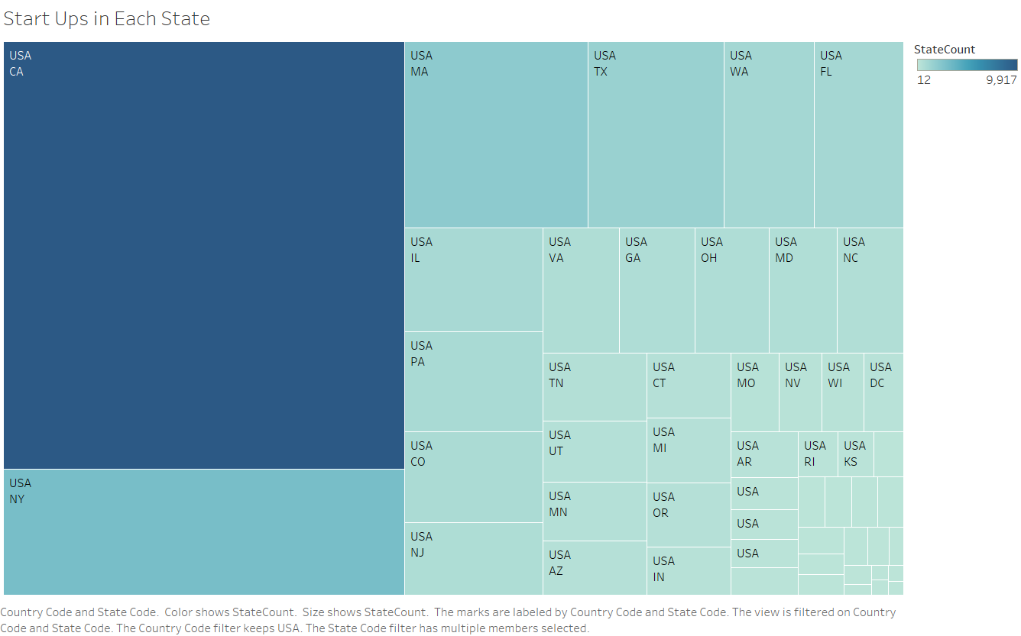

Slide 3
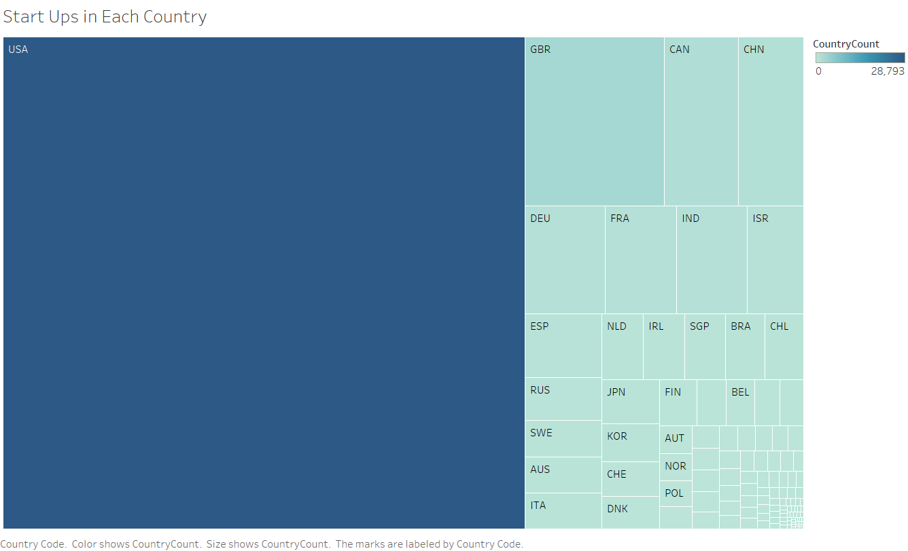

Slide 4
