Slide 1
happiness
File created on: 7/29/2020 4:17:40 PM

Slide 2


Slide 3
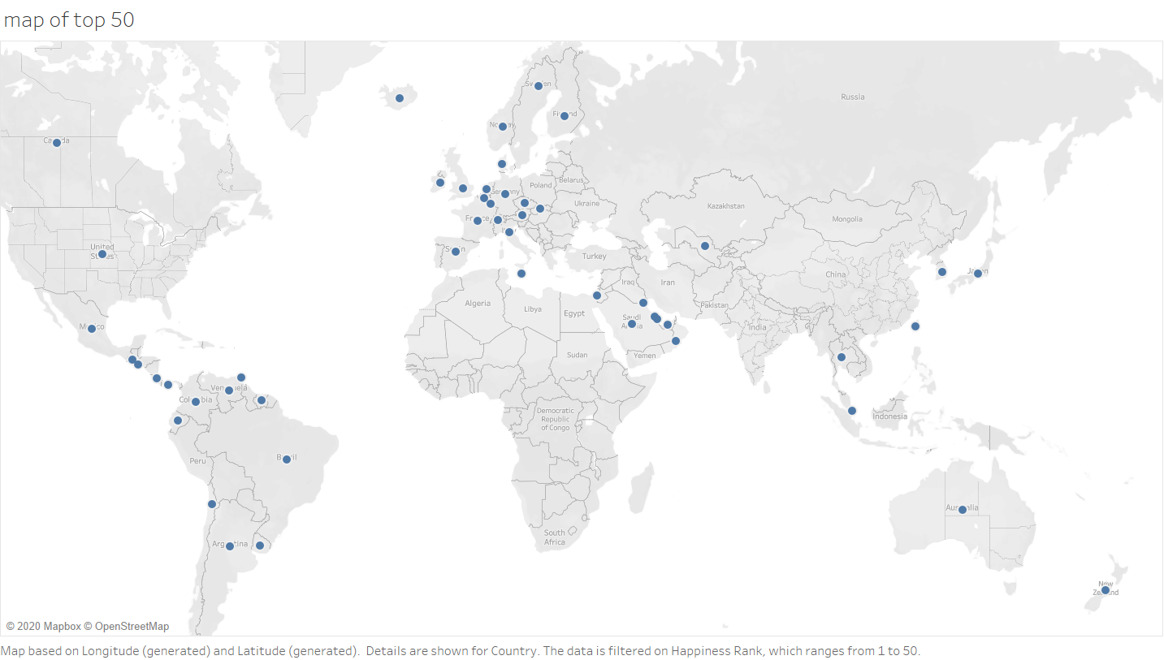

Slide 4


Slide 5
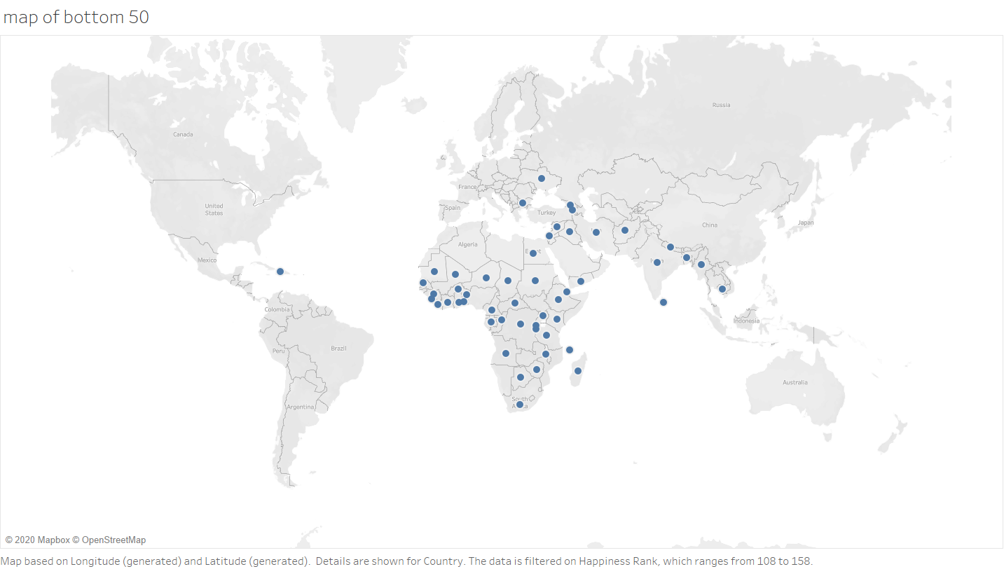

Slide 6
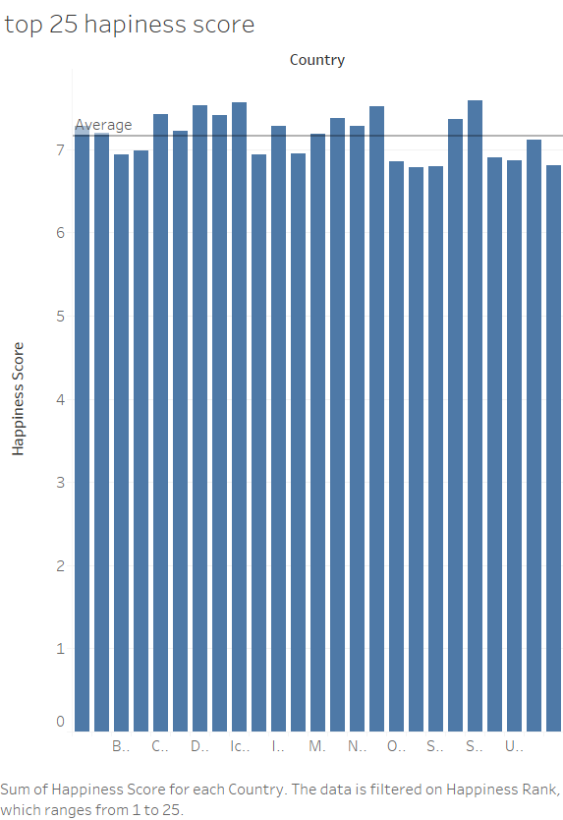

Slide 7
