Slide 1
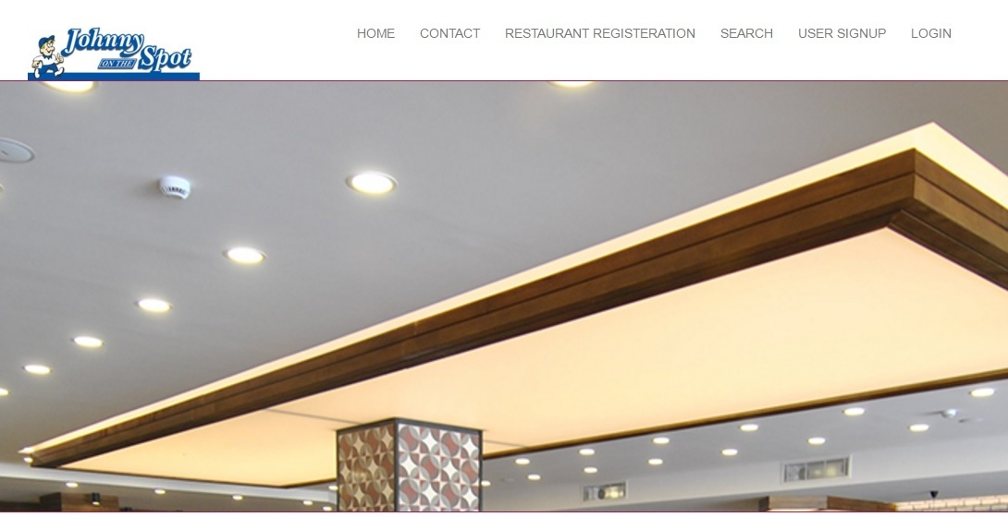
ONLINE RESTAURANT SEARCH
GUIDE NAME:
MR. AMIT KUMAR SHARMA
ASST. PROFESSOR
BBDIT, GZB
PRESENTED BY:
VAIBHAV SHRIMALI
KSHITIZ KUMAR GUPTA
MOHAMMED FARAZ ANWER

Slide 2
FEATURES
Restaurant registration.
Social features allow user to rate and review restaurants.
Allow to search almost every restaurant in the desired location.
User registration is required only for Rating and Review.
Restaurants can update their offers regularly.

Slide 3
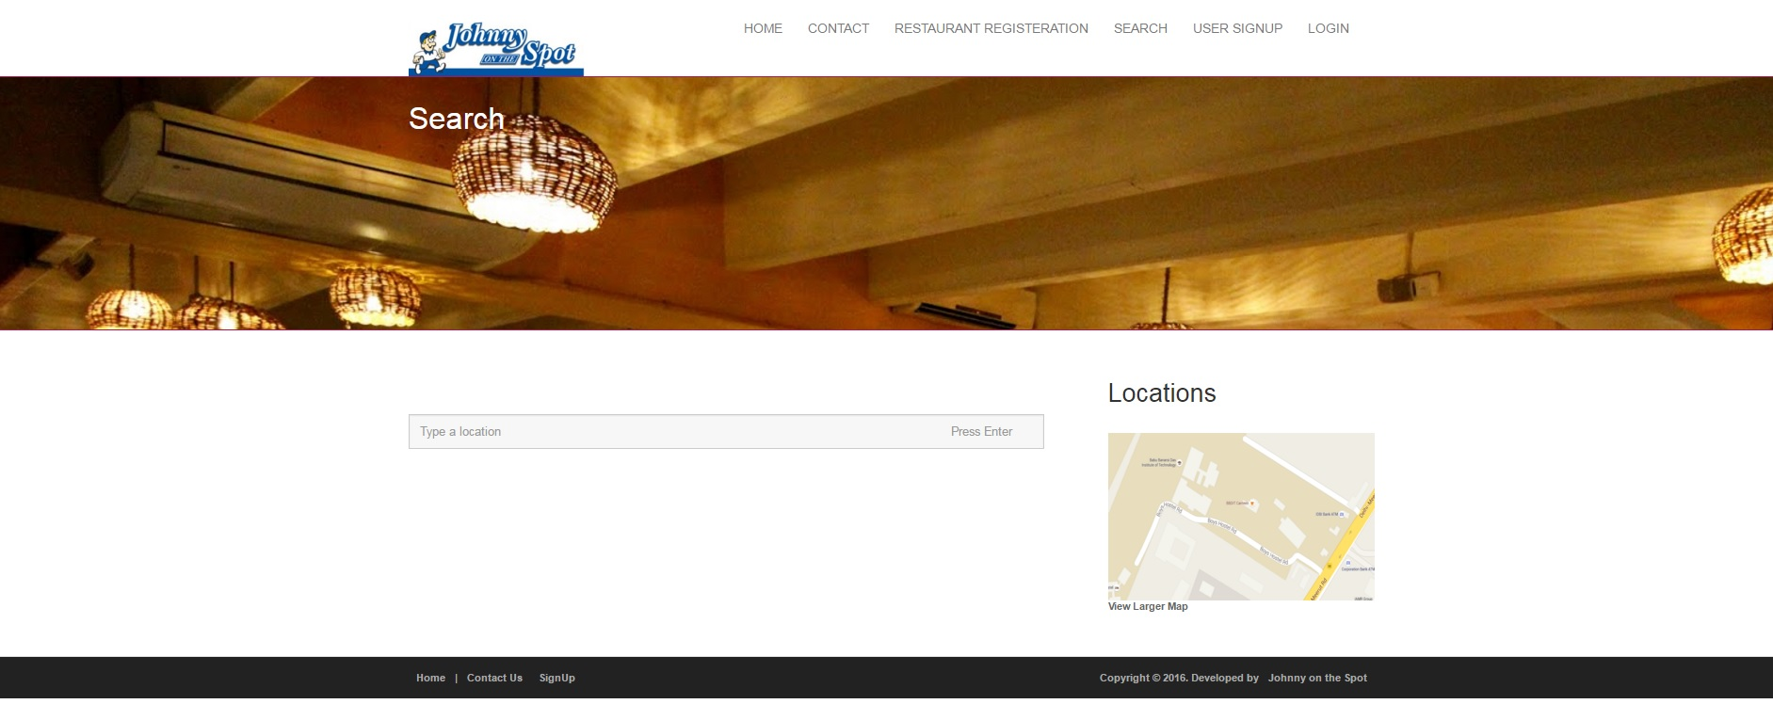
HOME PAGE
City
Place
Quick Searches
Filter of restaurant
Footer

Slide 4
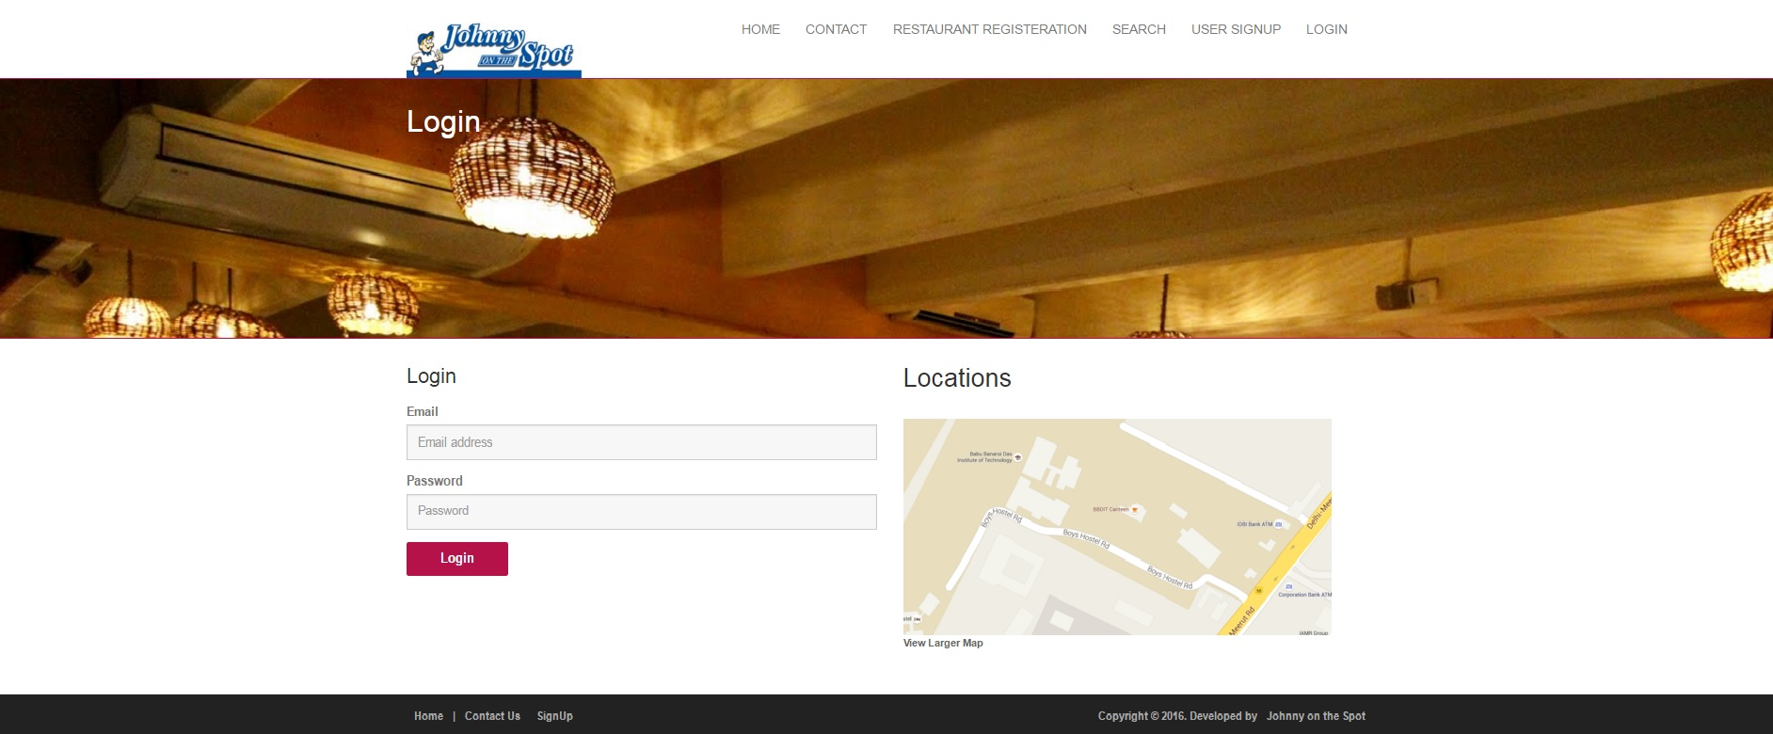
LOGIN PAGES
Restaurant Login
Customer Login
Admin Login

Slide 5
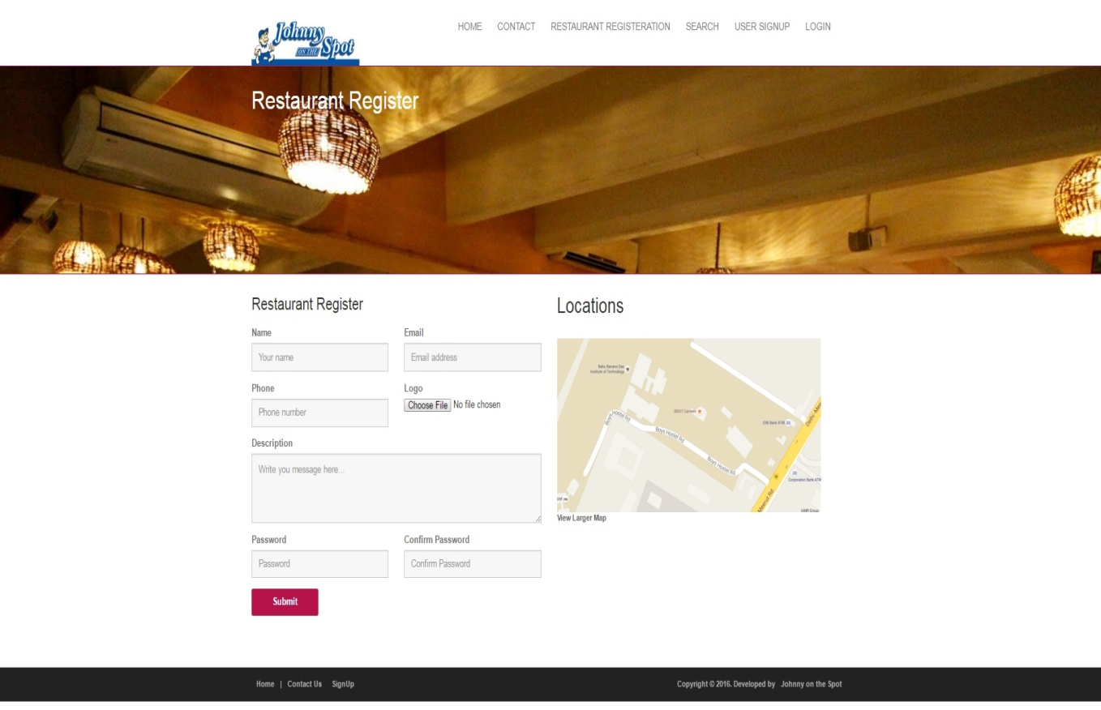
RESTAURANT REGISTRATION
Username & Password
Email Address
Contact Details
Location
Menu
Offers

Slide 6
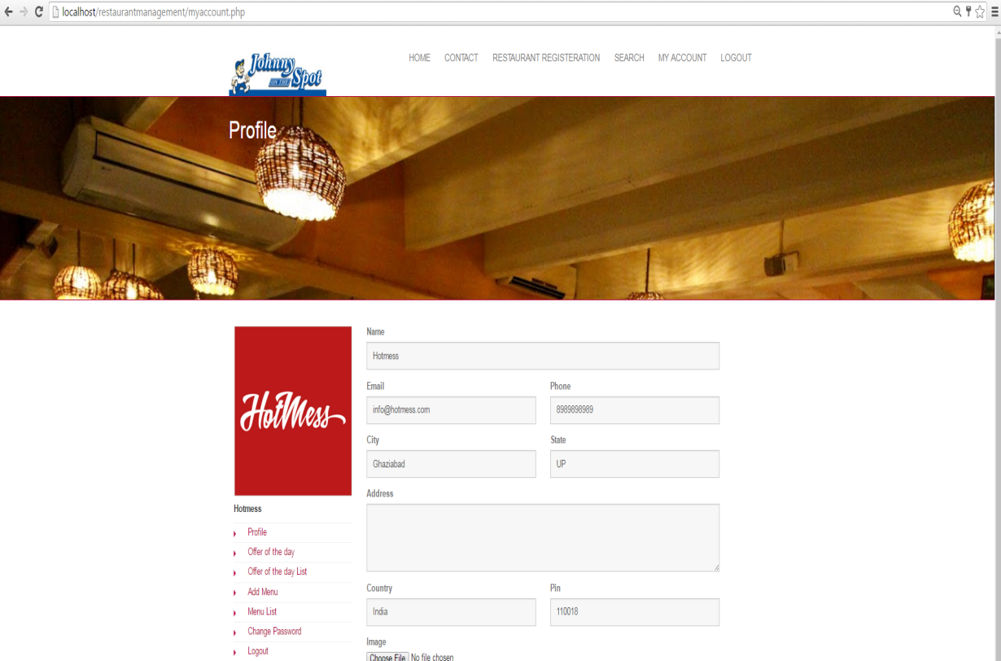
RESTAURANT HOMEPAGE
Update Profile
Update Menu
Offer of the Day

Slide 7
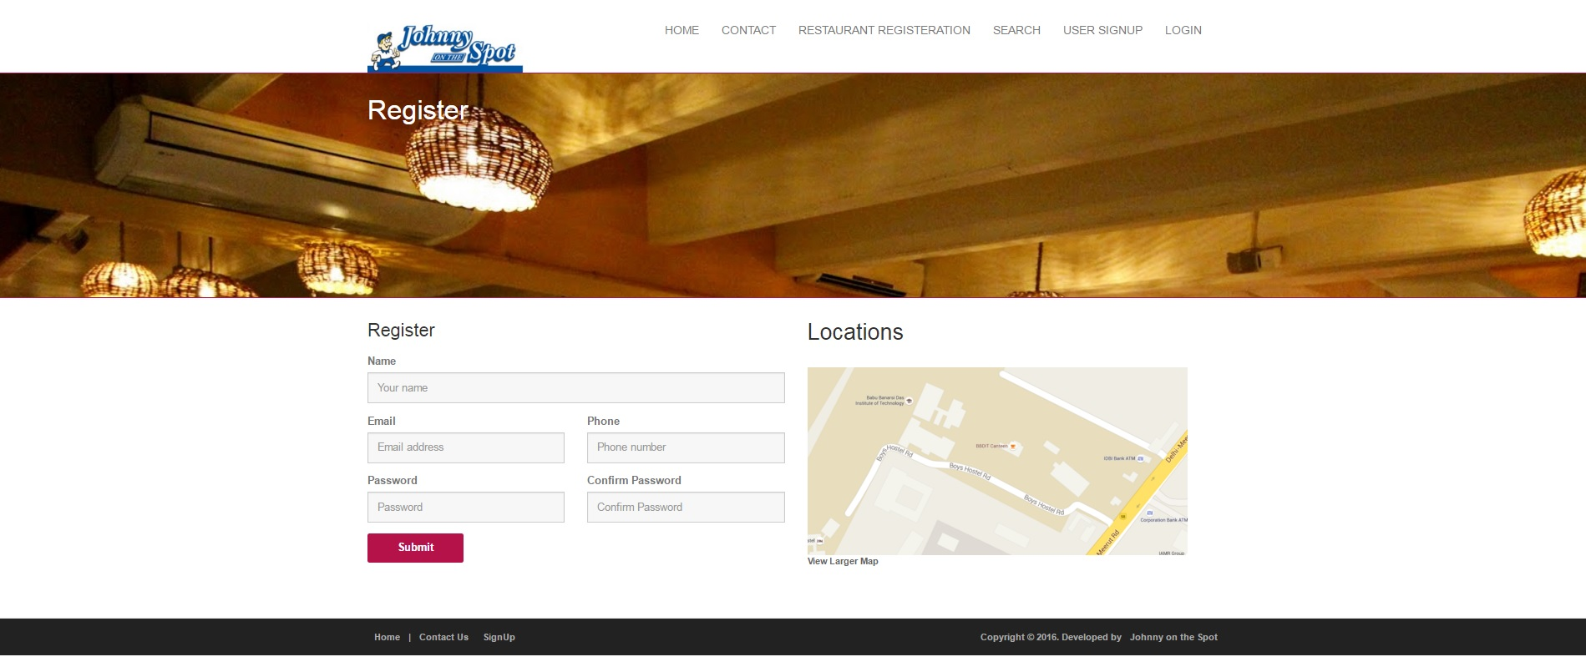
USER REGISTRATION
Username & Password
Email Address
Contact Details
Registered User could review& rate

Slide 8
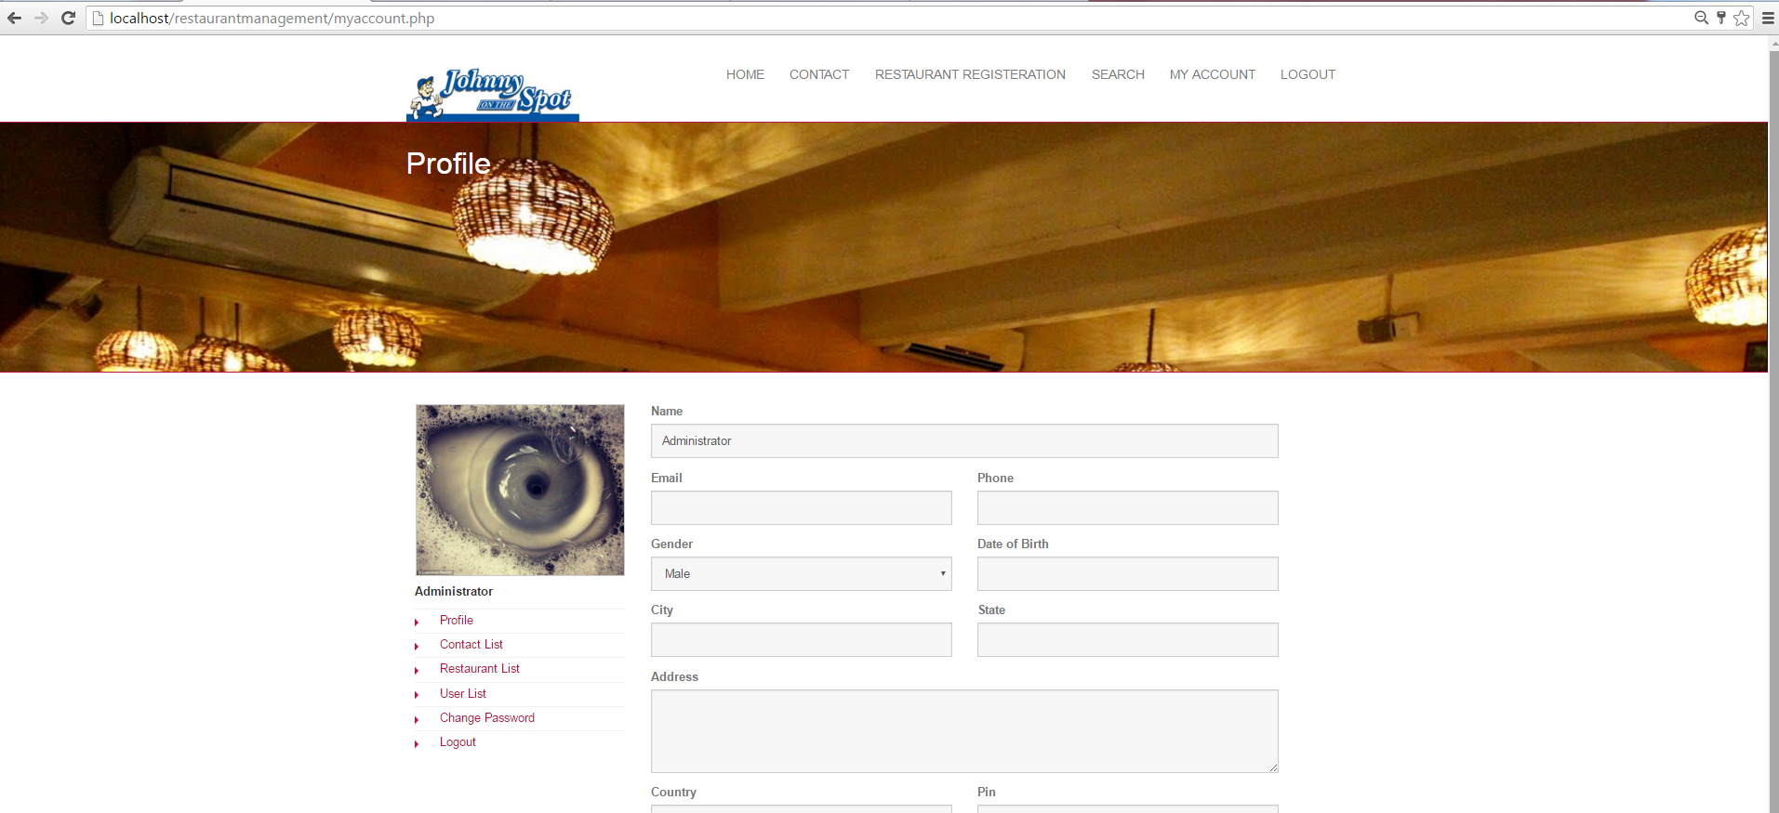
ADMIN PAGE
Contact List
Restaurant List
User List

Slide 9
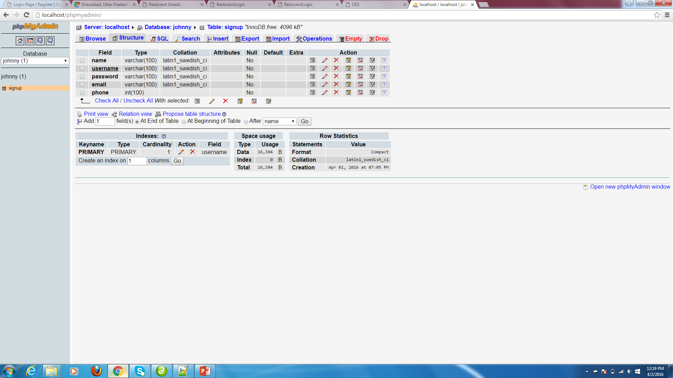
DATABASE
Contact
Offer of the day
Restaurant Menu
Restaurant Rating
User

Slide 10
Thank You

