Slide 1
Using Python for Real Time Signal Analysis
By Mohammad Farhan

Slide 2
A little bit about myself
Application Engineer at ThinkRF
Developed APIs/GUIs in C/C++, Octave, Matlab, Labview, Python, Visual Basic
Email: mfarhan102@gmail.com
Github: github.com/mfarhan12
Interests: signal processing (biological/wireless)

Slide 3
Schedule
Intended Audience
What is a signal
What is signal analysis
Why use Python
Demo (Example code, Example Scripts/Apps)

Slide 4
Intended Audience
Beginners
Hobbyists
Industry Professionals

Slide 5
What is a Signal
In electrical engineering, a signal is a function that conveys information about the behavior or attributes of some phenomenon
RF Signals (Wifi, Cellular, Bluetooth, FM/AM Radio)
Audio Signals
Electro-Biological Signals (ECG, EMG, EEG)
https://en.wikipedia.org/wiki/Signal_(electrical_engineering)

Slide 6
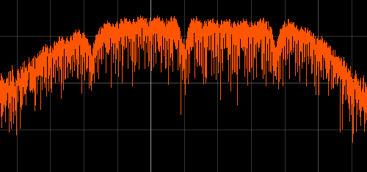
What is Signal Analysis
Is the process of acquiring, processing and packaging a signal through the use of hardware and software
Hardware
Signal of Interest
ANALOG
DIGITAL
Gain
Clean
Digitize
Clean
Send
Data (Network, USB, API)
PC (Python)
Compile
Visualize
Clean
Read

Slide 7
Why Use Python
Free
Flexible
High level language
Lots of open source libraries great for signal analysis
PyQt/PySide, Numpy, Scipy, PyQtGraph
Great community, tons of resources and examples

Slide 8
PC (Python)
Compile
Visualize
Clean
Read
Read: C/C++ API, PyUSB, Sockets, PyAudio, PySerial
Clean: Numpy, Scipy
Visualize: Pyside (Qt), MatplotLib,
PyQtGraph
Compile: PyInstaller

Slide 9
Demos!

