Slide 1
Investigation of Bubble Behavior in Rectangular Channel
Moatasim Farooque
MAE/NE-577 Midterm Project Update, March 27, 2023

Slide 2
Motivation and Project Objectives
Multiphase Flow
Bubble Behavior in Rectangular Channel
PHASTA (Parallel Hierarchic Adaptive Stabilized Transient Analysis)

Slide 3
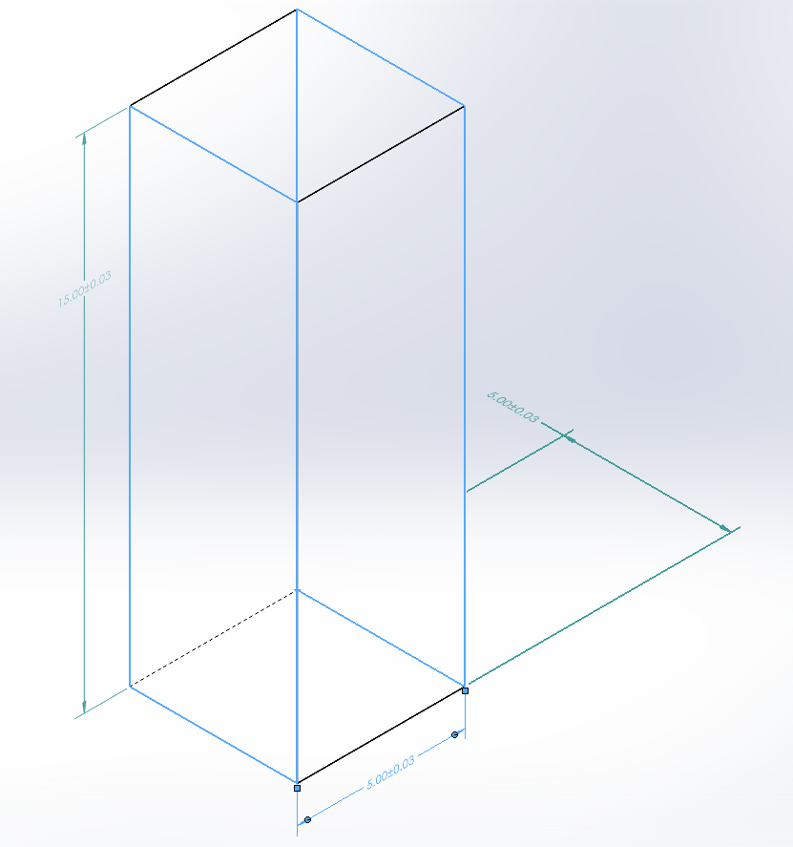
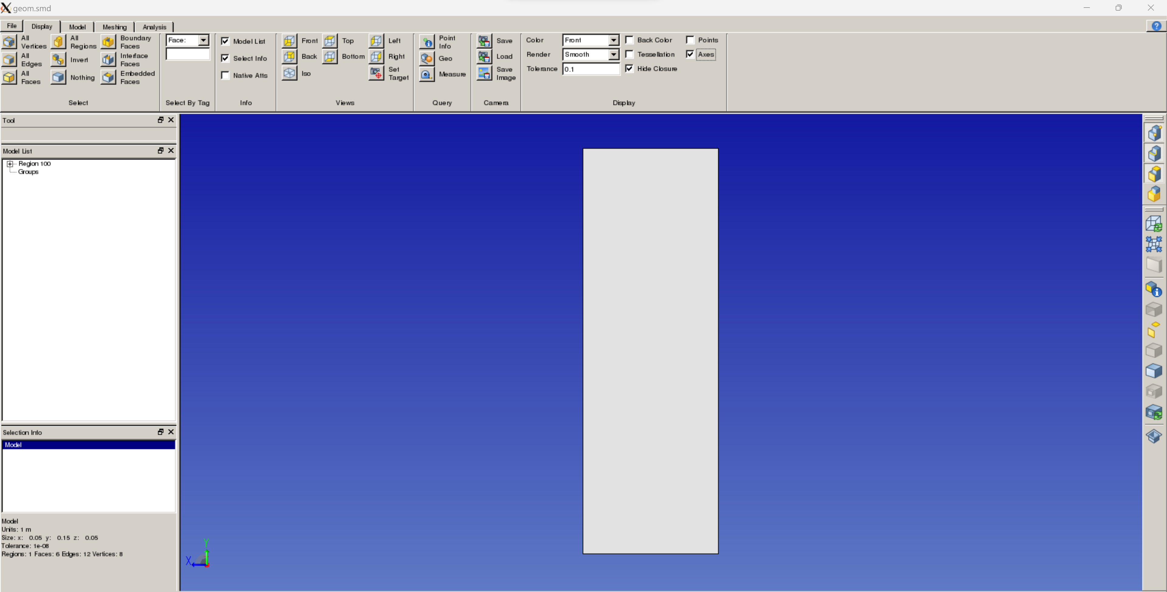
Problem formulation
Simmodeler--- Analysis (Initial Consditions and BCs) ----Attributes.inp (Mesh Attributes)

Slide 4
Progress up to date

Slide 5
Challenges and future work

